Slide 1
WG1: RELIABLE, ECONOMIC AND EFFICIENT SMART GRID SYSTEM

Slide 2
SUMMARY
ETIP-SNET’s role is to guide Research, Development & Innovation (RD&I) to support Europe’s energy transition.
WG1 is focused on system aspects, addressing the main functionalities, quality and efficiency of the electricity system as such and considering the benefits of its integration with the other energy vectors.
WG1 activity is mainly devoted to provide support in developing:
  ETIP SNET vision,
  SET Plan Action 4.1 Implementation Plan and
  SET Plan Action 4.2 Implementation Plan
Next year activities will be concentrated on on-going projects, monitoring and knowledge sharing, updating ETIP-SNET 10-year roadmap, interacting with EC in the definition of the new framework program for Research & Innovation,

Slide 3
CONTENTS
WG1 mission
WG activity
  ETIP SNET vision,
  SET Plan Action 4.1 Implementation Plan and
  SET Plan Action 4.2 Implementation Plan

Slide 4
WG1 MISSION
Specific objectives
Addresses the mid and long-term business and technology trends contributing to the overall energy system optimization at affordable investment and operation costs, with particular reference to system development scenarios, network planning, operation, observability and control, asset management, flexibility as seen from the system aspects and resilience
Focus on system aspects, addressing the main functionalities, quality and efficiency of the electricity system as such and considering the benefits of its integration with the other energy vectors
WG1 follows on Set Plan Action 4: Grid smartening in the sense of grid observability and controllability, which bring to the system improved forecasting and operation, tools for managing the variability and uncertainty of operational conditions at several timescales and increased grid hosting capacity. The economic efficiency of the system through the use of ICT (Information and Communication Technology) equipment’s as well as through the implementation of appropriate market design

Slide 5
WG1 MISSION
Subjects to be considered
Power System modernisation and increased cross-border connections capacities
Transmission/Distribution network expansion and investments based on a ‘connect and manage’ approach
Integration within the energy system
Market aspects
Notes:
Power System modernisation and increased cross-border connections capacities:
Optimising the existing assets and the network capacity making use of new technologies
Developing pan-European electricity highways with both AC and DC technologies
Studying and demonstrating new grid architectures both at transmission and distribution level as a source of flexibility.
Decreasing the environmental footprint of the network reinforcements.
Developing new planning tools to account for the full complexity of electricity networks (distributed and intermittent generation, variable and controllable loads, power electronics, storage, etc.).
Transmission/Distribution network expansion and investments based on a ‘connect and manage’ approach:
Standardizing and making interoperable system architecture, protocols and data models.
Optimal management and activation of local flexibilities.
Accelerating the large scale deployment and validation of advanced automation and control solutions
Increased exchange of information between TSOs and DSOs
Increased TSO collaboration
Integration within the energy system:
Strong coupling with the gas network (via power to gas technologies) offering storage and flexibility via large CHPs, Strong coupling with heat pumps in e.g. district heating networks
Interacting with the gas network for storage of chemical energy.
Interacting with the heat network for storage of thermal energy.
Interacting of the transmission and distribution grids with the gas and heat networks so as to better operate the power system.
Optimising the (whole) energy system
Market aspects:
Defining activities of new players in both the wholesale and retail markets
Optimizing the integration of market and network operations all time scales (from long-term to real time).
Integrating new market players providing system services.
Participating in the assessment of the regulatory framework for storage operations and the associated remuneration of system services.
Enabling well-functioning retail markets so as to empower the end users.

Slide 6
WG1 ACTIVITY
Five fields of activity in 2017
Comments on EU WP 2018-2020
Comments on Intensys4EU Implementation Plan
TF 1: Colaboration on ETIP SNET Vision of the Energy System
TF 2: Input on SET Plan TWG4: 4.1 Targets & Action Plan
TF 3: Input on SET Plan TWG4: 4.3 Targets & Action Plan
Additionally, WG1 is providing support to Intensys4EU team on the Regional workshops for outstanding national/regional projects monitoring & knowledge sharing.

Slide 7
WG1 ACTIVITY: Vision
  TF 1 ETIP SNET Vision
  Is a high level document
    in line with the Vision and Strategy for European Electricity Networks of the Future
    (ETP Smart Grids in 2006) and
    with the Vision document developed at European level for the Aviation sector.
  Considers aspects such as the central role of Europe as sector leader, the environmental concerns, the energy system scenarios, the inclusion of the consumer, the necessary innovation requirements etc.
  Considers targets 2030 and progressively 2050
  Leverages the
    European Energy Scenarios (2030 and 2050),
    EHighWay2050-Scenario analyses,
    TYNDP 2016/2018 (Draft) Scenarios
  Vision (document publication) target date is in 12 - 18 months
  INTENSYS4EU coordinates the work of gathering and distilling the final vision document.
Notes:
ETIP SNET Vision Development – 12 - 18 months process
Set up of a Vision team, of max. 10 persons by April 2017
Finalisation of vision by January 2018
Approval by ETIP SNET Governing Board by March 2018
Publication of Vision by June 2018

Slide 8
WG1 ACTIVITY: TWG 4
TFs 2 & 3 Updating targets Action 4.1 & 4.2.
  SET Plan – Declaration on Strategic Targets in the context of an Initiative on Energy Systems (Brussels, 19th October 2016)
  Strategic Targets for Action 4.1) An optimised European power grid (by 2030)
    Grid observability and controllability, Demand response, flexible Generation, Energy storage
  Strategic Targets for Action 4.2) Integrated local and regional energy systems
    Integrated local and regional energy systems, Management of energy networks, Minimising the consumption of non-renewable resources, Flexibility of the energy system, Resiliency, ….

Slide 9
WORK SCHEDULE FOR 2017
TF 2 ETIP SNET Vision – Inputs to TWG Action 4.1
  Time schedule:
  for reformulating the targets
  for developing a joint action plan
  End May – End October
April 28 | Initial proposal from TWG A4 chairs for reformulation of Targets 4.1 to member states nominated members of TWG A4
April 28 – May 30 | Collection of feedback / input from MS nominated TWG A4 participants as well as collection of initial feedback from ETIP SNET and it´s WGs
May 30 | ETIP SNET governing board meeting - Discussion and consolidation of feedback on targets from ETIP SNET and its WGs

Slide 10
Thank you for your attention
info@etip-snet.eu
www.etip-snet.eu

Slide 11
CONTENTS
ETIP-SNET mission and structure.
WG1 mission.
WG activity:
  ETIP SNET vision,
  SET Plan Action 4.1 Implementation Plan and
  SET Plan Action 4.2 Implementation Plan
Summary

Slide 12
ETIP-SNET MISSION & STRUCTURE
ETIP SNET: mission
Setting-out a vision for research and innovation for Smart Networks for Energy Transition and engage stakeholders in this vision
Preparing and updating the Strategic Research and Innovation Roadmap
Reporting on the implementation of RD&I activities at European, national/ regional and industrial levels
Providing input to the Strategic Energy Technology Plan (SET Plan)
Identifying innovation barriers, notably related to regulation and financing
Developing enhanced knowledge-sharing mechanisms that help bring RD&I results to deployment
Preparing consolidated stakeholder views on Research and Innovation to European Energy Policy initiatives

Slide 13
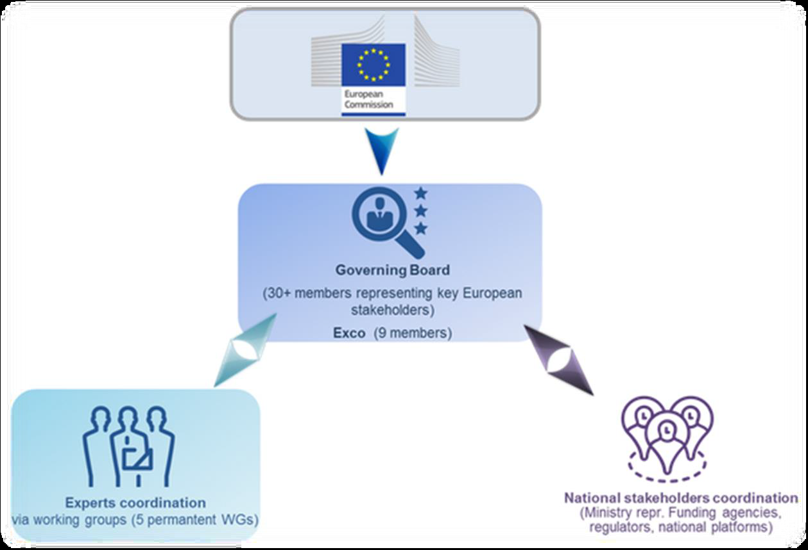
ETIP-SNET MISSION & STRUCTURE
Organization
Notes:
Governing Board (GB) & Executive Committee (Exco)
WG1 Reliable, economic and efficient smart grid system
Chair: Vicente Gonzalez (REE), ENTSO-E
WG2 Storage technologies and sector interfaces
Chair: Cristiana La Marca (ENEL), EASE
WG3 Flexible Generation
Chair: Michael Ladwig (GE), EUTurbines
WG4 Digitisation of the electricity system and Customer participation
Chair: Maher Chebbo (SAP), ESMIG
WG5 Innovation implementation in the business environment
Chair: Emmanouil Kakaras (MHPS), EPPSA
A National Stakeholders Coordination Group to liaise with various national actors

Slide 14
WG1 MISSION
Key input documents
Strategic Energy Technology Plan - Towards an Integrated Roadmap: Research and Innovation challenges and needs of the EU energy system [https://setis.ec.europa.eu/system/files/Towards%20an%20Integrated%20Roadmap_0.pdf]
Communications of the EC COM(2015) 80 final: A Framework Strategy for a Resilient Energy Union with a Forward-Looking Climate Change Policy
[http://www.eea.europa.eu/policy-documents/com-2015-80-final]
Communications of the EC C(2015) 6317 final: Towards an Integrated Strategic Energy Technology (SET) Plan: Accelerating the European Energy System Transformation [https://setis.ec.europa.eu/system/files/Communication_SET-Plan_15_Sept_2015.pdf]
SET Plan – Declaration on Strategic Targets in the context of an Initiative on Energy Systems [draft]

Slide 15
WG1 ACTIVITY: Vision
TF 1. ETIP SNET Vision
Initial process
  ETIP SNET set up a Vision team, i.e. small group of stakeholders of max. 10 persons
    Use ETIP SNET WGs
    Use ETIP SNET Governing Board (GB)
    Use INTENSYS4EU team
    Use Other specialists
  Vision Team elaborates on a kernel this document
  Vision Team sends kernel to the 5 WGs and to NSCG for their targeted elaborations
INTENSYS4EU coordinates the work of gathering and distilling the final vision document.
  Use existing studies as input to Vision
  Dedicated studies at no costs for INTENSYS4EU by EC contractors (PRIMES + METIS + Foresight)
  Involve DG ENER to share the development of this Vision process
  Further INTENSYS4EU versions of Roadmap and Implementation Plans can wait (2017)
Notes:
ETIP SNET Vision – Table of contents (draft)
Energy Systems Needs – A greenhouse gas free emission based secure, economic and sustainable service environment
The European Energy Systems Needs - Vision 2050
Needed inspiring “enthusiasm, ambitiousness and commitment”
“Purpose” (why?) and “direction” (where to go): “Extreme Future oriented” aspects (compared to those of today, of 2030 (and of the past)); provides a picture of what the energy system (more than electricity) looks like in the long-term future.
Ensuring keeping those society needs (security and quality of supply) that we are used to
Added value for each stakeholder (Consumer issues; Privacy; Cyber-Security; etc)
Ensuring European Leadership (Winter Package; Energy Union; SET Plan as enablers towards future). “Uniqueness of the setup”
Steps to achieve the vision
Needed “core / excellence competencies” of involved stakeholders; Necessary innovation requirements etc. Categories: policy/regulatory; technology; market, customer adoption
“Ambitiousness / challenge”
From Vision via Research, Demonstration and Innovation to Products and Services

Slide 16
WG1 ACTIVITY: TWG 4
TFs 2 & 3. Updating targets Action 4.1 & 4.2. Action Plan

Slide 17
WORK SCHEDULE FOR 2017
TF 2. ETIP SNET Vision – Inputs to TWG Action 4.1
  TWG Proposal for the approach for reformulating the targets:
  The targets will be grouped along the following overarching categories
    Sustainability
    Resilience
    Flexibility
  The original quantification of the targets as described in the stakeholder declaration shall serve as a benchmark in the new formulation
  Example:
  Original formulation: ”… the percentage of substations … equipped with remotely accessible monitoring and control devices should be 80% or higher for HV and MV substations and around 25% for LV substations. …”
  New formulation: ”Develop and implement solutions in order to shorten time to fix faults in the grid, at least at the same level that would be achievable by monitoring and control of 80% of devices in the HV and MV substations and 25% for LV substations”

Slide 18
WG1 ACTIVITY: TWG 4
TFs 2 & 3 Inputs to TWG Action 4.
Notes:
2014 Integrated Roadmap
2015 (Winter/Spring) 4 Energy Union Priorities
2015 (Fall) SET Plan 10 Key Actions
2016 (October) SET Plan – Declaration on Strategic Targets in the context of an Initiative on Energy Systems [draft] Oct 2016

