Slide 1
WG2:
Storage Technologies and Sector Interfaces
18 September 2017
Mathilde Bieber (General Electric)

Slide 2
Agenda
Working Group 2
Regional Workshops
18 September 2017
WG2 scope
WG2 organisation
WG2 activities
Regional workshops
ETIP SNET Vision
SET Plan Implementation Plan
ETIP SNET Implementation Plan 2017-2020
H2020 Work Package 2018-2020 lobbying
WG2 next steps

Slide 3
Working Group 2
Regional Workshops
18 September 2017
WG2 scope
WG2 organisation
WG2 activities
Regional workshops
ETIP SNET Vision
SET Plan Implementation Plan
ETIP SNET Implementation Plan 2017-2020
H2020 Work Package 2018-2020 lobbying
WG2 next steps

Slide 4
Working Group 2
Regional Workshops
18 September 2017
WG2 scope
Name: Storage Technologies and Sector Interfaces
Specific objective: addressing the technological and market developments related to energy storage solutions and the interfaces between energy sectors as tools to ensure the required level of flexibility for the transmission and distribution of electricity.
All energy storage technologies and all possible interfaces are covered, among others:
Power-to-power
Power-to-gas
Hydro and marine storage
Compressed air energy storage
Thermal mass of buildings
Hot water storage…
The entire value chain of all energy storage options is also covered, starting from the development and demonstration of new materials, technologies and solutions, addressing their integration into the overall energy system, the evaluation of their impact on flexibility and the related costs/benefits.
Interfaces between the power sector and the sectors heat, gas and transport are also included.

Slide 5
Agenda
Working Group 2
Regional Workshops
18 September 2017
WG2 scope
WG2 organisation
WG2 activities
Regional workshops
ETIP SNET Vision
SET Plan Implementation Plan
ETIP SNET Implementation Plan 2017-2020
H2020 Work Package 2018-2020 lobbying
WG2 next steps

Slide 6
Working Group 2
Regional Workshops
18 September 2017
WG2 organisation
Chair: Cristiana La Marca (Enel)
Co-chairs: Mathilde Bieber (General Electric) and Carlos Arsuaga (Circe)
Special adviser: Omar Perego (RSE)
Organizational support: Marine Delhommeau (EASE), Maria-Laura Trifiletti (EASE)
Experts are divided into:
Tier 1: 35 experts, actively participating in the WG2 activities
Tier 2: 54 experts, supporting Tier 1’s activities

Slide 7
Working Group 2
Regional Workshops
18 September 2017
WG2 scope
WG2 organisation
WG2 activities
Regional workshops
ETIP SNET Vision
SET Plan Implementation Plan
ETIP SNET Implementation Plan 2017-2020
H2020 Work Package 2018-2020 lobbying
WG2 next steps

Slide 8
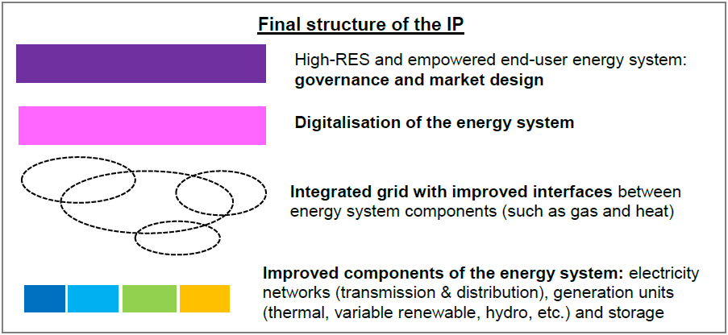
Working Group 2
Regional Workshops
18 September 2017
WG2 activities
ETIP SNET Implementation Plan 2017-2020
3 topics
Topic 2: Market design for trading heterogeneous flexibility products
6 topics
11 topics
Synergies between electricity and heat systems
Topic 10: Coupling of electricity and thermal sectors
Topic 11: Increase energy efficiency by utilising excess heat from other processes via heat networks and thermal storage
Synergies between electricity and gas systems
Topic 12: Coupling of electricity and gas sectors
Synergies between electricity transmission networks, generation and storage
Topic 15: Multiservice storage applications to enable innovative synergies between system operators and market players
Coupling between flexible generation and storage
Topic 19: Towards fully dispatchable RES: Variable RES with Storage
18 topics
Electricity networks
Storage units
Topic 31: Advanced energy storage technologies for energy and power applications
Topic 32: Coupling of electricity and transport networks
Generation units

Slide 9
Working Group 2
Regional Workshops
18 September 2017
WG2 activities
ETIP SNET Implementation Plan 2017-2020
Topic 2: Market design for trading of heterogeneous flexibility products
Develop a market concept that allows the trading of ‘heterogeneous’ flexibility products (coupling electricity, heat and gas markets, both at the wholesale and retail level), taking into account the specific capabilities of each resource
Challenges: growing need for short, medium and long-term flexibility to balance intermittent renewables beside conventional fossil-fuel based generation units; flexibility needed at different time scales, different locations, applicable to different end users
Topic 10: Coupling of electricity and thermal sectors
Develop methodologies and tools to quantify and test the technical and cost performances of the coupling while addressing governance and market issues
Challenges: major part of heating and cooling still generated with fossil fuels; management and efficient operation of integrated energy systems, organisation of interactions, associated business models...
Topic 11: Increase energy efficiency by utilizing excess heat from other processes via heat networks and thermal storage
Investigate how to capture excess heat in an efficient way (energy efficiency and costs) so as to decarbonize the heat sector
Challenges: use excess heat wasted in power plants, industry, waste incineration, focus on heat network and thermal storage
Topic 12: Coupling of electricity and gas sectors
Provide additional flexibility options to manage the power system. At transmission level, gas networks can provide an alternative solution to perform large-scale storage (chemical energy) of renewable excess electricity. At distribution level, the existing gas networks, especially in cities, could be used to promote green fuels for thermal or transport applications.
Challenges: avoid dismantling of obsolete gas networks and give them a new purpose with Power-to-Gas

Slide 10
Working Group 2
Regional Workshops
18 September 2017
WG2 activities
ETIP SNET Implementation Plan 2017-2020
Topic 15: Multiservice storage applications to enable innovative synergies between system operators and market players
Demonstration of bulk storage integration options in the transmission system aimed to valorize the multi (ancillary) services offered by these technologies
Challenges: storage facilities in transmission systems as promising solution for advanced grid services, for increased system flexibility and less back-up conventional energy
Topic 19: Towards fully dispatchable RES: Variable RES with Storage
Demonstrate the local coupling of storage with solar and/or wind energy assets enabling renewable energy to be fully flexible and ensuring the sustainability of the future energy system
Challenges: Economic hybrid systems with storage units localized at the generation plant to make renewable dispatchable, predictable, flexible.
Topic 31: Advanced energy storage technologies for energy and power applications
Validation in demonstrations of different technological options, together with R&I activities related to integration issues and business models (degradation and failure mechanisms which impact profitability) and with a focus on multiservice business models which might be a solution for profitability provided that the system services brought by storage are valued on a fair basis
Challenges: energy storage technologies for energy and power applications far from meeting technical and economic targets, strong need to optimize and demonstrate especially for intraweek and seasonal modulation
Topic 32: Coupling of electricity and transport networks
How to unlock the potential of V2G (vehicle to grid) applications by e.g. testing new business models and market mechanisms.
Challenges: energy transition in transport sector using intermittent rewable energy sources

Slide 11
Working Group 2
Regional Workshops
18 September 2017
WG2 activities
Horizon 2020 Work Package 2018-2020 contribution
Finally, the WG2 provided input to the draft of the Horizon 2020 Energy Work Programme 2018-2020. WG2 recommendations included:
General comments
Low share of ‘Energy Systems’ topics compared to ‘Energy Efficiency’ and ‘Renewable Energy’
Development of technologies should be considered on top of integration strategies
Topic ES1 – Consumer and demand response
Explicitly mention energy storage solutions to allow automation in demand management.
Topic ES2 - Distribution Grid
Include demonstration of small scale storage integration in low-voltage network, focusing on the role of the aggregators, and propose solutions of full scale virtual power plants
Topic ES3 – Transmission Grid
Include stand-alone storage installation at utility scale in specific transmission network nodes
Topic ES4 – Integrated Energy Systems
Better express the need of introducing thermal storage capacity to increase flexibility and reliability of fully integrated energy systems.
Topic ES5 – Islands
Include storage coordinated with conventional generators and renewables to provide a reliable and efficient hybrid system operation in an isolated system
Topic ES7 – Advanced tools
Add advanced technologies (storage and hybrid)

Slide 12
Working Group 2
Regional Workshops
18 September 2017
WG2 scope
WG2 organisation
WG2 activities
Regional workshops
ETIP SNET Vision
SET Plan Implementation Plan
ETIP SNET Implementation Plan 2017-2020
H2020 Work Package 2018-2020 lobbying
WG2 next steps

Slide 13
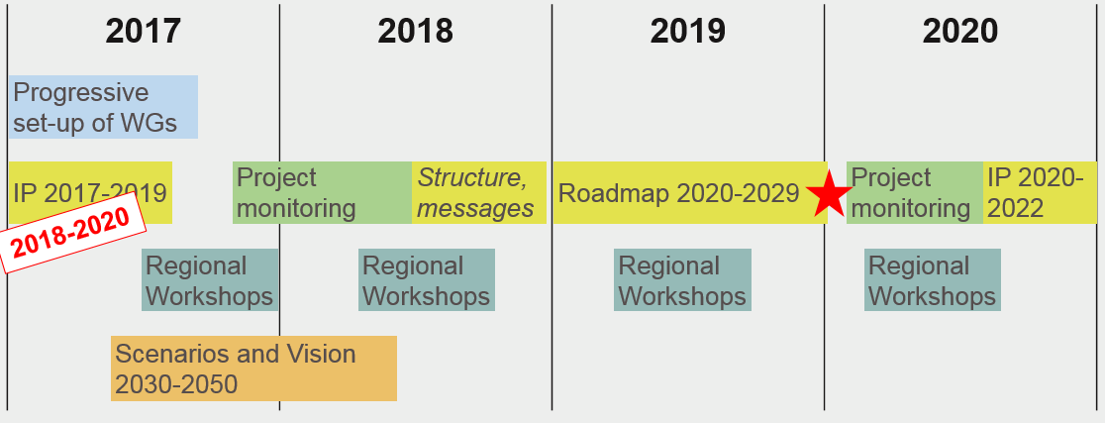
Working Group 2
Regional Workshops
18 September 2017
WG2 next steps

Slide 14
Working Group 2
Regional Workshops
18 September 2017
Thank you for your attention !

Slide 15
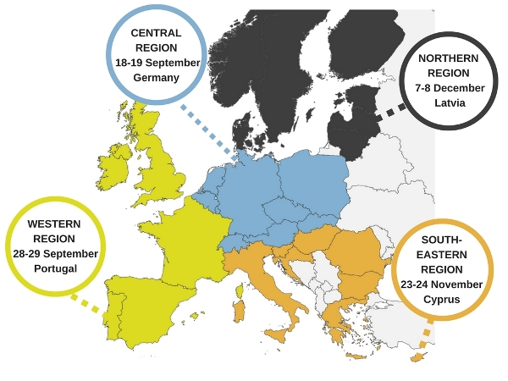
Working Group 2
Regional Workshops
18 September 2017
WG2 activities
2017 regional workshops
WG2 experts proposed relevant national and regional projects to enrich an initial list of candidate projects prepared by INTENSYS4EU (criteria: non H2020, European added value, system integration, maturity). The representatives of those projects selected were invited to participate as speakers, here for Central Region Workshop:
StEnSEA
WESpe
Underground Sun Storage
SAVE
Several WG2 experts will participate as attendants to the various regional workshops, taking part in the discussions.

Slide 16
Working Group 2
Regional Workshops
18 September 2017
WG2 activities
ETIP SNET Vision
The WG2 members also participate in the elaboration of the ETIP SNET Vision, which is a document that should highlight issues including and beyond those already documented, researched, implemented, developed, and which are key for satisfying the needs of the future energy system towards 2050.
For developing this vision, the experts were asked to point at already published extreme, “hard-to-solve” scenarios covering the whole energy system for 2030 and 2050, considering in particular energy storage and sector interfaces issues.
The processing of the ~20 scenarios collected is ongoing.
In addition, the experts are working on answering 7 open questions addressing the future of smart energy networks to help frame the vision: international context, environmental sustainability, social welfare, challenges, network organization…

Slide 17
Working Group 2
Regional Workshops
18 September 2017
WG2 activities
SET Plan Implementation Plan (IP)
The WG2 experts were asked to:
Review the strategic targets of Action 4.1 “An optimised European power grid” of the SET PLAN - Declaration of Intent
Identify the objectives and KPIs which are relevant to energy storage and interaction between energy networks
Discuss input for the reformulation of targets
In the next weeks, WG2 experts will be also tasked with:
Consolidating the “innovation fiches” of the draft SET Plan IP document
Encouraging Member States to implement them, after the SET Plan IP has been published
These “innovation fiches” represent in practice the actions of SET Plan Implementation Plan (IP) to be undertaken by Member States in order to address the targets and innovation challenges identified in the SET Plan’s Action 4.

