Slide 1
WG3 Flexible Generation
ETIP SNET Central Regional Workshop, Aachen
September 18 – 19, 2017
Alexander Wiedermann
MAN Diesel & Turbo SE

Slide 2
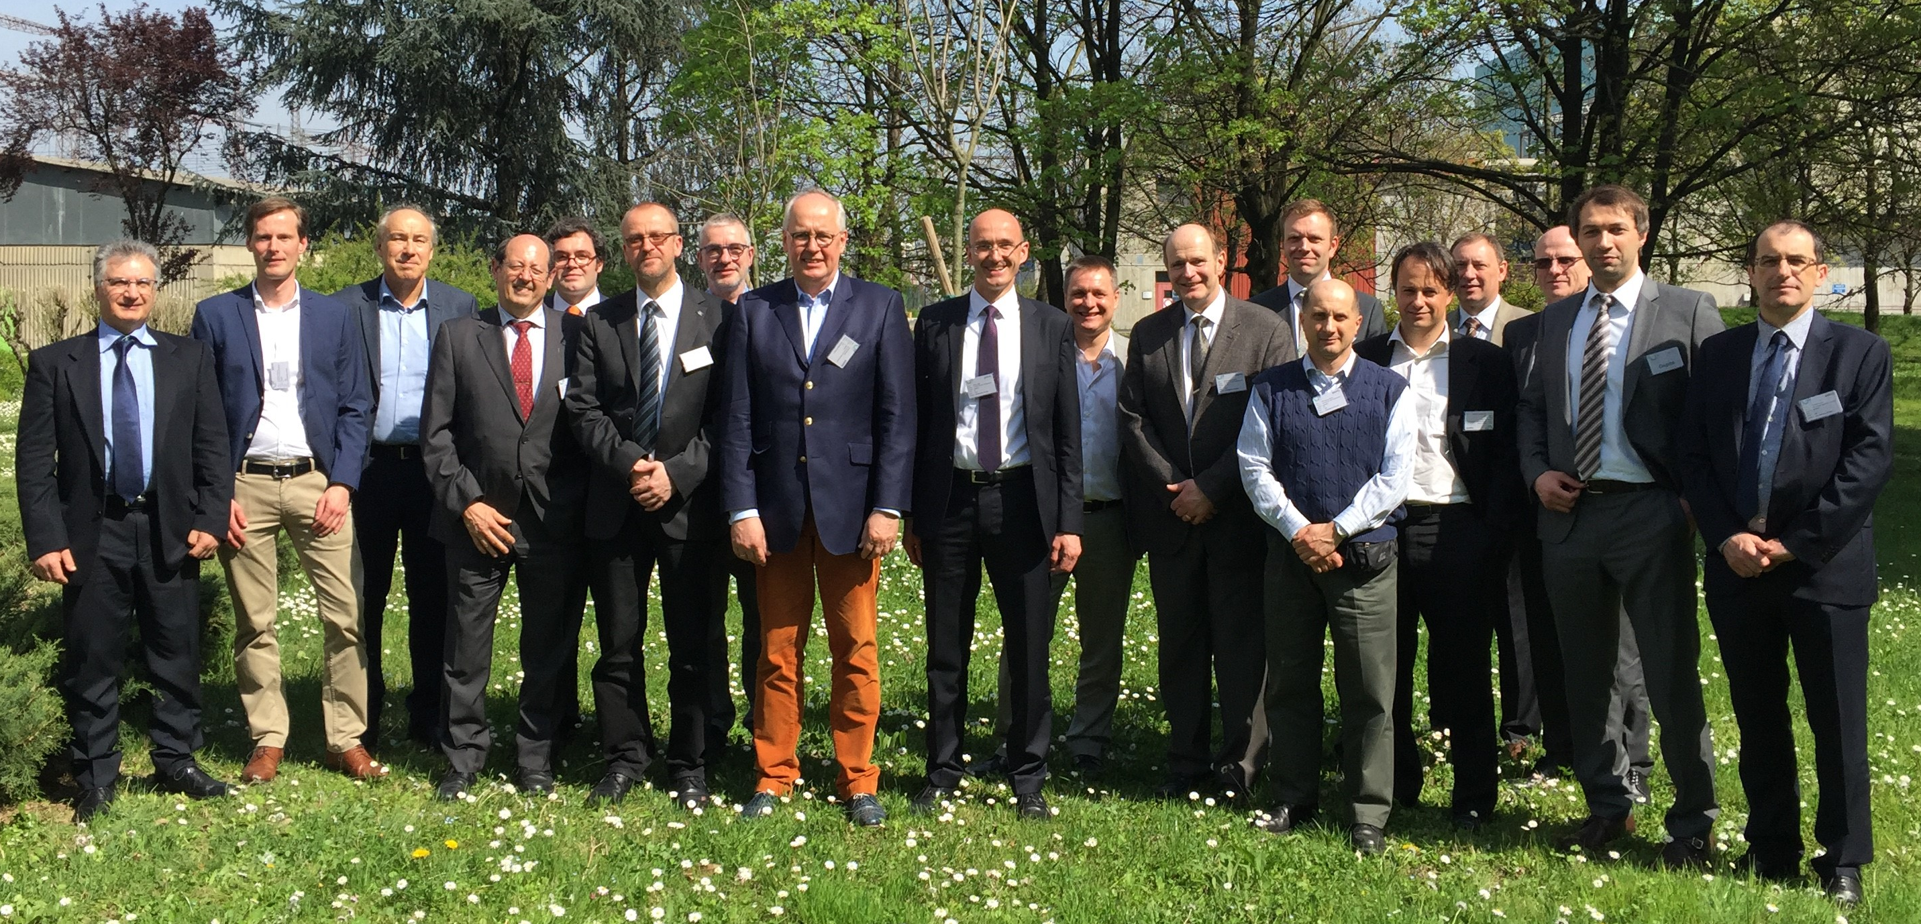
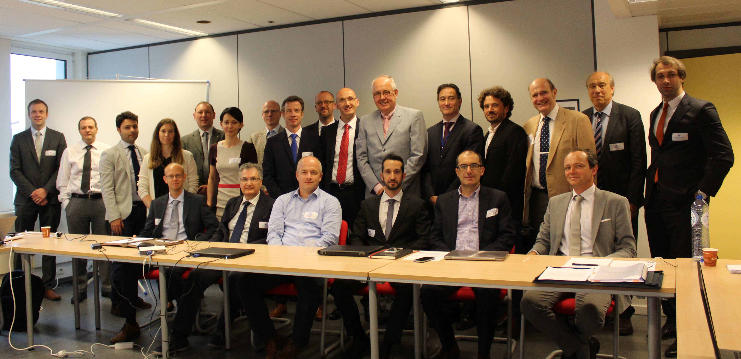
ETIP-SNET WG 3 - Organisation
Chair: Michael Ladwig (General Electric, CH)
Co-Chairs:
Jesus Garcia Martin (Iberdrola, ES)
Pascal Fontaine (CMI Energy, BE)
Advisor: Vincenzo Casamassima (RSE, IT)
March 30, 2017 1st WG3 Workshop in Milano
February 14, 2016 30 WG3 members appointed
May 31, 2017 2nd WG3 Workshop in Brussels

Slide 3
Specific Objectives (1/2)
Specific Objectives – WG3: Flexible Generation
WG3 (Flexible generation) addresses the business and technology trends considering
the contribution of generation flexibility from thermal power plants (centralized and distributed)
other innovative technologies and solutions in thermal-based high efficiency generation systems (e.g. micro-CHP, industrial co-generation), heat distribution (e.g. district heating)
embedded storage
other dispatchable generation sources (eg hydropower)
to address the needs for flexibility in the framework of an integrated energy system.

Slide 4
Specific Objectives (2/2)
Specific Objectives – WG3: Flexible Generation – ctd.
WG3 to address technologies and solutions of
the flexible generation (including thermal power plants, embedded storage and hybrid plants) from a technological, environmental, economic, regulatory and acceptance points of view
integrated solutions based on variable renewable energies (solar PV, wind energy and hydro)
energy storage devices
smart technologies focused on the large integration of renewable energies in the network (both, transmission and distribution grids)

Slide 5
WG 3 to review and extend structure of initial roadmap:
    Structure of ETIP-SNET roadmap 2017 - 2026

Slide 6
WG3 Topics in IP (1/7)
Coupling between
flexible generation
and storage:
Research challenges:
  Hybrid solutions for optimal combination of RES with storage and manage RES uncertainty
  Thermal energy storage prototype and implementation in overall plant configuration
  CO2-cycling for synthetic fuel generation
  Integration of power-to-fuel technologies into power plant (generation and storage of renewable fuels
  Establish process chain using compressed air, batteries etc. to increase thermal plant flexibility
  Interlink fuel generation to other sectors
Target TRL: 4-7
Estimated budget: Topic 18: 40 – 60 Million EUR (one big demo or multiple pilots)
Topic 19: 30 Million EUR

Slide 7
WG3 Topics in IP (2/7)
Thermal
generation:
Research challenges:
  Component improvements
  Improved operational flexibility
  Overall performance improvements (efficiency and emissions) at part load
  Enhanced thermal power plant robustness (reduce maintenance and repair costs)
  Enable multi fuel operation
  Novel monitoring and control
  Digitization
Target TRL: 3-7
Estimated budget: 65 Million EUR

Slide 8
WG3 Topics in IP (3/7)
Thermal
generation:
Research challenges:
  Combustion systems for stable combustion of gas mixtures with hydrogen up to 100%
  Extension of low emission load range
  Improving flexible load operation
  Improved design of combustor liner to reduce surface exposure to hot gas and radiation
  Development of safe hydrogen starting methodology
Target TRL: 3-6
Estimated budget: 10 Million EUR

Slide 9
WG3 Topics in IP (4/7)
Variable RES:
Research challenges:
  Improvement of renewables generators for better adaptation for provision of ancillary services
  New control strategies with support services like storage and manageable RES
  Instability mitigation of RES, new strategies to define stability criteria in future scenarios
  Investigate different energy mix configurations to ensure electrical system stability
  Communication protocols with storage systems with PEC
Target TRL: 3-6
Estimated budget: 25 - 30 Million EUR

Slide 10
WG3 Topics in IP (5/7)
Variable RES:
Research challenges:
  Identify qualification and interaction of smart converters
  Identify and develop concept of Renewable Flexible Modules (RFM) including components
  Adaptation of current RFM’s and explore additional functions of the future RFMs
  Integrate additional protection functions at RFM level
  Investigate role of storage systems and different energy mix configurations
Target TRL: up to 7
Estimated budget: 40 - 45 Million EUR (4 – 6 projects)

Slide 11
WG3 Topics in IP (6/7)
Hydropower:
Research challenges:
  Medium and large-scale demonstration projects to focus on more flexible hydropower plants
  Medium and large-scale demonstrators incorporating technical improvements and planning tools
  Smarter compatibility with environmental restrictions
  Better utilization of hydro power in sensitive areas
Target TRL: 5 - 7
Estimated budget: 20 - 25 Million EUR (Topic 37), 2-3 Million EUR (Topic 38)

Slide 12
WG3 Topics in IP (7/7)
Cross cutting
issues:
Research challenges:
  Simulation of plant components and electromechanical system at development and design phase
  Predictive maintenance methods
  Plant operation optimization based on data analytics
  New operative process base on new algorithms and methods (big data; artificial intelligence)
Target TRL: 5 - 7
Estimated budget: 25 Million EUR (3-5 projects)

Slide 13
Any Question, Comment or Feedback?
Alexander Wiedermann
MAN Diesel & Turbo SE
Contact: alexander.wiedermann@man.eu

