Slide 1
ETIP SNET WG4 : Digital Energy
Maher Chebbo
Chairman WG4 Digital Energy
Antonello Monti
TF Leader

Slide 2
WG4 Membership
~100 applications
~60 are selected to be active members of the WG4. Selection criteria :
Expertize
Stakeholders
European Coverage
Gender
Motivation and time allocated
…
The remaining ~40 will be informed Quarterly, will be invited sometimes as guest speakers if appropriate and will be invited to the GA

Slide 3
WG4 Stakeholders
Consumers
DSO/TSO
Equipment suppliers
ICT Technology providers
Telecom operators
Renewable Energy Sources providers
Research and Academia
Others

Slide 4
By 2025, can we predict that 90% of C&I and 70% of Residential Customers will run Energy Smarter ? Or ?
Generation Operations
Reduction in CO2 emissions 5-20 %
Green Energy
Increased EV integration 100% and Renewables 10-20 %
Redution in Operations costs 0-30%
Transmission
Intelligent
Networks
Distribution
Regulators
Smart Retail office
Retailers
Aggregators, ESCOs
Smart House
Reduction in peak to average load ratio 5-25 %
Smart Transportation
Smart Buildings
Smart Manufacturing
Smart Cities
Smart Residential Customers
Reduction in consumption 5-15%
90% of C&I (25 Sectors) with Smart Energy by 2020 ?
70% of Res. Customers as Smart Home by 2020 ?

Slide 5
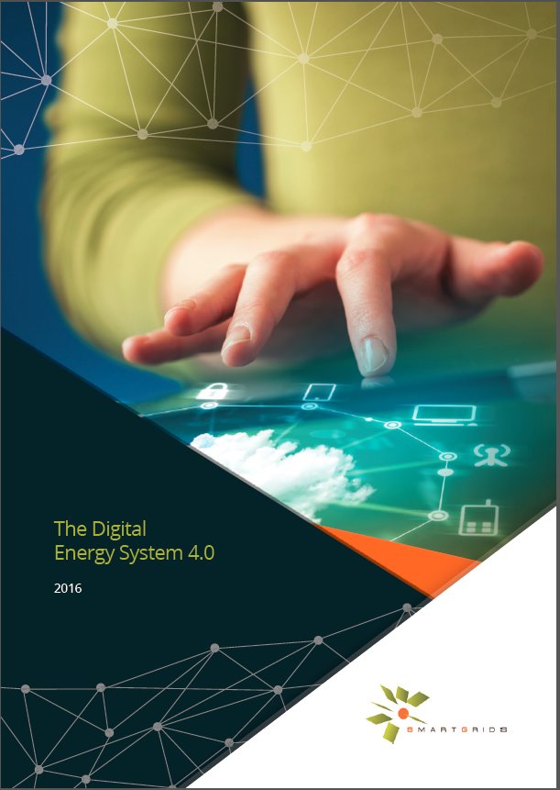
The Digital Energy System 4.0 by ETP SmartGrids
1) Foreword
2) What does Digital Transformation mean? What are the use cases ?
3) Practical use cases and field trials
3.1. Digital use cases for power generation
3.1.1 Probabilistic forecasting of wind generation, forecasting of extremes and optimal
use of forecasts in power system operations and markets.
3.1.2 Smart curtailment, dynamic line rating and Improved forecasting tools to maximize
integration of wind
3.2. Digital use cases for transmission & distribution networks
3.2.1 The STAR project: Remote operation and Grid Automation systems
3.2.2 Innovative Tools for Electrical System Security within Large Areas
3.2.3 Autonomous grid reconfiguration and forecasting in the MV grid
3.2.4 Meter data management for network operation in the LV grid
3.2.5 Collaborative Asset Management
3.2.6 Advanced tools and ICT servicers for Distribution System Operators
3.2.7 A Platform to interface demand side management with DSO needs
3.3. Digital use cases for retailers and aggregators
3.3.1 Empowering SG Market Actors through Information and Communication Technologies
3.3.2 IDE4L Use Cases on technical and commercial aggregators
3.4. Digital use cases for consumers & Prosumers 45
3.4.1 Dynamic pricing and Demand Response Management
3.4.2 Smart houses in a smart grid environment
3.4.3 Smart charging of electric vehicles
3.4.4 Neighborhood energy management
3.4.5 Use cases
3.4.6 Technology development needed to meet the challenges
3.5. Digital use cases for new market platforms
3.5.1 Local Energy Markets
3.5.2 ICT tools for cross-border markets
3.5.3 The DSO as market facilitator
3.5.4 The Universal Smart Energy Framework
4) Main recommendations on Digital roadmap
Conclusions
Appendix: ETP SG Workshop on Energy Digitalization
(ETP SmartGrids Digital Energy 4.0 task force chaired by M. Chebbo) – white paper issued in May 2016

Slide 6
Top 10 recommendations for the Digital Roadmap of Europe
Predicted spending of 50 b€ for the Digital Transformation of Europe
Energy 22% annual growth rate and €330 billion annual economic benefit for European Industry by 2020
Utilities can get additional 30% revenues from Energy Data Services
Do not miss the non-reversible Digital Transformation. Otherwise, it will be too late.
SmartGrids Management is not (yet) a plug and play story but Digital SmartGrids is!
We should empower ICT infrastructures using Digital simulation and forecasting models
The development of Open electronic Marketplaces will boost Digital Energy
Well-guided data confidentiality accelerates the digital transformation
Digital well designed Energy Management can successfully integrate massive renewables
Leveraging Digital technologies will also enable a well-functioning, open and flexible markets
Digital home technologies can shift residential consumption during peak demand
Keep investing in disruptive digital technologies while thinking first your digital use cases
Setup a Virtual Innovation Hub focusing on innovations in new Energy Services

Slide 7
Task Forces Themes
Digital Technologies and reference architectures and standards (Advanced IT, Telecommunications, …IOT, Big Data, Blockchain, Exchange Platform), data Science and Modeling (enablers)
Digital Energy Disruptive Use Cases and New Market and Business Models (services)
Digital Cyber-Security recommendations (robust)

