Slide 1
ETIP SNET (European Technology and Innovation Platform for Smart Networks for Energy Transition): for an innovative and successful European energy transition
First ETIP SNET regional workshop, Aachen, 18 September 2017
Konstantin Staschus, Ph.D., ETIP SNET Governing Board Chair Chief Innovation Officer, ENTSO-E; Director, Ecofys/Navigant

Slide 2
Outline
EU policy framework
The ETIP-SNET: a new platform addressing the energy system as a whole
Purpose of the workshop
Agenda of the workshop

Slide 3
European R&I energy policies
2008: The SET Plan
20 % Energy Efficiency**
-20 % GHG Emissions*
20% Renewable Energy
binding
2014: Towards an Integrated Roadmap
Individual Technologies → Energy system
Policy challenges
Consumer at the centre
Energy efficiency (demand)
System optimisation
Technologies (supply)
-40 % GHG Emissions*
27% Renewable Energy
27 % Energy Efficiency**
Not binding
2015: Energy Union – Priorities
Energy security, solidarity and trust
A fully integrated European energy market
Energy Efficiency (EE) first: moderation of demand
Transition to a low-carbon society: decarbonising the economy,
Research, Innovation and Competitiveness
* Compared to 1990 ** compared to BAU
Notes:
Wind
Solar
Electricity grids
CCS
Bioenergy
Nuclear
Smart Cities and Communities
Fuel cells and hydrogen
Bioenergy
Nuclear
Smart Cities and Communities
Fuel cells and hydrogen

Slide 4
The New SET Plan key actions
Performant renewable technologies integrated in the system
Reduce costs of renewable technologies
New technologies & services for consumers
Resilience & security of energy system
New materials & technologies for buildings
Energy efficiency for industry
Competitive in global battery sector (e-mobility)
Renewable fuels
Set up R&I activities applying CCS and CCU
Maintain safety level & improve efficiency in nuclear energy

Slide 5
Outline
EU policy framework
The ETIP-SNET: a new platform addressing the energy system as a whole
Purpose of the workshop
Agenda of the workshop

Slide 6
From a fragmented EU advisory to an integrated framework
A new focus on innovation / implementation and on sector coupling
Main objective is to address the innovation challenges in energy system and market evolution necessary for achieving climate protection and renewables integration with affordability and security of supply ... beyond smart electricity grids (whole energy system)

Slide 7
ETIP SNET’s mission
Set-out a vision for RD&I for Smart Networks for Energy Transition and engage stakeholders in this vision.
Prepare and update the Strategic Research and Innovation Roadmap.
Report on the implementation of RD&I activities at European, national/regional and industrial levels.
Provide input to the SET Plan action 4 which addresses the technical challenges raised by the transformation of the energy system.
Identify innovation barriers, notably related to regulation and financing.
Develop enhanced knowledge-sharing mechanisms that help bring RD&I results to deployment.
Prepare consolidated stakeholder views on Research and Innovation to European Energy Policy initiatives.

Slide 8
ETIP SNET’s stakeholders

Slide 9
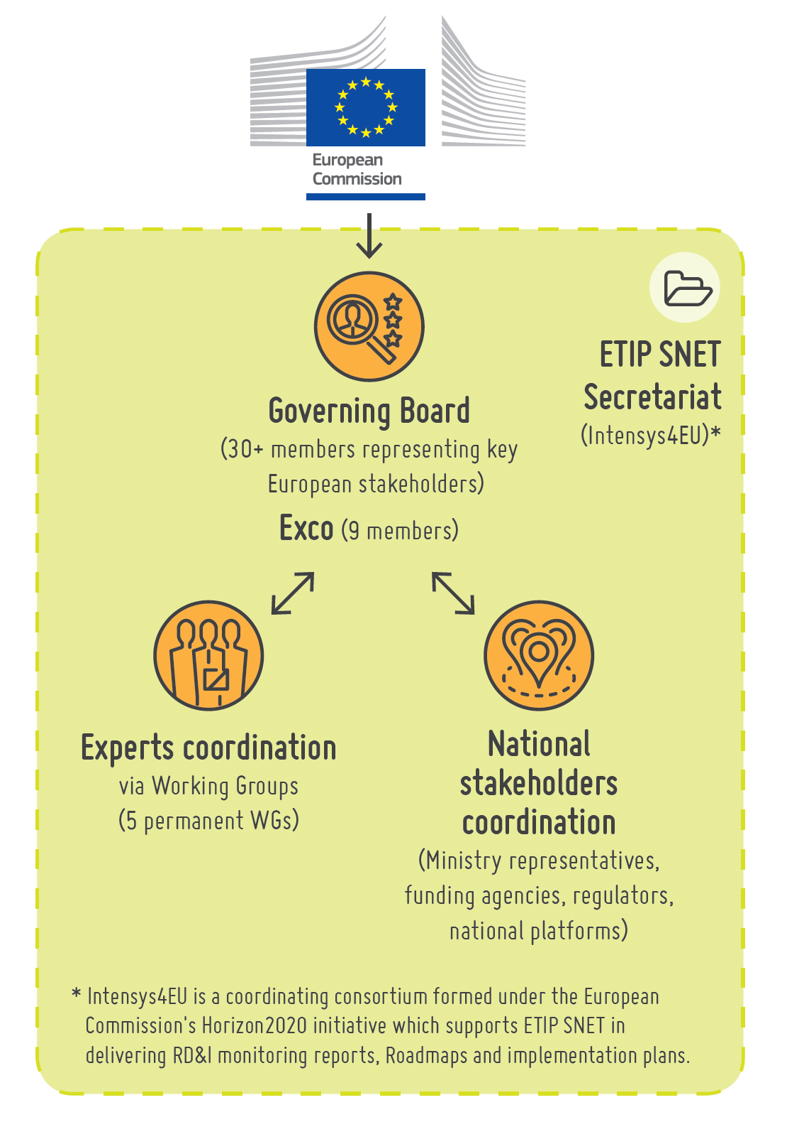
ETIP SNET’s organisation

Slide 10
Outline
EU policy framework
The ETIP-SNET: a new platform addressing the energy system as a whole
Purpose of the workshop
Agenda of the workshop

Slide 11
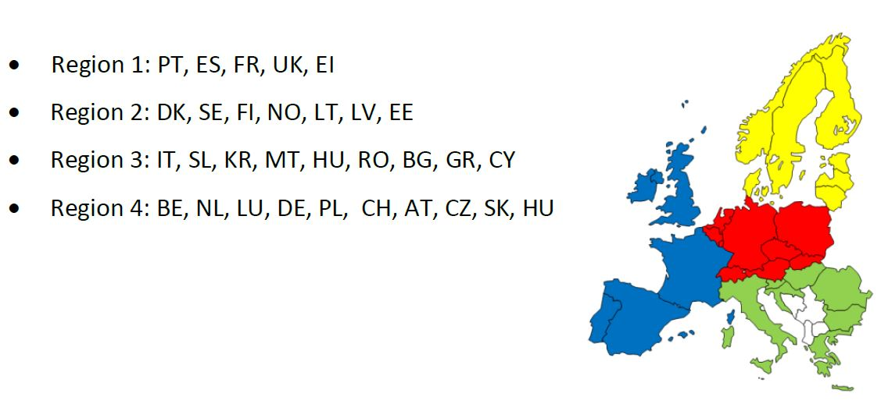
Main inputs from the regional workshops
Regional workshops
R&DI topics needed for the future, lessons learned and deployment perspectives, (focus on findings of significant EU added value and addressing energy system integration issues)
Region 4; Aachen (Germany), 18-19 September 2017
Region 1: Lisbon (Portugal), 28-29 September 2017
Region 3: Cyprus, 23-34 November 2017
Region 2: Riga (Latvia), 7-8 December 2017
http://www.etip-snet.eu/regional-workshops/

Slide 12
A new roadmap and associated Implementation Plans
Electricity system
Integration of RES
Electricity system
Integration of storage + other flexibilities Integration with other energy networks
Energy system as a whole
EEGI roadmap
2013-2022
ETIP-SNET roadmap 2017-2026
ETIP SNET roadmap 2020-2029
IP 16-18
IP 17-19
IP 19-21
IP 21-23
IPs every year
To be updated
INTENSYS4EU

Slide 13
… supported by workshops, public consultation and a monitoring exercise
The 10-year (2020-2029 ) ETIP SNET updated R&I roadmap specifying the future R&I needs for the energy system will be drafted based upon,
consolidated and balanced stakeholder viewpoints through “regional” workshops
consolidated and balanced stakeholder viewpoints through public consultation
a monitoring/review of national, European and international R&I activities
→ assess the coverage of the R&I activities by national and European projects

Slide 14
Outline
EU policy framework
The ETIP-SNET: a new platform addressing the energy system as a whole
Purpose of the workshop
Agenda of the workshop

Slide 15
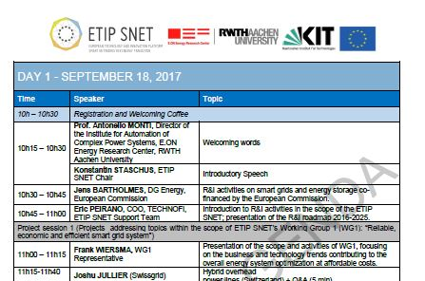
Agenda of the workshop

Slide 16
Thank you for your attention
Konstantin.Staschus@ext.entsoe.eu; k.Staschus@ecofys.com
More information:
etip-snet.eu
info@etip-snet.eu
@etipsnet
linkedin.com/groups/8208338

