Slide 1

Flexibility market development: Project Dynamo
Bram Sieben
Bram.sieben@alliander.com
19-09-2017

Slide 2
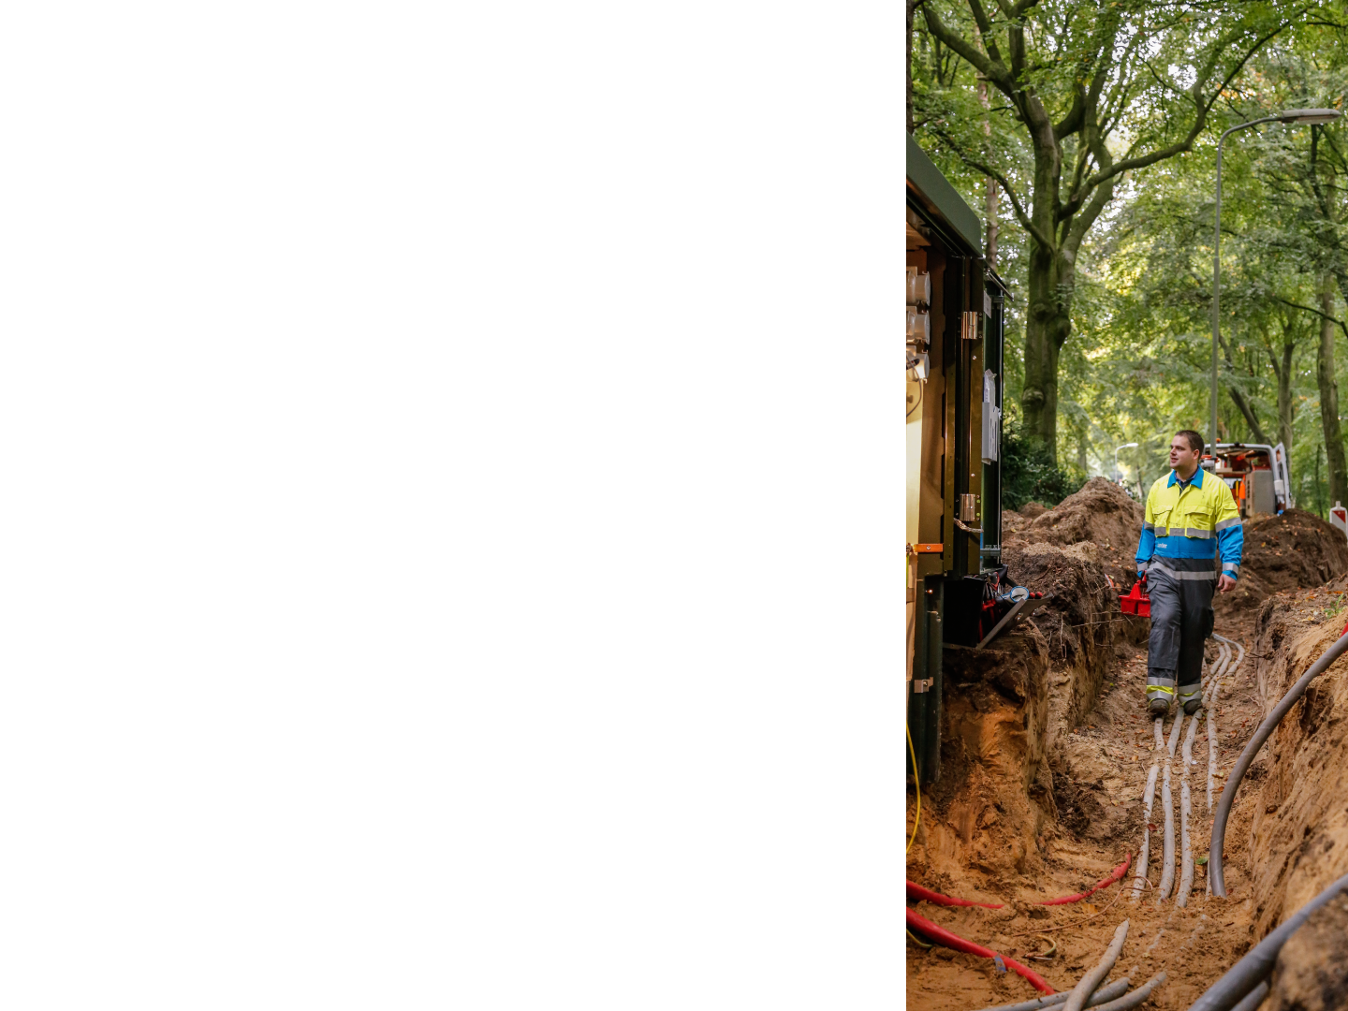
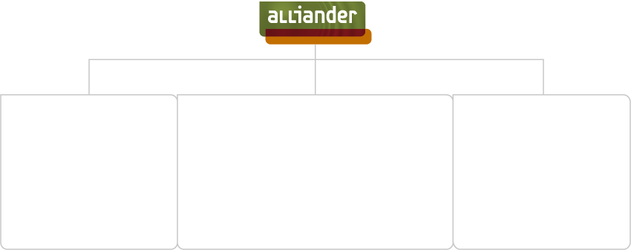
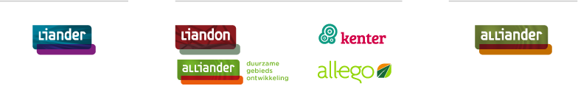


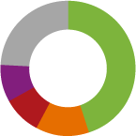
Network management
Infrastructure and Services
Germany
Shareholders 2016
End-users
3.2 mln
24% other shareholders
9% Amsterdam
9% Noord-Holland
Revenue
We maintain
89,000 km of electricity cables.
That’s twice
around the world!
45% Gelderland
13% Friesland
We install 1,000,000 smart meters each jaar
That’s 8 per minute!
1,6 bln
Employees
7100
Notes:
Basic information about Alliander NV:
6 million end-users
1.6 billion revenues
7100 employees
Organigram
shareholders
89,000 km of electricity cables: twice around the world!
Up to 2020 we will install 1,000,000 smart meters each year. That’s 8 per minute! And another 80 to 100 have been installed while I’ve been giving this presentation…

Slide 3





Alliander believes that grid operators of the future should have opportunities to control demand and supply as an alternative to grid reinforcement.
1. Facilitate dynamic energy tariffs
2. Facilitate a flexibility market
3. Provide dynamic connection tariffs
4. Intervene directly in capacity and/or equipment
5. Storage and conversion
Notes:
Furthermore, the new, flexible energy system will still be in development. How this will develop and at what pace
is currently unclear. Given the open character and the early stage of development of the energy market, Liander is therefore
choosing to keep all development options open.

Slide 4
Project Dynamo
The Dynamo Flexibility Market aims at developing and demonstrating an open flexibility market in 2019 where Liander can procure flexibility.
Inclusion for all customers and flexibility sources is supported. The flexibility market will be based on the USEF framework.
1 Alliander kick-starts an open, accessible and scalable flexibility market, based on the USEF-specifications.
2 Liander becomes a trusted partner who procures flexibility from the market to avoid network congestion and is able to incorporate the use of flexibility in their core process
3 Alliander stimulates individual users to make optimal decisions, for example through our demonstration side for new aggregators.
Notes:
SOMS Alliander en andere keren Liander → moet dit echt in onze Engelstalige presentatie?

Slide 5
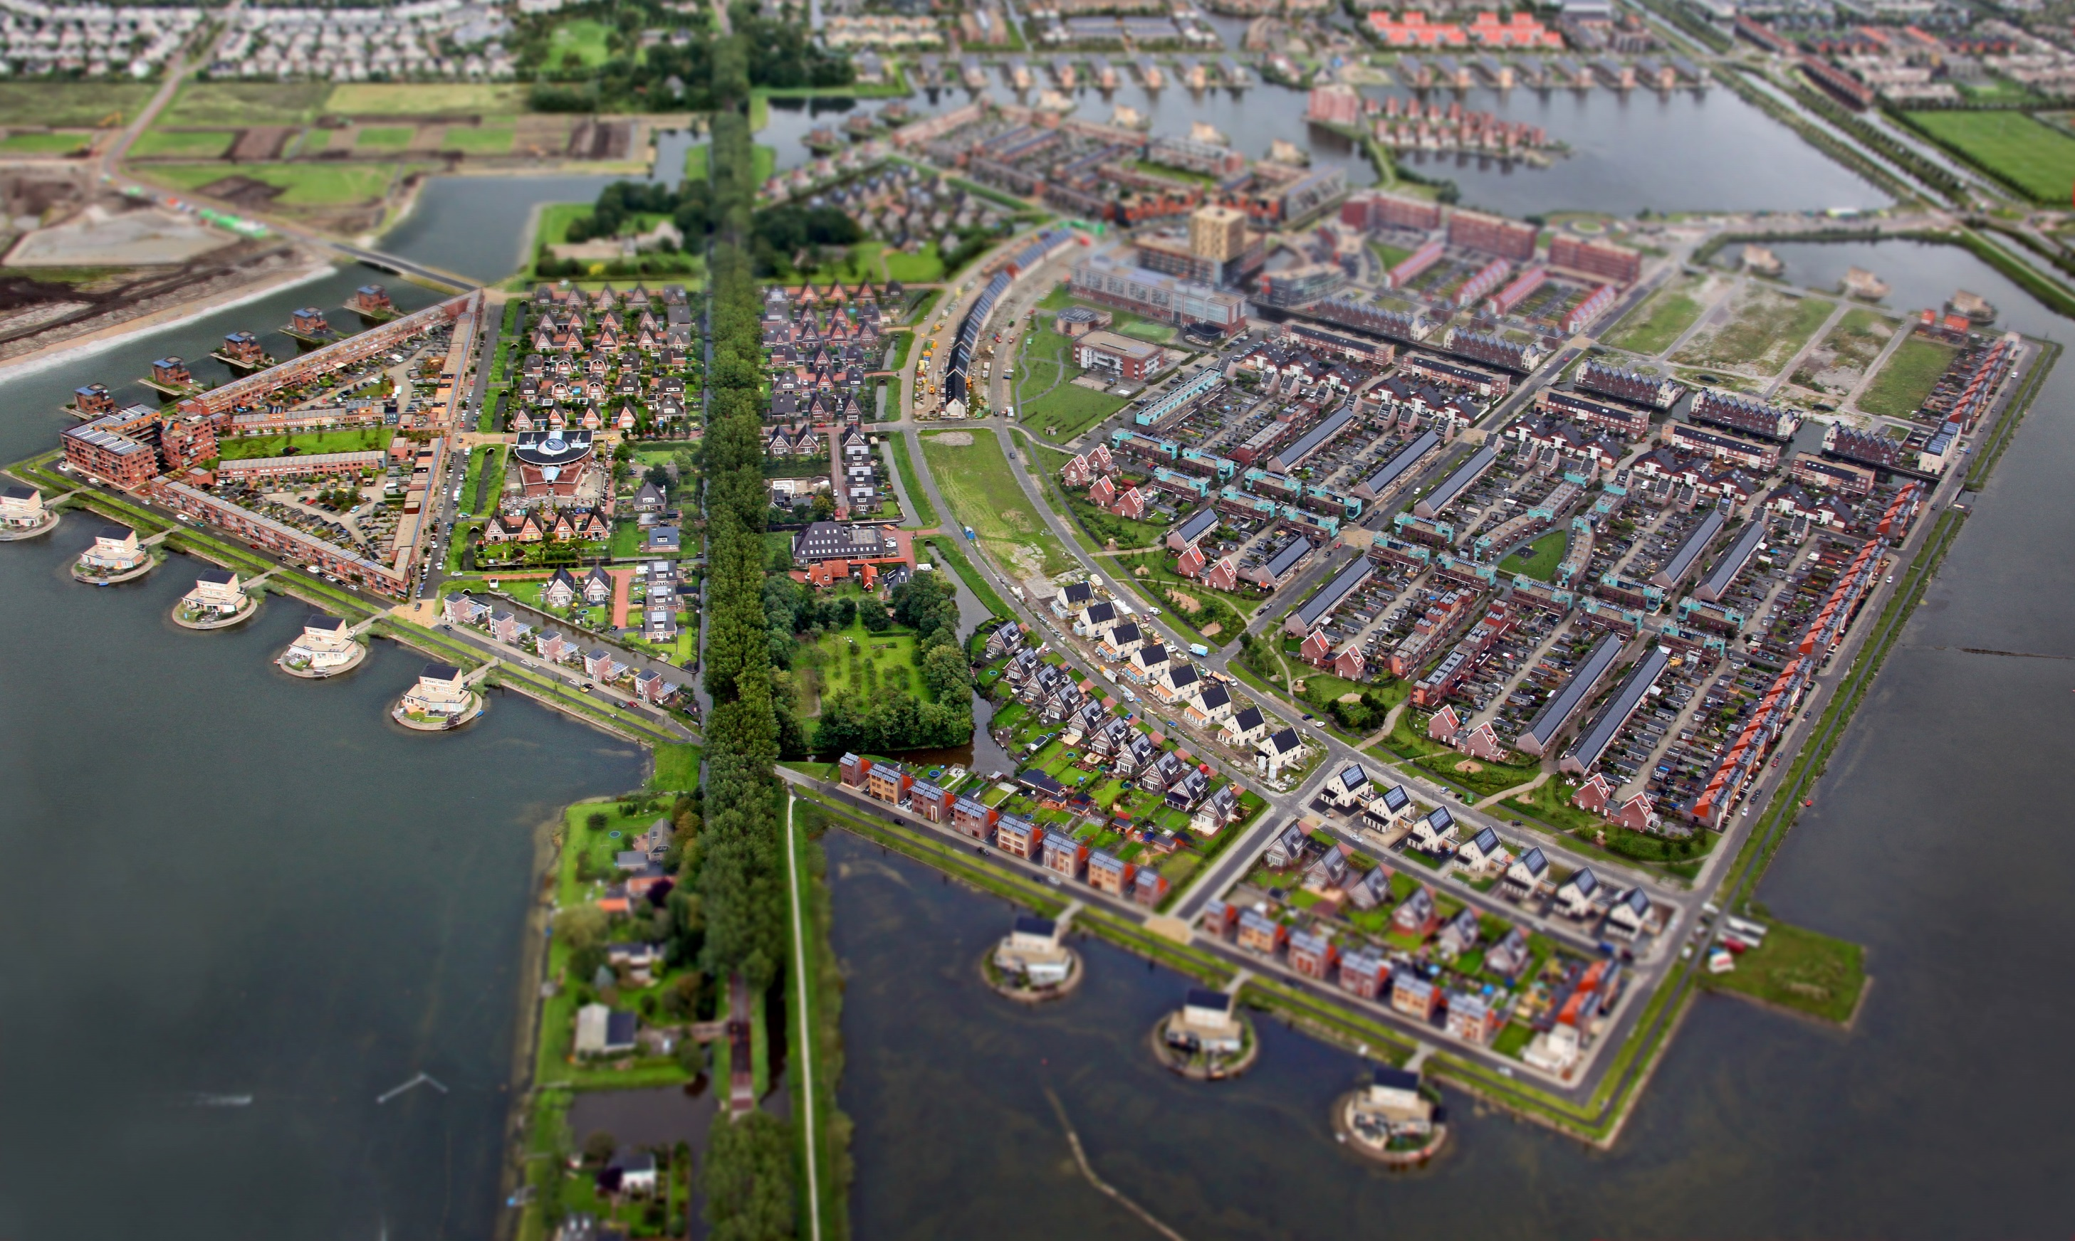
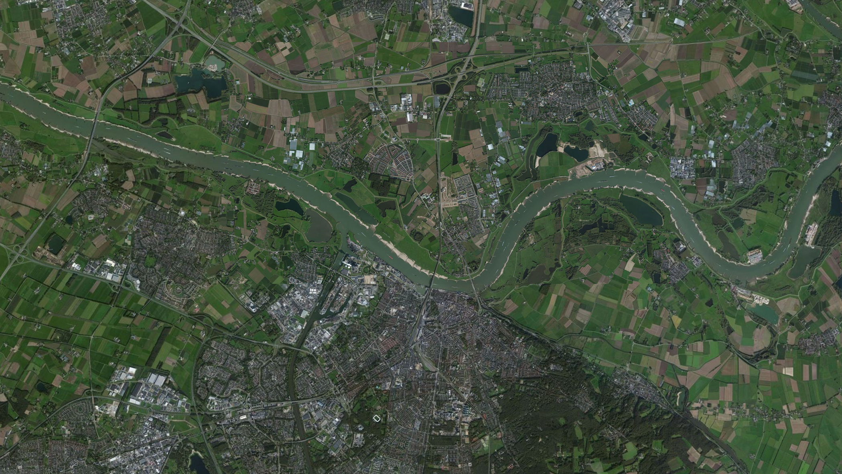
Het neerzetten en behouden van een realistische flexibiliteitsmarkt, volgens USEF-standaarden, operationeel op het laag- en middenspanningsnet.
Procesinrichting bij Liander zodat flexibiliteit ingekocht kan worden voor netbeheer.
Het vergroten van de (inter)nationale bekendheid en de mogelijkheden van een flexmarkt en de processen daarin inzichtelijk maken.
3
PROJECTDOELSTELLINGEN
DYNAMO
Dynamische
energiemarkt ontwikkeling
Dynamische
energiemarkt ontwikkeling
Notes:
So far we have identified 3 areas for project Dynamo.
Ik wil hier graag nog alle getallen:
Nijmegen Noord: eerste keer flex als alternatief voor een (tijdelijk) kabel. 1 dec 2017 start test en validatiefase . Deze fase is deze winter. Hierna zal een nieuwe aanbesteding komen. Gevraagde capaciteit voor de komende 5 jaar loopt op tot ongeveer 5 MW. Hierna zal er een nieuw station zijn aangelegd. Nijmegen Noord is een gebied waarin we groei verwachten in bedrijven, ong 8000 woningen en meer zon en win.
Heerhugowaard; 110 deelnemers (huishoudens)> test en demo site, waarop AGR op een laagdrempelig kennis kunnen maken met USEF en sturing van apparaten in consumentenmarkt. Virtuele congestie en open infratructuur is van Alliander
Rennovates: sturing warmtepompen in een nul op de meter woning. Bam is AGR. We willen weten wat het effect is van deze sturing op ons net. Verder is de impact van NOM woningen voor ons interessant. Virtuele congestie
Gevraagde capaciteit, wanneer en hoe vaak zal er afroep komen? Voor hoe lang?
Doelstellingen, deelnemers en tijdslijnen

Slide 6
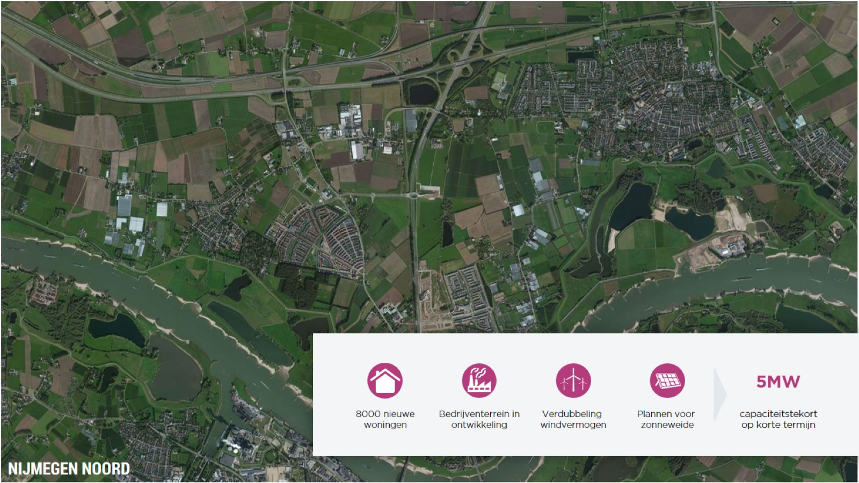

Slide 7
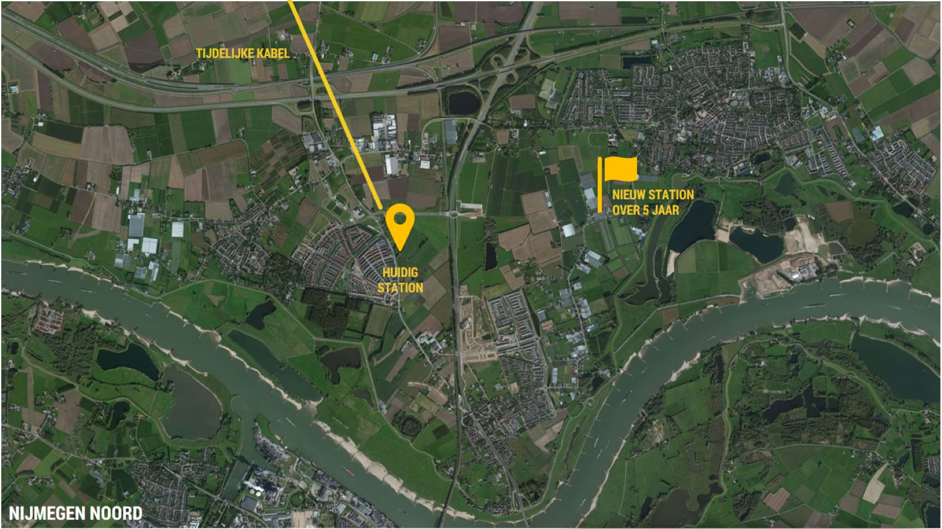
Notes:
Open market consultation: initially started with limited contracting period (1 year) with bilateral contracts for flex-availability and flex-delivery
Capacity only
Constraint is one-directional, capacity limitation to the area: flex provision when requested
DSO Requirements for flexibility product:
Capacity availability (in Nijmegen noord during peak-hours (in winter)
Suggestion and/or imitation of hours/PTU’s for the rebound (every evening peak)
Competitive bidding for flex-offers
Fixed timeslots for Day-Ahead and Intraday gate-closure
Allowing intraday trading until 2hrs before real-time
Settlement procedure in place for settling flex-delivery and non-flex delivery (measurement)

Slide 8
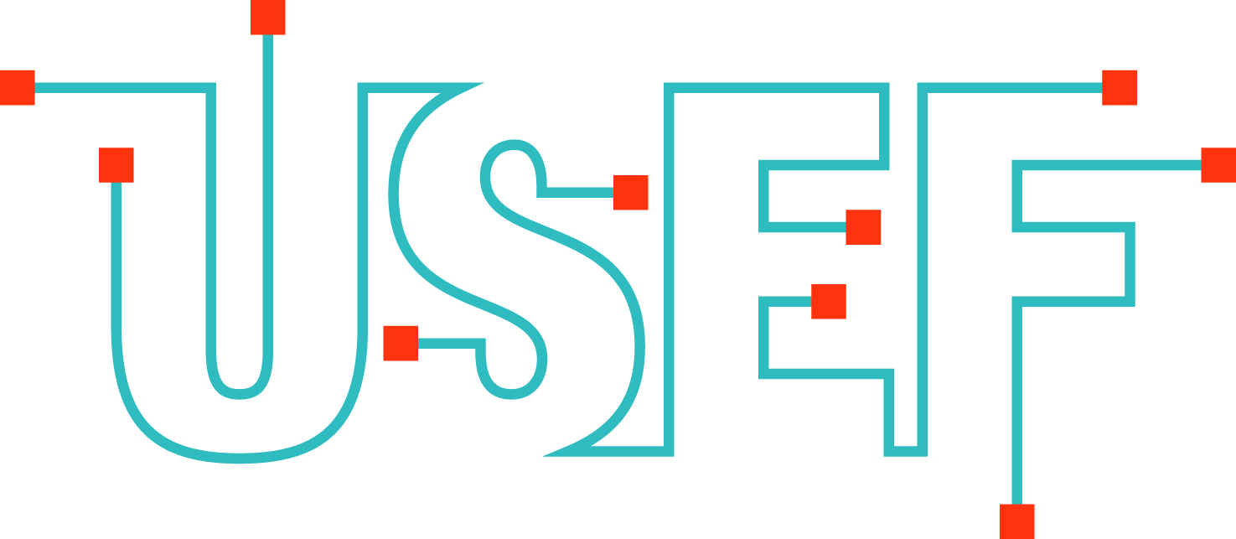
DYNAMO uses the (open-source) USEF framework and its market coordination mechanism
DYNAMO develops:
  Market consultations and tenders
  Contractual specifications and defines our DSO product requirements
  IT system: Dynamo cloud. Facilitating an easy entry for aggregators
  Internal DSO development: enhanced forecasting, risk assessments and investment decisions
Notes:
Maken gebruik van marktgebaseerde flexibiliteit

Slide 9



How is value created from flexibility? – The Market perspective
Cooling
Systems
Flex for
Portfolio
optimization
Emergency Generators
flex
BRP
Production Process
flexibility
flex
Flex
For grid
management
Heat Pump
Solar (& Wind)
Electric
Vehicle
Airco System
Aggregator
DSO
Prosumer
flex
Flex to
maintain
balance
TSO

Slide 10
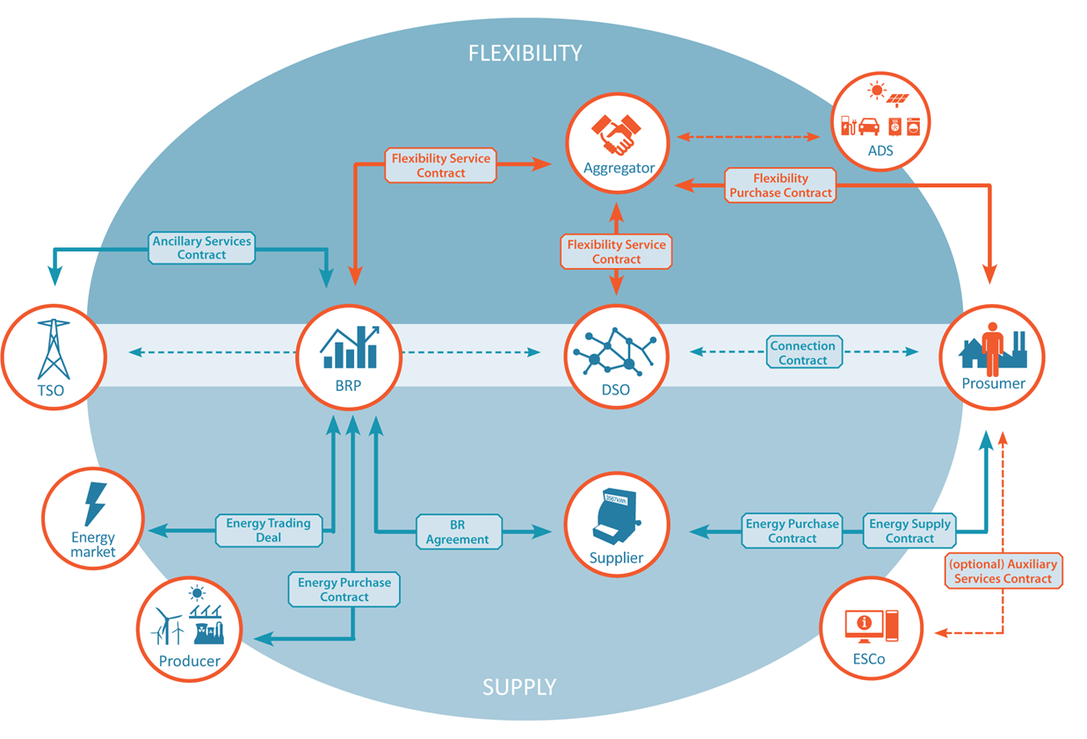
USEF role model
Notes:
Understanding that the market needs to be there to fulfill the needs of the energy system in the near future, we have described how DR can be effectively included in the market. This is done by our role model, our processes and defining the messaging. Whilst also providing the IT-architecture behind it open-source.
USEF describes the market design and market control mechanism that integrates demand side flexibility in the existing energy markets.
It is a role based model, describing how different roles can effectively use demand response of residential and C&I customers, to their own benefit, whilst doing so in a coordinated and informed way. The need to knows of the system operators are incorporated in the processes, to not only create a single market, but also provide enough control and means for the system operators to perform their tasks optimally.
DR is brought to the market by the aggregator.
How? By adding the market design and control mechanism to unlock, validate, operate and settle for DR in the market. It’s is role-based, but including not only the roles/responsibilities, necessary communication and timing of this communication, as well as

Slide 11
Market coordination mechanism: what information is required by whom when?
Contract
Plan
Validate
Operate
Settle
Demand
Supply
Flexibility
Notes:
Looking at the total picture, USEF specifies how flexibility runs through the system, comparable or complementary to existing market processes.
The framework also describes the new and existing roles and their responsibilities and how they interact in this extended market model
So, USEF designed processes that are similar to existing wholesale processes based on 5 phases.
These phases are the Contract, Plan, Validate, Operate & Settle.
In these processes flexibility is used to find the optimal economic solution to decision to fulfil the needs of the users in the system.

Slide 12
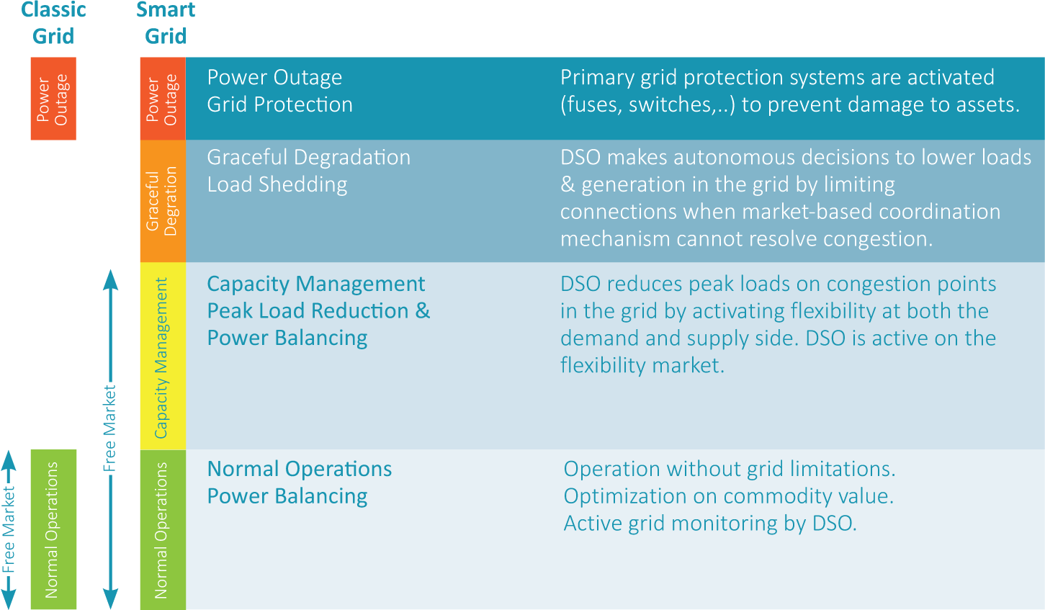
USEF Operating regimes

Slide 13



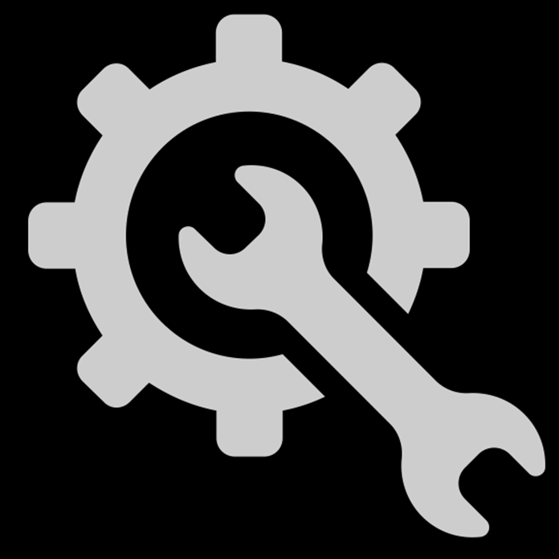
USEF is market-based, open-source and replicable for any new flexibility market
Regulatory framework
for DR
Flexibility
Products (TSO/DSO/BRP)
Market coordination mechanism
Process / information model
Implementation
USEF SCOPE
Parts of the current USEF framework are expected to end up in either the regulatory framework,
or in flexibility products

Slide 14
DYNAMO DSO product – location 1: Nijmegen-Noord
Open market consultation:
  initially started with limited contracting period (1 year) with bilateral contracts for flex-availability and flex-delivery
Capacity only
  Constraint is one-directional capacity limitation to the area: flex provision when requested
DSO Requirements for flexibility product:
  Capacity availability at peak-time (in Nijmegen noord during peak-hours (in winter)
  Suggestion and/or limitation for the rebound (e.g. prevent battery recharge during evening peak)
  Competitive bidding for flex-offers
  Fixed timeslots for Day-Ahead and Intraday gate-closure
  Settlement procedure in place for settling flex-delivery and non-flex delivery (measurement)
Notes:
Furthermore, the new, flexible energy system will still be in development. How this will develop and at what pace
is currently unclear. Given the open character and the early stage of development of the energy market, Liander is therefore
choosing to keep all development options open.

Slide 15
DSO and the use of flexibility
Flexibility could be of real value for DSO’s, because:
Long-term prognosis can be difficult
New requests for capacity might move faster then we as DSO can handle
Prevent faster depreciation of assets then necessary
Flexibility is not a solution when:
Structural capacity issues (difficult to rely on flex)
Costs: negative business case vs. for example grid-reinforcement
Risk of flex availability (e.g. flex from Electric Vehicles)
  But keep in mind:
  Location, location, location is what matters for the DSO
  It will always be one of the options for a DSO
  DSO maintains to be a DSO, 3 freedom’s are guaranteed

Slide 16
Further innovation suggestions:
Availability of flexibility
  Flex-providers (AGR/BRP): stimulate technical advancement for availability and integration in (existing) energy markets
  Flex-users (DSO/TSO): stimulate the cultural, technical, economical shift for system operators
Data is key for all stakeholders, including the active consumer, enhance processability of data whilst protecting privacy/security.
Stimulate open-platforms for active customers to access services they wish to access
Stimulate OEM’s to already equip flex-assets to reduce hardware costs for (new) retail
Stimulate system solutions, next to unilateral or bilateral innovation projects
Stimulate harmonization for information exchange and products: 29 solutions won’t help in achieving low-cost availability of flexibility
Understand interaction between implicit and explicit demand-response (and necessary DSO-requirements)

Slide 17
Questions?

