Slide 1
Notes:
Hello everybody, my name is Joshu Jullier and I am working for Swissgrid, the Swiss Transmission System Operator.
My presentation will be about hybrid overhead lines in Switzerland. What am I speaking about?

Slide 2
Hybrid AC/DC overhead lines The concept idea
Notes:
The project idea is to convert an existing alternating current line in a hybrid line.
This means that we transform one of the two AC systems in a Direct Current (DC) system. The second system remains AC. With this technical solution we can increase the transmission capacity by up to 50%. Thanks to the increased capacity, the building of a new line (beside the existing line) could be avoided. New line projects have a low acceptance. We assumed at the beginning of the project that this solution will have a higher public acceptance.
Background:
Remote renewable & pumped hydro power (Strategy 2050)
Need for more transmission capacity
Low acceptance for new lines
Approach:
Conversion of existing infrastructure
Increased capacity (DC)
Support of existing grid (AC)
Low visual impact → higher acceptance
Challenges:
Coupling between AC and DC
Grid stability

Slide 3
Objectives & partners
Technology
Acceptance:
Acceptance for conversion?
Importance of uncertainties?
Technology:
Optimal hybrid tower design?
Maximum transmission power?
Environmental effects?
System & Economy:
Influence on existing AC grid?
Ideal Swiss corridor?
Benefit for hydro power?
Economy
& Grid
Acceptance
Notes:
It is a ETH Zürich project under the national research programme 70 with different partners like the University of Bern and Swissgrid
The project is divided in three parts: acceptance, technology and System and Economy
Acceptance: Has the conversion of an existing line in a hybrid line really a higher acceptance than a new line?
Technology: How should the line be designed for highest possible increase of capacity with at the same time acceptable low environmental effects?
System and economy: What is the influence on the existing AC grid and where could be possible corridors in Switzerland?
I start now with the part about acceptance.

Slide 4
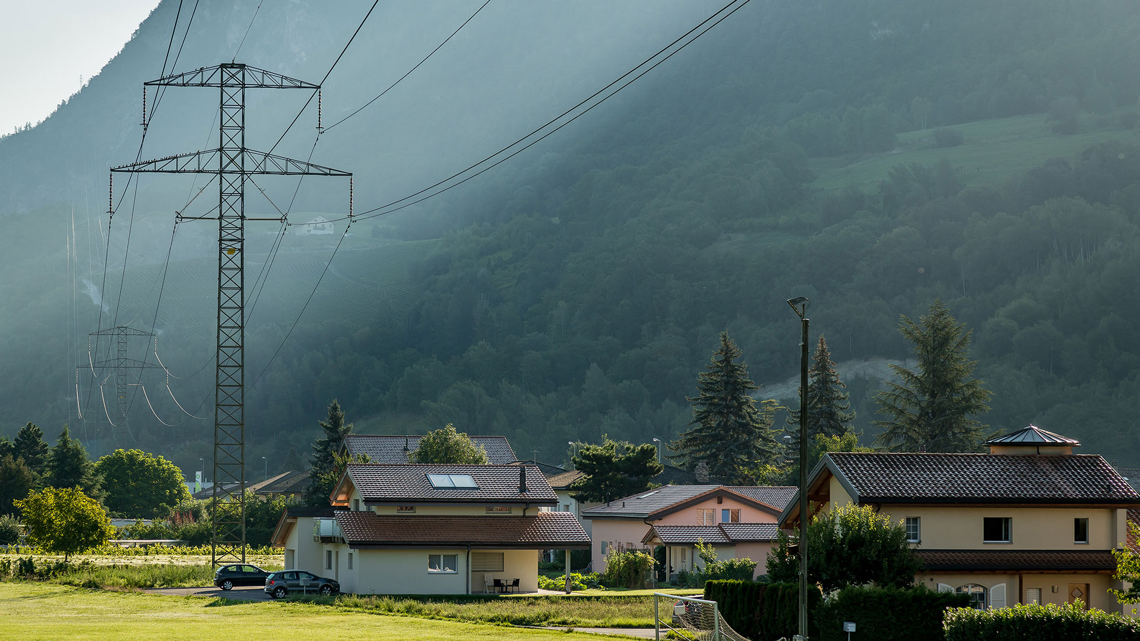
Lack of acceptance An issue
Notes:
Lack of acceptance for power lines is one of the main reasons for project delays in Europe. In our project, the university of Bern made a study about the acceptance of power lines with a representative sample of the Swiss population.
Generally, the people perceive power lines as disturbing. (The percentage is lower for people which live close to a line (43% compared to 63%))
Why are power lines disturbing?

Slide 5
Lack of acceptance Main problem of high voltage lines
Open question: «What is from your point of view the main problem?»
Graphic: Swissgrid Stakeholder Research, 2016
Notes:
What is the main problem of power lines? You see here the answer to this question according to the Swissgrid Stakeholder Research 2016.
The most mentioned problem is clearly the perception of health risks. More than 50 % of the respondents say that health risks are the main problem.
The second most mentioned problem is the impact of lines on the landscape (17 %)
The third most mention problem is audible noise (8%)
What is interesting is that less respondents who say that they see a line from their house mention health risks as the main problem than people who do not perceive a line close to them. The rejection of power lines seems to have it roots mainly in rather diffuse fears. These diffuse fears can be reduced by the real experience of a line. This assumption explains also the fact, that people close to a line say more often that there is no problem.
For the landscape disruption, the effect is contrary. People with view on a line from their house say more often that landscape disruption is the main problem. This makes sense.

Slide 6
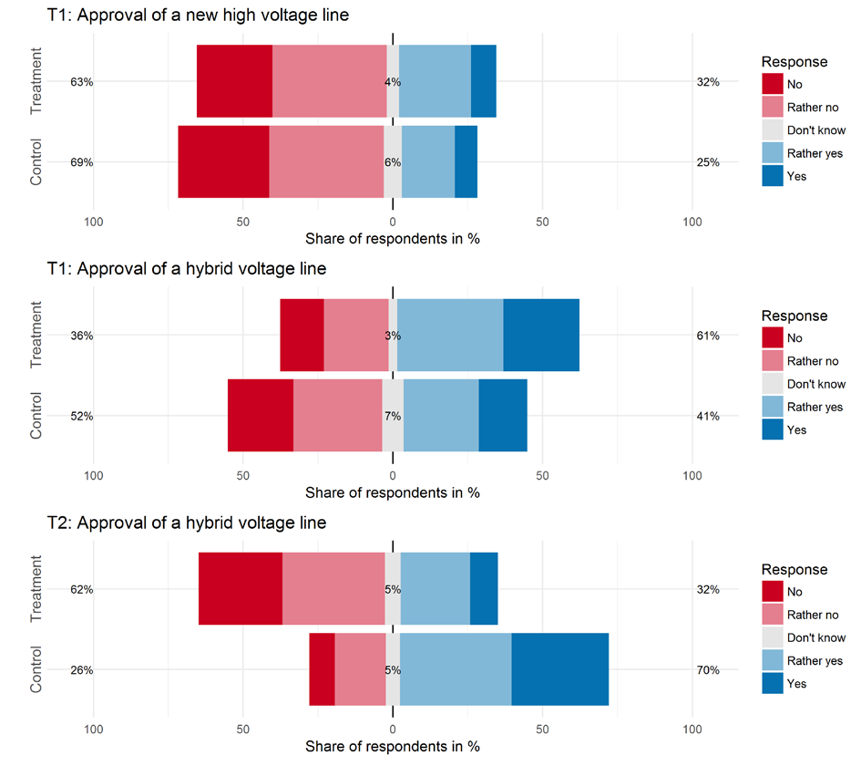
Acceptance for a new technology Information matters
T1: Approval of a new high voltage line
Response
Treatment T1:
Extra high voltage lines are necessary for electricity transmission. Indeed, today’s grid capacity does not suffice to meet future demands.
Treatment
Response
Treatment
No
Rather no
Don’t know
Rather yes
Yes
Control
Control
T1: Approval of a hybrid line
Treatment
Response
No
Rather no
Don’t know
Rather yes
Yes
Treatment T2:
However, this new generation of extra high voltage lines might yield more noise and might be felt more intensely when standing right below a line.
Control
T2: Approval of a hybrid line
Treatment
Response
No
Rather no
Don’t know
Rather yes
Yes
Control
Graphic: «Information effects and public acceptance of new technologies in energy policy – the case of hybrid high voltage lines», Isabelle Stadelmann-Steffen, University of Berne, 2016
Notes:
We come back on the study of the university of Bern. We asked for the approval of a new overhead line and of a hybrid line and we gave two treatments, a positive about the necessity of the lines and negative for the hybrid line: a hybrid line can produce more corona noise and might be felt more intensely when standing right below a line.
The acceptance for new overhead lines is rather low. If we explain the necessity as a positive information treatment the acceptance is a bit higher.
The acceptance for a hybrid line is generally high. The positive treatment has a bigger effect as for a new lines.
The effect of a negative treatment (more noise and feel more intensely right below the line) is in the case of the hybrid line very high. Negative information has an higher effect as positive information.
Information has a high effect for new technologies, whereas the effect for conventional technologies is rather low. Therefore Information plays a very important role for the acceptance of hybrid lines.

Slide 7
Acceptance for a new technology Preference for hybrid lines and underground cables
T2: Preferences for conversion or for new overhead line
Treatment T2:
However, this new generation of extra high voltage lines might yield more noise and might be felt more intensely when standing right below a line.
Treatment
Response
Surely support new line
Rather support new line
I cannot decide
Rather support conversion
Surely support conversion
Control
T3: Preferences for underground cable or for overhead line
Treatment T3:
However, this latter variant is more expensive and when being constructed generates broad traces (like a highway) which can subsequently not be used to plant deep-rooted and high-stock trees (e.g., forest, fruit trees).
Treatment
Response
Surely support overhead line
Rather support overhead line
I cannot decide
Rather underground cable
Surely underground cable
Control
Graphic: «Information effects and public acceptance of new technologies in energy policy – the case of hybrid high voltage lines», Isabelle Stadelmann-Steffen, University of Berne, 2016
Notes:
If we ask if the people prefere the conversion of an existing overhead line or the construction of a new overhead line, a hybrid line is clearly prefered. The information effect stays also here highly significant, if we inform about negative effects. The preference for a new overhead line increases with the treatment.
The same effect you can see for underground cables, also a rather new technology for transmission lines. An underground line is also prefered compared with a overhead line but when we inform about the negative effects, broad traces and more expensive, the amount of people how prefere a overhead line increases.
These results confirm our assumption that the acceptance is more volatile for new technologies and dependent of the information given.

Slide 8
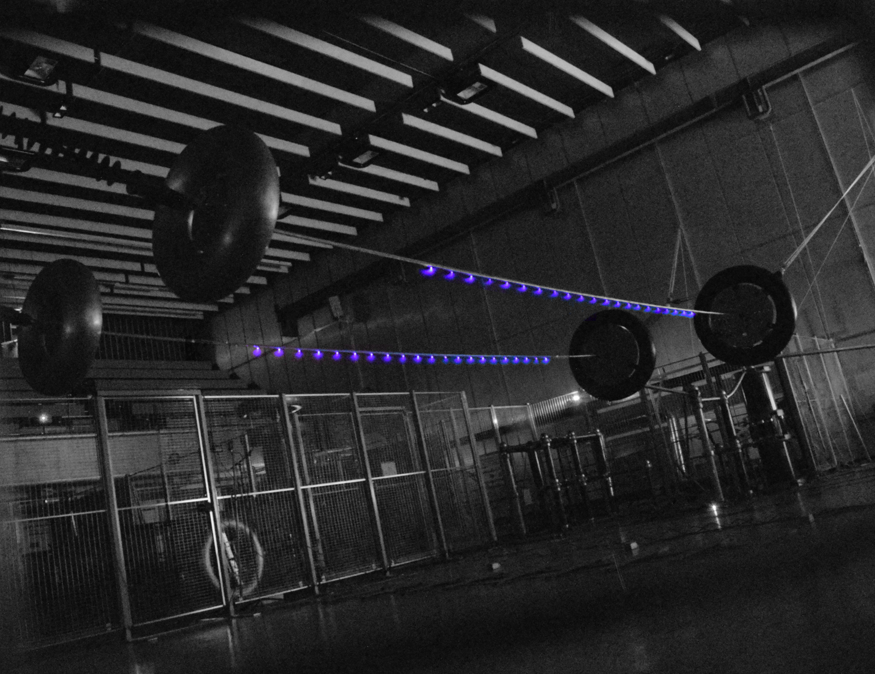
Technology Environmental effects
Audible noise due to corona
AC and DC interfere with each other
DC Corona increases electric field
Notes:
Negative effects on the environment are therefore very relevant for the acceptance. They have to be as small as possible.
Corona – Ionisation of the air (bei hohen Feldstärken (field strengh) durch hohe Spannung)
DC Corona increases electric field on the ground (due to ion drift). Therefore the could be felt more intensely when standing right below a line.

Slide 9
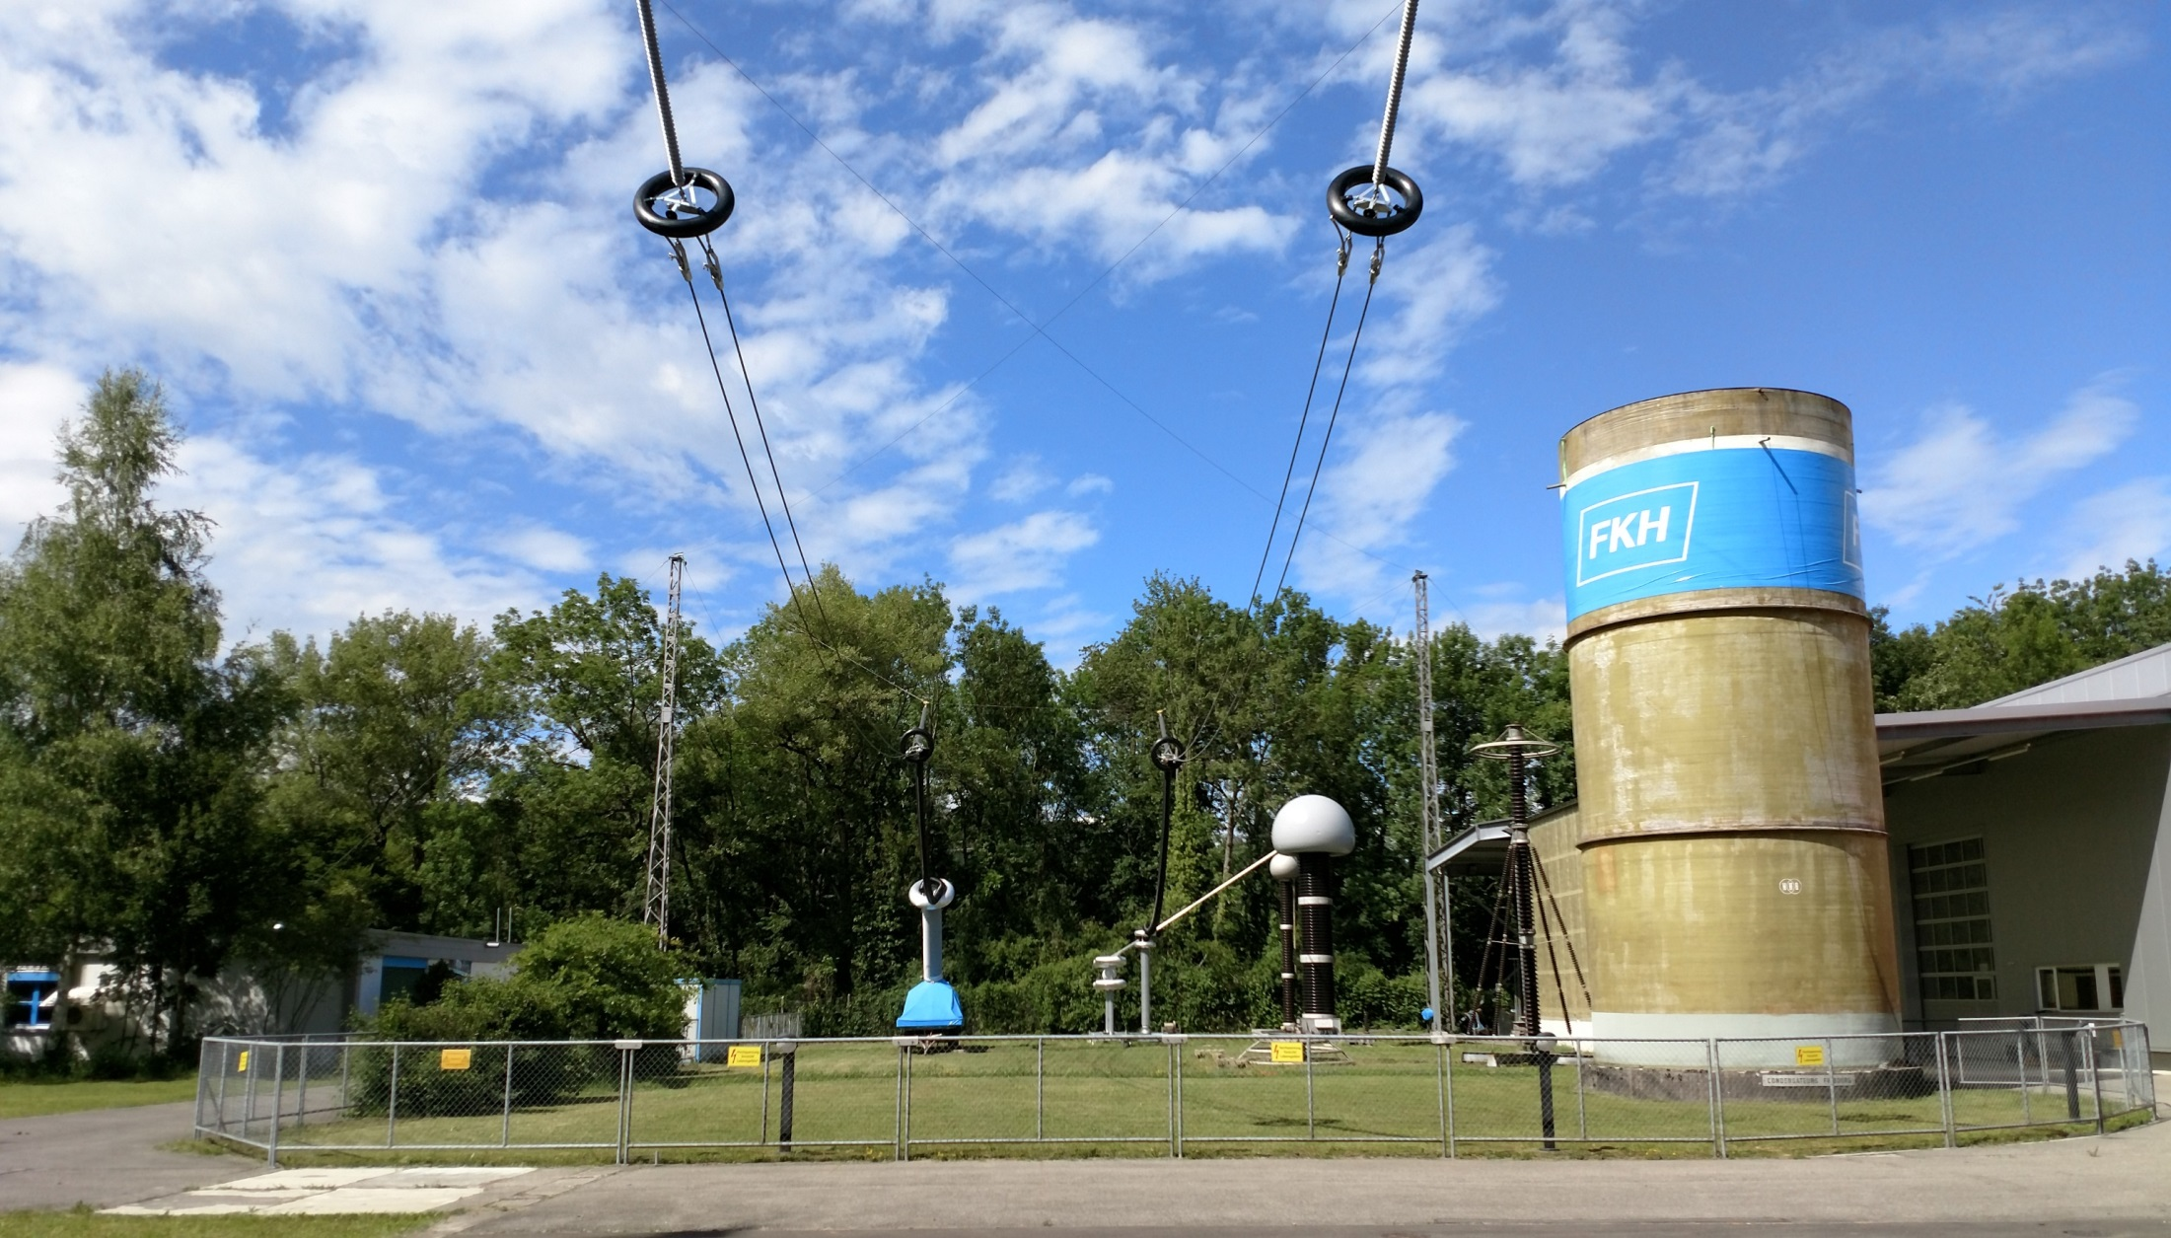
Technology Outdoor hybrid test line
Influence of weather and pollution
Separation distance between AC and DC
AC line
DC line
Notes:
Weather & pollution (water drops and pollution like insects, particles increase corana)
Separation distance between AC and DC (more distance, less corona)
Realistic dimensions, longterm (1 year)
Nur falls Fragen:
double bundle
AAAC 600mm²
h_{line} = 8m
d_{sep} = variable

Slide 10
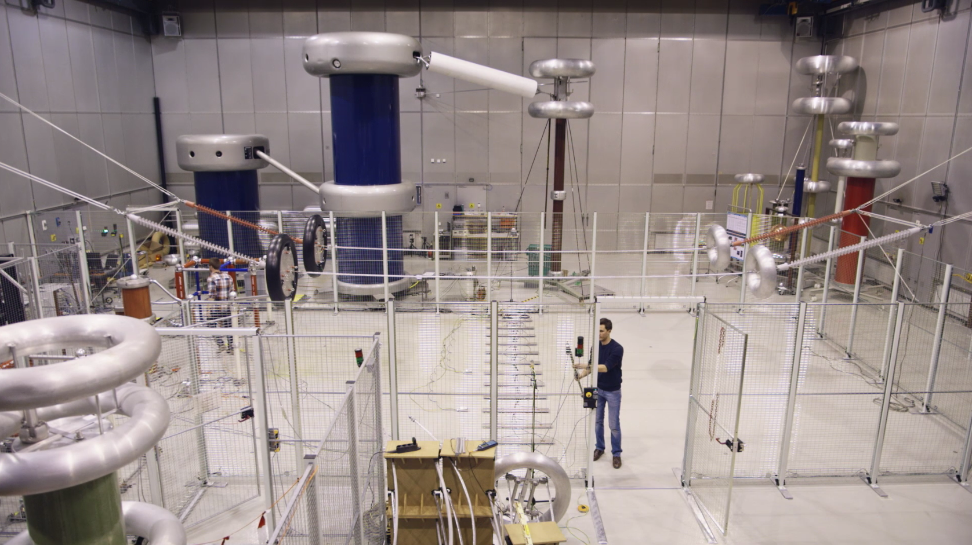
Conclusions
Hybrid power lines and underground cables are clearly the preferred option for increasing grid capacity.
Given the high volatility in attitudes and preferences, early and forward-looking information is crucial.
Laboratory tests have shown the interference of AC and DC lines
Notes:
Hybrid power lines and underground cables are clearly the preferred option of increasing grid capacity. However,
Given the high volatility in attitudes and preferences, early and forward-looking information on negative effects as fields and noise is crucial for acceptance. The probability of “negative campaigning” could be decreased.
Laboratory tests have shown the interference of AC and DC lines… now we have to verify the results of the laboratory tests (folie wechseln) in the outdoor hybrid test line

Slide 11
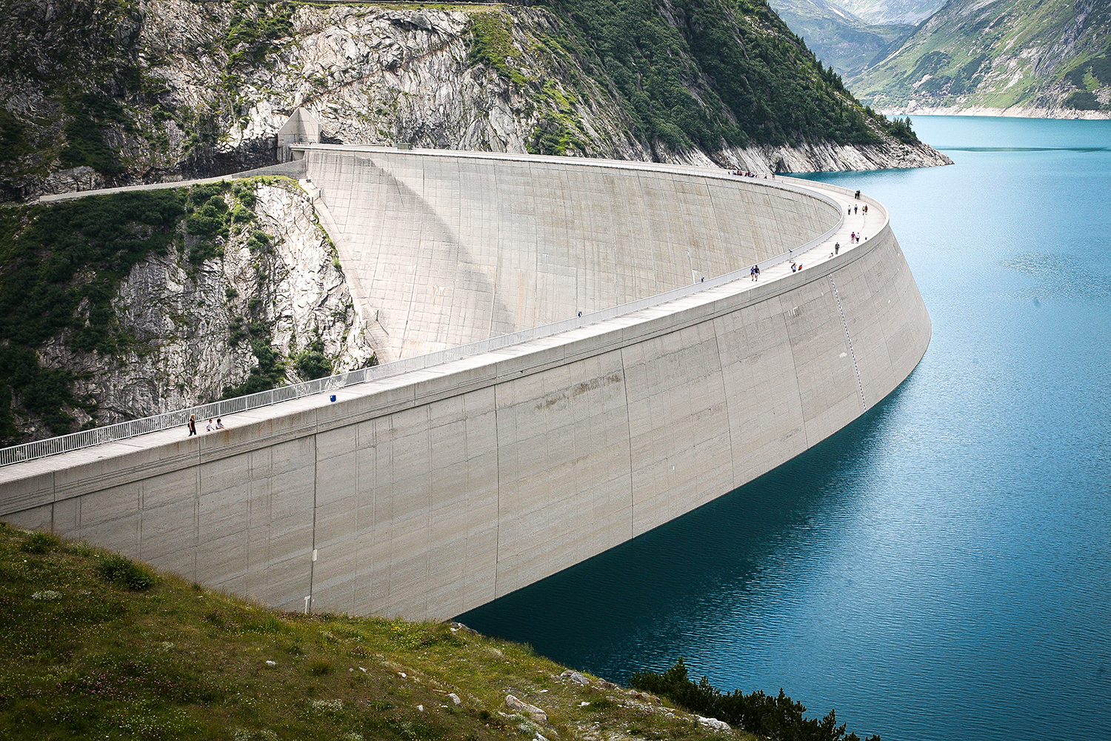
Next project steps
The results of the laboratory tests have to be verified in the outdoor hybrid test line
Study on economic benefits of hybrid line
Possible influences on the existing grid
Notes:
Possible influences on existing grid: system stability
Further research:
A lot of effects which are coupled (Optimierungsproblem): Spannung, E-Feld, Magnet-Feld, Noise, Aussehen des Mastes
What is the exact effect on acceptance of positive and negative information treatments for conventional and new technologies (persistence over time)? Has a hybrid line (conversion of a existing line) a higher acceptance than new underground cables? What are the real effects (more noise and more electric fields, ion currence/drift) on the acceptance (optisch aber anders wahrnehmbar)?
How to reach high acceptance for new technologies (no negative campaigning)? What are effects of real projects (Ultranet)?
Where in the European grid further hybrid or DC lines would make sense (system modelling)? Economically and from the point of system stability

Slide 12
Implementation Possible Swiss corridors
UltraNet
SuedLink
Laufenburg
Grynau
Mettlen
Sils
All’Acqua
Project San Giacomo
Greenconnector
Notes:
Finally, we interested in the question where hybrid lines in Switzerland could make sense. For the transport of the electricity from north to south of Europe, hybrid lines in Switzerland could make sense if one of the two DC Projects of Common Interests will be realised.
Greenconector: Sils -> Verderio → Hybrid line from Mettlen to Grynau to Sils to connect the Greenconnector
Project San Giacomo (All’Acqua-> Pallanzeno) – Laufenburg -> Mettlen -> All’Acqua
Grosse Projekte DC in Deutschland / Italien
Evtl noch Vorteile von Wasserkraft (Mehr Kapazität im Inland und für Importe von Erneuerbaren)

