Slide 1
Notes:
Hello everybody, my name is Joshu Jullier and I am working for Swissgrid, the Swiss Transmission System Operator.
I will present you today a 3D Decision Support System.
But before I come to our project, I start at the beginnning.
What is the problem we have?

Slide 2
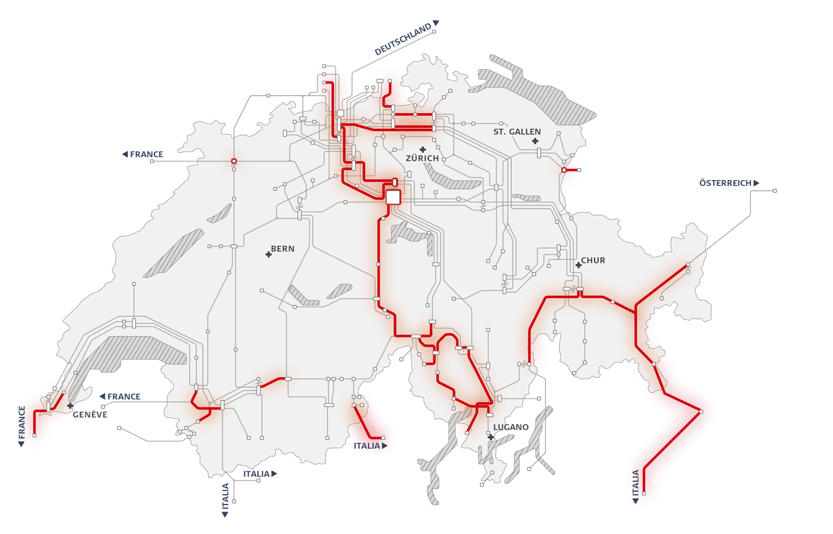
Bottlenecks – a major problem
Structural bottlenecks
Notes:
Increasing electricity demand / increasing renewable energy production
We have bottlenecks in the grid, marked here in red for Switzerland, but also in the rest of Europe
In the whole of Europe, the grid has to be enhanced, there is a
Necessity of increasing grid transfer capacity
But: Project delays
A major reason: opposition / lack of acceptance

Slide 3
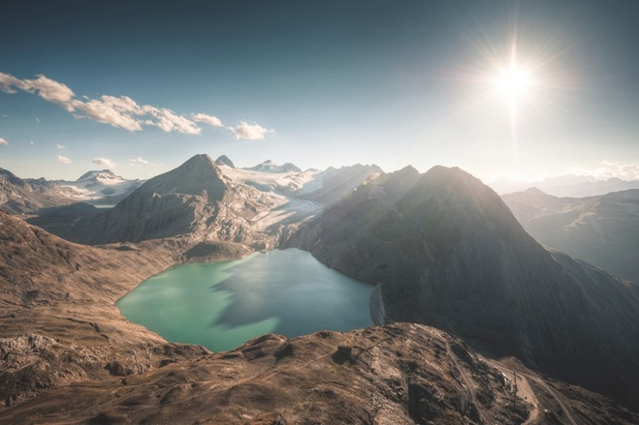
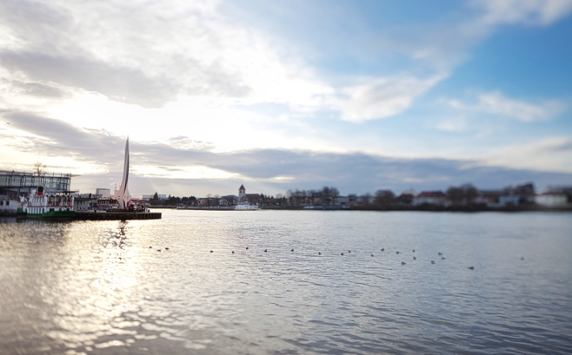
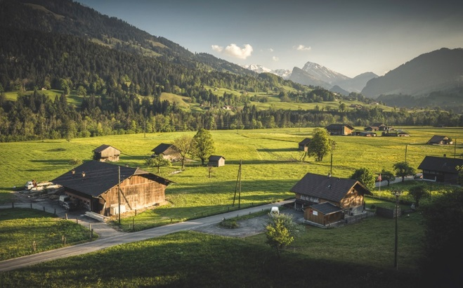
Main drivers of grid expansion in Switzerland
New large power plants
For example, construction of a new pumped storage power plant
International association
Increasing international energy exchange can lead to grid overload
Supply of downstream grids
New connection requests can lead to congestion
Notes:
In Switzerland, the main drivers of grid expansion are
New power plants like the pump storage power plant Nant de Drance in the Wallis
Import and export of electricity. Switzerland produces too much electricity in summer and not sufficient in winter
Supply of distribution grids

Slide 4
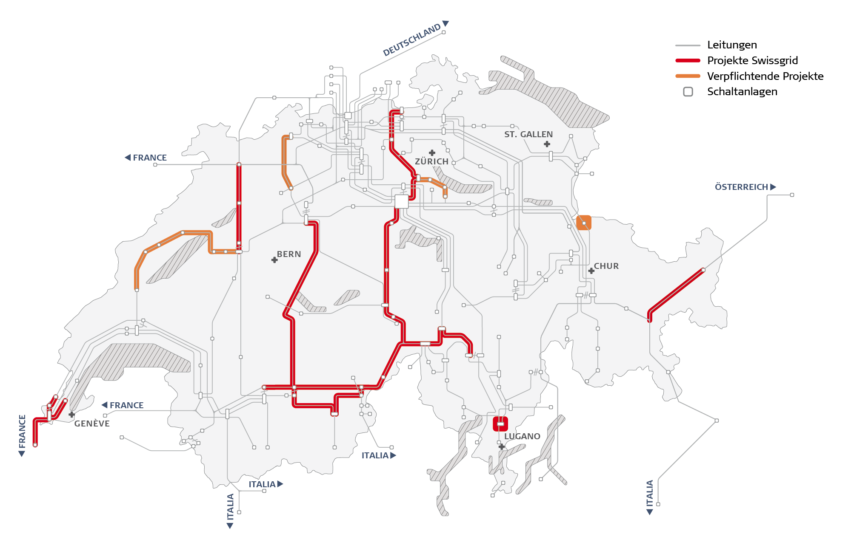
Expansion of the grid required
Strategic Grid 2025
193 km grid optimisation
87 km grid enhancement
370 km grid expansion
Substations
Lines
Swissgrid projects
Mandatory projects
Notes:
The here red and orange marked projects are necessary in Switzerland. We can see that from the Wallis, the mountainous region, the electricity of hydro power plants has to be transported to the regions with high consumption like Zürich and Bern. Here are the bottlenecks where we have to increase grid capacity

Slide 5
Project delays: Why?
Notes:
We have all over Europe the problem that the grid projects can not be realised on time. Why?
Lines are perceived as disturbing and therefore there is a lack of acceptance
Vorwegnehmen: Netzausbau geht nur schleppend voran.
Gründe?
Dilemma: Akzeptanz fehlt – weil Leitungen als störend wahrgenommen werden. Strom brauchen hingegen alle, daher ein Must have!
Der grösste Teil der Netze in 50er/60er Jahren gebaut
Die Zeiten ändern sich…
Früher stand das Übertragungsnetz für Fortschritt, heute stört es
Siedlungsgebiete dehnen sich aus: wachsende Bevölkerung und wachsende Ansprüche
Es gibt immer weniger «Platz», wo man Ü-Leitungen überhaupt noch bauen darf
Gesetzliche Rahmenbedingungen ändern
Umweltschutz: NISV

Slide 6
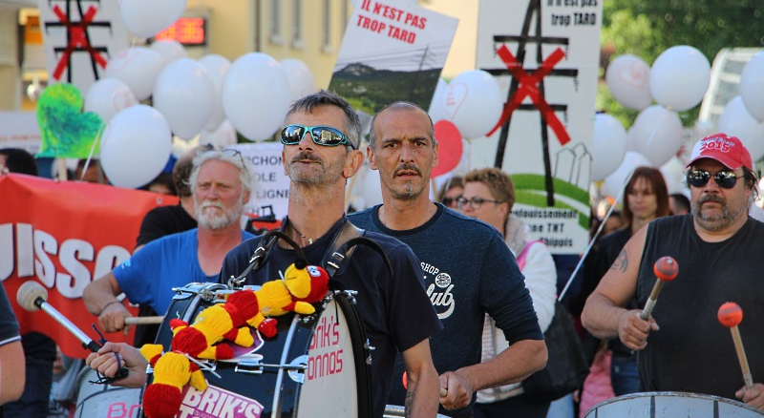
Lack of acceptance: a major reason for project delays
Notes:
Direct affected people do not like new lines. They have principally fears that the line is a health risk and they say that a line disrupt the landscape.

Slide 7
Overarching objective of the project
Find the solution with the highest acceptance amongst all affected stakeholders
Multi-Criteria Decision Analysis (MCDA) allows to respect the interests of all stakeholders
Notes:
To increase the acceptance for new lines we want to find in our project the solution with the highest acceptance amongst all affected stakeholders
We do this with a Multi-Criteria Decision Analysis. That allows us to respect the interest of all stakeholders

Slide 8
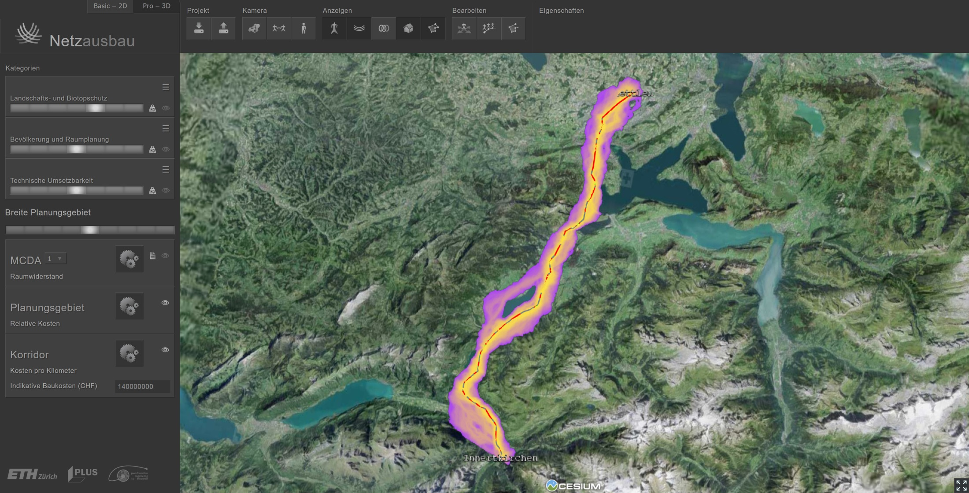
Idea of the project
Notes:
Hence we developed a 3D Decision Support System. The idea was to develop a tool that helps to find the solution with the highest acceptance
To develop a tool which helps to find the solution with the highest acceptance

Slide 9
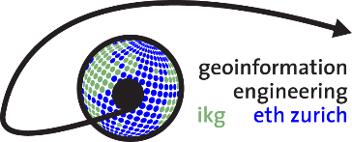
Project team
Financial and technical support
Notes:
The Institute of Cartography and Geoinformation and the Institute for Spatial and Landscape Development of the ETH Zürich are developing the tool.
The project is supported by the Swiss Federal Office of Energy (SFOE) and three grid operators, one distribution grid and two transmission grid operators, the Austrian Power Grid and we, Swissgrid

Slide 10
Three dimensions of our Multi-Criteria Decision Model
technical feasibility
environment & landscape
urban planning
Notes:
We consider following three dimensions with multiple factors within the Multi-Criteria Decision Analysis (MCDA)
Technical feasibility: e.g. the factor natural hazard zones
Environment & landscape: e.g. nature reserves, (visibility), landscape protection zones, etc.
Urban planning: e.g. settlements, bundling of infrastructure, recreation areas

Slide 11
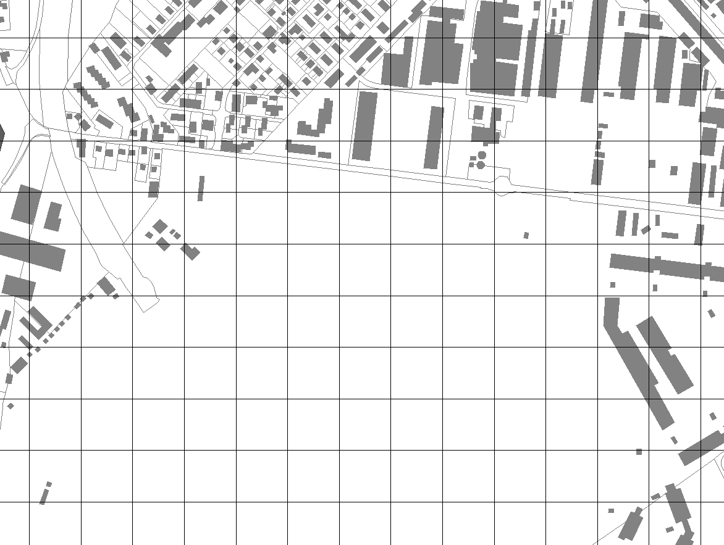
How spatial Multi-Criteria Decision Analysis works
Factors are spatially explicit
F₁,F₂,F₃,F₄
Notes:
As we consider these spatially explicit areas as factors…
we can assign them a specific resistance. What this means: would you like to see a overhead line in a nature reserve or in a recreation area? No, thus (somit) we assign each factor a resistance against the construction of an overhead line. We then sum up all resistances of the same dimension. For example, there is a settlement zone and a recreation area in the dimension of urban planning which overlap, then the two are sumed up
Spatially explicit = ortsgebunden

Slide 12
How spatial Multi-Criteria Decision Analysis works
resistance x weight
x 0.45
x 0.25
$${total}_{x}=\sum_{i=1}^{n}{{resistance}_{i}⋅{weight}_{ix}}$$
high
low
x 0.30
Notes:
Then we give a weight to each dimension, for example 45% for environment and landscape, 25 % for urban planning and 30% for technical feasibility. Then we multiply resistance with the weight and we receive the total resistance of an area, here is the formula.
By applying this formula, we get this map. Dark areas have a high resistance whereas bright areas have a low resistance. Thus the bright areas are more suitable for constructing a transmission line than dark areas.
x = Ort / location (an einer Stelle x)
i = Faktor I
n = Anzahl Faktoren

Slide 13
Stepwise procedure from the study region to the corridor
study region
planning area
planning corridor
Notes:
The tool has a three step procedure:
Step 1: we define a study region and calculate the total resistance of each point in the study region
Step 2: All points which are too costly to reach, will be filtered out. And we get a planning area in which multiple corridors are possible (Schritt 2: alle die Punkte, die zu teuer/aufwendig sind, um sie zu erreichen, werden herausgefiltert.)
Step 3: We continue this filtering process until we arrive at the planning corridor with the lowest total resistance.

Slide 14
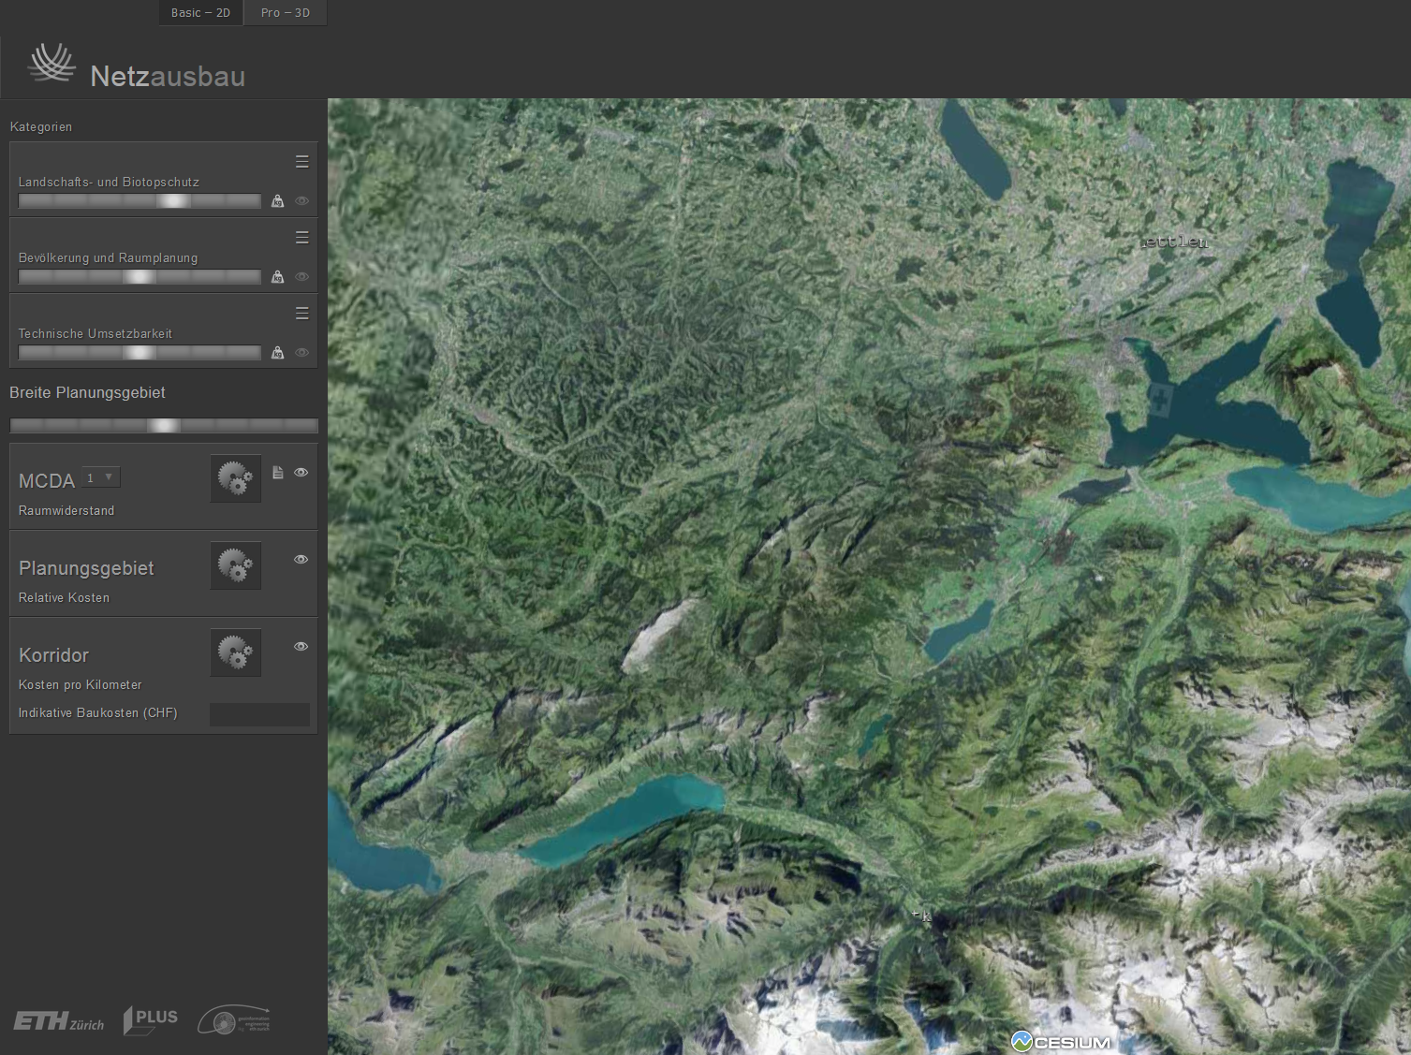
Live Demo
Notes:
Three dimensions
Resistance of each factor, for example nature reserves in each dimension
Then I can calculate the total resistance in the whole study region
Then I calculate the planning area
Then I calculate the planning corridor with the lowest resistance
There are two different algorithms, the first algorithm respects sharp borders between the areas with different resistances. The second algorithm gives to each area a safety distance. That means if there is a settlement area, the area next to the settlement zone has within the safety distance area has also a higher resistance that decreases with the distance.
Disclaimer:
100*100 m Cluster: Lösung kann Hickse haben?
Schnelller Algorithmus: Erfordert durchgängigs Gebiet zwüschen A und B, in dem eine Leitung möglich ist. Unterscheidung Mast und Leitung: Gebiete können überspannt werden.
-> Es geht nur um die Rechnenzeit (darum nicht in Plattform)

Slide 15
Conclusions: How does an additional safety distance influence the results?
without safety distance:
more direct connection
with safety distance: circumvention of densely inhabited areas
Notes:
Two effects:
Substantially different result
Significantly higher acceptance of affected stakeholders
Weitere Hintergrund Infos:
Erklären, was mit buffering gemeint ist. Einfach erklärt: Ich gebe zu einer Schutzzone noch eine zusätzliche Schutzdistanz nach aussen hinzu.
Erklären, weshalb Pufferung die Akzeptanz erhöht: Weil durch die zusätzliche Schutzwirkung die Angst bzw. die Einwände gegenüber HSL gemindert werden.
Diese Schutzdistanz wurde von Experten festgelegt. Die Schutzwirkung nimmt nach aussen ab.
@Joram: Karten mit Google Maps einfügen

Slide 16
Next steps: Visualization of LiDAR data
Notes:
LiDAR = light detection and ranging

Slide 17
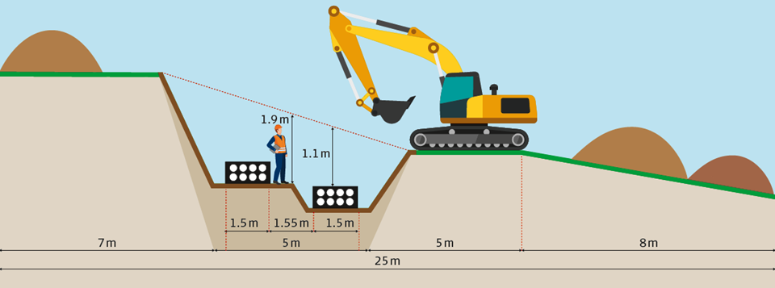
Next steps: Develop an approach to integrate cable solutions
Notes:
Andere Bilder (diese sind nicht verwendbar): Bild 1: Freileitung, Bild 2: Kabelgraben
oder: …needs a similar, but different approach
To integrate (anstatt compute)
Kabellösungen (anstatt earth cables)

Slide 18
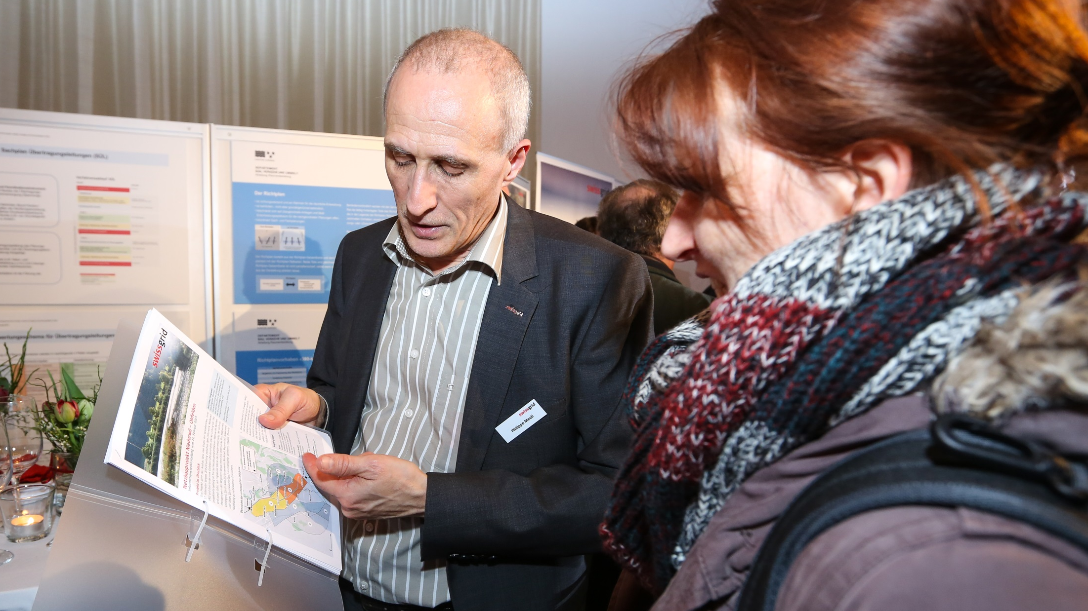
Implementation in real grid projects
Use for planning
Support decision of the planning territory and planning corridor
Explain the proposed options at information events
Visualisation of the final route from the perspective of the affected stakeholder
Notes:
Results of the tool as a base for planning
Results of the tool as a base for the decision of the planning territory and planning corridor (workshops in the support group of the Swiss Federal Office for Energy)
Presentation of the results of the tool used to explain the proposed options at information events
Visualisation of the final route from the perspective of the affected stakeholder (at information events and for the discussion of easement contracts with landowners)

Slide 19
How we reach higher acceptance with the tool
Demonstrate openness for different solutions and technologies
Respect the interests of all important stakeholders by using MCDA
More Transparency in decision process
Higher credibility based on realistic visualisation of the line
Notes:
«because of»: thanks to?

Slide 20
Notes:
Weitere Forschung:
Positionierung weitere Bauwerke: Umwandlungsstationen (Gleichstrom), Positionierung UWs, Übergangsbauwerke
Verbindung Freileitung-Erdkabel: Auf welchen Abschnitten? Was für ein Verfahren soll man brauchen, um das zu berechnen (Optimierung, Statistik)?
Verkabelung:
SüdLink: Postionierung der Muffenstollen (gezwungen)
Tunnelbau: Wie kommt man durch Erdschichten?
Wie gehe ich mit Unsicherheit in den Daten um? (Gebiete mit wenig Daten)
Was für einen Einfluss haben Decision Support Systems auf die Entscheidung (Entscheidungsfindung der Entscheidungsträger)? Hat sich Entscheidung verbessert (mehr Akzeptanz)?

