Slide 1

BRIDGE
Accelerating smart grid and storage deployment by removing barriers to innovation
Jens Bartholmes
DG Energy
ETIP SNET Central Region Workshop
Aachen

Slide 2
































BRIDGE projects overview
Distribution grids | Distributed Storage | Transmission grids | Large-scale storage | RES and H&C
2014:
10 projects, 60 M€
2014:
7 projects, 72 M€
2015:
4 projects, 82 M€
2015:
2 projects, 25 M€
2016:
2 projects, 8 M€
2016:
7 projects, 90 M€
Overall, 325 MEur EU funding over 3 years

Slide 3
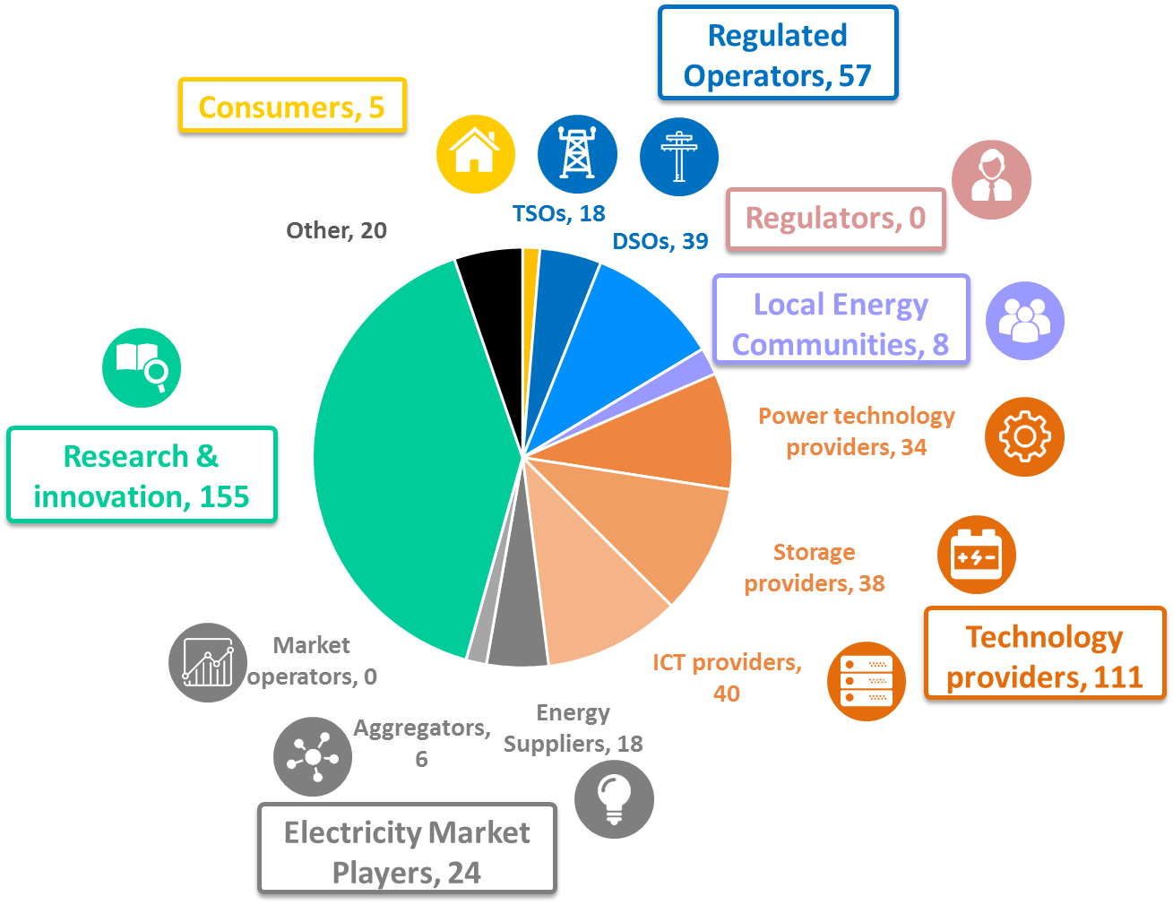
A wide range of Stakeholders

Slide 4
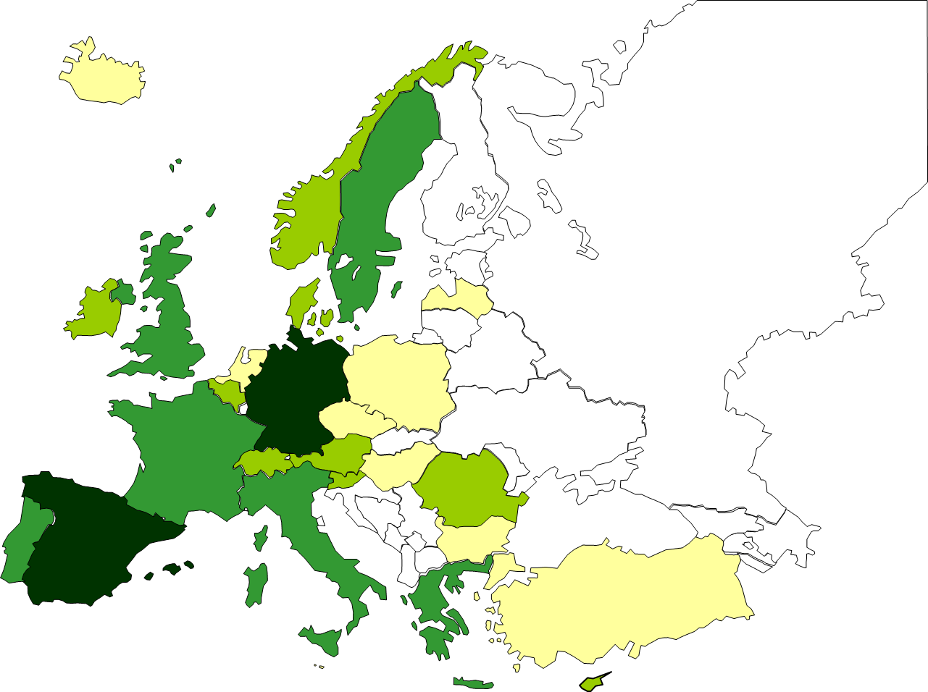
A wide geographical distribution
26 countries are hosting BRIDGE demos or pilots
Locations of the BRIDGE demos and pilots

Slide 5
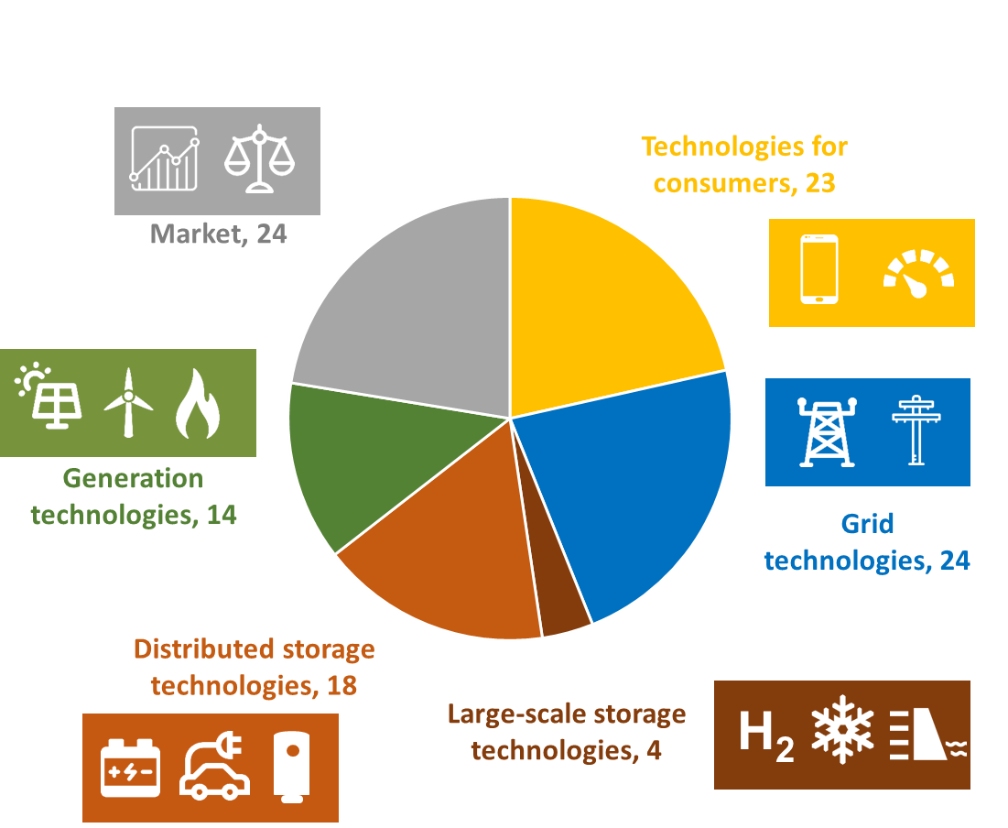
A wide range of Technologies
Number of projects addressing each family of technologies
Notes:
Updated 19/05

Slide 6
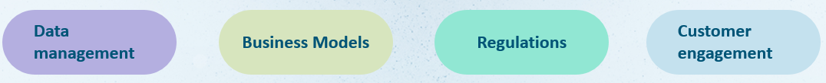
Which barriers to Innovation were identified ?
BRIDGE
Is a European Commission initiative
Gather Horizon 2020 Smart Grid and Energy Storage demonstration projects
Creates a structured view of obstacles to innovation.
Fosters continuous knowledge sharing amongst projects
Deliver conclusions and recommendations with a single voice
http://www.h2020-bridge.eu/ @BRIDGE_H2020 BRIDGE brochure

