Slide 1
Consumer in Control
By Bart Janssen, managing HelloData

Slide 2
Smartwatch (sensor)
GPS tracking
Built-in heart rate monitor
Sleep
Distance
Steps
Calorie burn

Slide 3
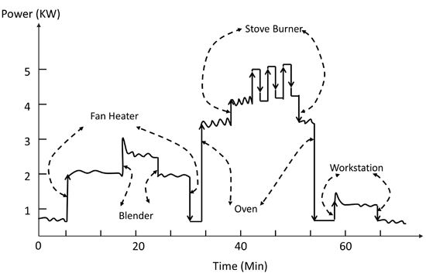
Smart meter (sensor)
Power
Time stamps (10 seconds)

Slide 4
Current situation (NL)
Roll out up till now: more than 7 million smart meters
Roll out does not match the expected energy saving
Consumer is clueless what to do with the smart meter
Low number of energy services based on real time energy data
Vendor lock-in situation
No level playing field: no access start ups
Implementation GDPR: energy sector ready?!

Slide 5
Current situation (EU)
Implemented GDPR for member states
Winter package:
Access for consumers to energy data
Consumer in control: who do they give access to
On demand response necessary?
Balancing energy market
One European energy system
Standardization of data

Slide 6
Our principles
Setting a new standard for the secure sharing of energy data.
Control
Anonimity
Connectivity and freedom of choice
Security
Independent

Slide 7
How it works

Slide 8
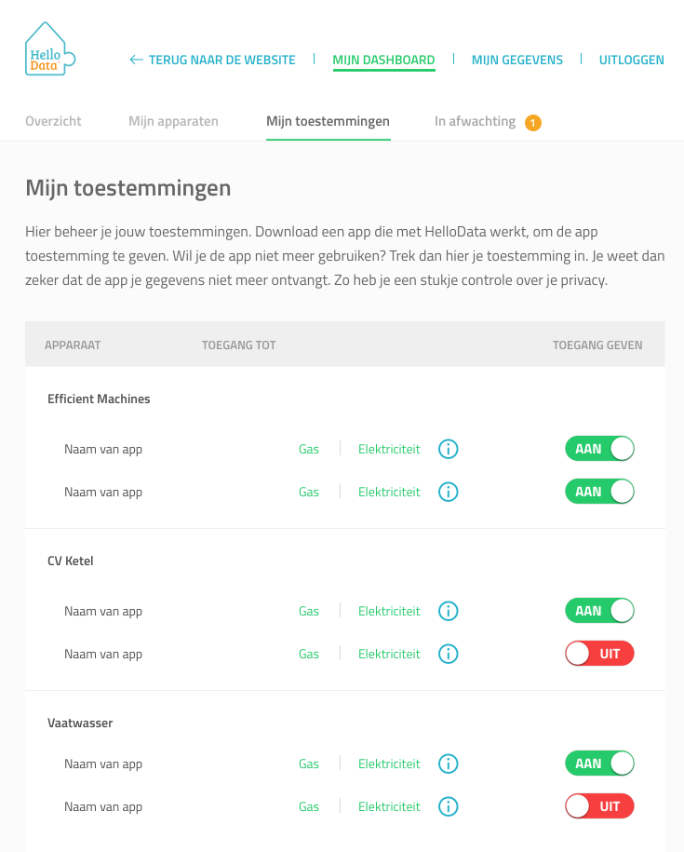
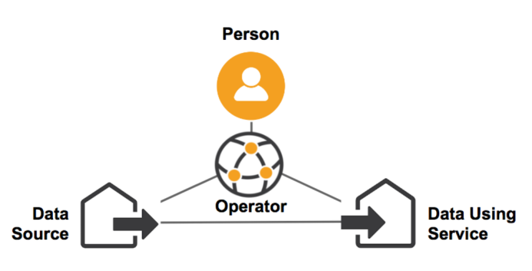

Slide 9
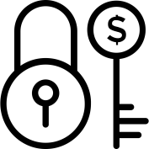
Privacy is not for sale!

Slide 10
Solution
Implementation GDPR energy sector
Authorizing energy data
Identification
Data portability
Right to be forgotten
Level playing field
Standardization

Slide 11
Positive key learning aspects
Independent role (NGO)
Anonymous users
Open source potential

Slide 12
Difficult/unexpected issues
Technical issues
Complex market
Development team

Slide 13
Q&A

