Slide 1


KRYOLENS – Cryogenic Air Energy Storage
ETIP SNET Regional Workshop
Aachen, 19.09.2017
Dr. Christian Bergins
Sven Bosser

Slide 2






Kryolens – Project Overview
R&D project:
Timeline:
Partners:
Funding:
Financing:
Targets:
„Kryolens“ – Kryogene Luftenergiespeicherung (Cryogenic air energy storage)
October 1st 2016 until September 30th 2019
Mitsubishi Hitachi Power Systems Europe GmbH
Linde AG
Ruhr-University Bochum with the following chairs
  Energy plant technology (LEAT), Thermodynamics (TH),
  Thermal Turbomachines (TTM) and Energy systems and energy economics (LEE)
RWE Power AG
Uniper Technologies GmbH
Lausitzer Energie Kraftwerke AG (LEAG)
Federal Ministry for Economics Affairs and Energy (FKZ 03ET7068)
2,8 m€ overall project budget incl. 57 % net public funding and 4 %
external funding by LEAG, RWE and Uniper
Increase technology readiness level by process and component optimisation
as well as determination of the technology‘s techno-economic potential

Slide 3

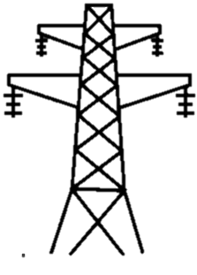

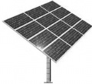
LAES (Liquid Air Energy Storage) -
Principle & main advantages
charge
store
discharge
Compression
Liquefaction
Liquid air storage
Evaporation/
heating
Expansion
AIR
Pump
AIR
Cold-storage
Heat-storage
Electricity IN
Electricity OUT
External Heat
(OPTION)
No geologic limitations
No social and ecological issues
Flexibility and scalability
Efficiency up to 75%*
Based on mature technology
Realization time < 3 years
*Definition of efficiency, please see backup slides

Slide 4
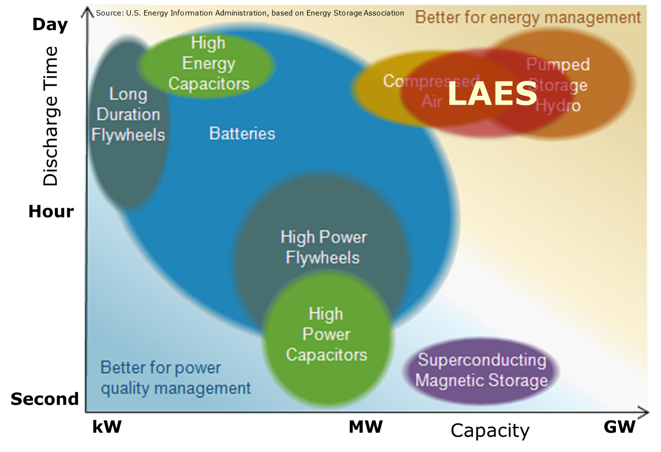
Mapping of Energy Storage Technologies
Chemical Storage

Slide 5
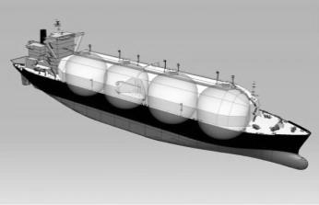

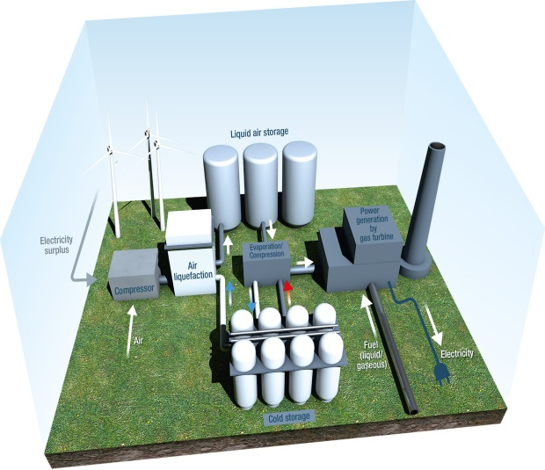
Integration Capabilities of LAES
Peak shaving from RES to avoid curtailment
Utilization of LNG regasification cold to avoid cold storage in LAES system
Utilization of industrial waste heat, supply of cold, utilization and supply of pressurized air
LAES
Ancillary services, Voltage support, energy trading, minimize grid expansion
Flexibilization of conventional power plants
District heating and cooling

Slide 6
Research Project - Content
Work packages |  |  | Lead | 16 | 2017 |  |  |  | 2018 |  |  |  | 2019
 |  |  |  | Q4 | Q1 | Q2 | Q3 | Q4 | Q1 | Q2 | Q3 | Q4 | Q1 | Q2 | Q3
AP 1 | 1 | Project management | Linde | x | x | x | x | x | x | x | x | x | x | x | x
AP 2 Process analysis | 2.1 | Definition of applications and process variants | MHPSE | x | x
 | 2.2 | Technical boundary conditions and interfaces | MHPSE | x | x | x | x
 | 2.3 | Process analysis | LEAT | x | x | x | x | x | x | x | x | x | x | x | x
 | 2.4 | Operational behaviour | LEAT |  |  |  |  |  |  |  |  |  | x | x | x
AP 3 Component analysis | 3.1 | Hot plant section | MHPSE | x | x | x | x | x | x | x | x | x | x | x | x
 | 3.2 | Cold plant section | Linde | x | x | x | x | x | x | x | x | x | x | x | x
 | 3.3 | Turbomachinery | TTM | x | x | x | x | x | x | x | x | x | x | x | x
 | 3.4 | Thermal Storage | TH | x | x | x | x | x | x | x | x | x | x | x | x
AP 4 Economic analysis | 4.1 | Analysis of plant specific data and boundary conditions of energy economics | LEE | x | x | x | x | x | x | x | x | x | x | x
 | 4.2 | Economic analysis | LEE |  | x | x | x | x | x | x | x | x | x | x | x
 | 4.3 | Life Cycle Approach | LEE | x | x | x | x | x | x | x | x | x | x | x | X
Process design
Component design
Economics and
Life Cycle Approach
today
MS 1
MS 2
MS 3
MS 4
Milestones
MS 1 State of the art imaged; Most promising markets defined; Revenue potential of SOTA determined
MS 2 Preferred process variants defined; First economic assessment finished; Technical potential of core components
defined; Process calculation for basis processes finished; Design and order of cold storage test facility finished
MS 3 Conceptual design of core components finished; Experimental investigations finished
MS 4 Balance of plant and operational behaviour analysed; Economic assessment finished; Overall assessment available

Slide 7
AP 2: Process Analysis
Definition of preferred Process Variants – Flex-LAES
(coal-fired) Power Plant
Priority 1: Flex-LAES
Flexibilisation of existing and new power plant
Time shifted power generation
Peak power supply
Power out
.
HP
Pre-Heating
m const.
LP Pre-Heating Bypass
Air heating with steam (PP max. load / LAES discharging)
Compression heat for feed-water pre-heating (PP min. load / LAES charging)
Cold Storage
G
LAIR Storage
M
Power in
LAES Discharging
LAES Charging

Slide 8

Flex-LAES: Efficiency & Load Range for PCPP + LAES
0,5
Combined Powering PCPP + LAES
$$η_{Net}[−]$$
Steam Cycle
0,4
Additional power in combined operation of PCPP and LAES system
Time Shifted Power Generation
0,3
Reduced minimum Load of PCPP
0,2
0,1
0 200 400 600 800 900
P
[MW]
Net

Slide 9
AP 2: Process Analysis
Definition of preferred Process Variants – A-LAES
Heat storage
Exh. air
Intercooled air-compression
G
Power out
Power in
Multi-stage air expander
Lique-
faction
Cold storage
Evapo-rator
Priority 2: Adiabatic-LAES
Power-to-Power storage
No external heat or fuel use
Comparability with batteries
Liquid
air
Liquid air pump

Slide 10
AP 2: Process Analysis
Definition of preferred Process Variants – Fuel-LAES
Fluegas
out
HRAH
Intercooled air-compression
Air expander
Power in
G
Power out
Lique-
faction
Cold storage
Evapo-rator
Air in
Priority 3: Fuel-LAES
Hybrid storage
(with fuel use)
High efficiency and
energy density
Development of turbomaschinery
(derived from GT)
Natural gas In
Liq. air pump
G
Power out
Liquid
air

Slide 11
AP 2: Process Analysis
Definition of preferred Process Variants – Industry-LAES
External heat from industrial process
Exh. air
Intercooled air-compression
Heat storage (optional)
G
Power out
Power in
Multi-stage air expander
Lique-
faction
Cold storage
Evapo-rator
Priority 4: Industry-LAES / LNG-LAES
High potential of efficieny increase (use of waste heat and cold)
LNG cold could replace cold storage
Limited availability of heat and cold
Not site independent
Liq. air pump
External cold from LNG regasification
Liquid
air

Slide 12
Keynotes
Main lessons learned and barriers to innovation deployment:
  Flexibility of Flex-LAES (start-up time) need to be increased because
  fast reacting short term storage is most important for power plant utilities
  Solid bed cold storage can significantly increase the efficiency of the process
  Cost reduction necessary to compete with alternative storage technologies
The next project steps:
  Identification of most relevant process sub-variants
  Detailed component design for Flex-LAES and A-LAES
  Identify cost reduction potential
Needs for future R&I activities coming out of the project:
  Small scale pilot plant to prove technical feasibility
Deployment prospects of the most promising solutions.
  Flex-LAES to improve flexibility of power plants in Western Europe
  (hard coal and lignite)
  A-LAES as alternative to large scale batteries in island grids

Slide 15
Backup Slides

Slide 16
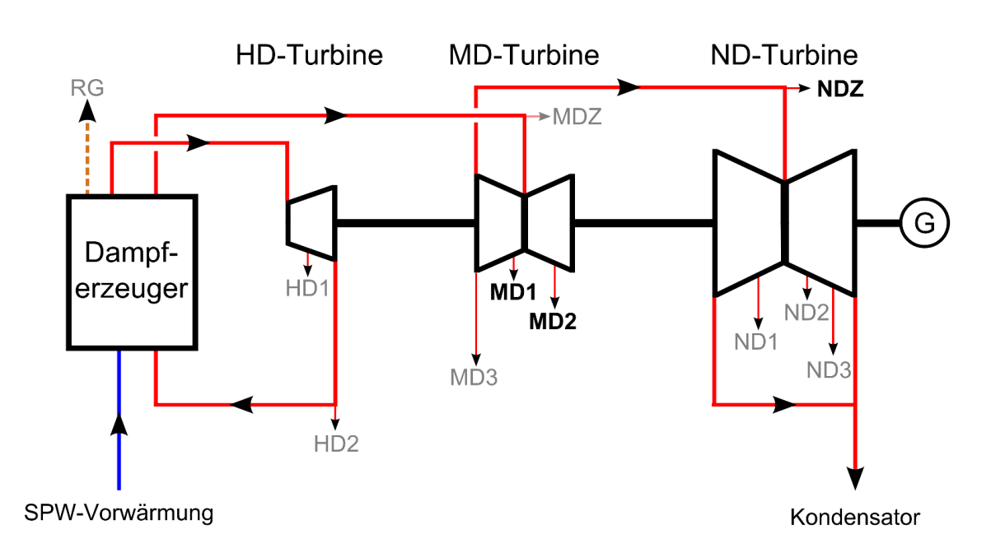
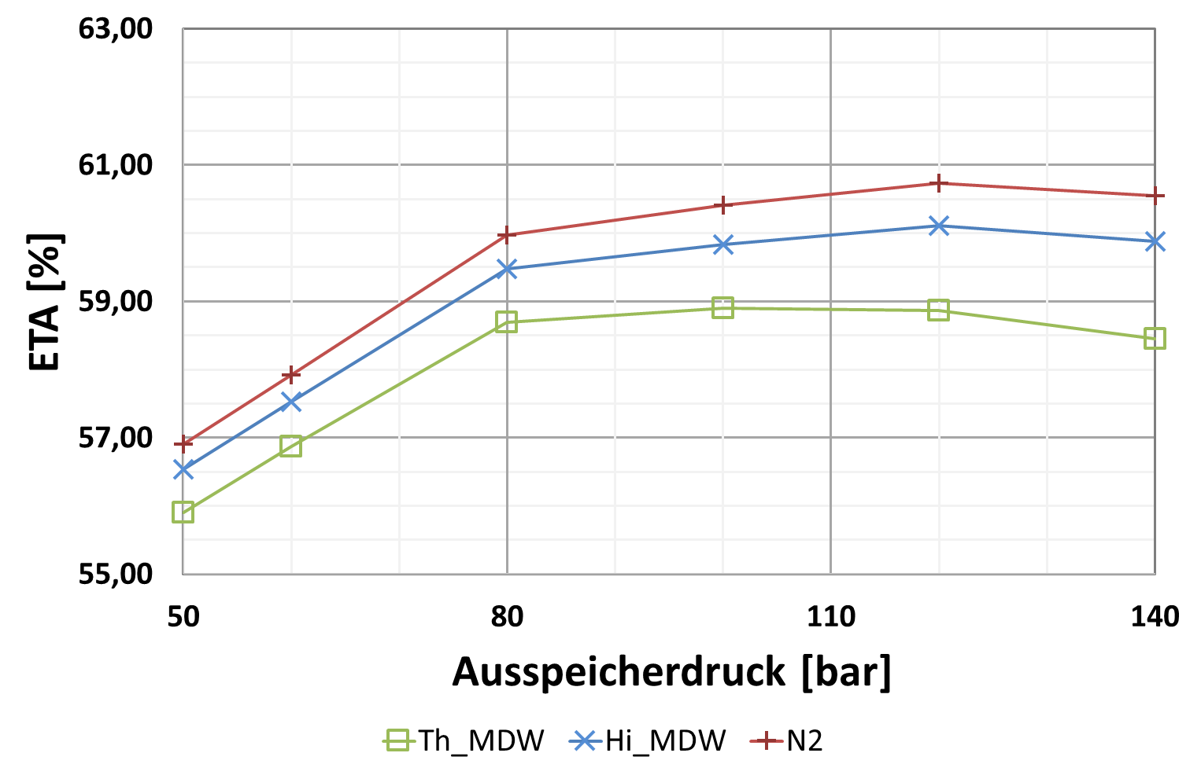
AP 2: Process Analysis
Process calculations of Flex-LAES and A-LAES (LEAT)
Reference power plant for thermal calculations of Flex-LAES process is conceptual study of the reference power plant NRW (RKW NRW) from 2004
Investigation of different integration points (charging and discharging)
→ 2 process variants defined for detailed analysis
Influence of different heat transfer fluids on efficiency of A-LAES process:
Different heat transfer fluids and heat storage fluids under investigation for A-LAES
7 process variants identified for further investigation
Discharging pressure

Slide 17
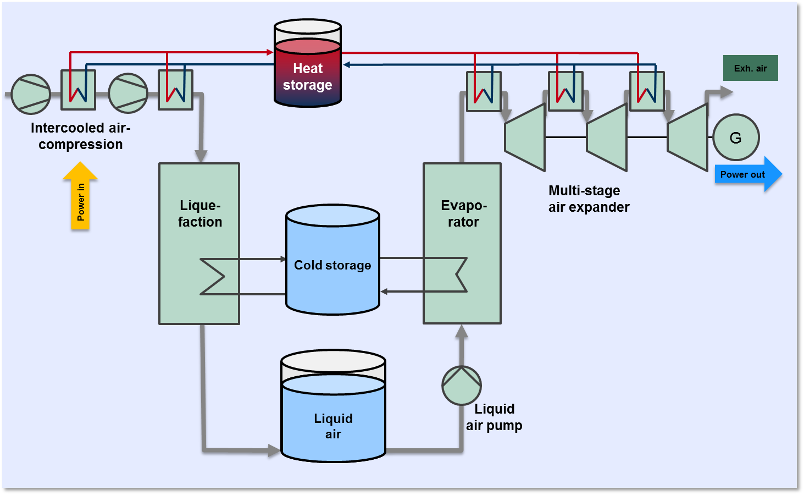
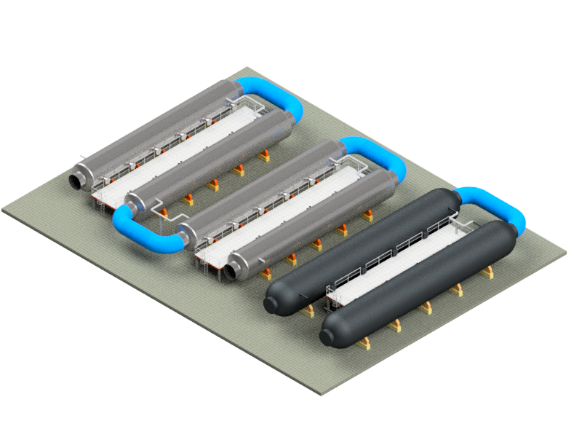
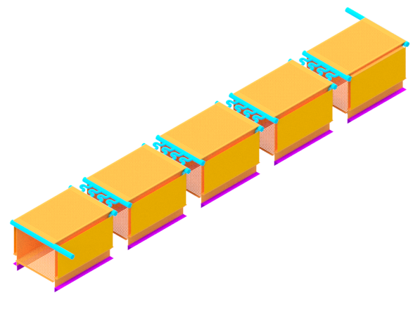
AP 3: Component Analysis
Hot plant section – heat exchanger (MHPSE)
Design, construction and arrangement planning for heat exchanger of the hot plant section
Example:
arrangement planning for
A-LAES gas liquid heat exchanger
Modular construction → quick adjustment to size requirements
Optimisation of component parameters and materials for cost reduction and efficiency improvement

Slide 18
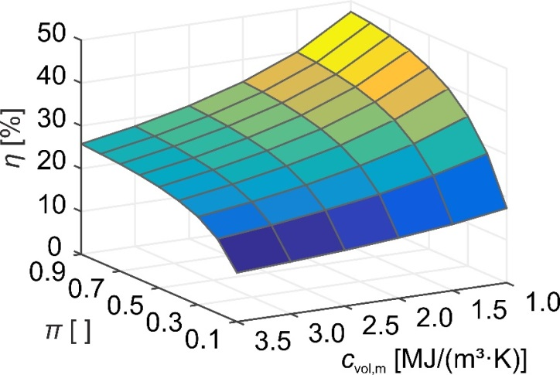
AP 3: Component Analysis
Storage Materials for Packed Bed Cold Storages (RUB–TH)
Storage mass and cylinder volume
  Material price, storage mass and cylinder volume are economic indicators of the packed bed cold storage
Analysis of storage efficiency and material properties:
Analysis of storage materials
  Nine materials are investigated
  Lead yields the best storage efficiency η
  PP, PE, NaCl and quartz yield the best compromise of feasibility and economy

Slide 19
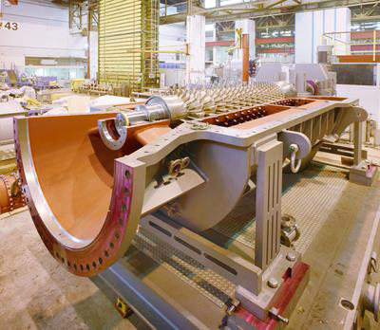
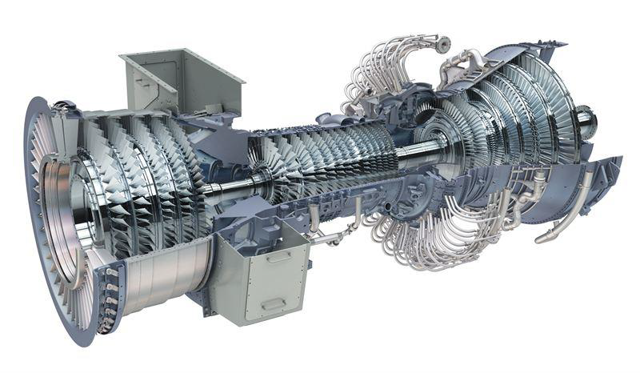
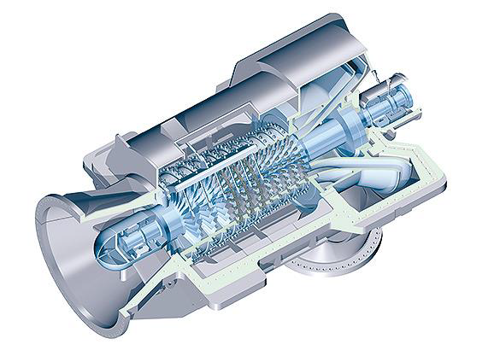
AP 3: Component Analysis
Market Screening for adiabatic Compressors for A-LAES (TTM)
Example: adiabatic axial compressor (Siemens) with T_{max,compression} = 350 °C
Example: Aero derivative gas turbine GE LMS 6000 with T_{max,compression} = 625 °C
source: General Electric
Compression end temperature of 350°C with state of the art compressors available
Higher temperatures up to 625°C (aero derivative gas turbines with π=34) by using axial compressors and gas turbine technology (high temperature materials)
source: Siemens AG

Slide 20
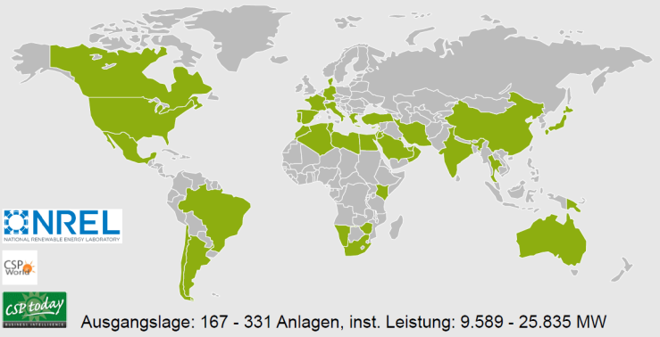
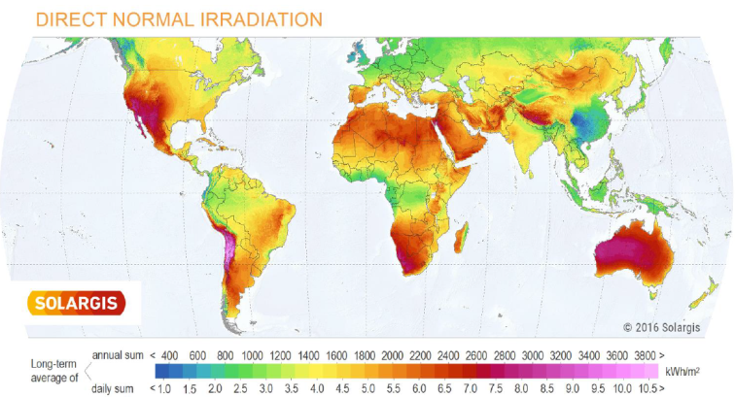
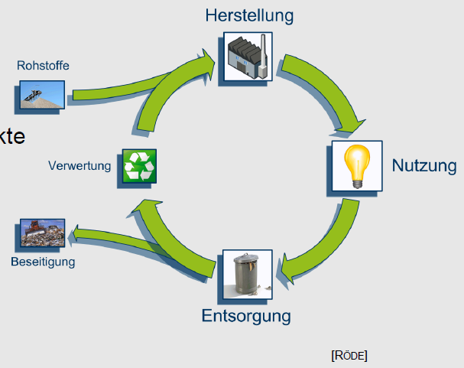

AP 4: Economic Analysis
Benchmark PV+A-LAES vs. CSP+TES and Life Cycle Approach (LEE)
Investigation of CSP+TES projects woldwide for definition of: techno-economic parameters of CSP plants
Definition of A-LAES size (input for process and component analysis AP2/AP3): 50MW, 350MWh
Investigation of relevant CSP and PV markets
Definition of suitable CSP projects for benchmark dependent on: technical parameters, market attractiveness and solar radiation
consideration of whole life cycle (manufacturing, use phase, disposal)
Comparison of resources and emissions with other storage technologies and power plants
source: J. Röder

Slide 21
Advantages of LAES
Based on mature technology
Long lifetime
No geologic limitations
Liquid Air Energy Storage
Efficiency of up to 75 %
No social & ecological issues
Flexibility, scalability
Realization time < 3 years

Slide 22
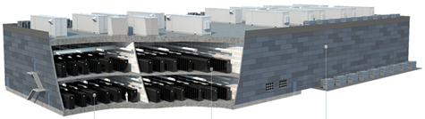
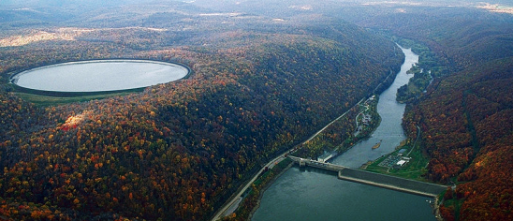
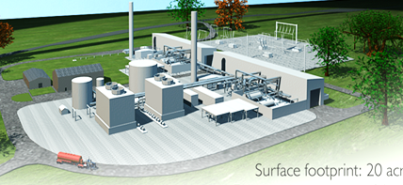
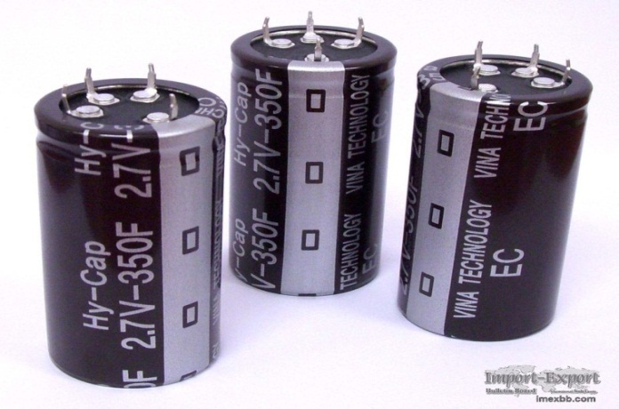
Known ES technologies face severe limitations –
A one-fits-all solution is out of sight
Batteries
  Limited lifetime
  High storage capacity costs
  Disposal
Pumped Hydro
  Need mountains
  Social, environ-mental issues
  Long realization time
Compressed Air
  Need salt dome
  Long realization time
Flywheels,
Capacitors
  Short duration of storage
  High storage capacity costs

Slide 23
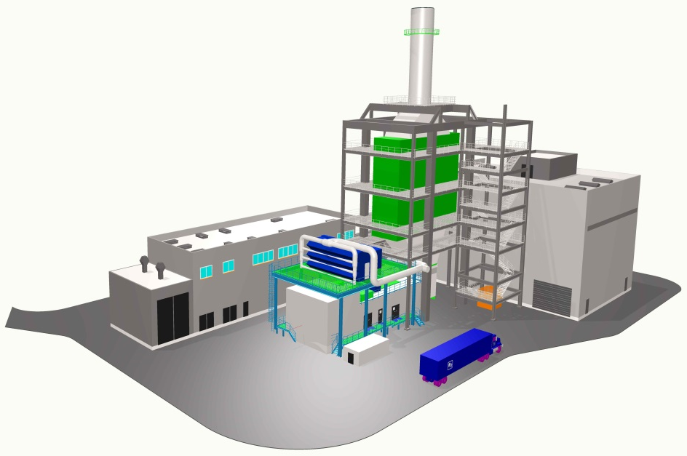
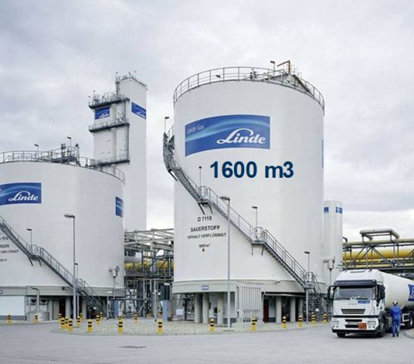
LAES – Fact Sheet
  Energy Density:
  70 – 100 kWh/m3
  Power output:
  10 – 600 MW
  Storage Capacity:
  > 1000 MWh
  Discharging duration:
  2 – 12 h
  Efficiency:
  50 – 65 %
  (>65 % by utilizing waste heat)
  Lifetime:
  20 – 30 years
50-100 bar
η_{GuD}=60%
Storage Density [kWh_{el}/m³]
η_{Sp}~50-65%
100
50bar, η_{Sp}~50-65%
10
100-500m,
η_{Sp}~70-85%
1
0,1
PHS
CAES
LAES
SNG
Pictures:
1) 3D plot of LAES power recovery unit (MHPSE)
2) Cryogenic storage tank 1600 m3 (Source: The Linde Group)

Slide 24
LAES - Comparison to CAES
CAES
LAES
 | Huntorf CAES | McIntosh CAES | GT-LAES Technology (4h dis.) (H25(32) / H80 / M501JAC)
Capacity, MWh | 480 | 1060 | 304 / 1004 / 2564 *
Power-Output, MW | 321 | 110 | 76 / 251 / 641 *
Round trip efficiency, % | 42 | 54 | 52 / 54 / 56
Storage volume, m³ | 310 000 | 538 000 | 1 900 / 6 000 / 11 300 **
Storage density, kWh/m³ | 1.55 | 1.97 | 160 / 167 / 227
Source: The Linde Group
Time-factor (Charging-/Discharging-time): Huntorf 4 / McIntosh 1.6 / LAES 2 (variable)
* GT power incl.
** LAIR

Slide 25
GT-LAES – Stand-alone or Retrofit based on mature Components
→ GT-LAES combines energy storage with GT peaker plant
Fluegas
out
Storage
Output (Air expander):
approx. 10 - 300 MW_{el}
Heat recovery air heater
Exh. air
Intercooled air-compression
Air expander
Power in
G
Power out
Lique-
faction
Cold storage
Evapo-rator
Storage
Input:
Air in
Gas turbine (new or retrofit)
approx. 10 - 200 MW_{el}
Efficiency:
η_{system} = 81 – 83 %
η_{s,50%} = 55 – 67 %
η_{RT} = 52 – 56 %
η_{F} = 83 – 86 %
m_{CO2} < 240 kg/MWh_{el}
Natural gas In
Liq. air pump
G
Power out
Liquid
air

Slide 26

CO₂-Footprint of produced Electricity OCGT / CCGT / LAES
OCGT
CCGT
*
GT-LAES
adiabatic LAES
(future outlook)
0
~230
[kg_{CO2}/MWh_{el}]
~345
~526

Slide 27

LAES Efficiency
System Efficiency:
η_{system} = $\frac{Air Expander Output}{Compressor Input}$
Storage Efficiency:
η_{s,NG%} = $\frac{LAES Output − ηNG ∙ Gas Input}{Compressor Input}$
Round-trip Efficiency:
η_{RT} = $\frac{LAES Output }{Compressor Input + Gas Input}$
Fuel Efficiency:
η_{F} = $\frac{LAES Output }{Gas Input}$

