Slide 1
Proaktives Verteilnetz - Proactive Distribution Grid
ETIP SNET Workshop
Aachen, September 18-19

Slide 2
The majority of the new producers are connected to the distribution grids
There is a global trend for DER, Germany is one of the main applications
One of the key attributes of DER-generation is its volatility
There is also a trend for increasing flexibility and demand on the demand side
The usage of flexibility in supply&demand in distribution grids is necessary to guarantee a sustainable and reliable energy system
Energiewende
UHV
HV
MV
LV

Slide 3
Traffic light concepts enable synergies between a market- and grid-driven usage of flexibility
Drivers
Goals of the traffic light system
Open up flexibility
Resolving grid congestions
Expand energy grids at optimal (system) costs in the long term
Enhancing interaction of grid & market
More consumption
Higher coincidence
Fluctuating Feed-In
today
tomorrow
prospective
The traffic light system is… |  |  | The traffic light system is not…
✓ | Indication of the actual status of grid <-> market interaction |  | ✗ | Indication of the actual grid condition or available grid capacity
✓ | Market information of the actual usage of flexibility through DSOs |  | ✗ | Information on the acutal grid stability and security of supply
✓
✗

Slide 4
A valuable flexibility concept needs to incorporate grid and market interests in a common manner
market oriented use portfolio optimization of demand and supply
system oriented use balancing independent of location
Flexibility adaption of generation or demand behavior by external signals
Customer oriented use self-consumption
grid oriented use avoid local grid constraints

Slide 5
Interaction of Market & Grid - Traffic light concept enables a flexible market environment
Green
Flexibility is offered by sales/ aggregators for market and system oriented portfolio optimisation and for balancing
Yellow
Flexibility is requested by DSO on a contractual basis to avoid economic inefficient network expansion
Red
Flexibility is controlled by DSO without contractual basis to preserve a secure network operation

Slide 6
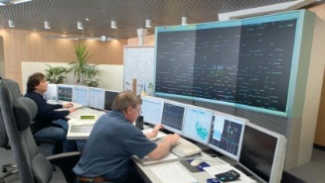
Target: Creating an operational grid <-> market interaction model within a demanding environment
Optimize grid operation especially within areas of high DER-share to resolve network bottlenecks
Design grid <-> market interactions within the „orange regime“
Development of generic requirements for a mediating communication and service platform
Develop and use flexibility for the distribution grid to minimize grid expansions
Deliver recommendations for a future market design
MARKET
GRID

Slide 7
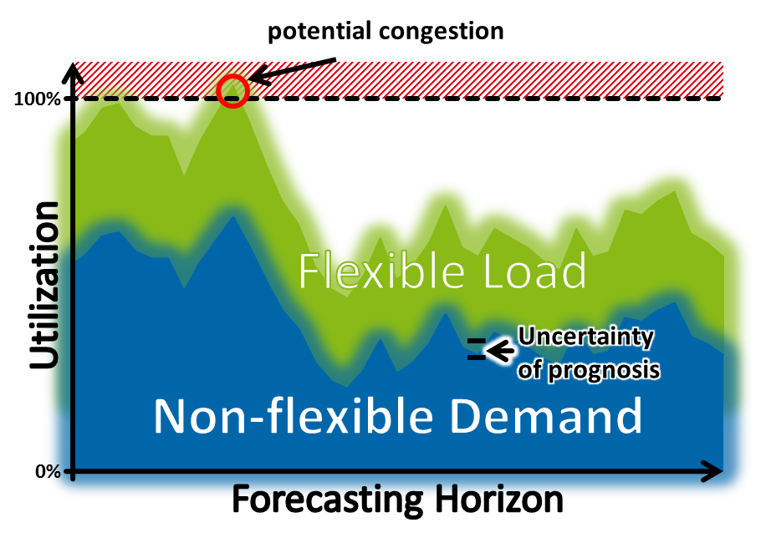
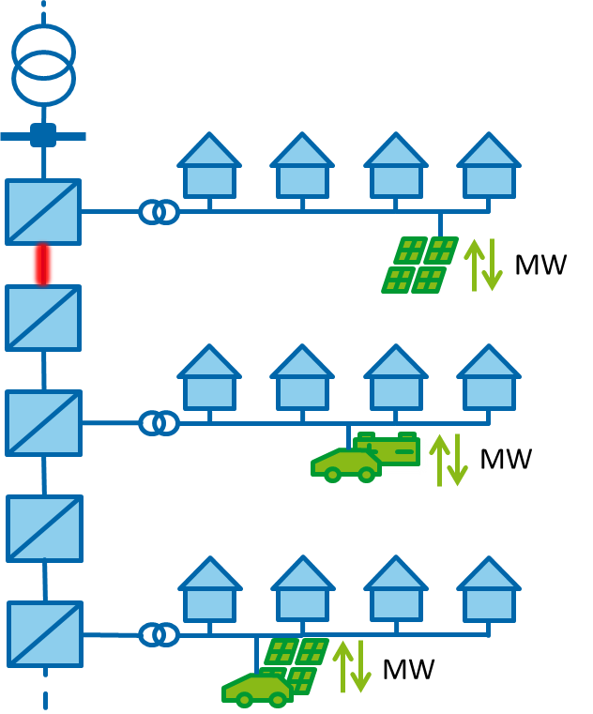
The traffic light concept enhances current grid operation concepts on various levels
SYSTEM- &
ENVIRONMENTAL DATA
STATE ESTIMATION
- Measuring Data
- Switching States
- Weather Data / Prognosis
- Historical Data - Schedules of Flexibility
- …
Calculation
Determination
Evaluation
FLEXIBILITY
Input Data
Action required?
Availability of Flexibility?
Grid related measures
Effect analysis on the Grid
Flexibility
Validation of Results
Grid security measures
Call of Flexibility
per Retailer
CONGESTION MANAGEMENT

Slide 8
By publishing the available power range, market participants are enabled to allocate flexibility best
Flex-Limitation Call
As of today, most power management interventions are resulting in cutting RES
The determination of an individual, non-discriminatory power range per retail company is facilitating a optimal congestion management as each retailer is able to select suitable schedules of flexibility within his portfolio
Flexibility calls will be distributed non-discriminatory among all retail companies owning / operating flexibility within the involved grid topology
Due to unique call IDs, retail companies could perform secondary trading on their flexibility calls, to e.g. hold SLAs with customers
Call-Information
Call-ID
DSO
Period
28169132
Westnetz
From→ Until
Available Power Range
Pmin
-3,71 MW
Pmax
+5,23 MW
Affected Metering Points
ID
Metering Point ID
Sensitivity
+Data
1
DE123456…
0,97
ABC
2
DE234567…
0,79
BCD
n
DE987654..
0 → 1
XYZ
1. Boundary Condition
Pmin
Randbedingungen
-1,23 MW
Pmax
Randbedingungen 1
Pmin
-3,71 MW
+0,23 MW
ID
Metering Point ID
Sensitivity
Pmax
+11,23 MW
Pmin
-3,71 MW
ID
Zählpunktnr.
+Data
Pmax
+11,23 MW
1
DE123456…
0,93
Sensitivität
+Daten
ID
Zählpunktnr.
1
123456
ABC
Sensitivität
+Daten
1
0,97
ABC
123456
0,97
ABC
n
DE987654…
0 → 1
XYZ
n
987654
0 → 1
XYZ
n
987654
0 → 1
XYZ

Slide 9
A real-life demonstration will take place in an area with high penetration of RES
Demo
2015
2016
2017
The demonstration consists of:
a field-test with real customers (~5 MW RES generation, ~ 1,5 MW load)
a simulation for anticipating future scenarios in the year 2035
The goal of the demonstration is
To validate all new operational concepts
Testing the solution in a real environment and pave the way for a large-scale rollout
Trigging discussions with similar projects and applications and promoting the results
7,5 MW maximum Load & 23,5 MW installed RES
Wettrup
Gersten
UA Lengerich
Lengerich
Handrup
Lange

