Slide 1

Hydrogen and Storage Research Center
WESpe – Project
Wind-Hydrogen-Energy Storages
(Windwasserstoff – EnergieSpeicher)
Ulrich R. Fischer
ETIP SNET
Central Region Workshop
September 18th, 2017, Aachen, Germany

Slide 2
AGENDA
INTRODUCTION HYDROGEN RESEARCH CENTER
MOTIVATION FOR HYDROGEN PRODUCTION AND SECTOR COUPLING
OVERVIEW WESpe - PROJECT
EXAMPLE RESULTS
SUMMARY / FUTURE PROSPECTS
Notes:
Kurz die Gliederung vorstellen

Slide 3
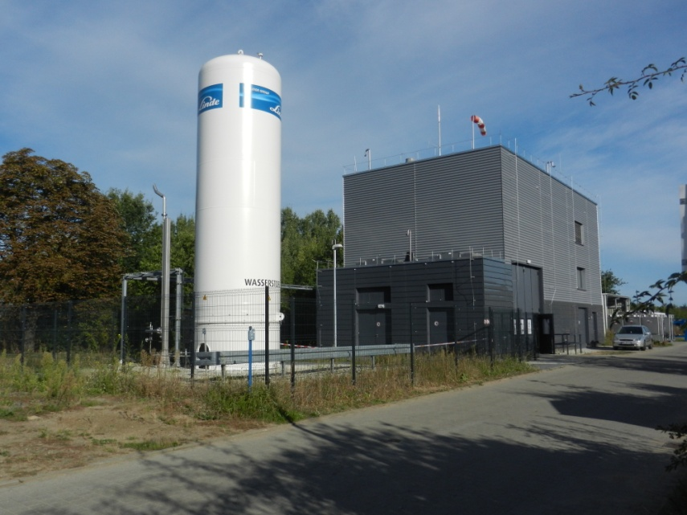
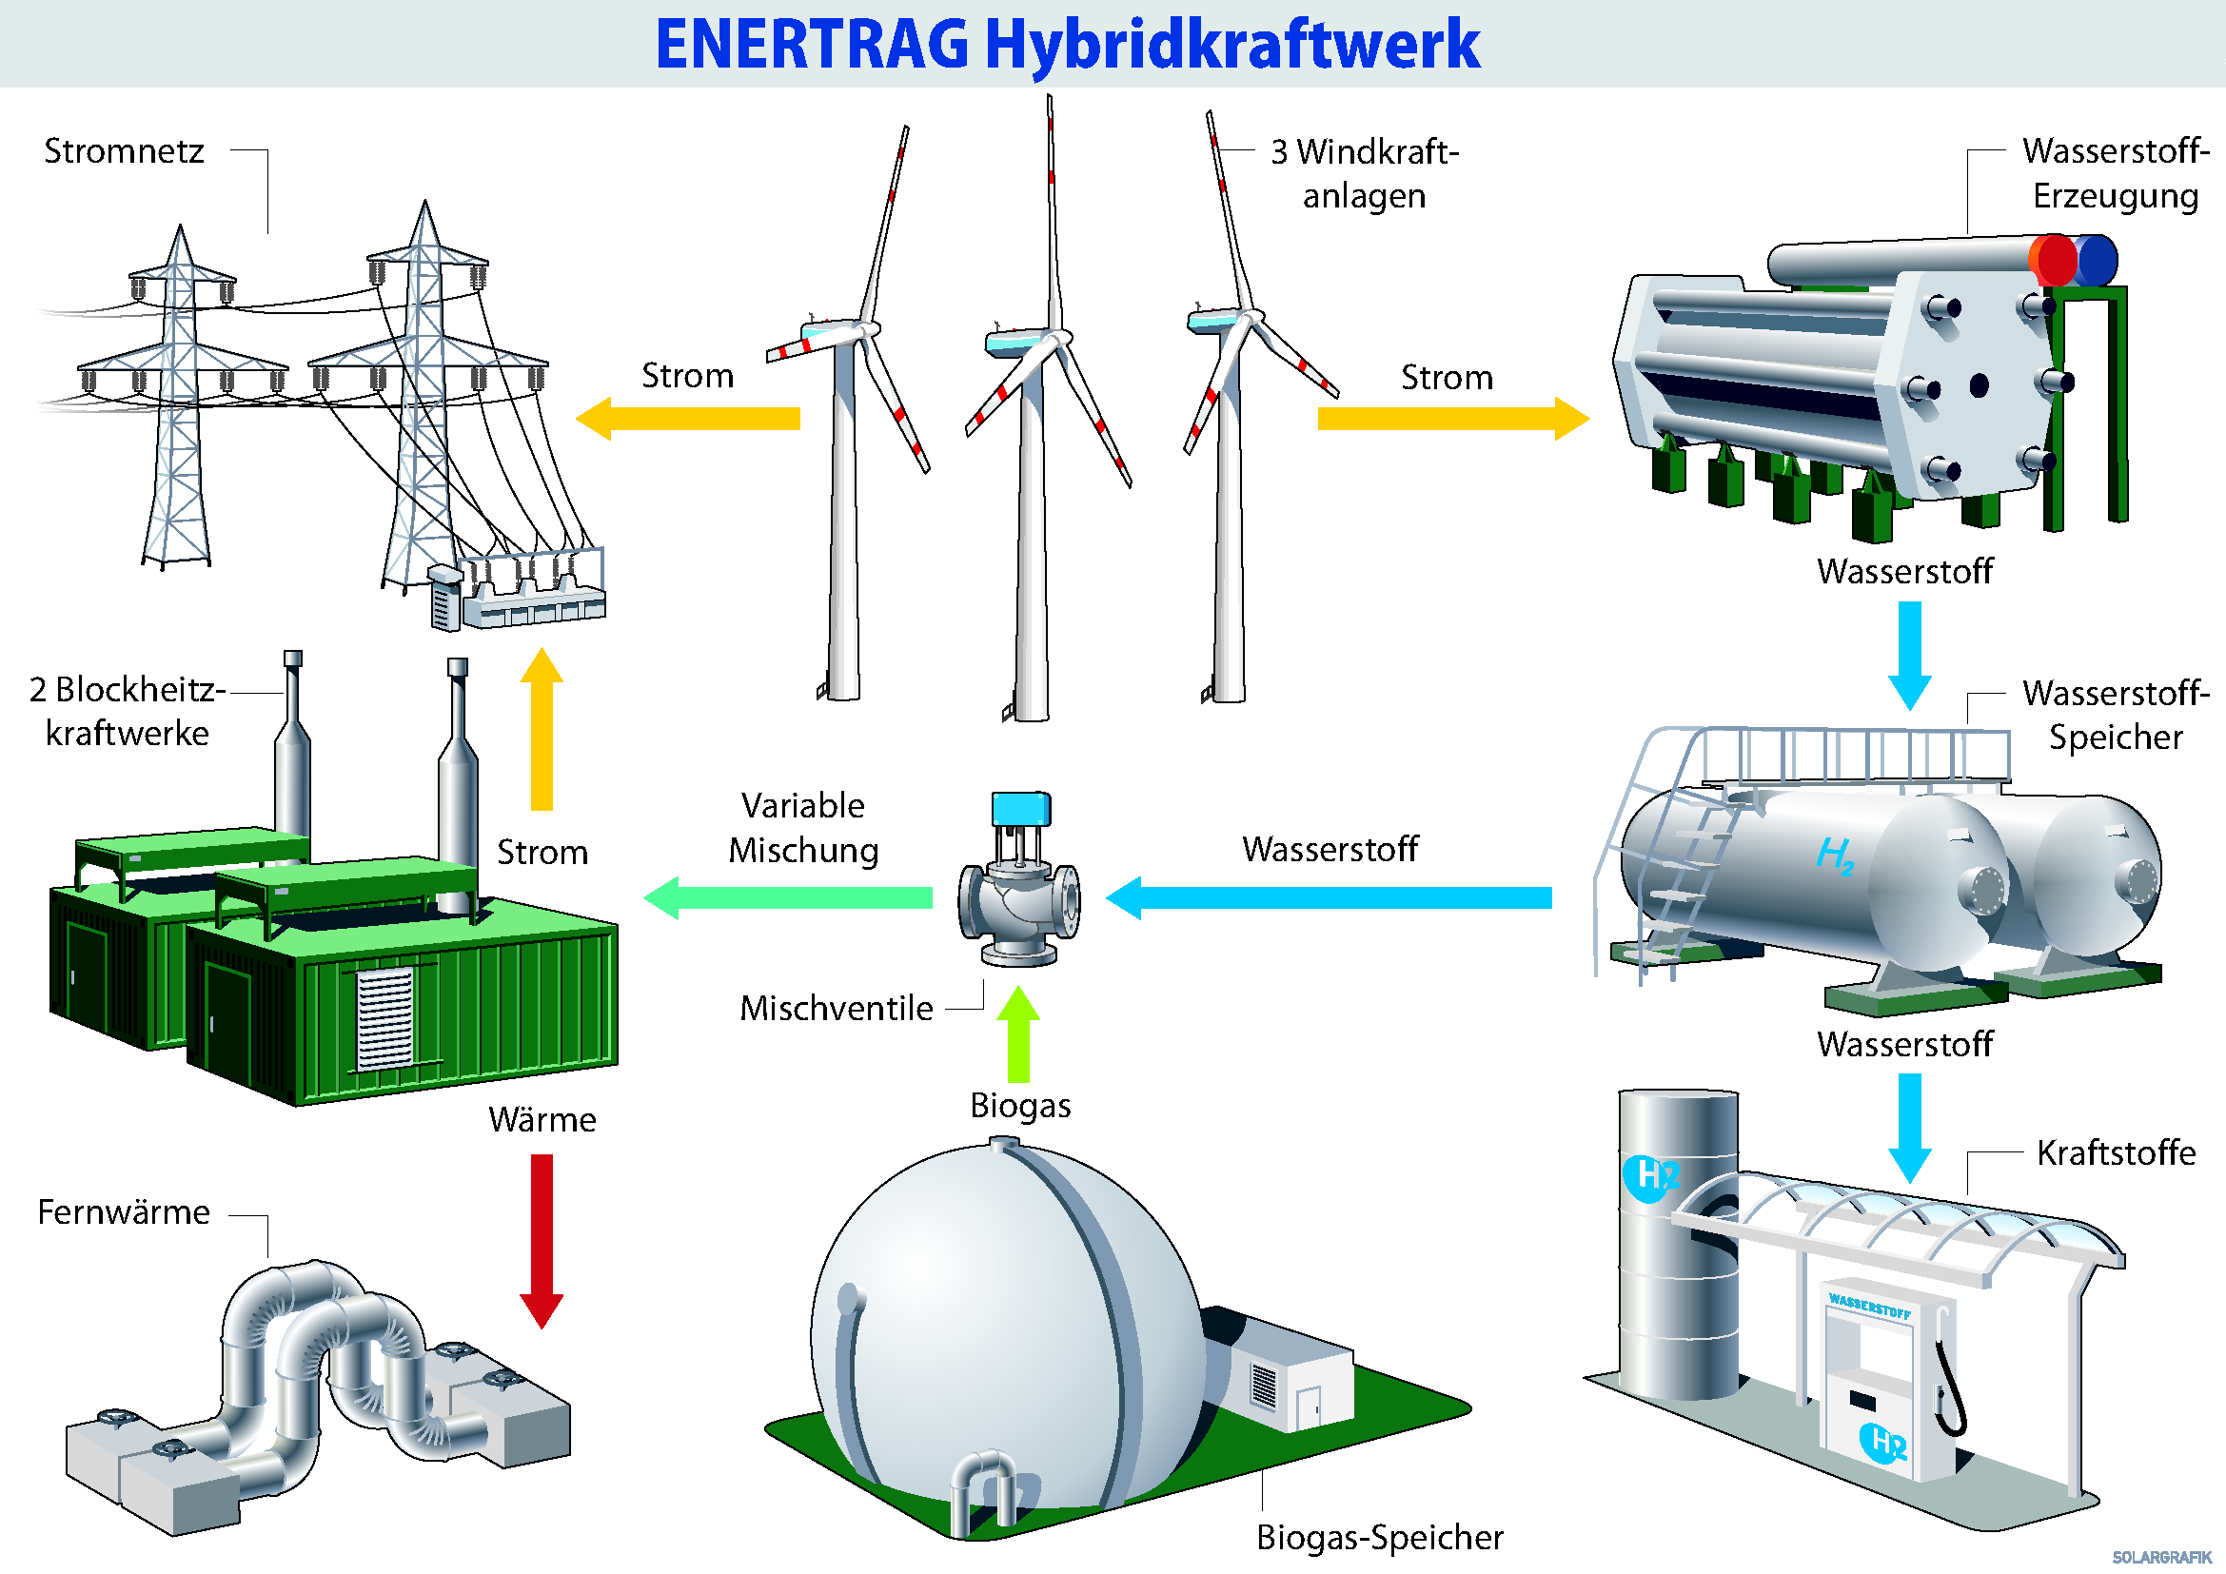
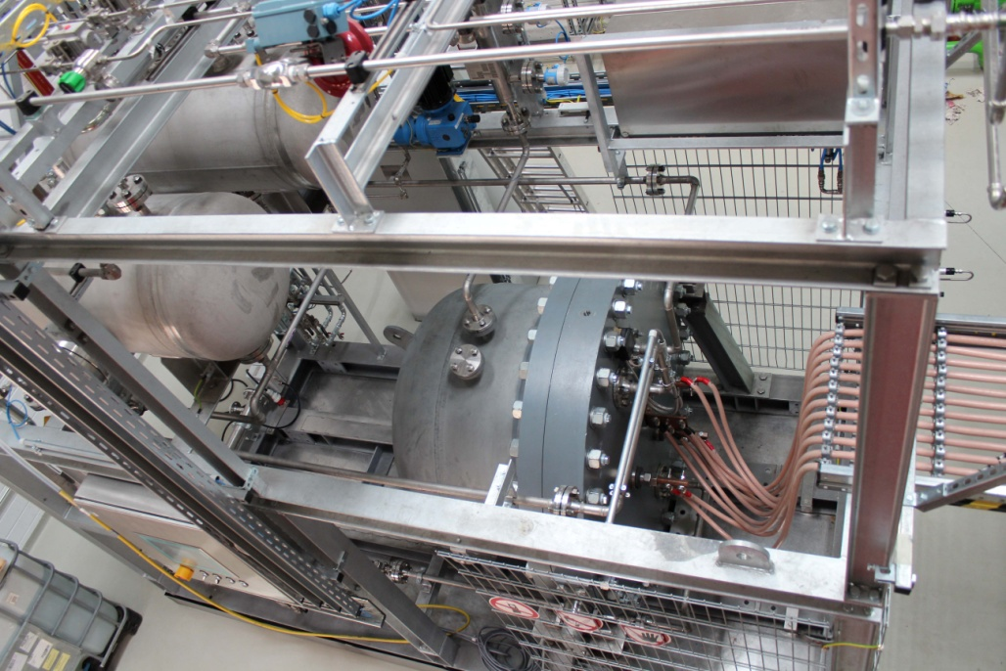
INTRODUCTION HYDROGEN ANSD STORAGE RESEARCH CENTER
Research in alkaline electrolysis connected to fluctuating renewable energies sources
  Research Electrolyzer 20 Nm³/h hydrogen, max. 58 bar
Feed with synthetic wind and PV-power profiles
Operating strategies of hybrid power plants
Image source: Enertrag AG

Slide 4
AGENDA
INTRODUCTION HYDROGEN RESEARCH CENTER
MOTIVATION FOR HYDROGEN PRODUCTION AND SECTOR COUPLING
OVERVIEW WESpe - PROJECT
EXAMPLE RESULTS
SUMMARY / FUTURE PROSPECTS
Notes:
Kurz die Gliederung vorstellen

Slide 5
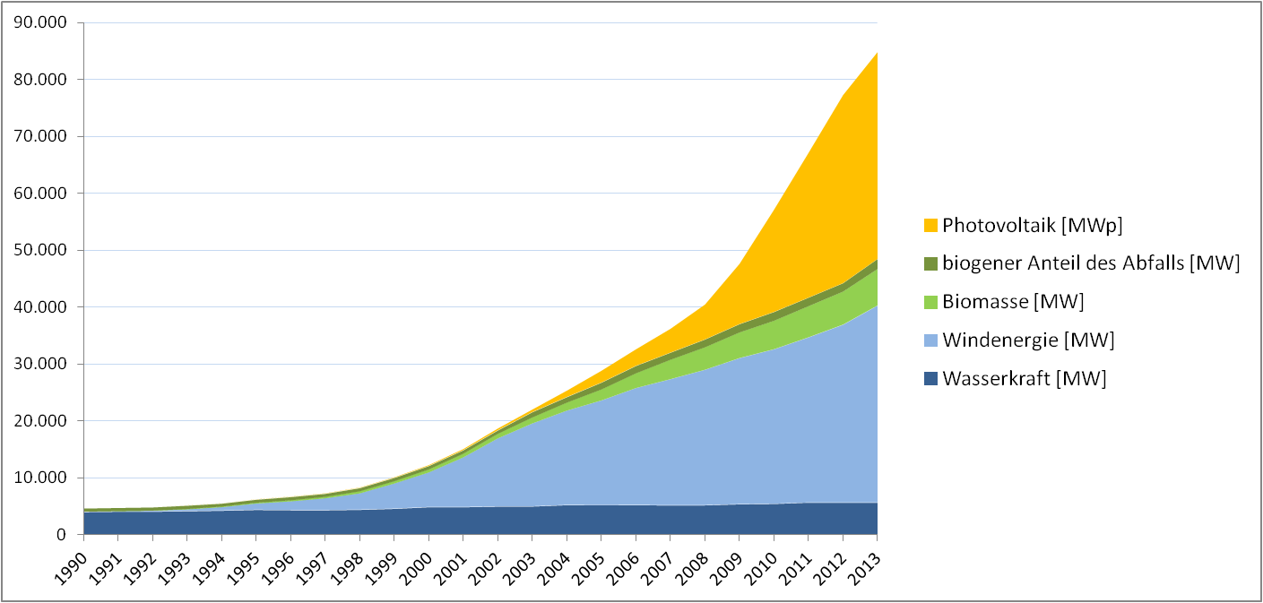
MOTIVATION FOR HYDROGEN PRODUCTION AND SECTOR COUPLING
Hydrogen Market driven by Renewable Energies
MW
Installed power
Datenquelle: BMU
PV end of 2015: 39.7 GW (annual production 38.4 TWh)
Wind end of 2015: 45 GW (annual production 88 TWh)
Sum of Wind, PV, hydropower and biomass in 2016: 190 TWh (35% of the total net energy production)

Slide 6
MOTIVATION FOR HYDROGEN PRODUCTION AND SECTOR COUPLING
Residual load and long-term storage demand
Residual load = instantaneous electrical energy demand - supplied renewable energy power.
Different studies estimate the long-term storage capacity to be in the range of 7 TWh–100°TWh in 2050
study | min RL | max RL | annual excess | annual deficit | wind-power | PV-power | long-term storage | remarks
 | GW | GW | TWh | TWh | GW | GW | TWh
UBA¹ | -100 | 50 | -154 | 53 | 105 | 120 | 80 | 100% renewable energy scenario Electricity only
ISE² | ca. -120 | ca. 50 |  |  | 201 | 166 | 100 | Cost optimal scenario with 85% CO₂-reduction Renwable and fossil energy All sectors: electricity, heat, transport
¹Klaus, Th. et al. (2010). Energieziel 2050: 100% Strom aus erneuerbaren Quellen. Bundesumweltamt, Dessau-Roßlau
²Henning, H.-M., Palzer, A. (2016). Was kostet die Energiewende? Wege zur Transformation des deutschen Energiesystems bis 2050, Fraunhofer-Institut für Solare Energiesysteme ISE, Freiburg.
Notes:
A significant term in the electrical energy sector is the residual load. The instantaneous residual load represents the difference between the instantaneous electrical energy demand and the supplied renewable energy power. A negative residual load represents a situation with a renewable energy power greater than the demand. This situation usually indicates the time periods appropriate for filling energy storages or delivering energy to other energy sector, e.g. the transport sector. A positive residual load represents a situation with a renewable energy power smaller than the demand. The positive residual load has to be covered either with conventional power plants or energy from storages. Klaus et al.³ predict, for example, a minimum residual load of about ‑100 GW with a yearly energy excess of about ‑154 TWh and a maximum residual load of about +50 GW with a yearly energy deficit of about +53 TWh by 2050. At about 5000 hours per year we will have energy excess. The assumed scenario in this study is 100% renewable electrical energy production with 120 GW installed PV-power (104 TWh annual yield) and 105 GW wind power (344 TWh annual yield). The electrical storage capacity is about 80 TWh_{el}. Henning et al.⁴ investigated cost optimal energy system under the presumption of CO₂-reduction targets. The study considers a systemic view including all energy sectors. A scenario with 85% CO₂-reduction by 2050 compared to 1990 results in a PV-power of 166 GW (174 TWh annual yield) and 201 GW wind power (504 TWh annual yield). An installed electrolyzer power of 75 GW is calculated to deliver hydrogen for transport, heat and production of electrical energy. An annual energy amount of 100 TWh is stored in hydrogen storages. The battery storage capacity is 74 GWh.
VDE-Studie:
Adamek et al.⁵ considered in their study the electrical energy market only. Under the assumption of a share of 80% renewable energies by 2050 the estimated long-term storage (power to gas and pumped storage hydroelectric) demand is 7.5 TWh and the short-term storage demand (batteries) 70 GWh.

Slide 7
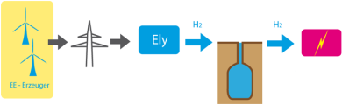
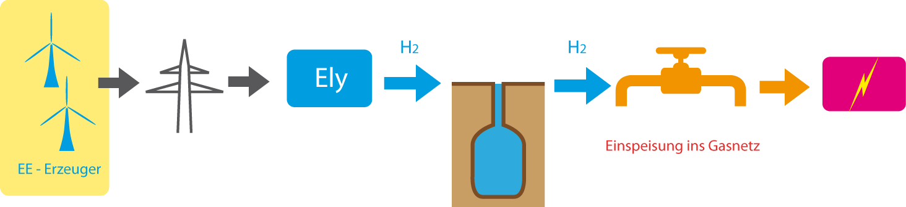
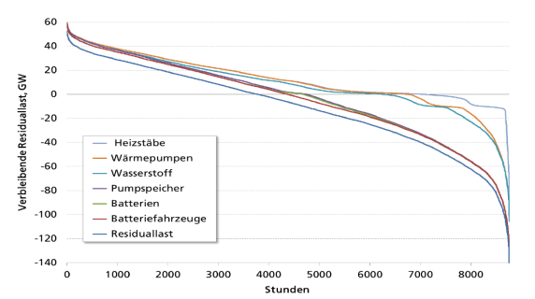
MOTIVATION FOR HYDROGEN PRODUCTION AND SECTOR COUPLING
Residual load (RL) and long-term storage demand
Electrolysis works at negative residual load (excess)
Electricity generation at positive residual load (deficit)
Injection in gas pipeline
2050 ~5000h
2050 ~4000h
Source: Henning, Palzer: „Energiesystem Deutschland 2050“, 2013
Notes:
Because the Henning-study comprises all energy sectors, the installed PV and Wind power is higher
Text aus veröffentlichung: A significant term in the electrical energy sector is the residual load. The instantaneous residual load represents the difference between the instantaneous electrical energy demand and the supplied renewable energy power. A negative residual load represents a situation with a renewable energy power greater than the demand. This situation usually indicates the time periods appropriate for filling energy storages or delivering energy to other energy sector, e.g. the transport sector. A positive residual load represents a situation with a renewable energy power smaller than the demand. The positive residual load has to be covered either with conventional power plants or energy from storages. Klaus et al.³ predict, for example, a minimum residual load of about ‑100 GW with a yearly energy excess of about ‑154 TWh and a maximum residual load of about +50 GW with a yearly energy deficit of about +53 TWh by 2050. At about 5000 hours per year we will have energy excess. The assumed scenario in this study is 100% renewable electrical energy production with 120 GW installed PV-power (104 TWh annual yield) and 105 GW wind power (344 TWh annual yield). The electrical storage capacity is about 80 TWh_{el}. Henning et al.⁴ investigated cost optimal energy system under the presumption of CO₂-reduction targets. The study considers a systemic view including all energy sectors. A scenario with 85% CO₂-reduction by 2050 compared to 1990 results in a PV-power of 166 GW (174 TWh annual yield) and 201 GW wind power (504 TWh annual yield). An installed electrolyzer power of 75 GW is calculated to deliver hydrogen for transport, heat and production of electrical energy. An annual energy amount of 100 TWh is stored in hydrogen storages. The battery storage capacity is 74 GWh.
Adamek et al.⁵ considered in their study the electrical energy market only. Under the assumption of a share of 80% renewable energies by 2050 the estimated long-term storage (power to gas and pumped storage hydroelectric) demand is 7.5 TWh and the short-term storage demand (batteries) 70 GWh.

Slide 8
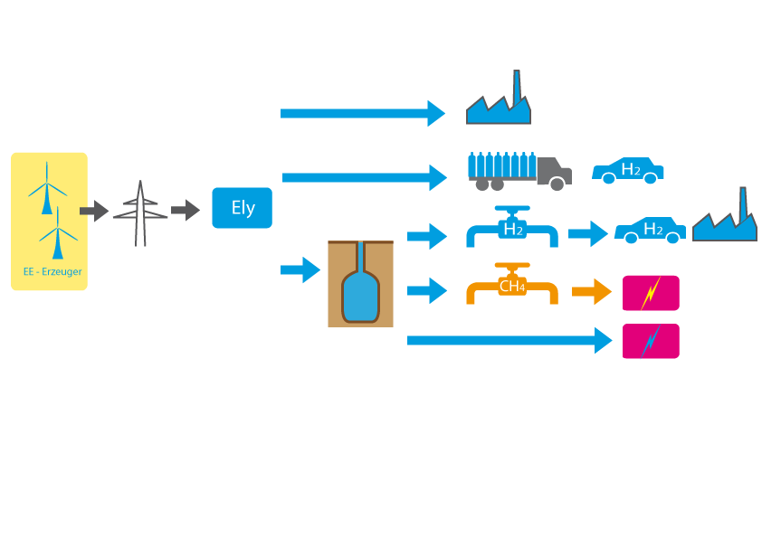
MOTIVATION FOR HYDROGEN PRODUCTION AND SECTOR COUPLING
Residual load and long-term storage demand
Also hydrogen delivery to other sectors
  Transport
  Chemical industry
  Heat
Only hydrogen (and subsequent products) offers storage capacitiy in the TWh-Range
⇒ Electrolysis is a key technology for the Energy Transition
Notes:
A significant term in the electrical energy sector is the residual load. The instantaneous residual load represents the difference between the instantaneous electrical energy demand and the supplied renewable energy power. A negative residual load represents a situation with a renewable energy power greater than the demand. This situation usually indicates the time periods appropriate for filling energy storages or delivering energy to other energy sector, e.g. the transport sector. A positive residual load represents a situation with a renewable energy power smaller than the demand. The positive residual load has to be covered either with conventional power plants or energy from storages. Klaus et al.³ predict, for example, a minimum residual load of about ‑100 GW with a yearly energy excess of about ‑154 TWh and a maximum residual load of about +50 GW with a yearly energy deficit of about +53 TWh by 2050. At about 5000 hours per year we will have energy excess. The assumed scenario in this study is 100% renewable electrical energy production with 120 GW installed PV-power (104 TWh annual yield) and 105 GW wind power (344 TWh annual yield). The electrical storage capacity is about 80 TWh_{el}. Henning et al.⁴ investigated cost optimal energy system under the presumption of CO₂-reduction targets. The study considers a systemic view including all energy sectors. A scenario with 85% CO₂-reduction by 2050 compared to 1990 results in a PV-power of 166 GW (174 TWh annual yield) and 201 GW wind power (504 TWh annual yield). An installed electrolyzer power of 75 GW is calculated to deliver hydrogen for transport, heat and production of electrical energy. An annual energy amount of 100 TWh is stored in hydrogen storages. The battery storage capacity is 74 GWh.
Adamek et al.⁵ considered in their study the electrical energy market only. Under the assumption of a share of 80% renewable energies by 2050 the estimated long-term storage (power to gas and pumped storage hydroelectric) demand is 7.5 TWh and the short-term storage demand (batteries) 70 GWh.

Slide 9
AGENDA
INTRODUCTION HYDROGEN RESEARCH CENTER
MOTIVATION FOR HYDROGEN PRODUCTION AND SECTOR COUPLING
OVERVIEW WESpe – JOINT RESEARCH PROJECT
EXAMPLE RESULTS
SUMMARY / FUTURE PROSPECTS
Notes:
Kurz die Gliederung vorstellen

Slide 10






OVERVIEW WESpe – JOINT RESEARCH PROJECT
Joint Research Project within the framework of the Research Initiative „Energy Storage“ („Energiespeicherung“)
The project was funded by the Federal Ministry for Economic Affairs and Energy, Contract No.0325619
Partner | Main research
 | Communication concept Proof of concept
 | Technical and geological requirements of H2-caverns H2 – pipeline feed-in, materials
 | High efficient PEM-electrolysis, cell-level Degradation effects
 | High efficient PEM-electrolysis, stack-level System analysis power-to-gas
 | Alkaline pressure electrolysis System integration with RE
Work packages
Wind-Hydrogen-System
Location 1
Wind-Hydrogen-System
Location 2
Wind-Hydrogen-System
Location …
WP 0 Evaluation of best PtG-sites
WP 1 Evaluation of core components
WP 2 Requirements for H2–cavern storage
WP 3 Modelling
WP 4 Environmental impact
WP 5 Transparency and acceptance
WP 6 System analysis and economics

Slide 11

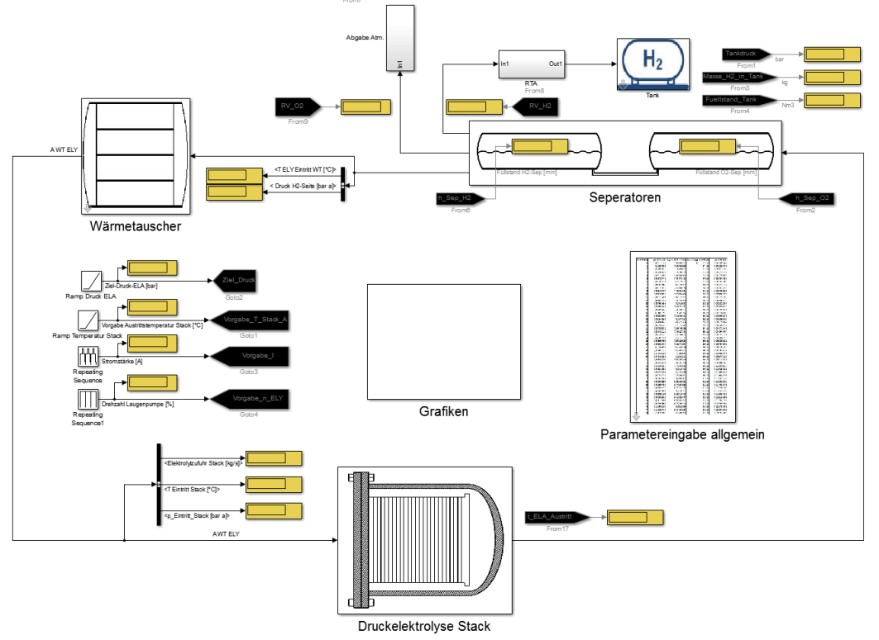
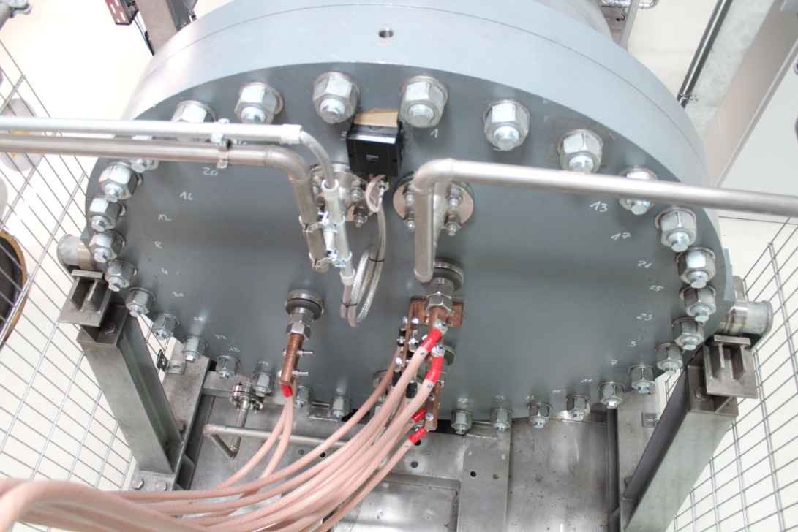
OVERVIEW WESpe – JOINT RESEARCH PROJECT
Sub-Project
Alkaline pressure electrolysis (selected issues)
Modeling
  Dynamic operation
  Control strategies
Measurements of pressure and temperature dependence
  Validation of the model
Conclusion: Pressure Electrolysis advantageous

Slide 12

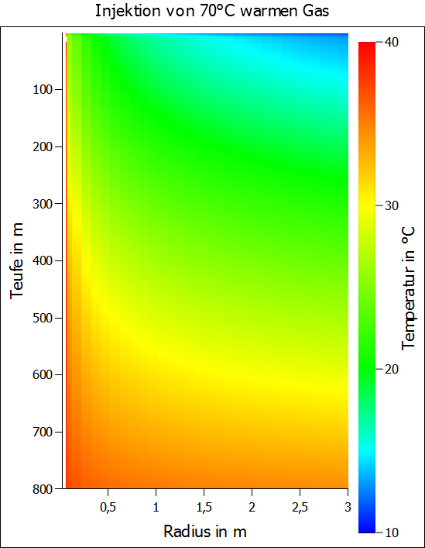
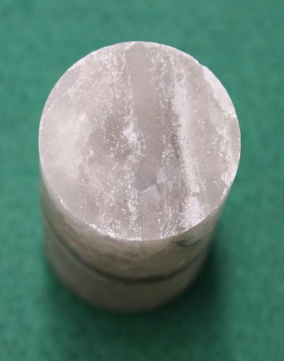
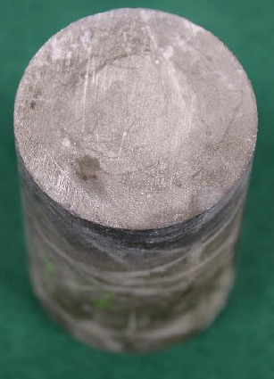
OVERVIEW WESpe – JOINT RESEARCH PROJECT
Sub-Project
Cavern storage (Selected issues)
salt sample
concrete sample
BOXX – Kopplung von Thermik, Hydraulik und Mechanik in einem Tool
Modeling of cavern-casing and tubing
  Thermal
  Hydraulic
  Mechanical
Conclusion:
  Critical values for maximal pressure swing during cavern feed-in obtained
Exposion of different materials to hydrogen
  e.g. salt
  e.g. concrete
Conclusion:
  hydrogenetic rock (salt) sufficient tight
  Concrete: no significant influence on permeabilitiy and shear strength
Temperature increase of rock during injection
Image Sources: DBI
Notes:
Max Gradient: 10 bar/day, 0,6 GW , 4kg/s

Slide 13
AGENDA
INTRODUCTION HYDROGEN RESEARCH CENTER
MOTIVATION FOR HYDROGEN PRODUCTION AND SECTOR COUPLING
OVERVIEW WESpe - PROJECT
EXAMPLE RESULTS
SUMMARY / FUTURE PROSPECTS
Notes:
Kurz die Gliederung vorstellen

Slide 14

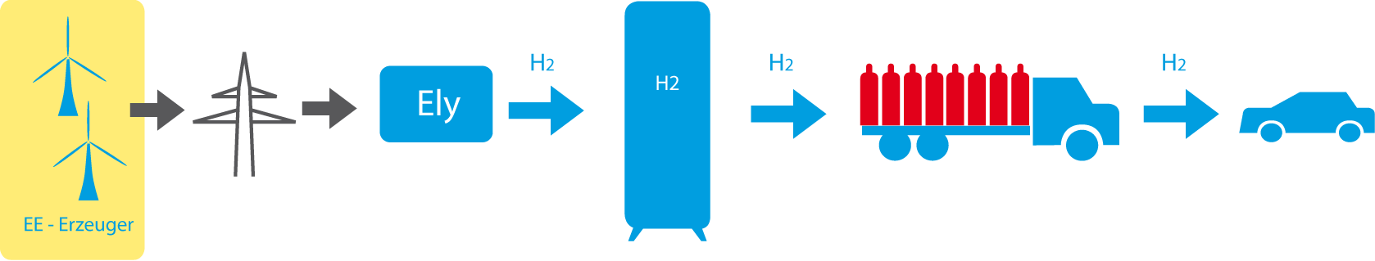
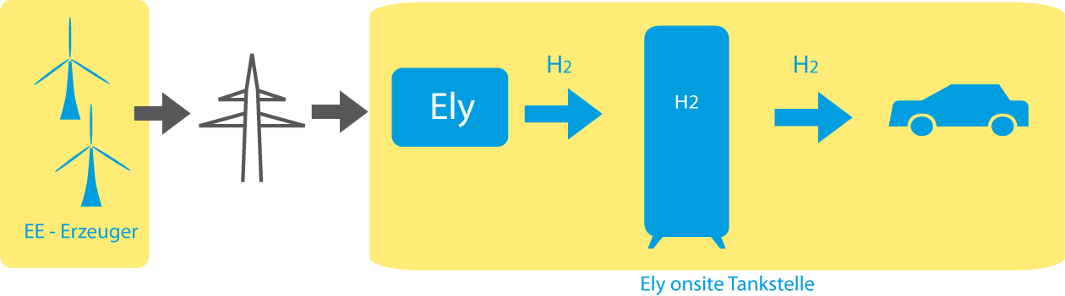
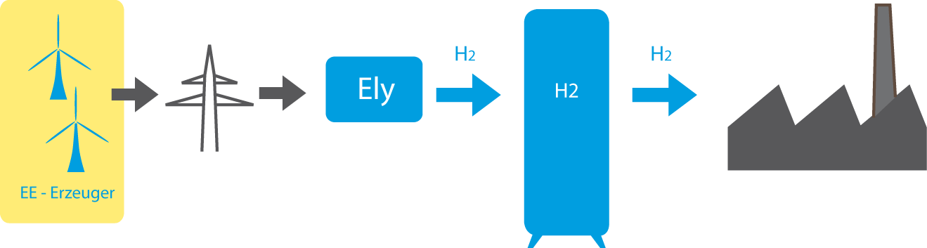
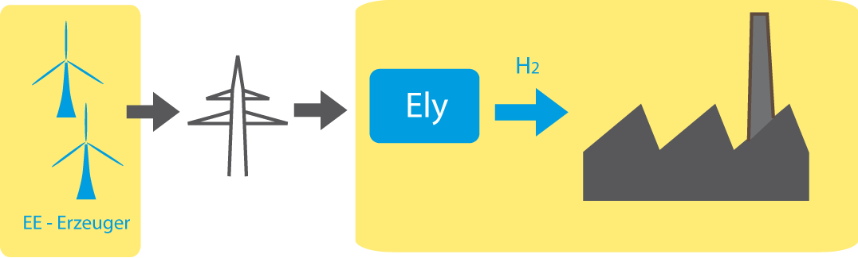
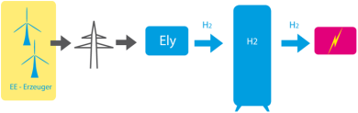
EXAMPLE RESULTS
Simulation of Representative Power-to-Gas Systems
Path Nr. | Path | Main Characteristics | Time scale
1 |  | H₂ cavern storage, gas pipeline, central power plant | 2030+
2 |  | H₂ cavern storage, local electricity generation | 2030+
3 |  | H₂ cavern storage, H₂-pipeline, mobility& industry | today
4a |  | Small scale H₂-delivery for mobility, ancillary services | today
4b |  | Onsite H₂-delivery for filling station | today
5 |  | H₂-delivery for industry, autarkic | today
6 |  | H₂-delivery for industry | 2030+
7 |  | Medium scale H₂-storage and electricity generation | today

Slide 15
EXAMPLE RESULTS
Simulation of Representative Power-to-Gas Systems
Path 5 – Main Characteristics
assumptions | 1.200 Nm³/h onsite H₂-delivery for industry, autarkic Electrolysis in 24/7 operation if wind/PV energy available Direct connection to wind park/PV – no public net (legal advantages) Sale of surplus H₂ Actual wind and PV data, Berlin region Security of supply
Technical and economic output | Technical Dimensioning LCOHy Optimal economic case
Notes:
Elektrolyse als einziger H2-Erzeuger für einen Industriestandort
Elektrolyse im 24/7 Betrieb bei EE-Verfügbarkeit
H2-Speicherung
Konstante H2-Abnahme von 1.200 Nm^3/h
Strombezug über lokales Stromnetz direkt beim Erzeuger
direkte Kopplung von ELA an EE-Anlagen
Einsparung von Netzentgelten
rechtliche Begünstigungen (nach Stromsteuergesetz ist ELA von Stromsteuer befreit, wenn H2 für verarbeitendes Gewerbe)
Wenn Speicher voll:
5a: keine Drosselung ELA
Verkauf von überschüssigem Wasserstoff wenn Speicher voll

Slide 16
EXAMPLE RESULTS
Simulation of Representative Power-to-Gas Systems
Path 5 – Variation of technical Parameters
Parameter | Range
Wind power | 0..4..40 MW
PV power | 0..4..40 MW
Electrolysis power | 8..4..40 MW | 1 600-8 000 m³/h i.N.
H2-storage capacity | 20..10..80 *300 kg je 92.5 m³ geom. | 66 000-264 000 m³ i.N. ≙ 1 850-7 400 m³ geom.
H2-demand | const. 0.03 kg/s | 1 200 m³/h i.N.
No simulation for wind+PV < electrolysis -> 7920 variations
Notes:
Elektrolyse als einziger H2-Erzeuger für einen Industriestandort
Elektrolyse im 24/7 Betrieb bei EE-Verfügbarkeit
H2-Speicherung
Konstante H2-Abnahme von 1.200 Nm^3/h
Strombezug über lokales Stromnetz direkt beim Erzeuger
direkte Kopplung von ELA an EE-Anlagen
Einsparung von Netzentgelten
rechtliche Begünstigungen (nach Stromsteuergesetz ist ELA von Stromsteuer befreit, wenn H2 für verarbeitendes Gewerbe)
Wenn Speicher voll:
5a: keine Drosselung ELA
Verkauf von überschüssigem Wasserstoff wenn Speicher voll
H2-Speichertank arbeitet als Kaskade aus einzelnen Tanks je 300 kg Speicherkapazität (Pfad 6 ohne Speicher)
Konstanter Druck der Endanwendung
Pfad 5: 1 bara
Pfad 6: 30 bara

Slide 17
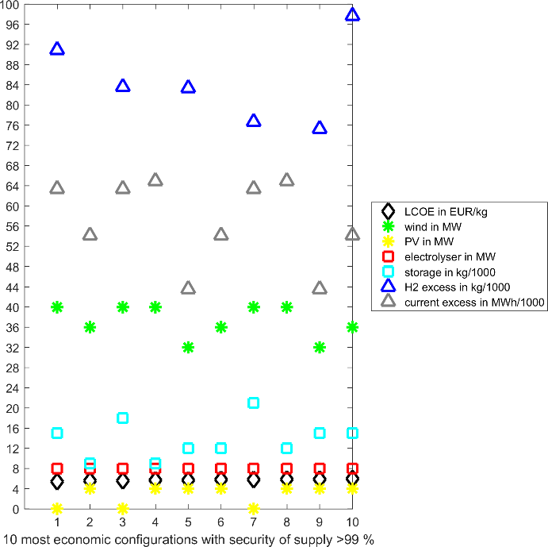
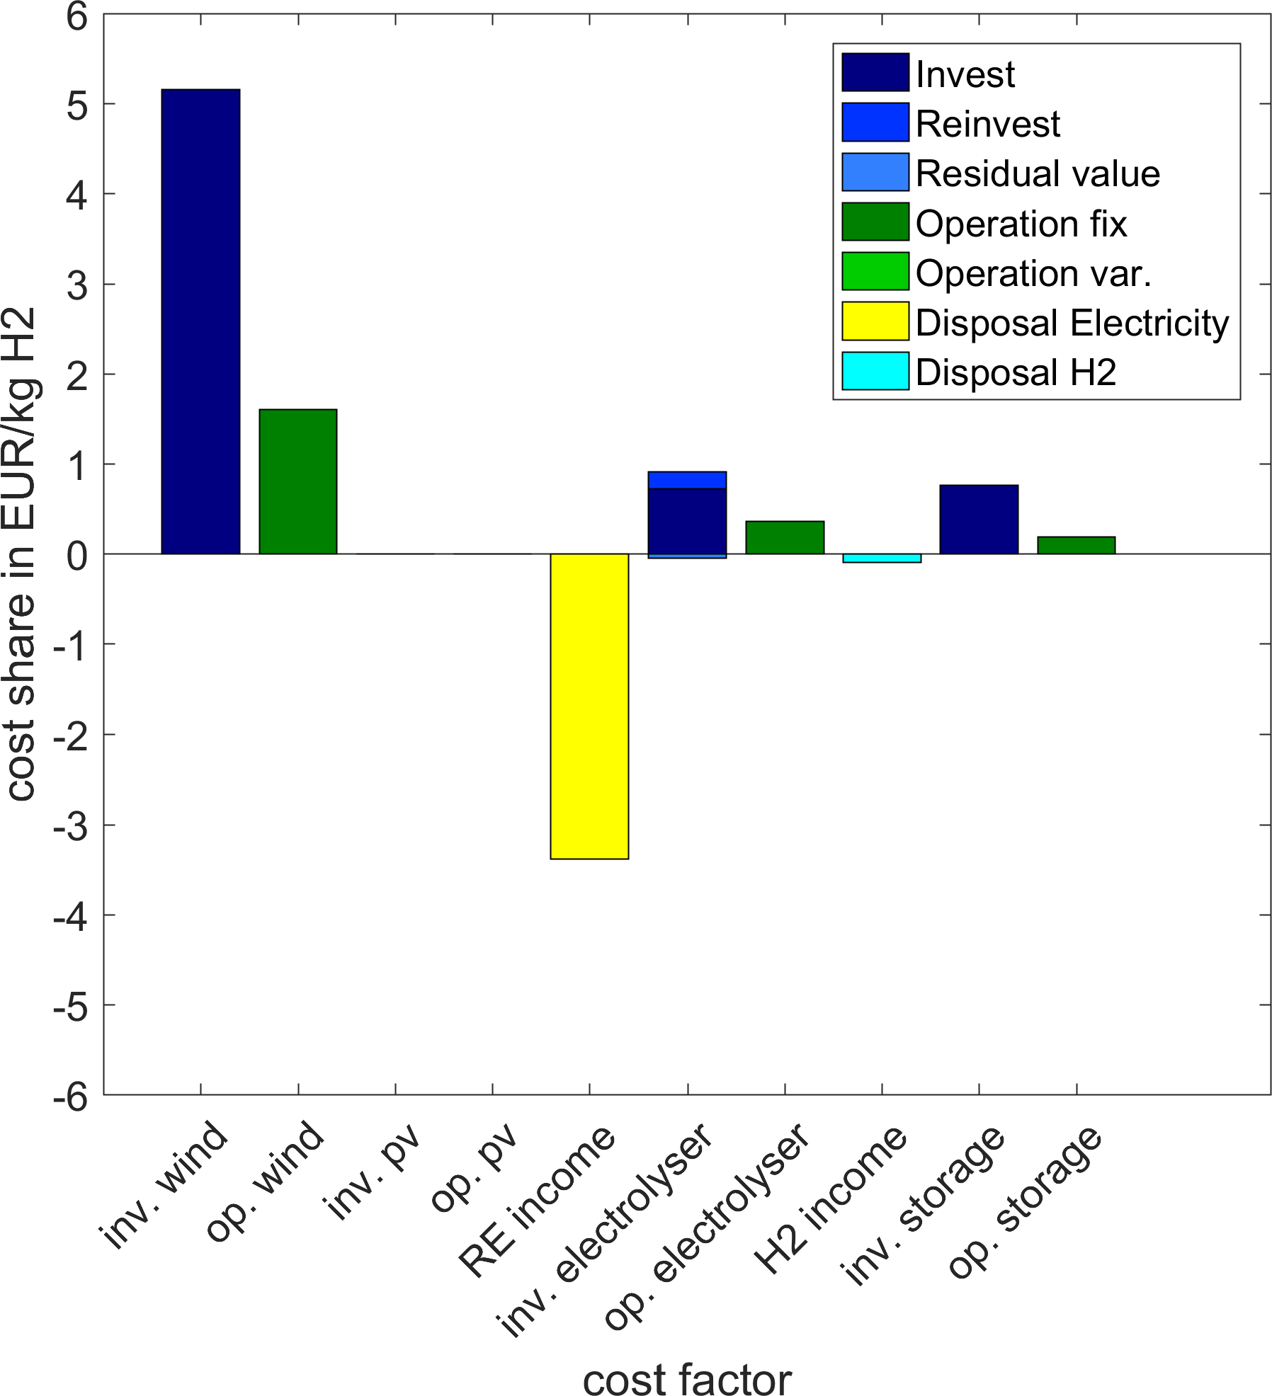
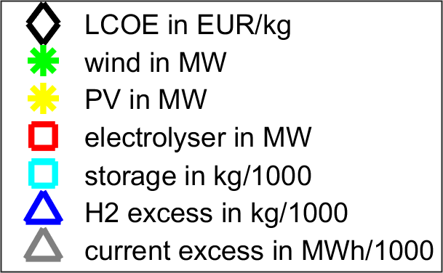
EXAMPLE RESULTS
Simulation of Representative Power-to-Gas Systems
sale of electrical current and H2
10 most economic configurations with security of supply >99 %
The most economic configuration with security of supply >99 %
tons
tons
GWh
Notes:
Mit Verkauf von Strom und H2 7.30 EUR/kg
Ohne Verkauf (moderate ökonomische Annahmen) 5.40 EUR/kg
Mit Verkauf -> viel Wind, kleine ELA -> höchstmöglicher Stromüberschuss
Ohne Verkauf -> deutliche Reduzierung von Wind, Anstieg von ELA+PV -> höchste Versorgungssicherheit mit geringsten Investitionen
Ohne Abregelung ELA -> großer Überschuss H2
Mit Abregelung ELA -> weiterer Anstieg Stromüberschuss
Mit Verkauf von Strom und H2 7.30 EUR/kg
Ohne Verkauf (moderate ökonomische Annahmen) 5.40 EUR/kg
Mit Verkauf (links)
-> viel Wind, kleine ELA
-> höchstmöglicher Stromüberschuss
Ohne Verkauf (rechts)
-> deutliche Reduzierung von Wind, Anstieg von ELA+PV
-> höchste Versorgungssicherheit mit geringsten Investitionen
Ohne Abregelung ELA (beide gafiken)
-> großer Überschuss H2
ebenso Stromüberschuss

Slide 18
AGENDA
INTRODUCTION HYDROGEN RESEARCH CENTER
MOTIVATION FOR HYDROGEN PRODUCTION AND SECTOR COUPLING
OVERVIEW WESpe - PROJECT
EXAMPLE RESULTS
SUMMARY / FUTURE PROSPECTS
Notes:
Kurz die Gliederung vorstellen

Slide 19
SUMMARY / LESSONS LEARNED / MAIN BARRIERS
Research on all technical components of this chain:
  Dynamic electrolysis operation and degradation (Alkaline and PEM)
  Dynamic H2-cavern storage
  H2 –feed into gas pipeline
All hydrogen paths technically viable
  Some paths also economically viable
  Best initial market: mobility
Direct hydrogen use is advantageous in comparison to methanation
Barriers
  Legal situation
    taxes, grid fees etc. for electrolyzer electricity
    no benefit for delivering storage
Notes:
Der Kurzzeitspeicherbedarf bei 14 GW/70GWh ist etwa die doppelte derzeit vorhandene Punpspeicherkapazität
Dieses Ergebnis ergibt sich nur bei rein bilanzieller Seite auf der Übetragungsnetzebne (immer Netzausbau vorausgesetzt)
Aber : bisher 98% der EE auf Verteilnetzebene. Auch hier können lokale Netzengpässe auftreten!!!
Dass bei 40% EE noch keine Speicher gebraucht werden ist wegen der Annahmen der Studien Fraglich:
dieses Fazit entsteht ja nur aus rein bilanzieller Sicht. D. h. wann ist insgesamt zu viel EE da,die eingespeichert werden muss. Die Studie setzt ja ein immer ausreichend ausgebautes Netz voraus. In der realität wird es aber örtliche Netzengpässe geben, die auch dann zu Speicherbedarf führen, wenn bilanziell noch keine negative Residuallast vorliegt.
Dass die Speicher keine Auswirkunge auf das Übertragungsnetz haben, gilt auch nur unter der in der VDE – Studie gemachten idealen Annahme, dass Ein-und Ausspeicherung am gleichen Ort erfolgen.
(eigene Meinung): wenn die örtliche Übereinstimmung nicht vorausgestzt wird ( und das .ird ja in der Zukunft der Fall sein, wenn ins Gasnetz einsepeist wird) dann kann es sehr wohl Einfluss auf Ausbau des Übertragungsnetzes geben.

Slide 20
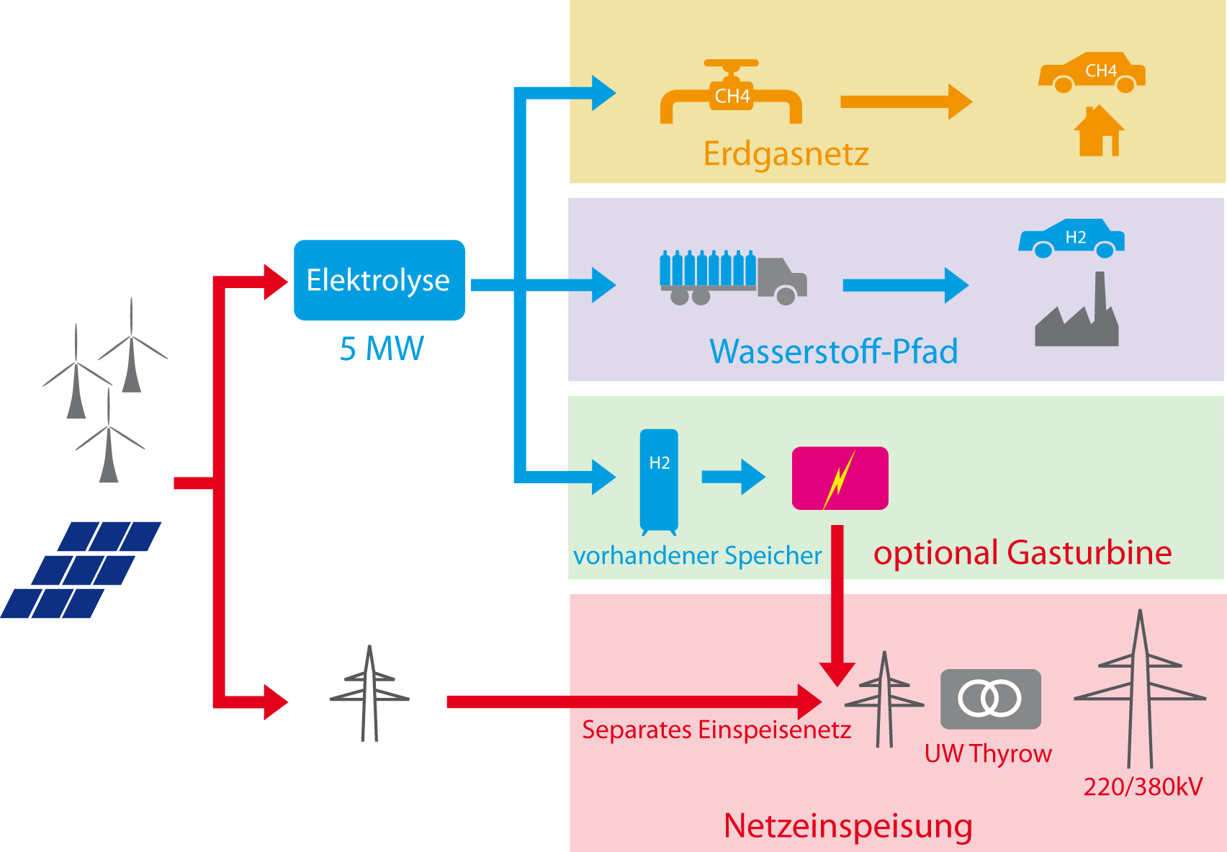
NEXT PROJECT STEPS / FUTURE R&D ACTIVITIES
Completion of Simulation of all hydrogen paths until end of 2017
Several R&D projects in the pipeline
  Project „AEL3D“ – Development of new electrodes (more efficient and cheap) for alkaline electrolysis (just started)
  HYPOS research cavern Bad Lauchstädt
  Multi Energie Kraftwerk Sperenberg (MEKS)
Notes:
Der Kurzzeitspeicherbedarf bei 14 GW/70GWh ist etwa die doppelte derzeit vorhandene Punpspeicherkapazität
Dieses Ergebnis ergibt sich nur bei rein bilanzieller Seite auf der Übetragungsnetzebne (immer Netzausbau vorausgesetzt)
Aber : bisher 98% der EE auf Verteilnetzebene. Auch hier können lokale Netzengpässe auftreten!!!
Dass bei 40% EE noch keine Speicher gebraucht werden ist wegen der Annahmen der Studien Fraglich:
dieses Fazit entsteht ja nur aus rein bilanzieller Sicht. D. h. wann ist insgesamt zu viel EE da,die eingespeichert werden muss. Die Studie setzt ja ein immer ausreichend ausgebautes Netz voraus. In der realität wird es aber örtliche Netzengpässe geben, die auch dann zu Speicherbedarf führen, wenn bilanziell noch keine negative Residuallast vorliegt.
Dass die Speicher keine Auswirkunge auf das Übertragungsnetz haben, gilt auch nur unter der in der VDE – Studie gemachten idealen Annahme, dass Ein-und Ausspeicherung am gleichen Ort erfolgen.
(eigene Meinung): wenn die örtliche Übereinstimmung nicht vorausgestzt wird ( und das .ird ja in der Zukunft der Fall sein, wenn ins Gasnetz einsepeist wird) dann kann es sehr wohl Einfluss auf Ausbau des Übertragungsnetzes geben.

Slide 21
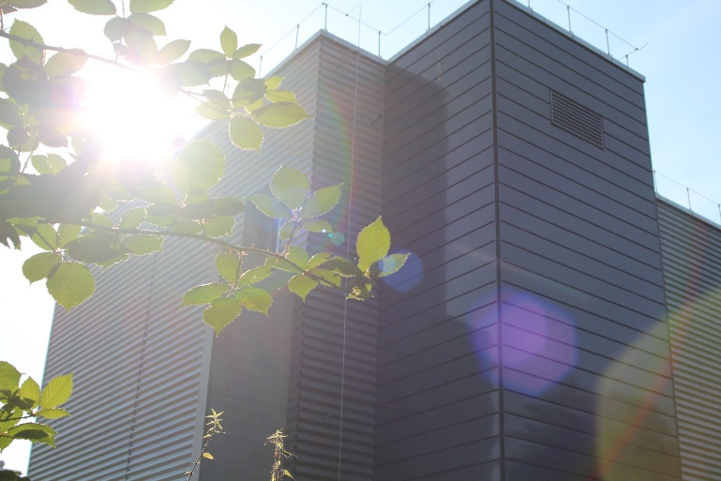
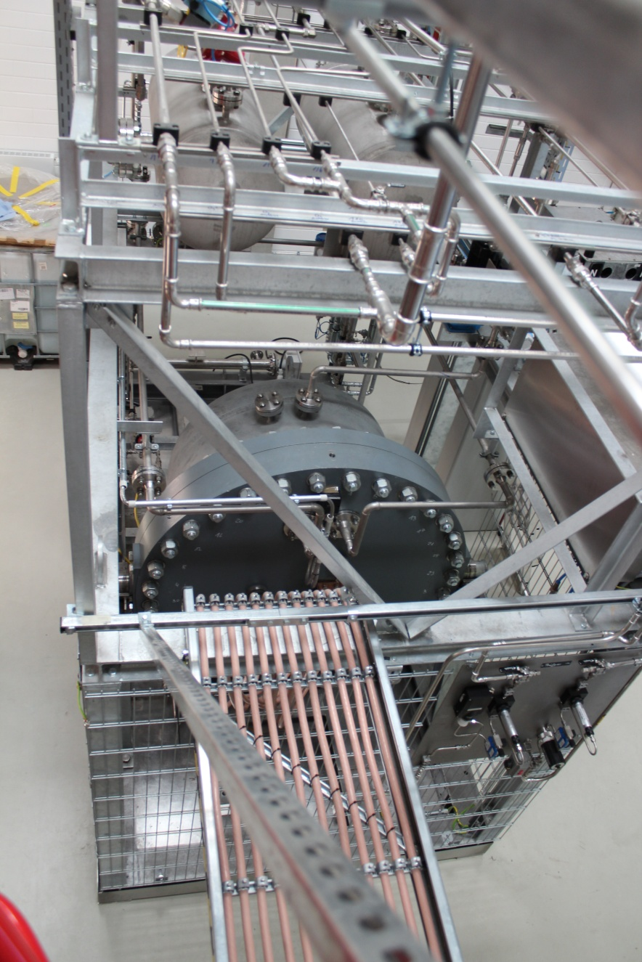
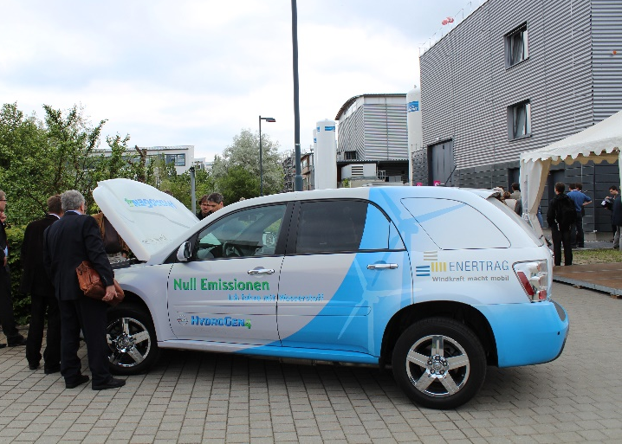
Thank You for Your Kind Attention!
Dr. Ulrich Fischer
Head of Hydrogen Research Center
Chair of Power Plant Technology
Brandenburg University of Technology Cottbus-Senftenberg
Postbox 101344
03013 Cottbus – Germany
ulrich.fischer@b-tu.de www.b-tu.de
The project was funded by the Federal Ministry for Economic Affairs and Energy, Contract No.0325619

Slide 22
Backup

Slide 23
INTRODUCTION HYDROGEN AND STORAGE RESEARCH CENTER
Research electrolyzer
20 Nm³/h nominal hydrogen production
Operating pressure max. 58 bar
Partial load 10%
Fast response time:
  50A/s
  ∼ 60s to max. power (warm stand-by)

Slide 24

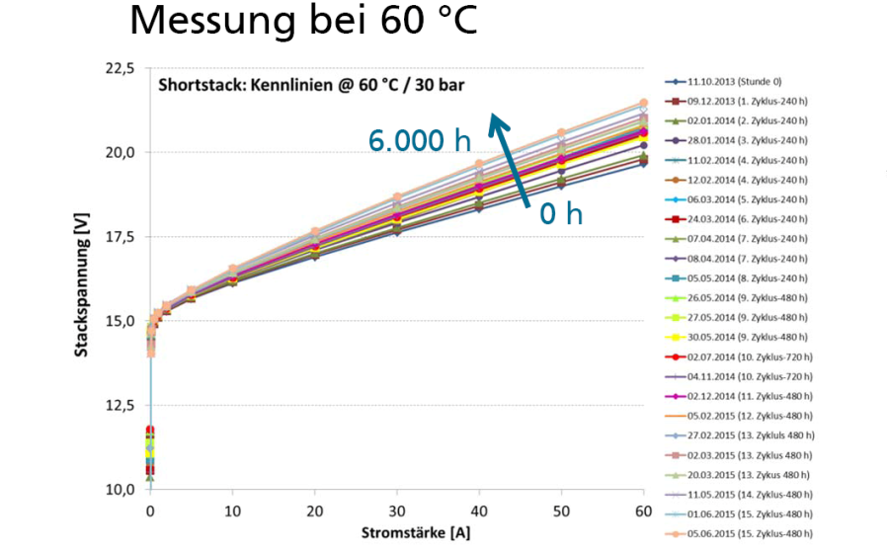
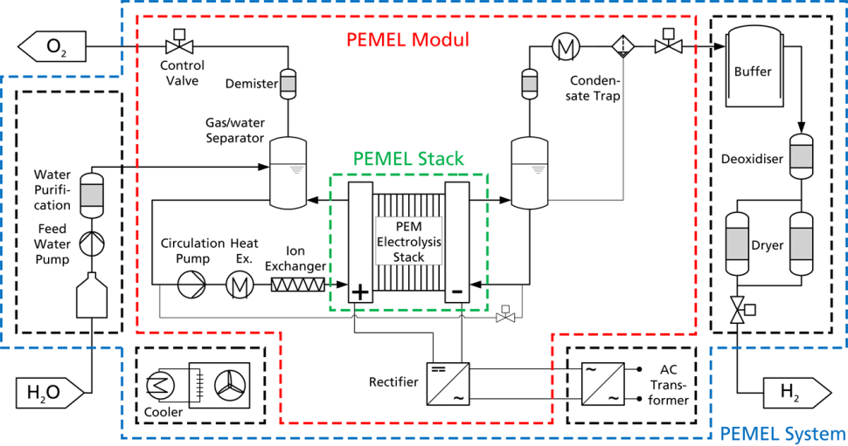
OVERVIEW WESpe – JOINT RESEARCH PROJECT
Sub-Project
PEM-electrolysis (selected issues)
Dynamic simulation
Degradation tests
Image Source: ISE Freiburgc
Image Source: ISE Freiburg

Slide 25
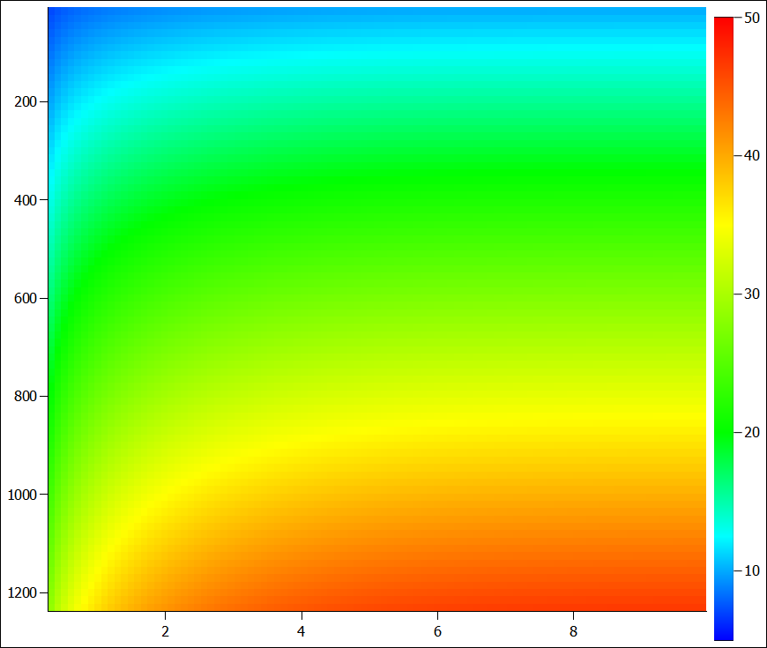
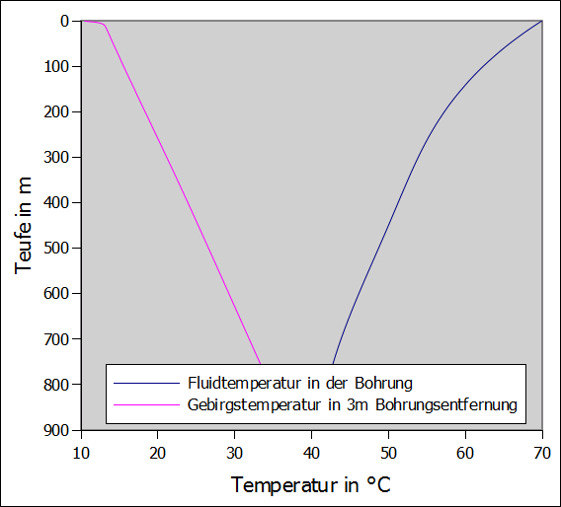
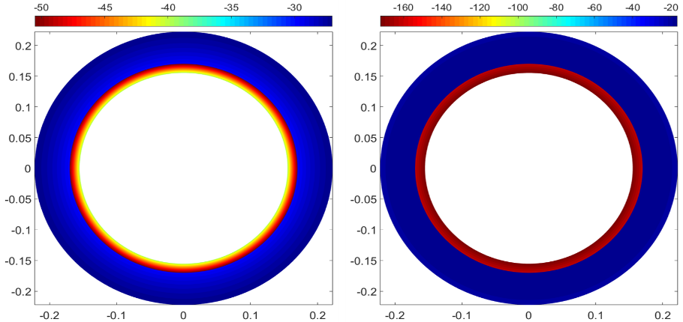
OVERVIEW WESpe – JOINT RESEARCH PROJECT
Sub-Project
Thermisch
- detaillierte thermische Darstellung und Simulation des Gebirges
Hydraulisch
- Berücksichtigung von verschiedensten Stoffeigenschaften des Speichermediums
Mechanisch*
- neue analytische Berechnungsansätze für Bohrung und Gebirge
BOXX – Kopplung von Thermik, Hydraulik und Mechanik in einem Tool
*wird implementiert

Slide 26
OVERVIEW WESpe – JOINT RESEARCH PROJECT
Sub-Project
BOXX – Kopplung von Thermik, Hydraulik und Mechanik in einem Tool

Slide 27
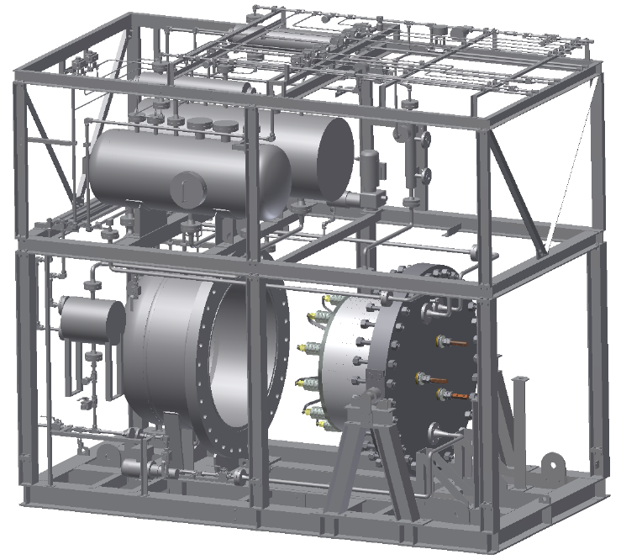
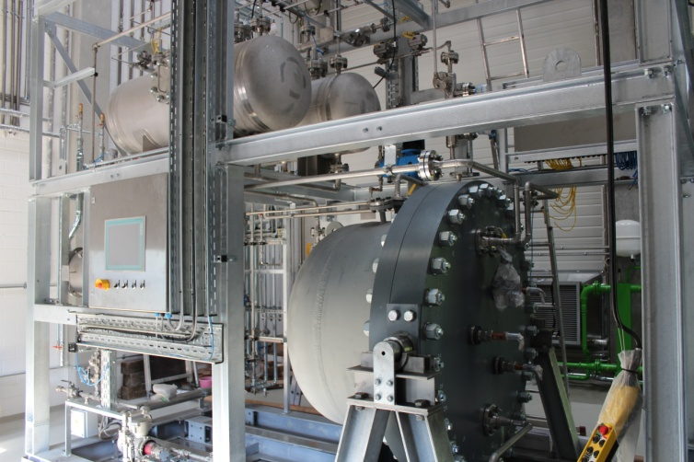
INTRODUCTION HYDROGEN AND STORAGE RESEARCH CENTER
Stack test center up to 60 bar stacks
  Possibility to replace stack
  Stack current up to 3000 A
  Dynamic input profiles possible
  Stack power up to 156 kW
Third party stacks for tests welcome!

Slide 28

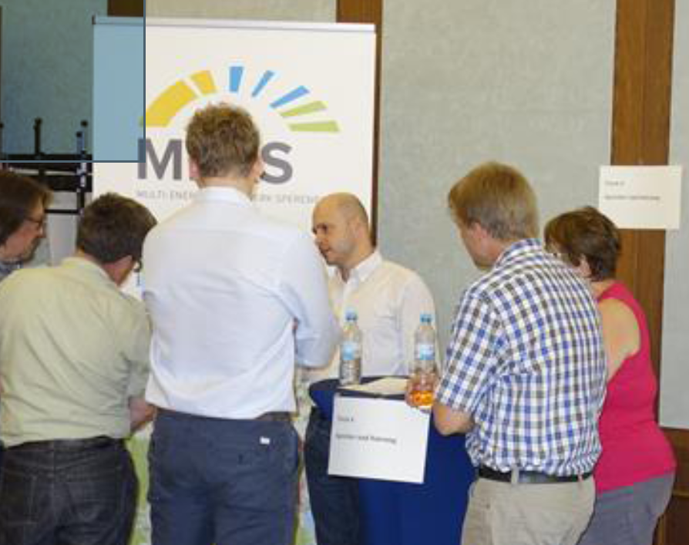
OVERVIEW WESpe – JOINT RESEARCH PROJECT
Sub-Project Environmental Action Germany ( )
Communication concept for transparency and acceptance (selected issues)
Development of communication concept
    Analysis of initial position
    Analysis of conflict potencials
    Concept for public participation
Proof of communication concept in practice (projected power-to-gas project)
  Introduction of project to local authorities
  Stakeholder workshops
  Public dialogues with concerned people and parties
  Mediation between supporters and opponents

Slide 29
EXAMPLE RESULTS
Simulation of Representative Power-to-Gas Systems
Path 5 – Economic assumptions
Component | CAPEX | years | OPEX/revenues
wind | 1 500 EUR/kW inst. | 30 | 2,5 % Invest /a
PV | 1 800 EUR/kW inst. | 30 | 2 % Invest /a
Electrolysis | 1 050 EUR/kW inst. | 20 | 4 % Invest /a
Storage Tank | 590 EUR/kg | 30 | 2 % Invest /a
Electricity (public net) | Stock exchange price |  | 5 ct/kWh
Renewable electricity sale | Stock exchange price |  | 5 ct/kWh
H2 sale | Steam reforming price |  | 1.00 EUR/kg
economics
Rate of interest | 0.07
Notes:
Investitionskosten
Reinvestment
Betriebskosten
Restwert
Erlöse
-> Alles zu Preisen von heute
Masse des der Industrieanwendung zur Verfügung gestellten Wasserstoffes
Resultat: Spez. Wasserstoffpreis je Produktionsmenge (EUR/kg)

Slide 30
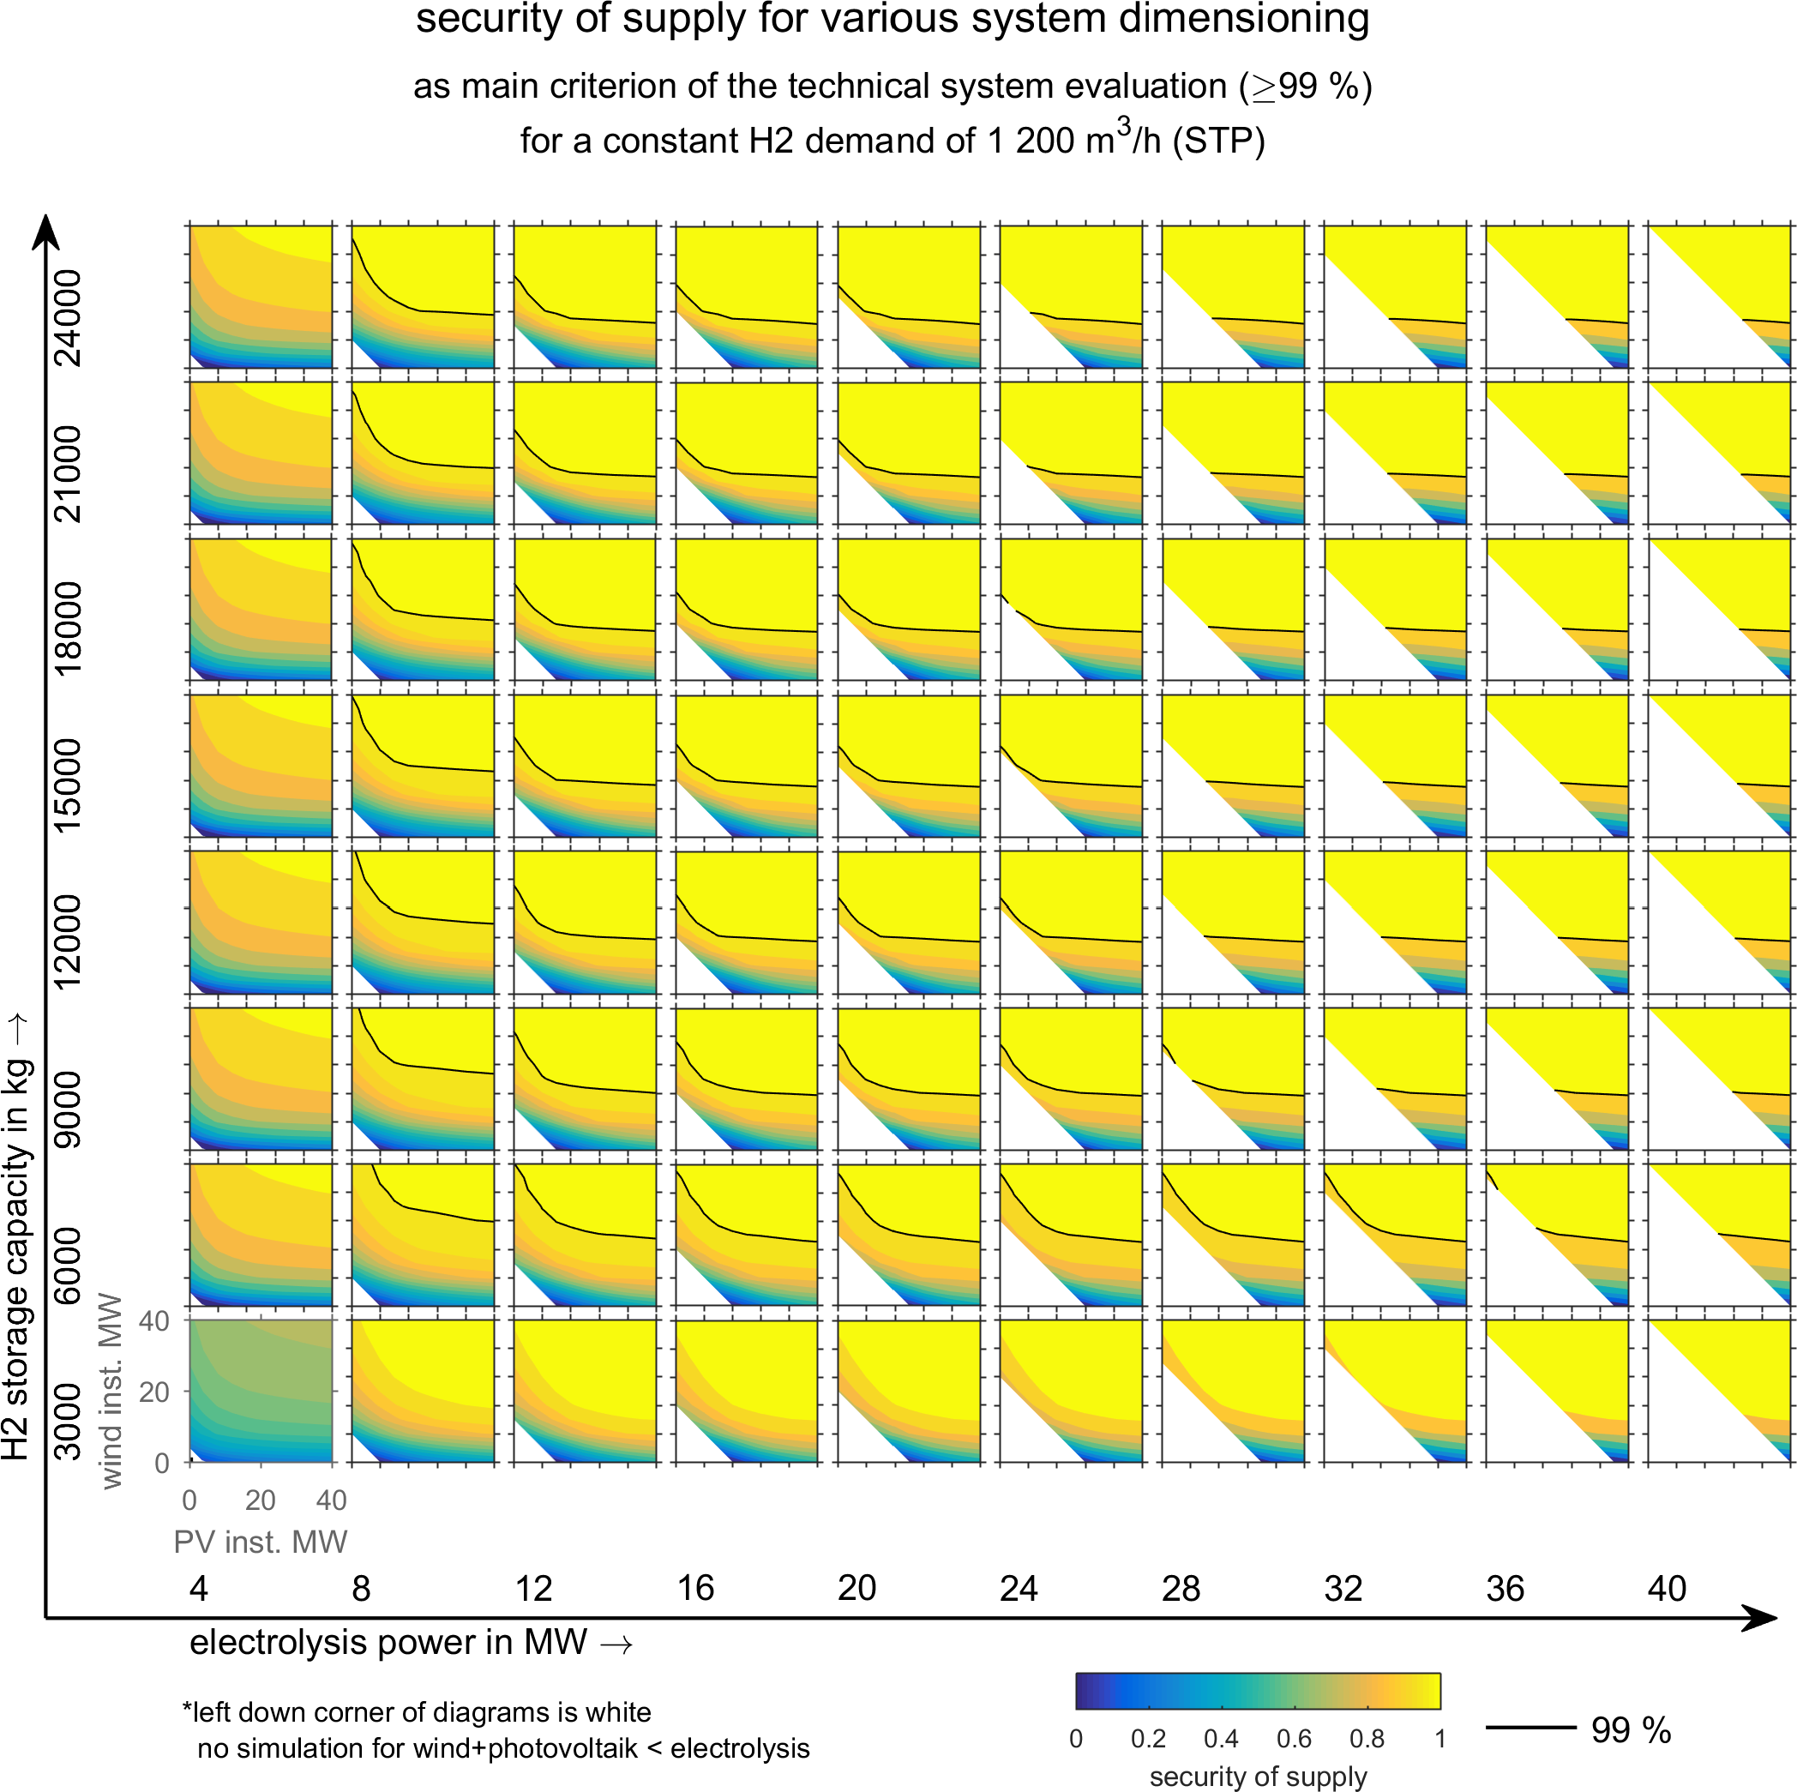
EXAMPLE RESULTS
Simulation of Representative Power-to-Gas Systems

Slide 31
Expectations from presentation
Main lessons learned and barriers to innovation deployment
Next project steps
Needs for future R&I activities coming out of the project (if any)
Deployment prospects of the most promising solutions
Notes:
Der Kurzzeitspeicherbedarf bei 14 GW/70GWh ist etwa die doppelte derzeit vorhandene Punpspeicherkapazität
Dieses Ergebnis ergibt sich nur bei rein bilanzieller Seite auf der Übetragungsnetzebne (immer Netzausbau vorausgesetzt)
Aber : bisher 98% der EE auf Verteilnetzebene. Auch hier können lokale Netzengpässe auftreten!!!
Dass bei 40% EE noch keine Speicher gebraucht werden ist wegen der Annahmen der Studien Fraglich:
dieses Fazit entsteht ja nur aus rein bilanzieller Sicht. D. h. wann ist insgesamt zu viel EE da,die eingespeichert werden muss. Die Studie setzt ja ein immer ausreichend ausgebautes Netz voraus. In der realität wird es aber örtliche Netzengpässe geben, die auch dann zu Speicherbedarf führen, wenn bilanziell noch keine negative Residuallast vorliegt.
Dass die Speicher keine Auswirkunge auf das Übertragungsnetz haben, gilt auch nur unter der in der VDE – Studie gemachten idealen Annahme, dass Ein-und Ausspeicherung am gleichen Ort erfolgen.
(eigene Meinung): wenn die örtliche Übereinstimmung nicht vorausgestzt wird ( und das .ird ja in der Zukunft der Fall sein, wenn ins Gasnetz einsepeist wird) dann kann es sehr wohl Einfluss auf Ausbau des Übertragungsnetzes geben.

