Slide 1


PV-Forecast
Regionalised forecasting of energy production from photovoltaic and their dynamics
ETIP SNET Workshop, Central Region 18.-19. Sept. 2016
KOSTER Daniel, BRAUN Christian MINETTE Frank, O’NAGY Oliver

Slide 2
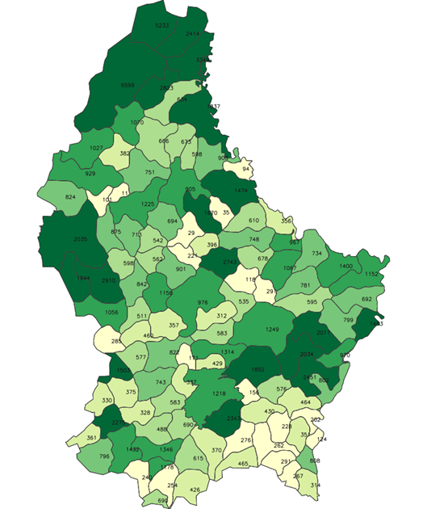


A model based solution for PV production forecasting
Objective:
Better integration of PV into
energy system / market
Assure grid stability
Challenge:
Reach adequate
accuracy at small
regional scale /
increase spatial
resolution
57 km
In collaboration with
82 km
122 [MW_{p}] PV installed
app. 207 [W_{p} / Inhabitant]
(End 2016)
Notes:
Annual consuption (elec.): 6,5 TWh
Peak power: 1,08 GW
PV prod.: 100 GWh

Slide 3
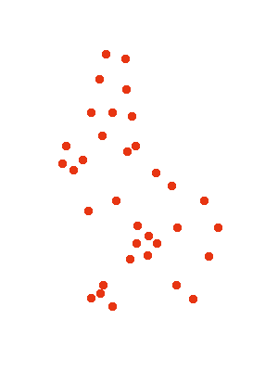
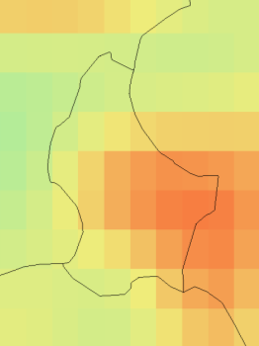

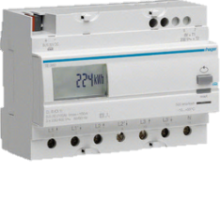
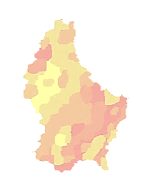
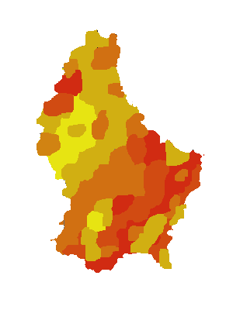
PV-Power
Forecasting
Solar irradiation forecasts (ECMWF)
Reference- systems
About 80
systems visited,
evaluated & charact.
23 chosen and integrated (8 + 15)
Processing irradiance forecasts on inclined surf.
Forecasts
Monitoring data & system profiles
Statistical PV-systems model
Photovoltaic power predictions
Regionalised power predictions on different time scales
t=n+1
t=n

Slide 4
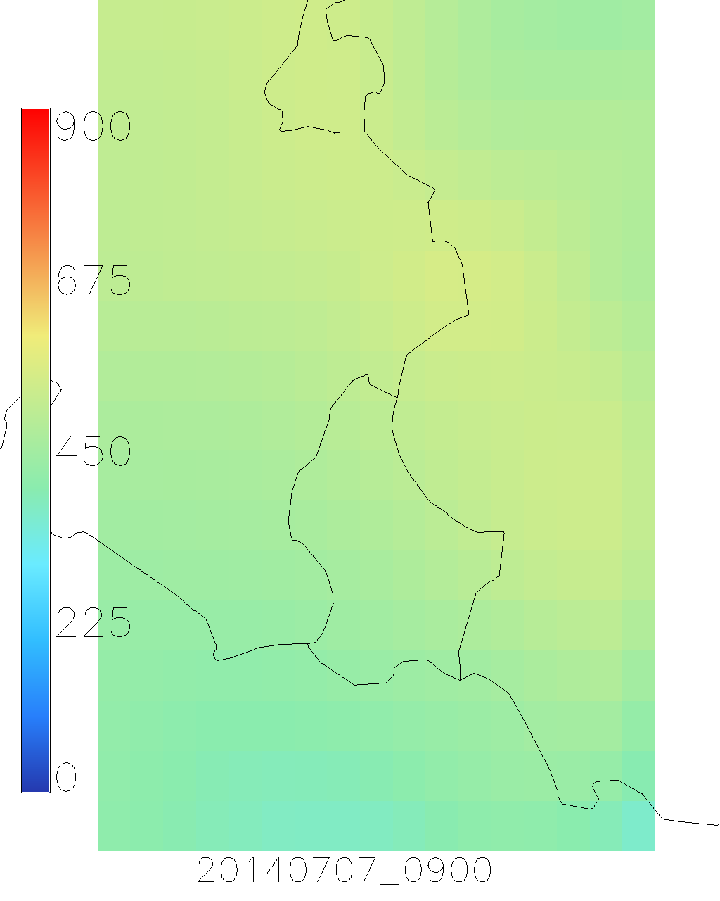
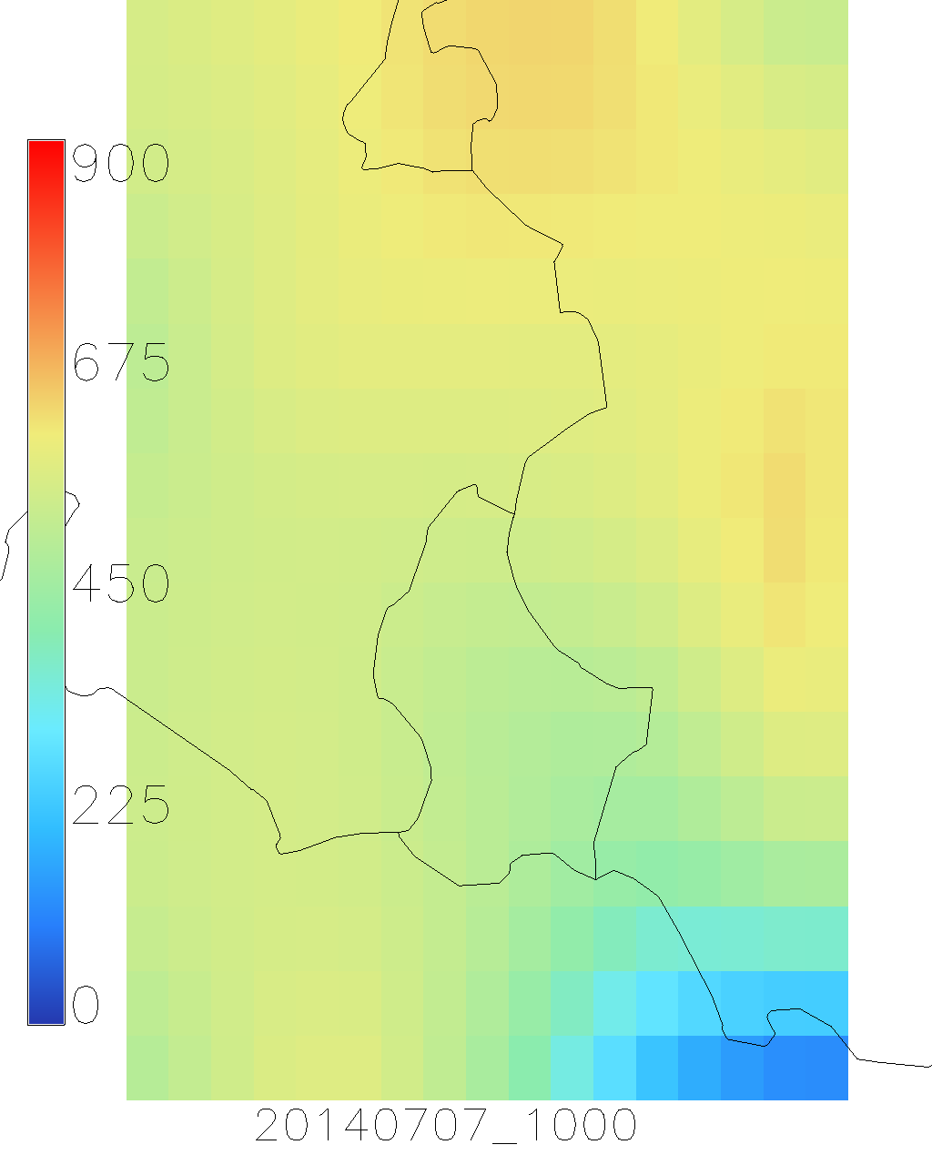
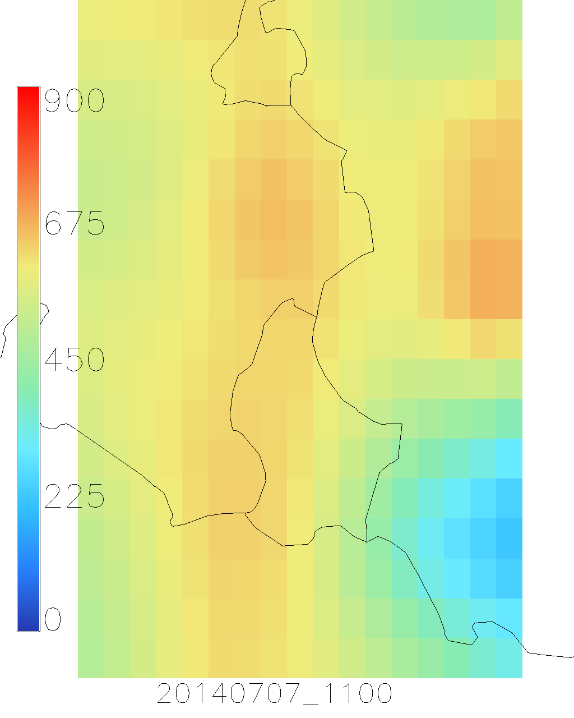
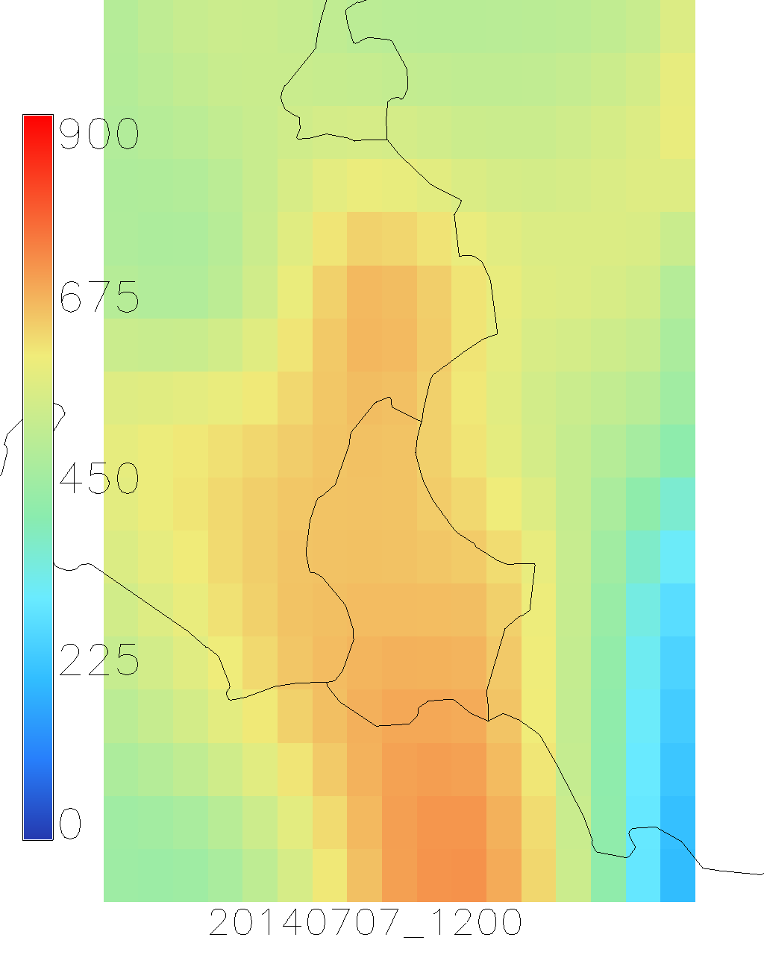
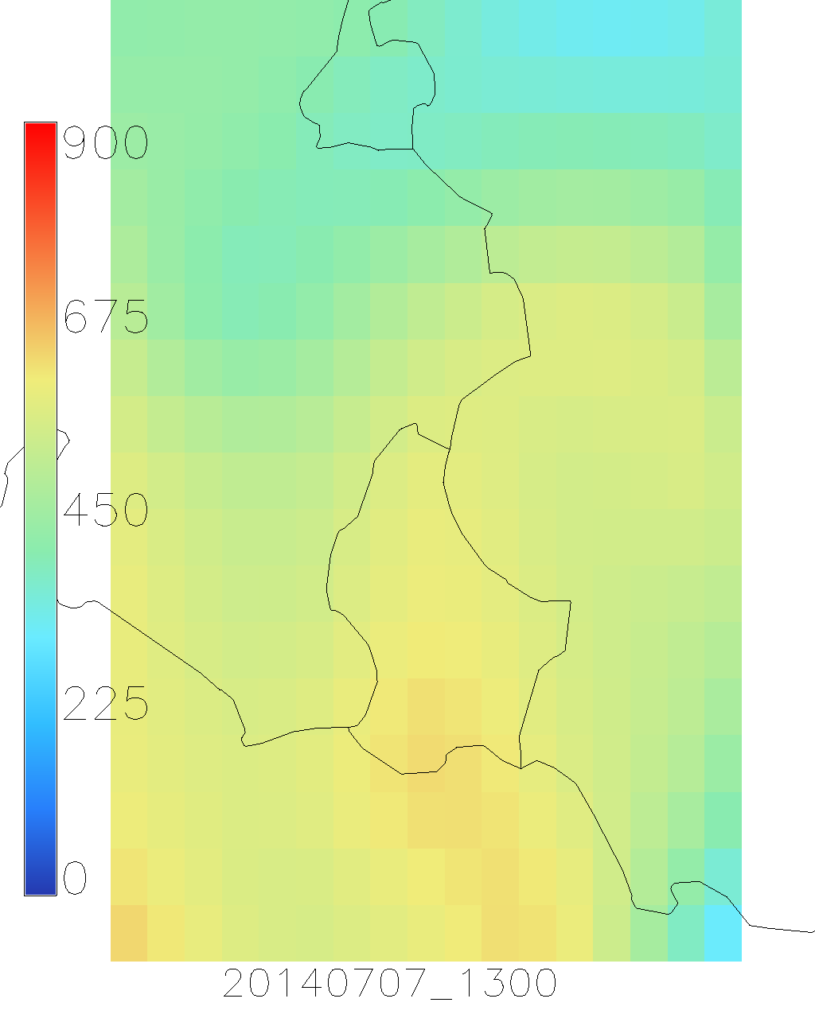
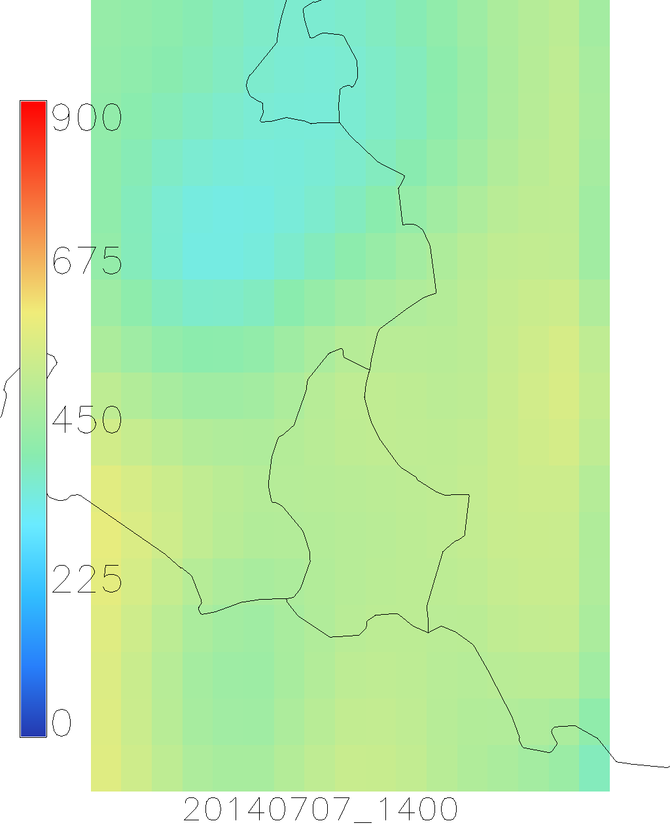
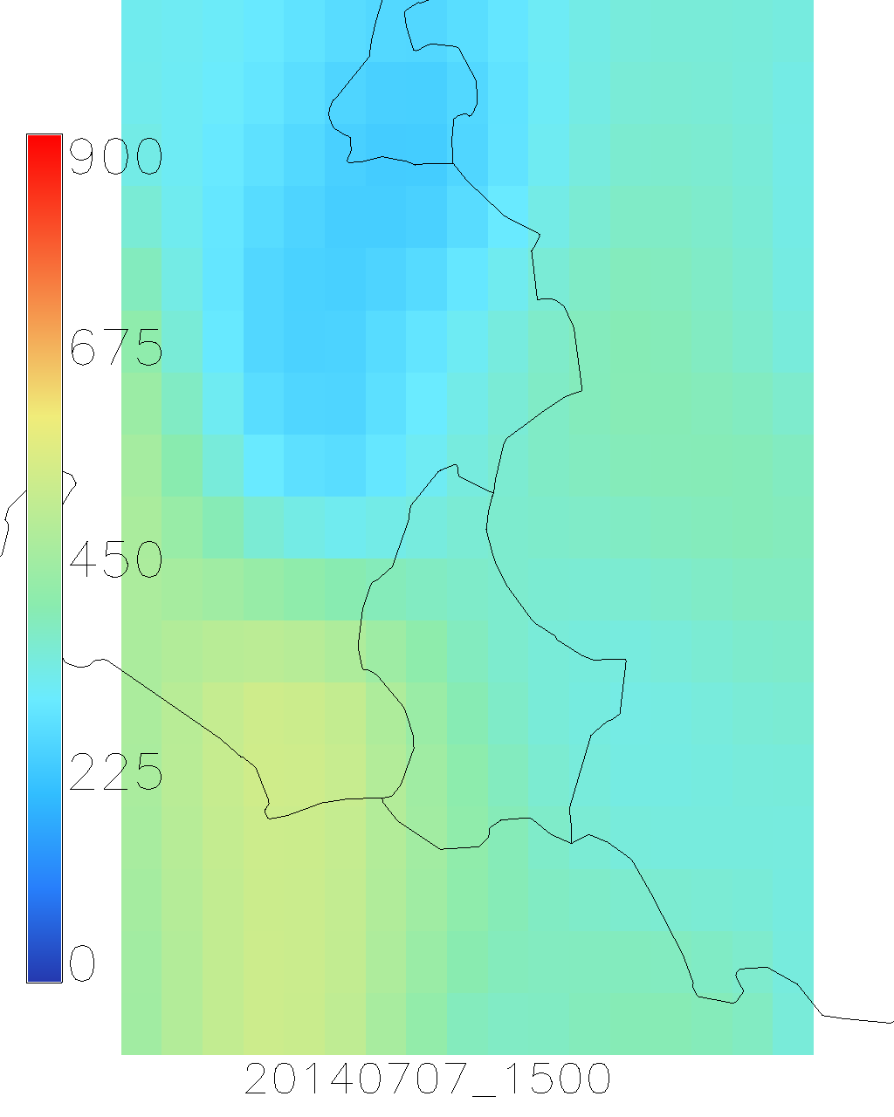
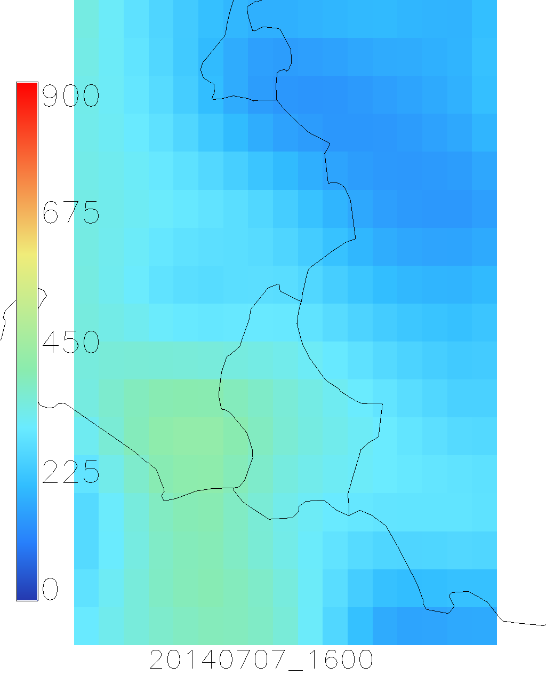
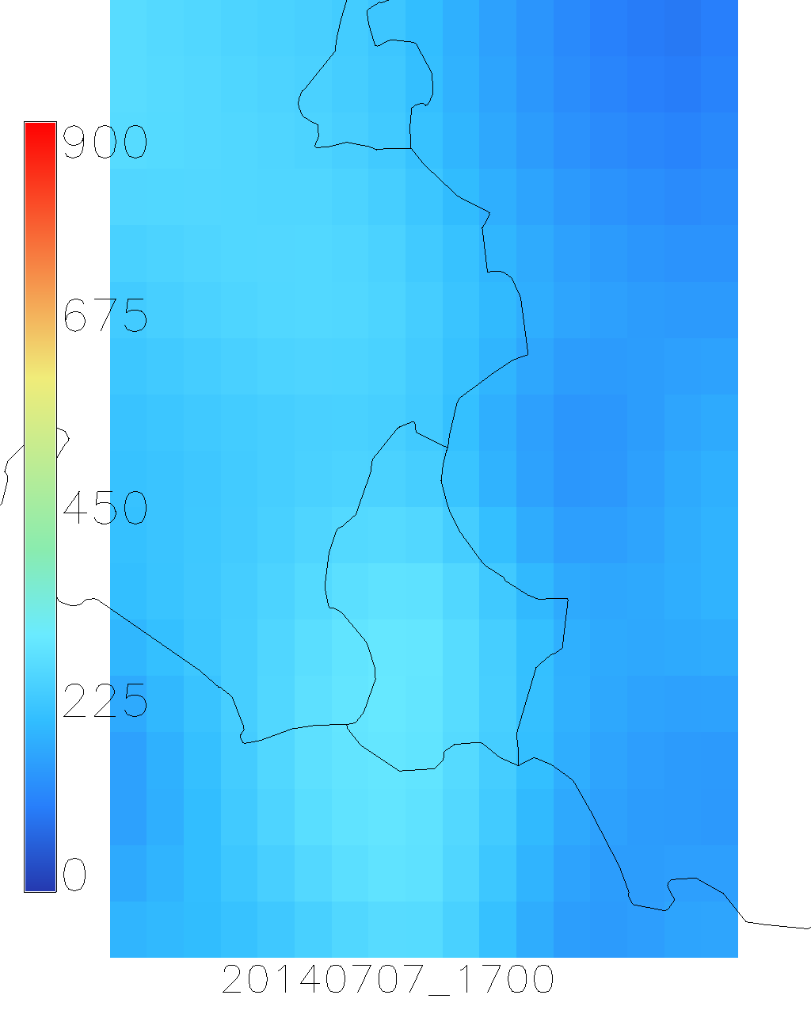
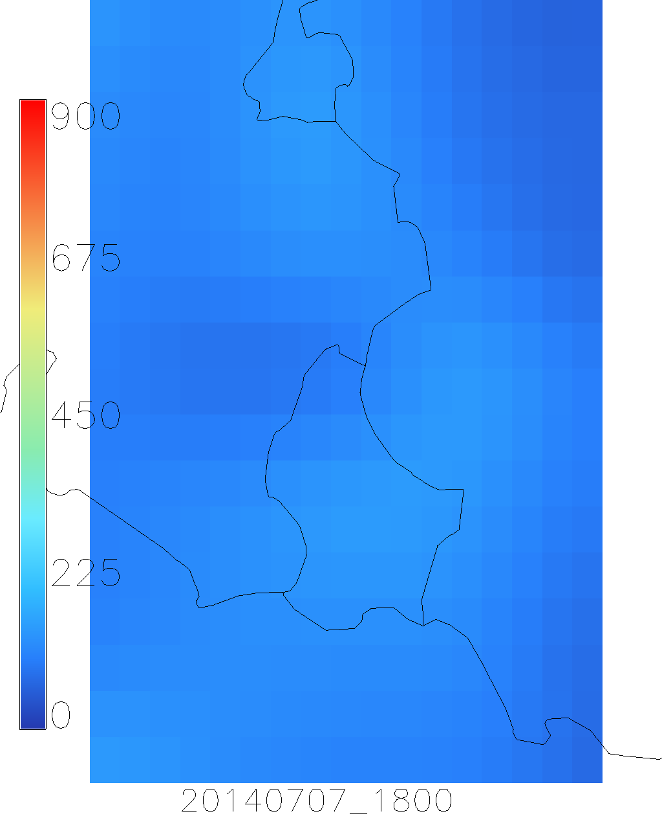
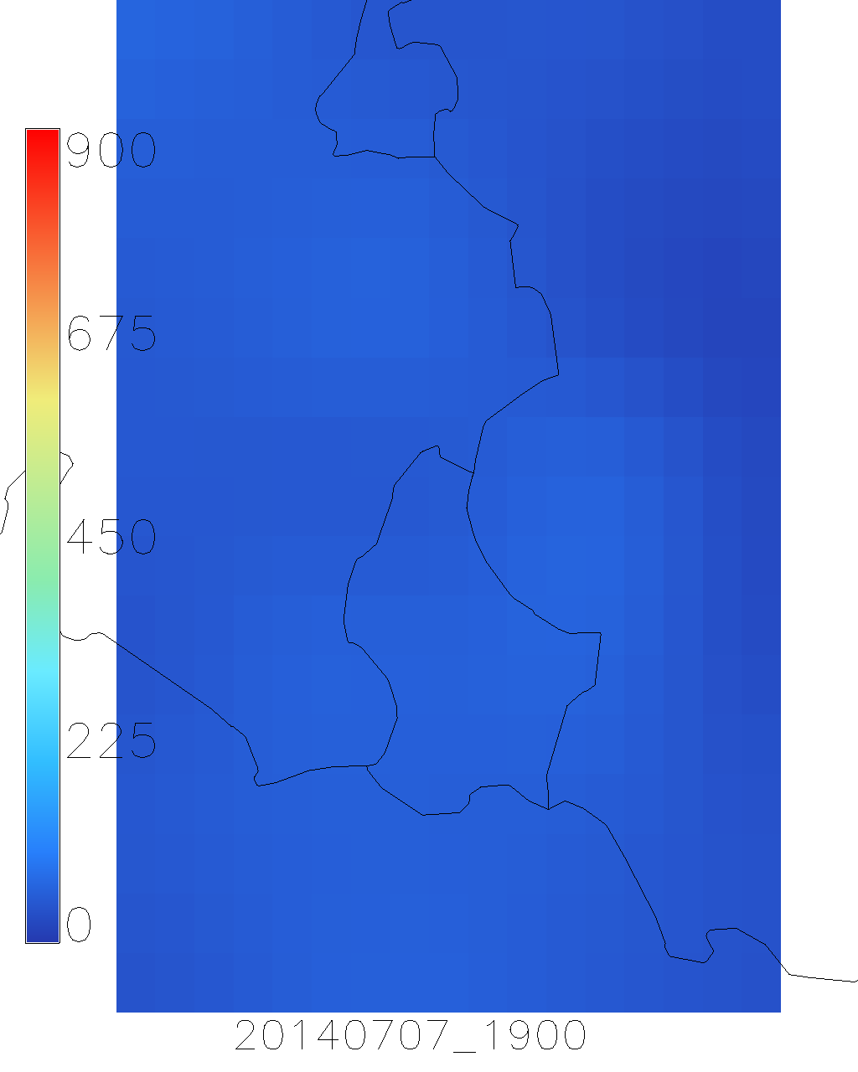
Notes:
0.125° x 0.125° -> 14x9km (?)

Slide 5
Individual forecasts for the reference systems
Global irradiance on inclined surface (G_{ψ})
Reflection losses (IAM factor)
T_{module} = T_{amb} + γ G_{ψ}
T_{module} = module temperature
T_{amb} = ambient temperature
γ = 0,020 for free standing PV systems
γ = 0,056 for building integrated PV systems
G_{ψ} = global irradiance in plane [W/m2]
η_{module} = f(T_{module} , η_{MPP} , G_{ψ})
Degradation losses = f(age)
2.5 % (within 1st year)
0.5 % / a (following years)
Missmatch losses
DC wiring losses = f (cabling scheme)
η_{Inv} = f (η _{partload} , η_{euro} , P_{PV arrays})
AC wiring losses = f (cabling scheme)
P_{sys Inv}

Slide 6
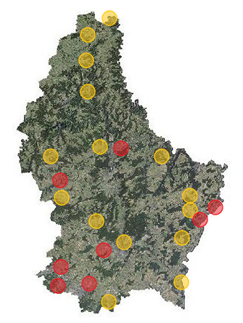
Reference systems
8 technically detailed reference systems (red)
15 synthetic reference systems (orange)
A total of 23 reference systems currently in use for the forecasting algorithm

Slide 7
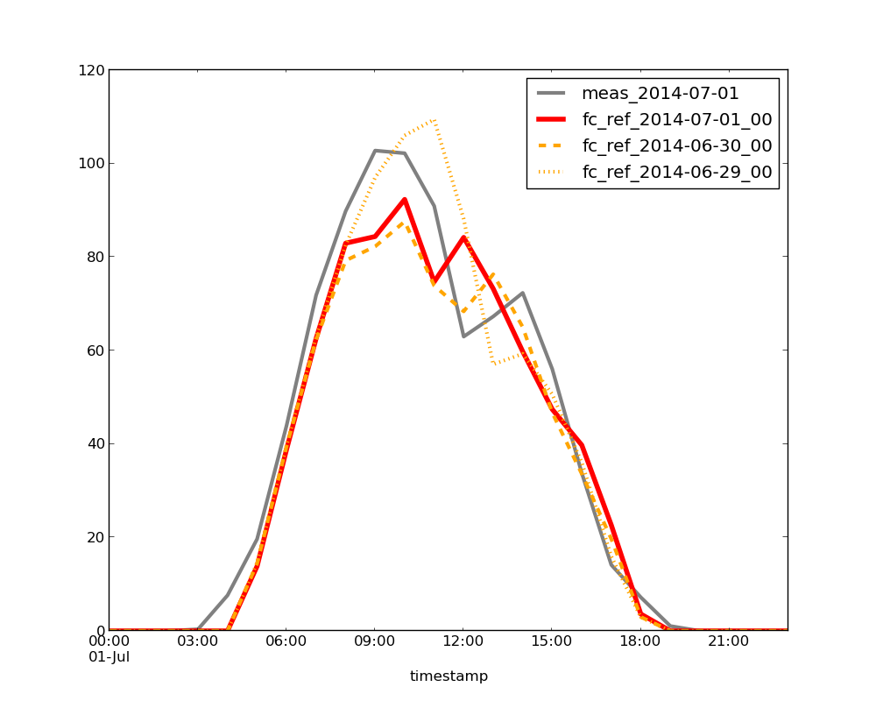
Example of an hourly forecast curve
[kW]
Example: 1st of July 2014, reference system Nr. 0067, showing the correlation of the three forecast horizons
(0-24h in red line / 24-48h in orange, dashed line / 48-72h in yellow, dotted line) and the measured values (grey line)

Slide 8
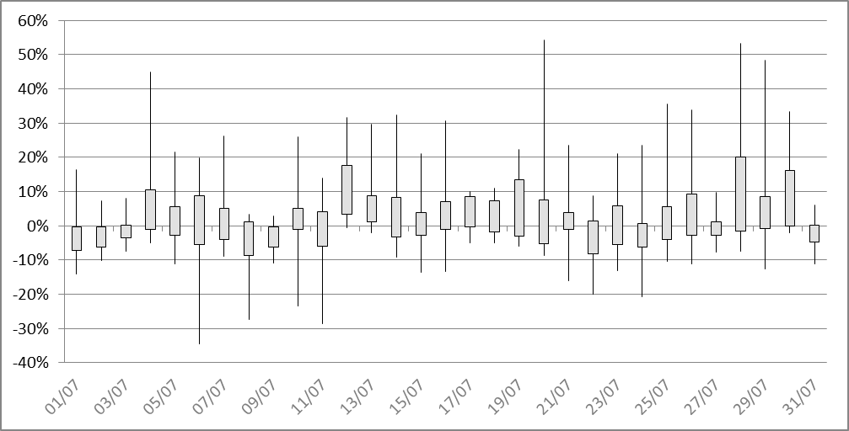
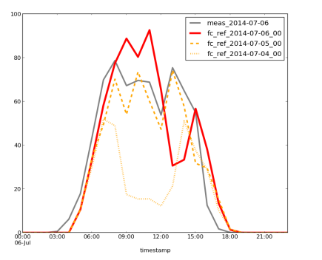

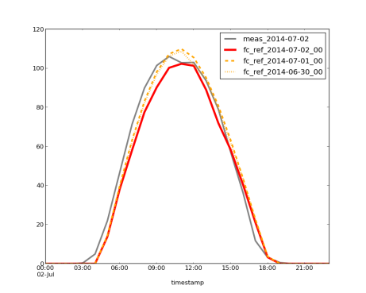
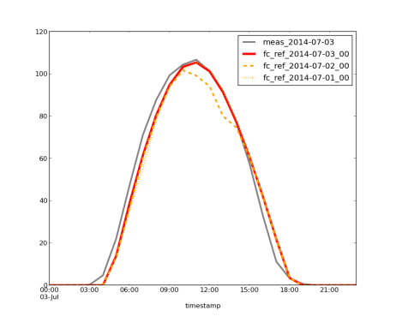
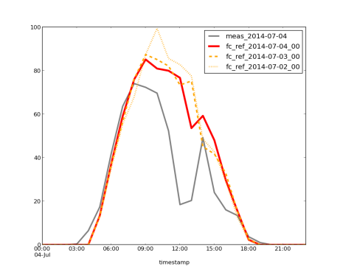
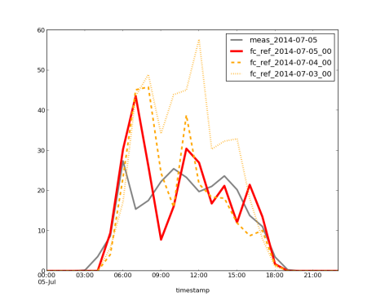
Example: hourly errors in daily plots
measured day x
fc of day x
fc day x-1
fc day x-2
Boxplot of the normalized error ε of the hourly forecast for reference system Nr. 0067 for July ’14
Example: six days in July 2014, showing the correlation of the three forecast horizons
(0-24h in red line / 24-48h in orange, dashed line / 48-72h in yellow, dotted line) and the measured values (grey line)

Slide 9
Example: hourly errors in daily plots
Boxplot of the normalized error of the hourly forecast for reference system Nr. 0067 for July 2014

Slide 10


Evaluation criteria of the performance of the forecasting model
Mean power – mean P
  mean value of the power in a certain time range, normalized to nominal power
Bias
  mean value of the error,
  normalized to nominal power
Root mean square error
  Gives higher weighting to larger deviations from the real value,
  suitable to power applications, where large error are
  disproportionally problematic (normalized to nominal power)
Day time values only – Suffix _{dt}
  Only forecast values different from 0 are considered, not to bias the evaluation criteria by trivial night time forecasts
  Performance can only be evaluated on individual PV system level – not country level
$$bias=\frac{1}{N}\sum_{t=1}^{N}{ε\left(t\right)}$$
$$RMSE=\frac{1}{\sqrt{N}}\sqrt{\sum_{t=1}^{N}{ε{\left(t\right)}^{2}}}$$

Slide 11
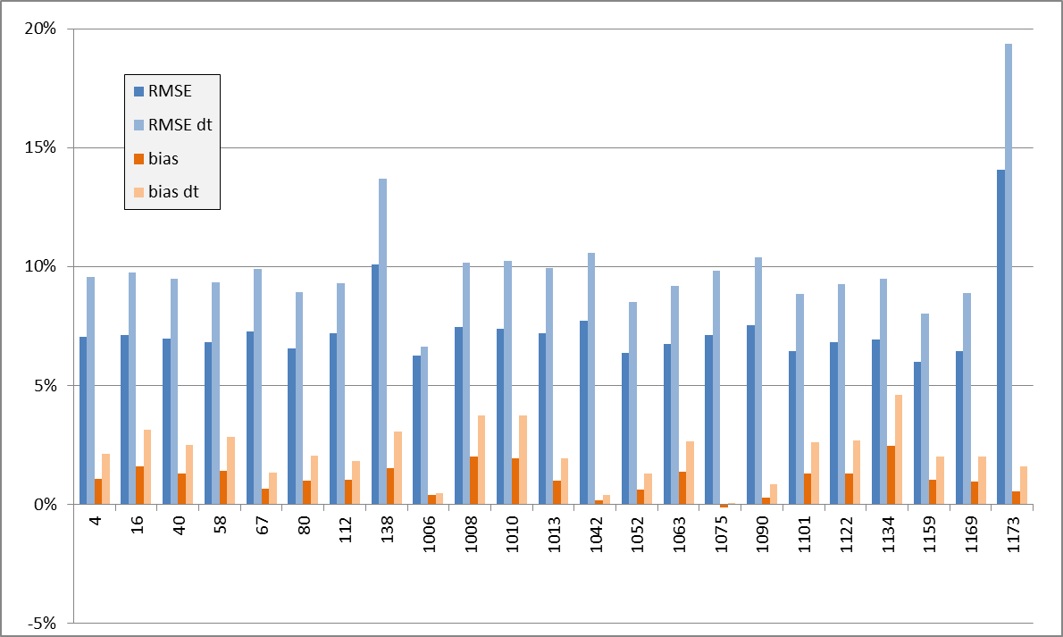
performance of the forecasting model for all reference systems over 2 years
Mean daily RMSE= 7.4% / RMSEdt= 10%
Mean daily bias= 1.1% / biasdt= 2.2%
mean evaluation criteria over 2 years (2014 & 2015) for the reference systems
Notes:
Mean daily RMSE= 7.4% / RMSEdt= 10%
Mean daily bias= 1.1% / biasdt= 2.2%

Slide 12
Forecast adaptations – two approaches tested
Adapting the short term forecasts based on measured deviations
Error persistence
Assuming that the deviations occurring at t_{n} would persist at time step t_{n+i}
Error movement vectors
Assuming that the deviations occurring at t_{n} , caused by improper forecasts of cloud movements, would propagate over the forecast region at time step t_{n+i}, with constant direction and time
12

Slide 13
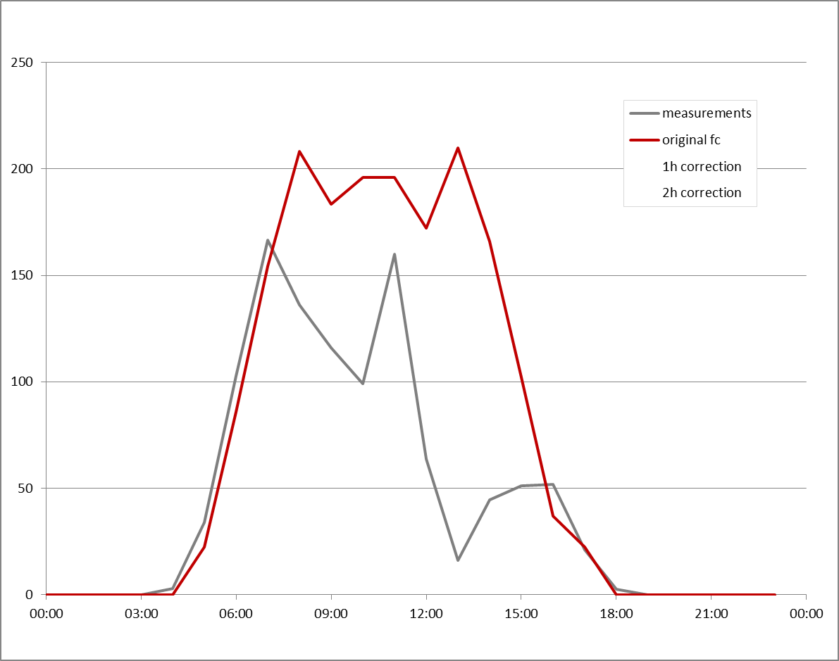
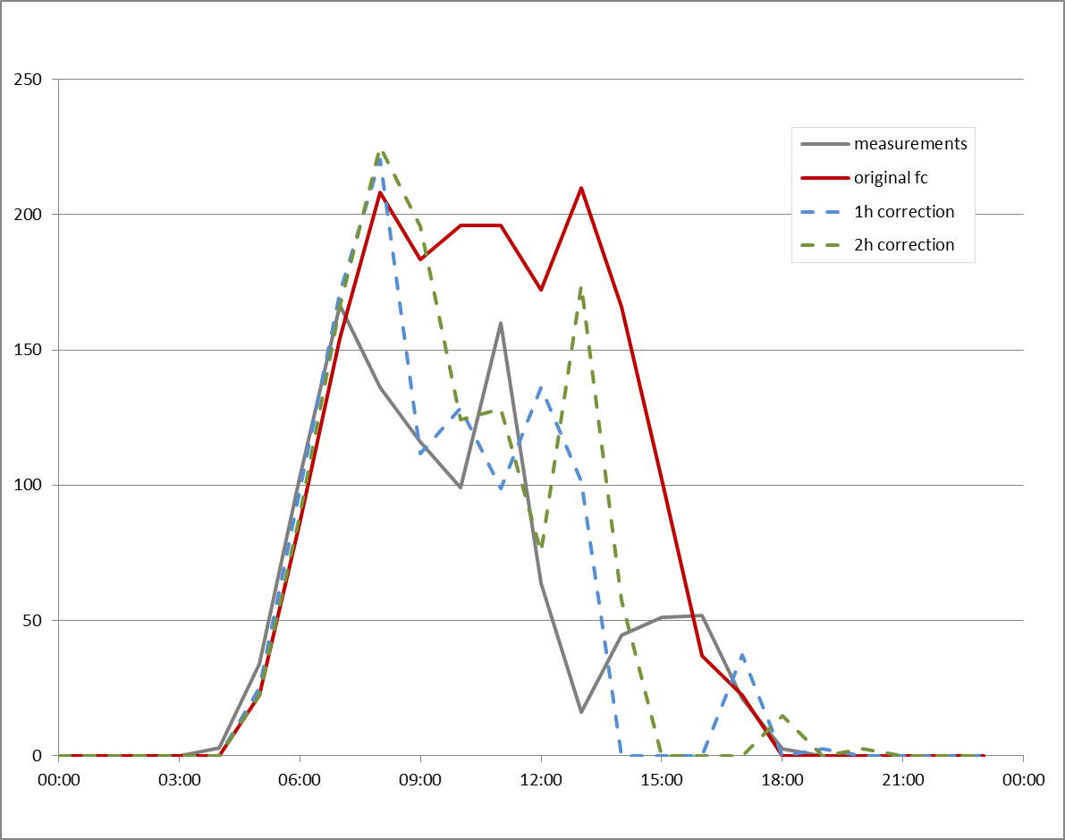
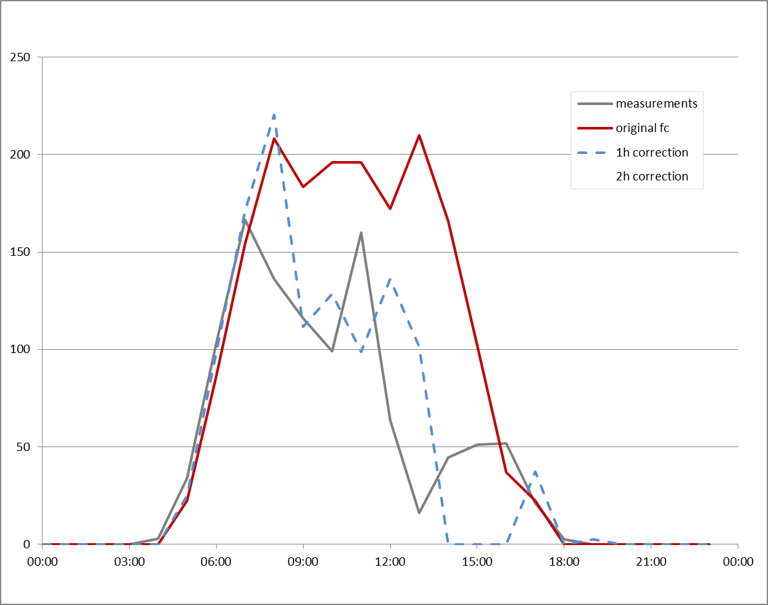
Forecast adaptations –
Correction by error persistence
[kW]
Example: 1st of May 2014, reference system Nr. 0067, showing the adaptation of the forecasts (red line), based on previously measured deviations (1 hour into the future (blue) / 2 hours into the future (green)) and the deviations from the measured values (grey line)
13

Slide 14
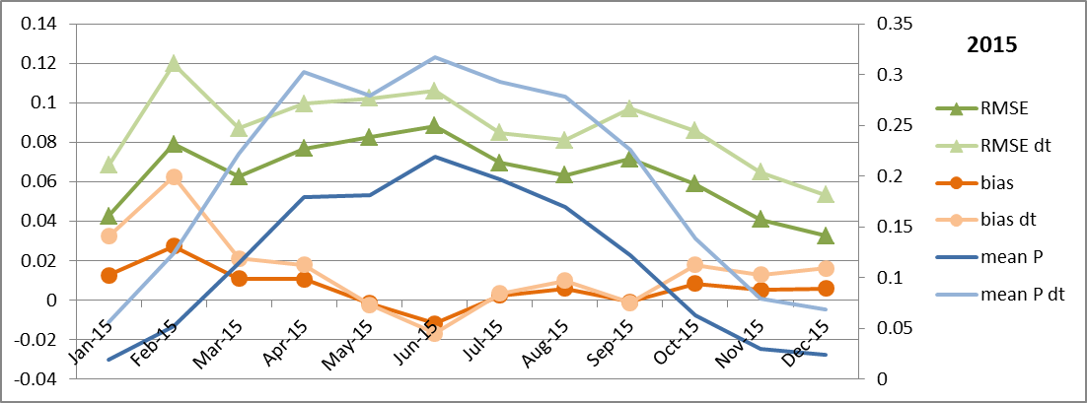
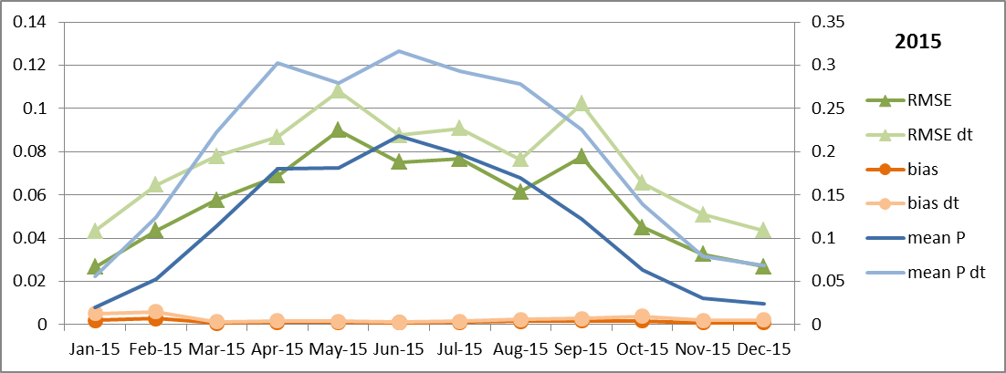
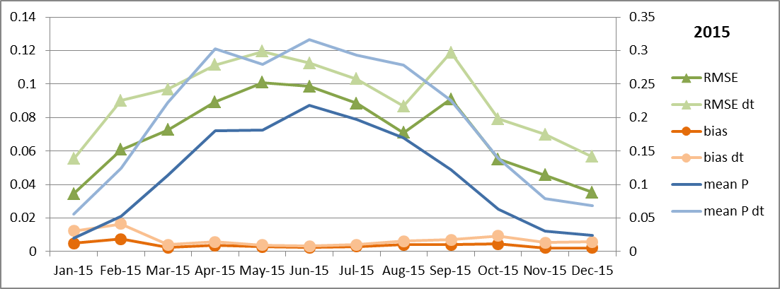
Correction by error persistence
No correction
1h correction
2h correction
Evaluation criteria on forecast accuracy for system Nr. 0080 in 2015 without correction based on error persistence (top), based on 1h error persistence (middle) and 2h error persistence (bottom)

Slide 15
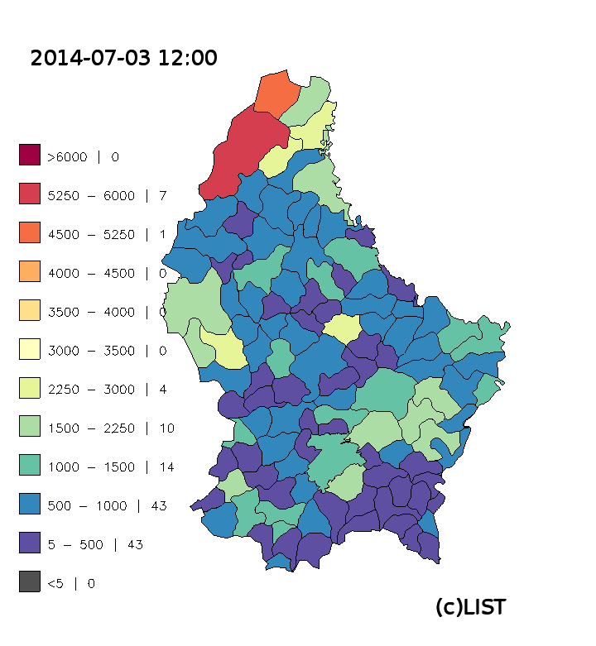
Forecasted PV power
Forecasted PV power [kWp] for 03.07.2014 12:00, aggregated per commune

Slide 16
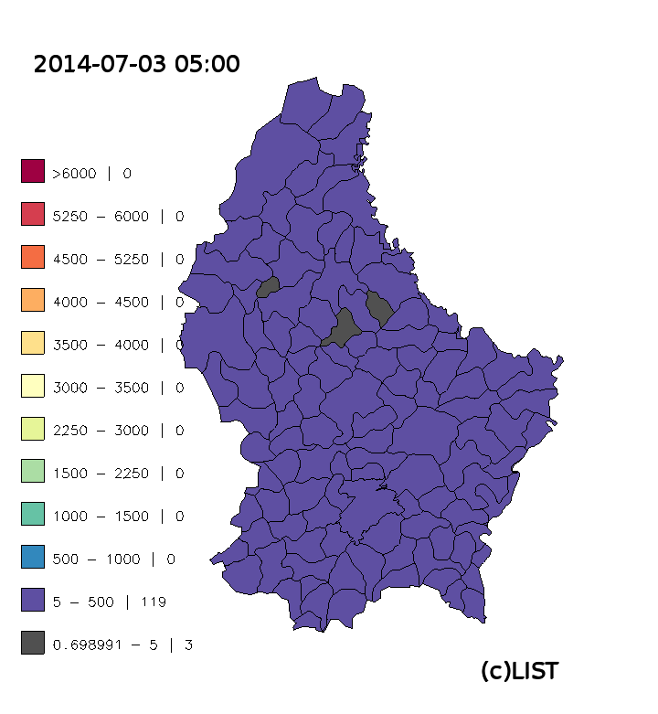
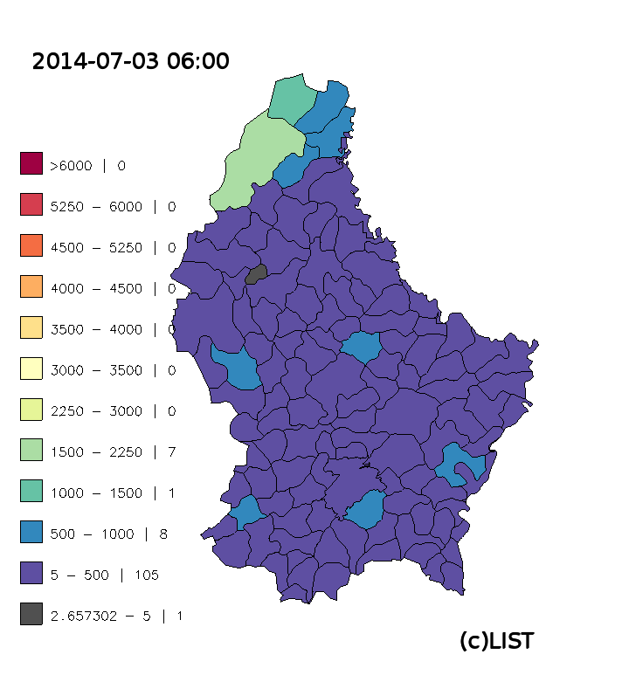
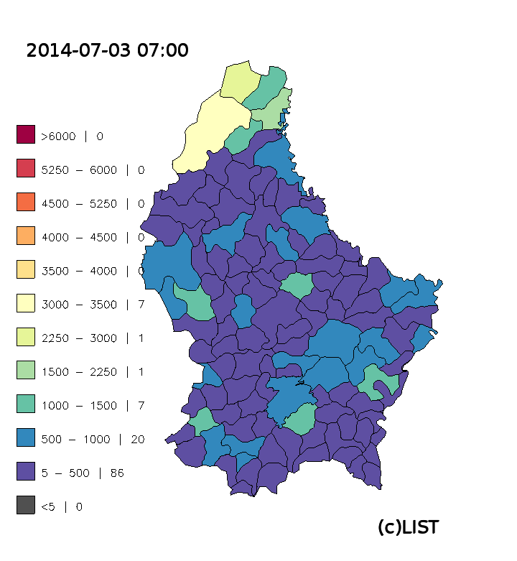
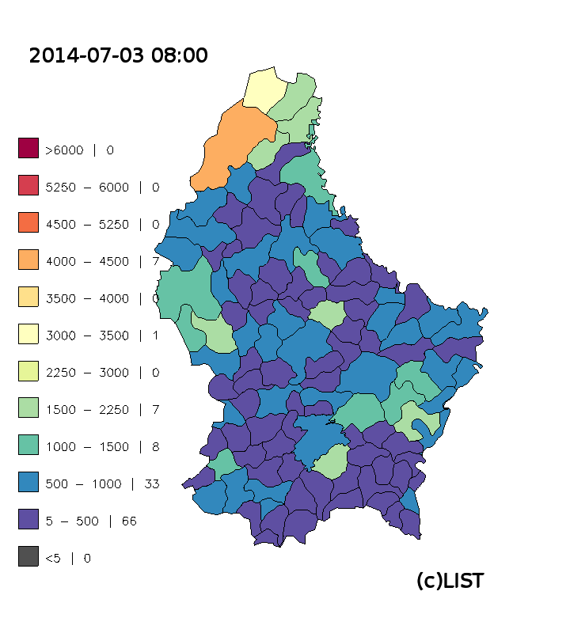
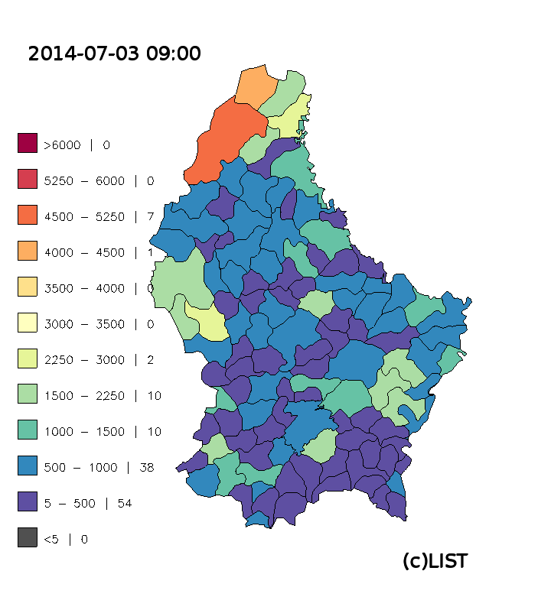

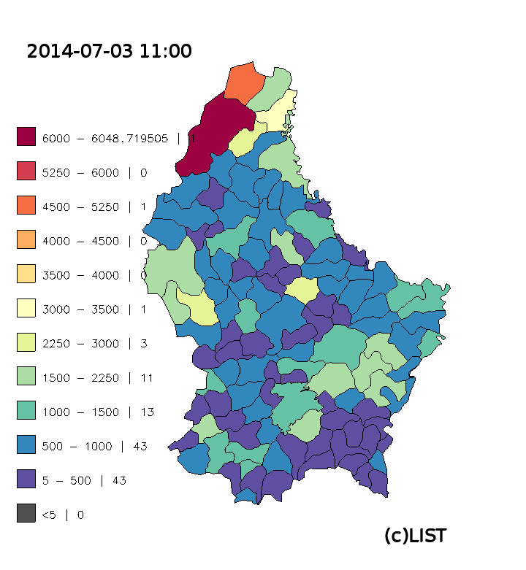
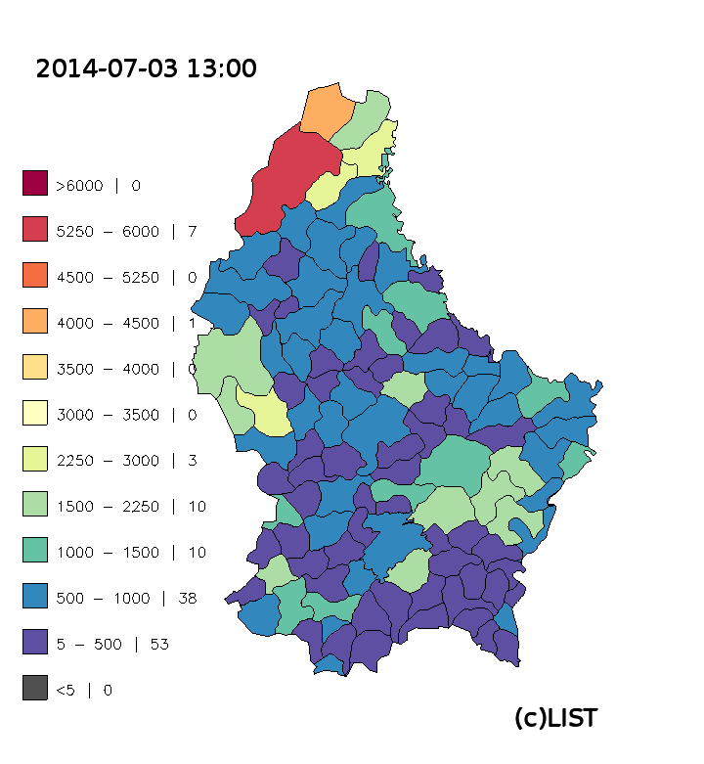
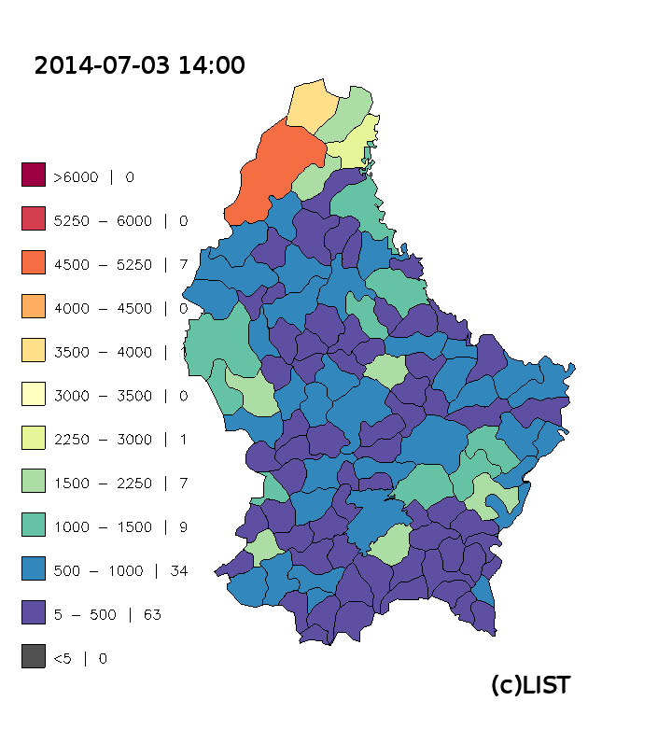
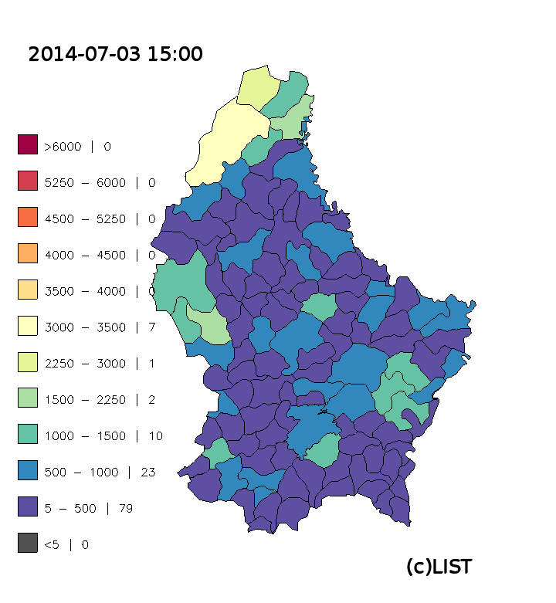
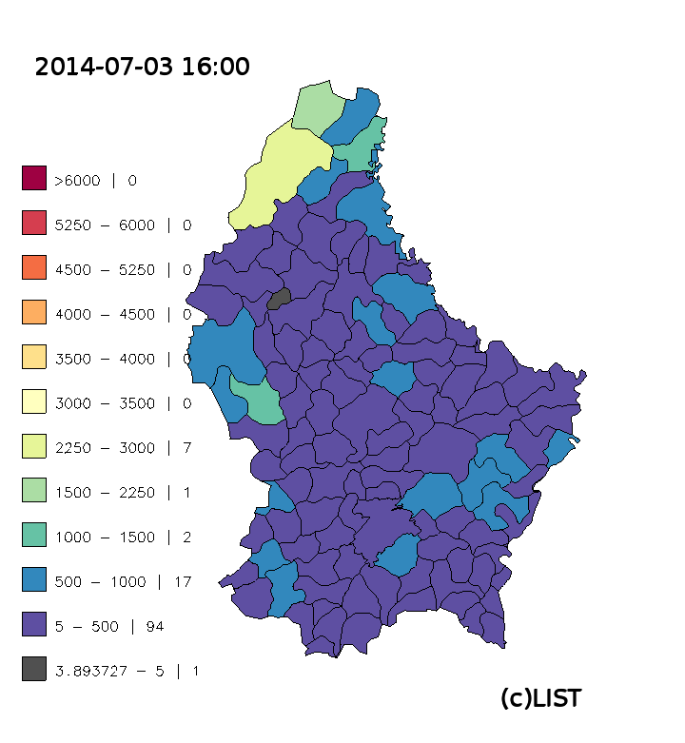
Hourly forecasted PV power (one day)
Animation
Sequence of hourly maps, illustrating the regionalized forecast of expected PV power, aggregated on communal level

Slide 17
Lessons learned / barriers to deployment
Photovoltaic power forecasting model for Luxemburg (combining NWP & performance model) –> good performance at evaluation on single sites
Characterisation & Modelling of photovoltaic installations successful
  on site characterisation – good results
  Virtual characterisation of existing PV installations (satellite images, …)
  => Simplified model with synthetic system profiles – works also well
Adaptation of system profiles and use of calibration factors improved forecast
two approaches to establish a feedback-loop in the forecast tested
  Error persistence – improves forecast, but only on short term forecast horizon (1-2h), systemic deviations (e.g. snow cover) can be effectively reduced
  Error movement vectors – improvement with current time resolution not possible.
Established a very representative statistical matrix, representing PV in Lux.
Upscaling procedure allows aggregation on different levels (currently communes); barrier for more detailed aggregation: knowledge on PV Systems characteristics
Implementation of the model currently in discussion
(shift from top-down to bottom-up model)
Notes:
NWP combi performance model, work well…
Mean daily RMSE= 7.4% / RMSEdt= 10%
Mean daily bias= 1.1% / biasdt= 2.2%
Synthetic profiles not much worse than detailed ones!
Feedback loop from existing PV systems as a reference could help to eliminate systemic errors such as caused by snow cover, but do only give added value on very short term time frame concerning other sources of error
“error movement vector” approach couldn’t be applied on coarse temporal resolution of 1 hour (NWP model) and coarse spatial res. of the NWP data
Upscaling can be done on rather detailed aggregation level. But degree of detail on level of PV systems is missing, esp. orientation and inclintion

Slide 18
Future improvements / implementation
The smart metering data available are not available close to “real time” – currently best case: the data for day x are available day x+1
deployment of the „smart meters“ started, but still ongoing
National data protection aspects hinder the implementation
Research project => provides algorithm development and validation – no „plug and play“ solution – further automation necessary
PV data set (nominal power / location) needs to be adapted to operator
Further development of the “error movement vector” method possible, if resolution (temporal & spatial) of NWP models increase
attribution of single PV systems to its transformers / distribution grid lines easily feasible – orientation and inclination necessary
Shift from point forecasting to probability forecasting envisaged

Slide 19
Thank you
for your attention !
Questions? Do not hesitate to contact me: daniel.koster@list.lu

