Slide 1

SHAR-Q in a nutshell
Stefan Vanya / Claudia Battistelli
ETIP-SNET Workshop
Aachen – September 19th 2017
This Project has received funding from the European Union’s Horizon 2020 research and innovation Programme under grant agreement No 636427

Slide 2

The Problem addressed by SHAR-Q
Energy consumers are becoming prosumers thanks to decreasing cost of renewable resources
The utilities take over the energy surplus the prosumers are generating
Prosumers can deploy energy storages to better utilize the yield of their renewable resources
Most of prosumers are away from home during the day when the power is generated
The economic viability of this option with large number of prosumers is questionable
Energy storages are expensive and therefore they are considerably increasing the overall unit-cost of self generated energy
however
however
however
SHAR-Q brings together prosumers with complementary consumption profiles and enables them:
  Utilization of overall self generation with much less storage capacities,
  And consequently, significant lowering of the overall unit-cost of self generated energy.

Slide 3
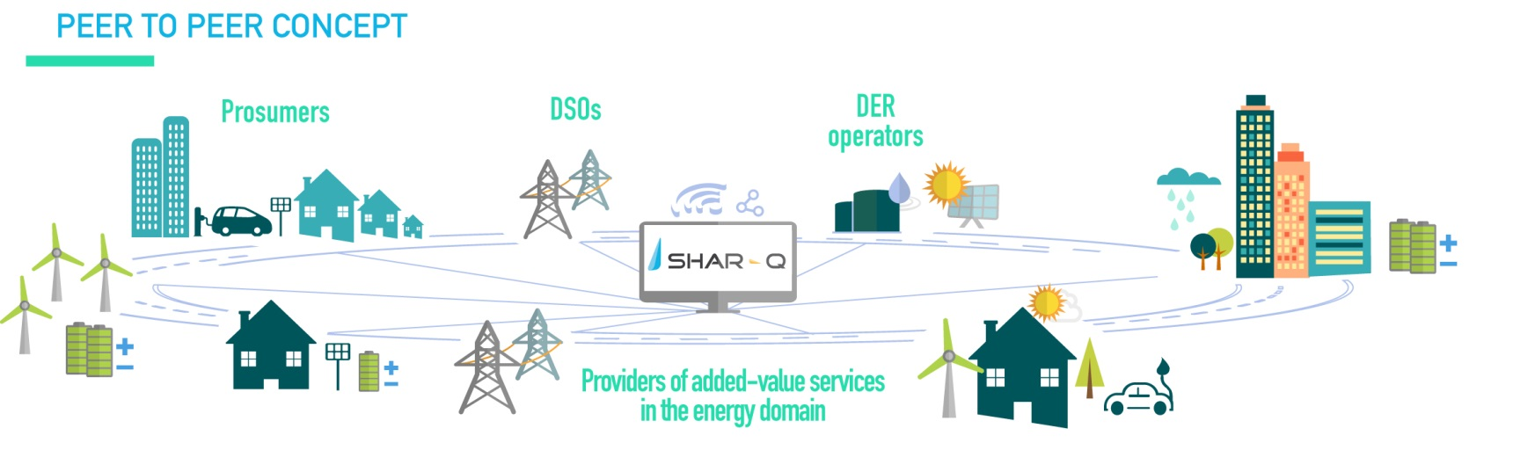
The SHAR-Q Overall Objective
The SHAR-Q project aims to build a distributed ecosystem that boosts the bottom-up collaboration among energy market players, with provision of peer-to-peer interoperability of smart energy components

Slide 4
Inspired by the success of social networks
Let’s create something similar for smart energy components, where:
In social media …
In the SHAR-Q concept …
energy sites with generation
and storage capabilities
Nodes
physical persons
Relationships
friendships
virtual neighborhoods
renewable generation units, storages,
e-vehicles, charging points, …
Shared objects
photos, videos, …
… and we can offer sharing-economy services over the connected energy components.

Slide 5
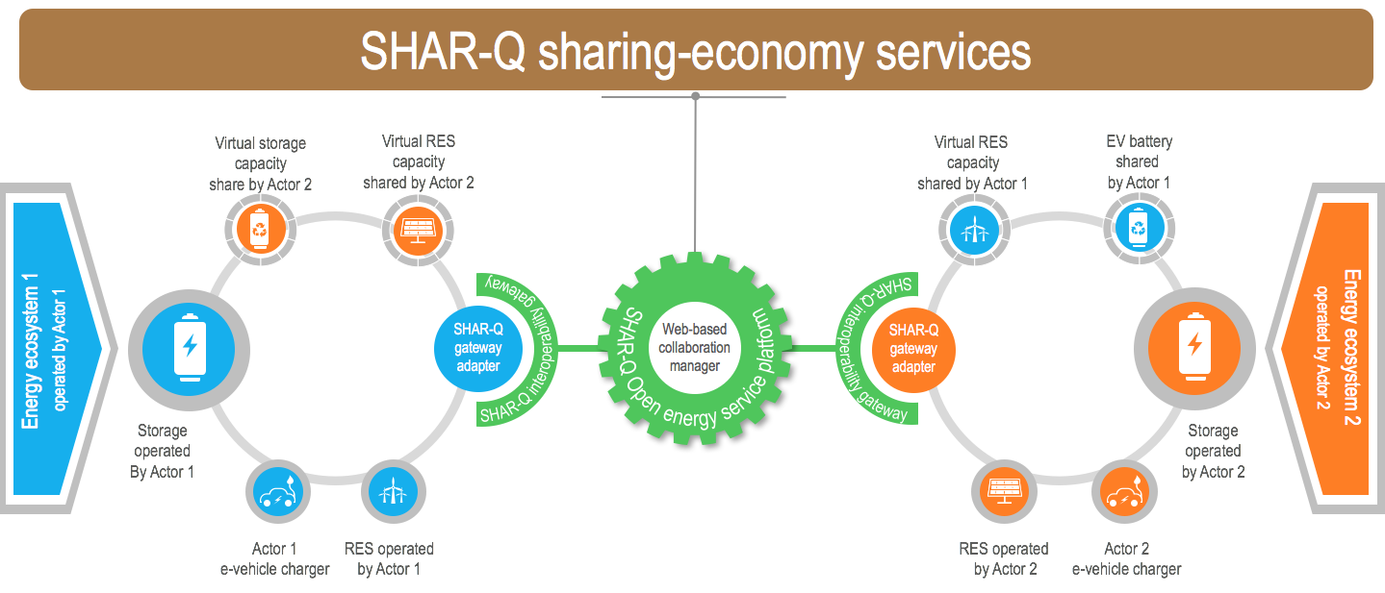
The peer-to-peer interoperability allows virtual neighbourhood of smart energy components

Slide 6
Sharing economy services per target groups
Prosumers coalitions:
Urban consumers:
DER operators:
E-vehicle owners:
SHAR-Q aims to release the potential of the high number small-scale energy infrastructures

Slide 7
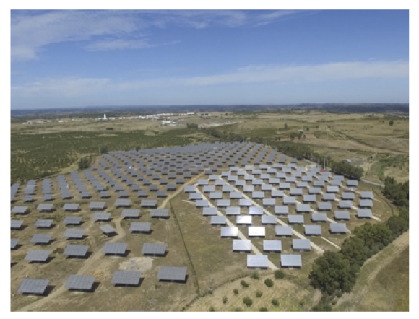
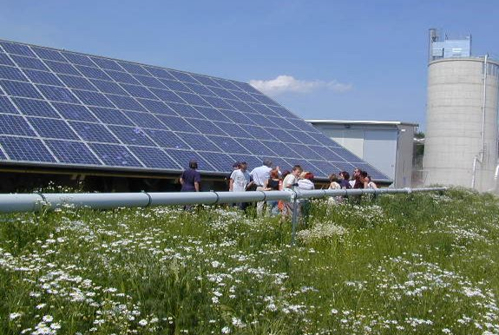
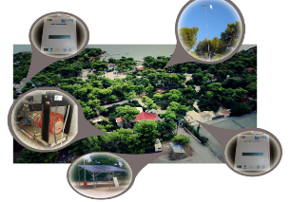
SHAR-Q Pilot Sites
Prosumer coalitions
DER operator
Guessing (AT)
Martim-Longo (PT)
EV owners
Meltemi (GR)

Slide 8
Critical SHAR-Q stakeholders
Beside the primary target groups, DSOs and ESCOs are of critical importance at the SHAR-Q scale up.
SHAR-Q will enable them:
  Offering services to their customers with added value,
  Mitigation of operational issues (improved balancing),
  Deferral of investments at upgrading grid components,
  Offering specific energy services such as dynamic pricing.
The SHAR-Q consortium is committed to bring attractive offerings to DSOs and ESCOs to engage them in the SHAR-Q platform and services.

Slide 9








The Consortium
ATOS | Spain, Czech R.
bAvenir s.r.o. | Slovakia
Ubimet | Austria
Enercoutim | Portugal
Europäisches Zentrum für Erneuerbare Energie Güssing GmbH | Austria
Basque Energy Cluster | Spain
Rheinisch-Westfälische Technische Hochschule Aachen | Germany
Institute of Communication and Computer Systems | Greece
DEDDIE – Greek National DSO | Greece
Energie Güssing GmbH | Austria

Slide 10
Project Status and Plan
Timing | Milestone | Status
11/2016 | Project kick-off | Done
07/2017 | Analysis of drivers, barriers and requirements | Done
10/2017 | Design of architecture and processes | Ongoing
04/2018 | Implementation of the core | Ongoing
10/2018 | Lab testing & integration of pilots | To do
04/2019 | Implementation of sharing-economy services | To do
08/2019 | Validation at pilots | To do
10/2019 | Final evaluation & Update of business models | To do
The SHAR-Q roll-out is planned in years 2019-2020

Slide 11
Factors, influencing the realization of SHAR-Q impact:
SHAR-Q Analysis results (1):
Drivers
Barriers
New EU package “Clean energy for all”,
Decreasing cost of smart energy components,
Expected massive growth of e-mobility,
Progress in smart components standardization.
Wide variety of incompatible communication standards,
Lack of stakeholders’ collaboration (contradicting plans and motivations),
Dependencies with traditional utilities,
Rigid regulations for grid operation.

Slide 12
Challenges in decentralized environments:
SHAR-Q Analysis results (2):
Security requirements,
  Preserving the integrity of the grid,
  Accountability tracking and enforcement,
  Exclusivity of resource allocations;
Privacy challenges,
  GDPR compliance,
  Consent management;
Tracking data ownership,
Trusted measures for energy billing.
Need for further R&I:
These challenges might be resolved with blockchain !

Slide 13
The next steps
Integration of pilots into SHAR-Q cloud platform & Lab testing:
Testing of SHAR-Q technical interoperability in E.ON ERC ACS RWTH labs, with technical integration and simulation of Smart Energy Facilities (SEFs) at pilot sites
Following activities are planned:
  Development and Implementation of SHAR-Q gateway adapters to connect SEFs and SHAR-Q cloud
  Planning, specification and execution of lab-testing with interface simulators of Smart Energy Components within the SEFs
  Review of the whole integrated system (SHAR-Q platform with pilots) for compliance with security requirements.

Slide 14
SHAR-Q strategy to scale-up
The SHAR-Q consortium is committed to bring attractive offerings to DSOs and ESCOs to engage them in the SHAR-Q platform and services.
  They are supposed to help us reach the primary SHAR-Q target groups:
    Prosumers,
    DER operators,
    Operators of e-vehicle charging points.
The implementation of “Clean Energy for all Europeans” package in the national regulations is supposed to act as a principal enabler of the SHAR-Q scale-up.

Slide 15


Thank you
Questions
Stefan Vanya stefan.vanya@bavenir.eu
Claudia Battistelli CBattistelli@eonerc.rwth-aachen.de
9/18/17
All rights reserved to the SHAR-Q consortium.
http://www.sharqproject.eu
15

