Slide 1

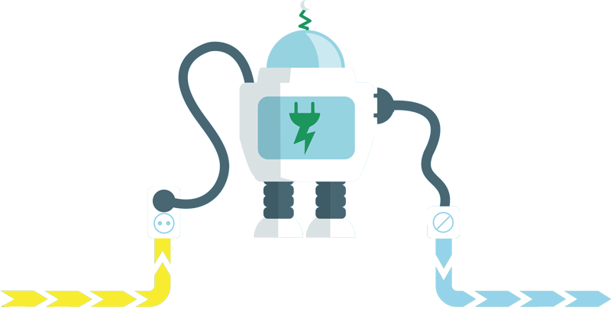


Slide 2
SAVE project - Smart use of own produced electricity by SMEs : opportunities in agriculture
Marleen Gysen, Innovatiesteunpunt
Presentation by
Jeroen Büscher, VITO/EnergyVille

Slide 3
Content
Project SAVE
Sectoral approach
Battery energy storage in agriculture

Slide 4
Content
Project SAVE
Sectoral approach
Battery energy storage in agriculture

Slide 5
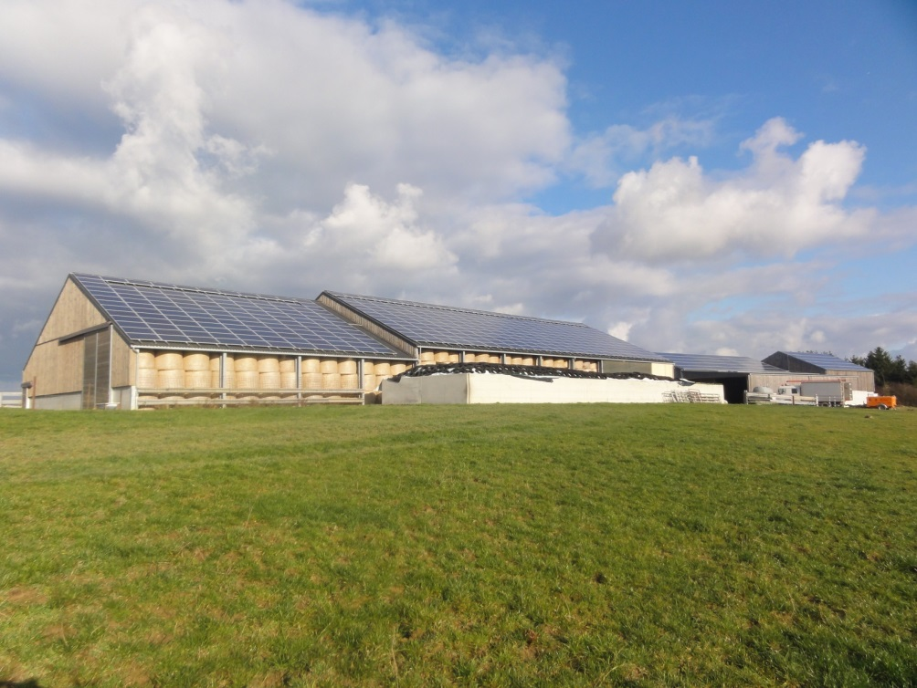
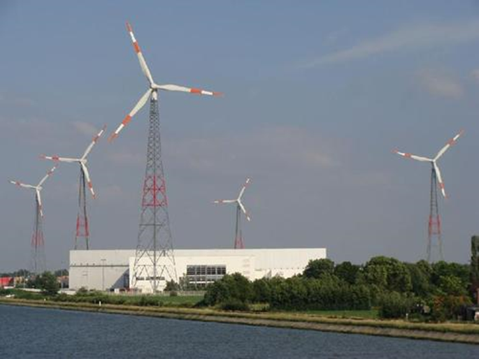
Why SAVE?

Slide 6
Consumption ↔ production
Maximum use of own produced electricity
  shift of electricity consumption
  buffering surplus energy with installed assets
  battery energy storage
Peak shaving

Slide 7










Online QuickScan & other simulation tools
Demonstration sites
Consultancy & implementation at SMEs
Dissemination & training

Slide 8
Content
Project SAVE
Sectoral approach
Battery energy storage in agriculture

Slide 9
Importance of energy profiles
How much electricity is needed? When?
  Day/Night (energy tariff)
  Seasonal dependence
  Power peaks (in relation with peak capacity and energy tariff)
  Baseload
Determination of flexible electricity consumption

Slide 10
Dairy farm

Slide 11
Fruit farm

Slide 12
Flexible processes
Cooling (buffer – indirect cooling)
Pumps
Hot water production
… (sector dependent)

Slide 13
35°
10°
Pre-cooler
Heat-recuperation
20°
40°
Winning
Cooling (buffer)
Production warm water (buffer & shifting)
Lighting
Others
Vacuum pump and milk pump
4° (1-4°C)
80° (80-95°C)
TL, led, high pressure
(NR) Manure robot
Every 3 days empty tank
2x/day cooling
Continuous low cooling
(R) Boiler
12 kWh/1000liter
1-6 kW
8-12 MWh/year
4-6 MWh/year (recup)
2 kW/200 l boiler
Control night tariff
Ground water pump
(NR) Milk tank
(R) Ice bank
Cleaning tubes
Cleaning tank
Milk calving
10 kWh/1000liter
1,5-3 kW
LEGEND
Red: not flexible
Green: flexible
80°
80°
40°
Process
2x/day
100 liter
2,5x/week
60 liter
2x/day
40 liter
Bound. con.
Technology
Consumption and power

Slide 14
Content
Project SAVE
Sectoral approach
Battery energy storage in agriculture

Slide 15
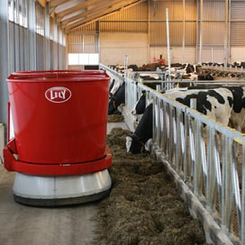
Batteries in agriculture
Self-loading applications (e.g. feeders)
Electric vehicles
Battery energy storage

Slide 16
Batteries in agriculture
Back up
Peak shaving
Increased self-consumption

Slide 17
Simulations dairy farm
Energy consumption: 50.000 kWh/year
PV: 50 kWp
Battery: 20 kWh

Slide 18
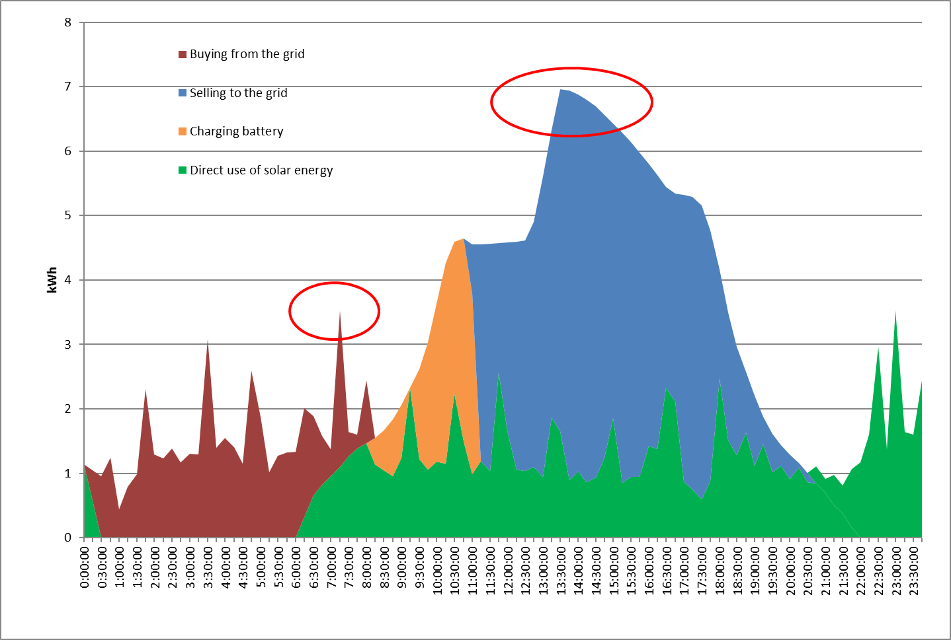

Slide 19
Simulations fruit farm
Energy consumption: 50.000 kWh/year
PV: 50 kWp
Battery: 20 kWh

Slide 20
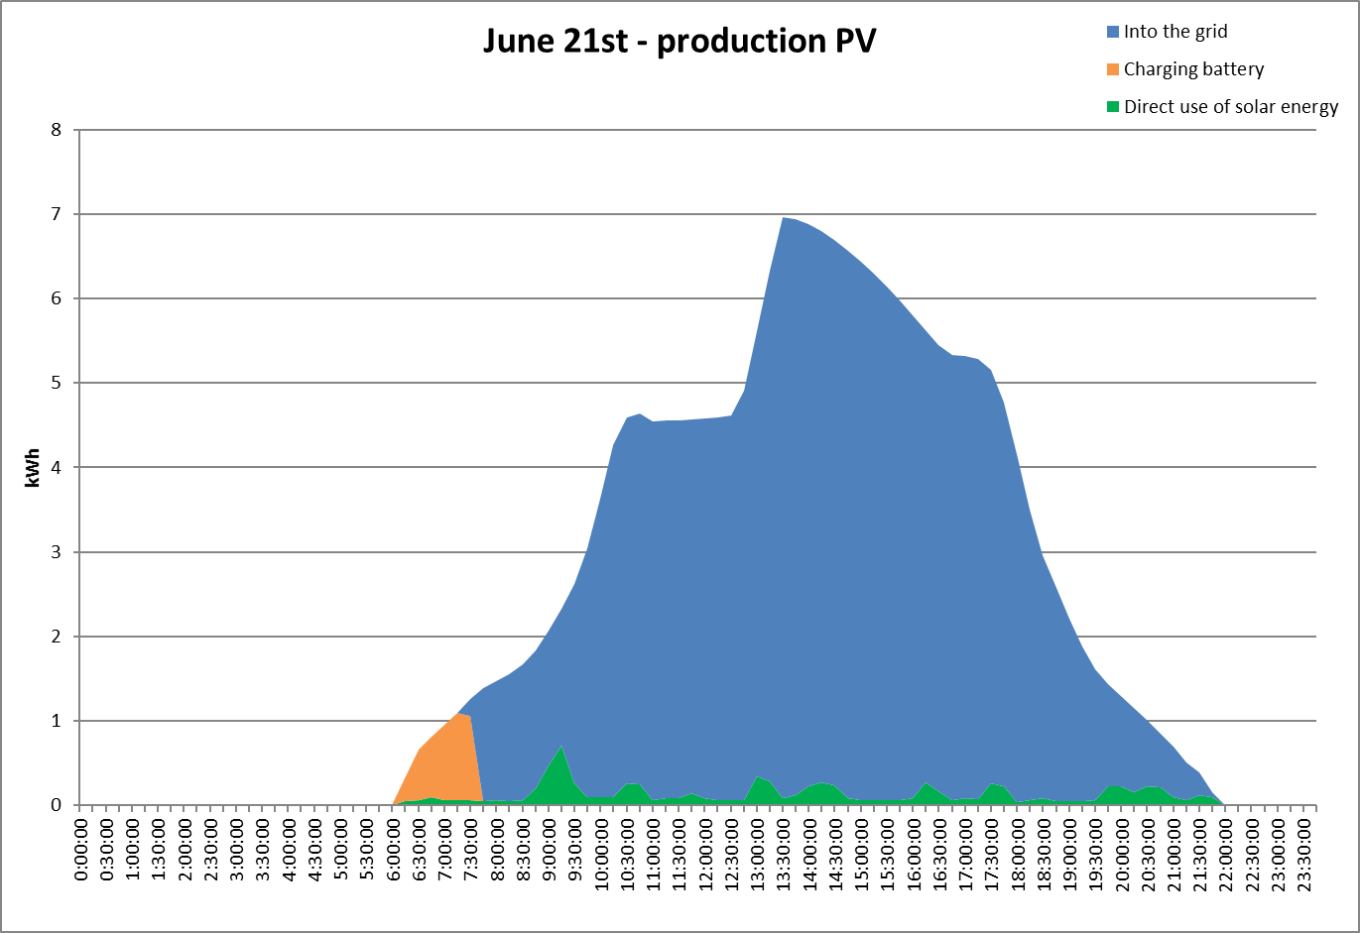

Slide 21
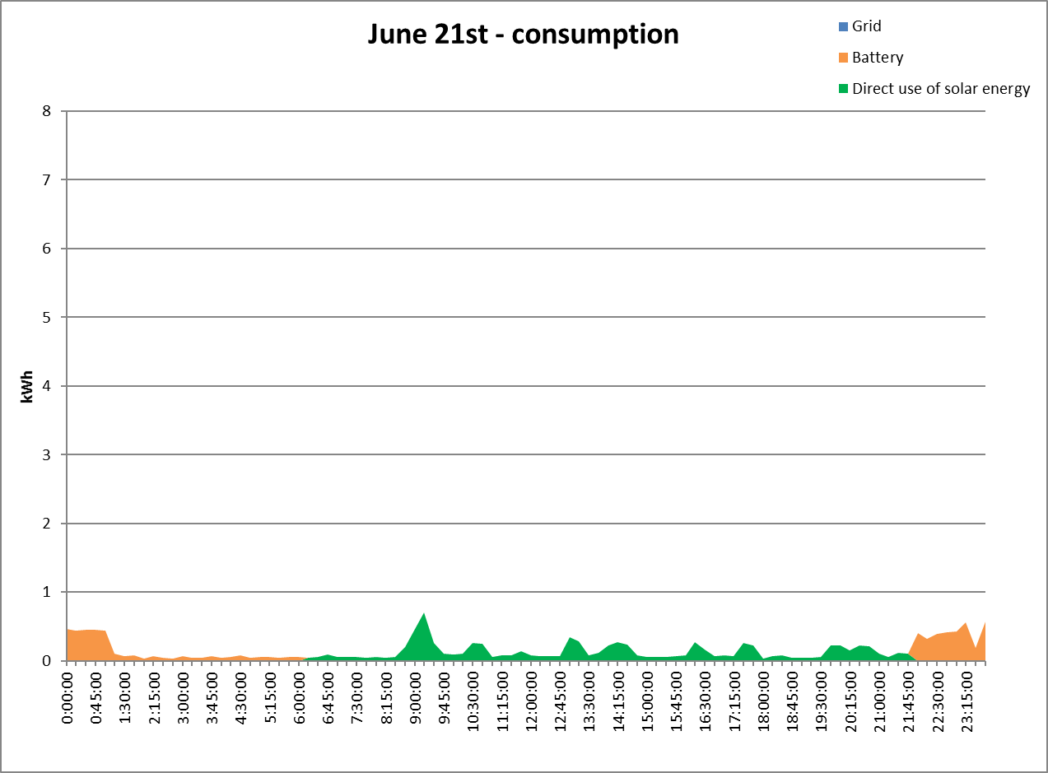

Slide 22
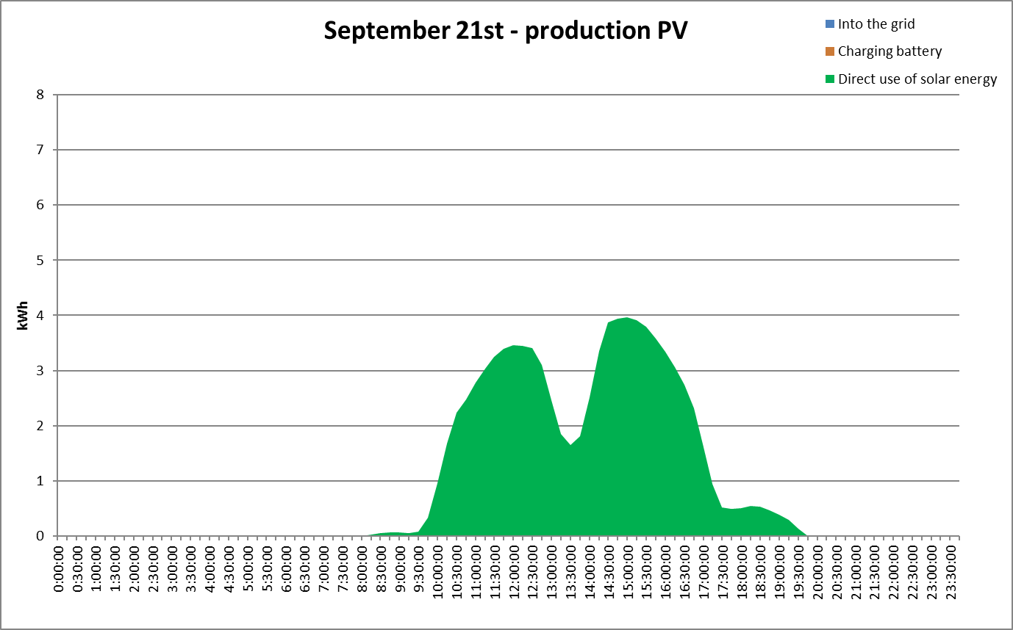

Slide 23
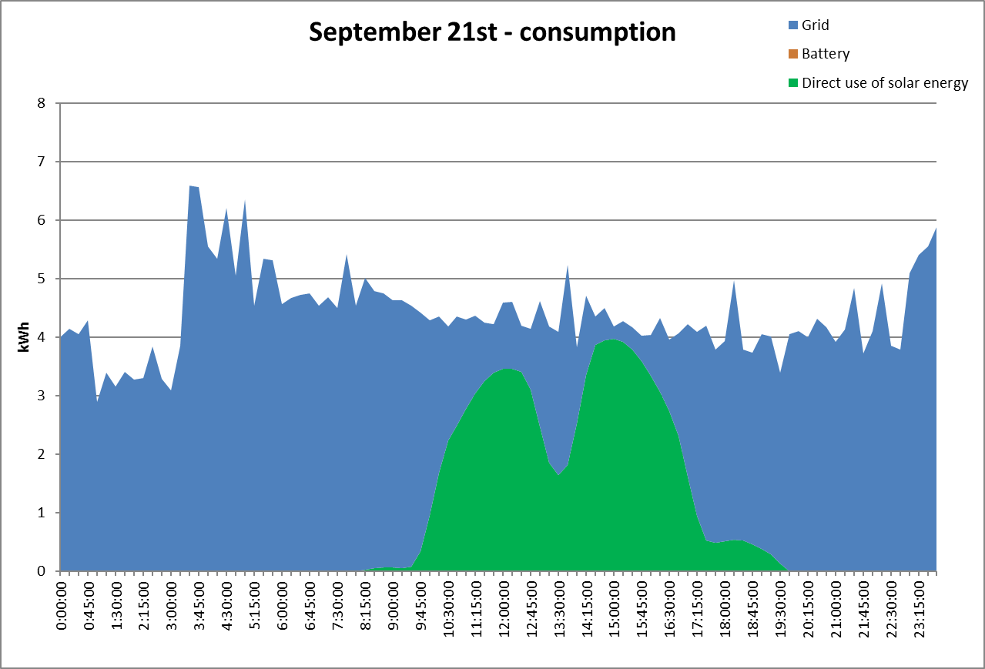

Slide 25
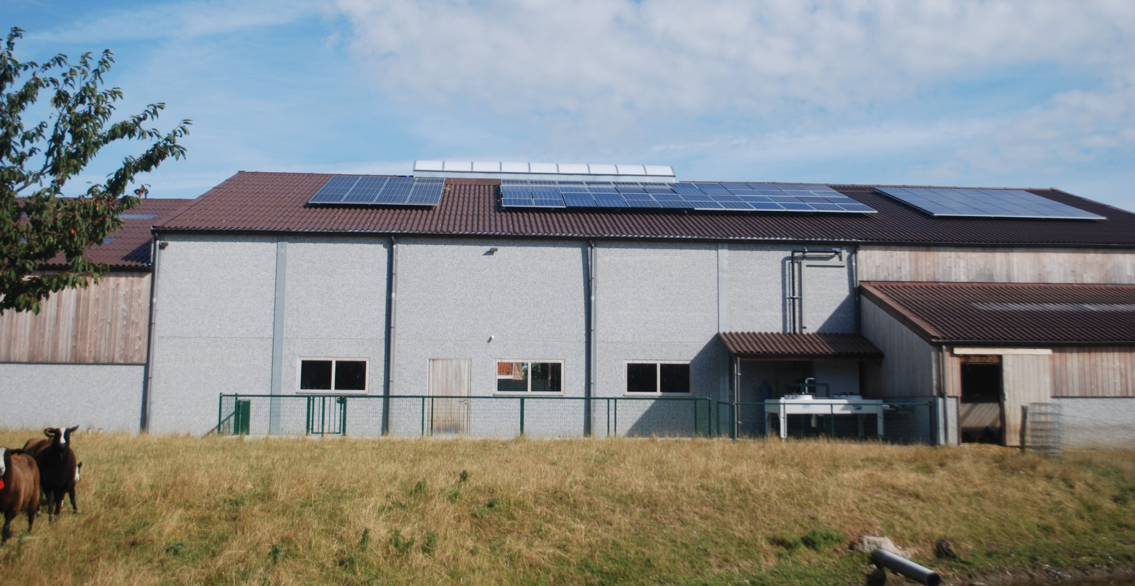
Demonstration site Inagro

Slide 26
18 000
PV
in kWh/year
10 000
8 000
Grid
Cooling, washing
35 000
45 000

Slide 27
Battery system
Inverter: 3 x 4,6 kW
Battery: 3 x 6,9 kWh
  3 kWh for back up
  17,7 kWh for increasing self-consumption
Off grid: some consumption will be switched off

Slide 28
Main lessons learned
A lot of interest – a lot of questions
Very hard to come up with a generic solution
Barriers:
  Lack of knowledge on technical potential of DSM + storage
  Lack of knowledge on investment costs and risks
  Training for technical installers

Slide 29
Next project steps
Running 3 demonstration sites
  Showing working principles
  Create confidence for different sectors
Advanced exercise on economical value of DSM + storage for SME’s
No need for extra R&I activities at this level
  Required technology is there
  Energy management solutions on the market
  It’s more about bridging the gap between addressable market
  and technology

Slide 30
Deployment prospects
QuickScan tool + handbook for SME’s
  First advice on DSM + storage possibilities
  Online
  Regional/sectoral workshops
Training for installers

Slide 31
More info?
marleen.gysen@innovatiesteunpunt.be
www.innovatiesteunpunt.be
www.slimaansturenvanelektriciteit.be
@IWTSAVE

