Slide 1
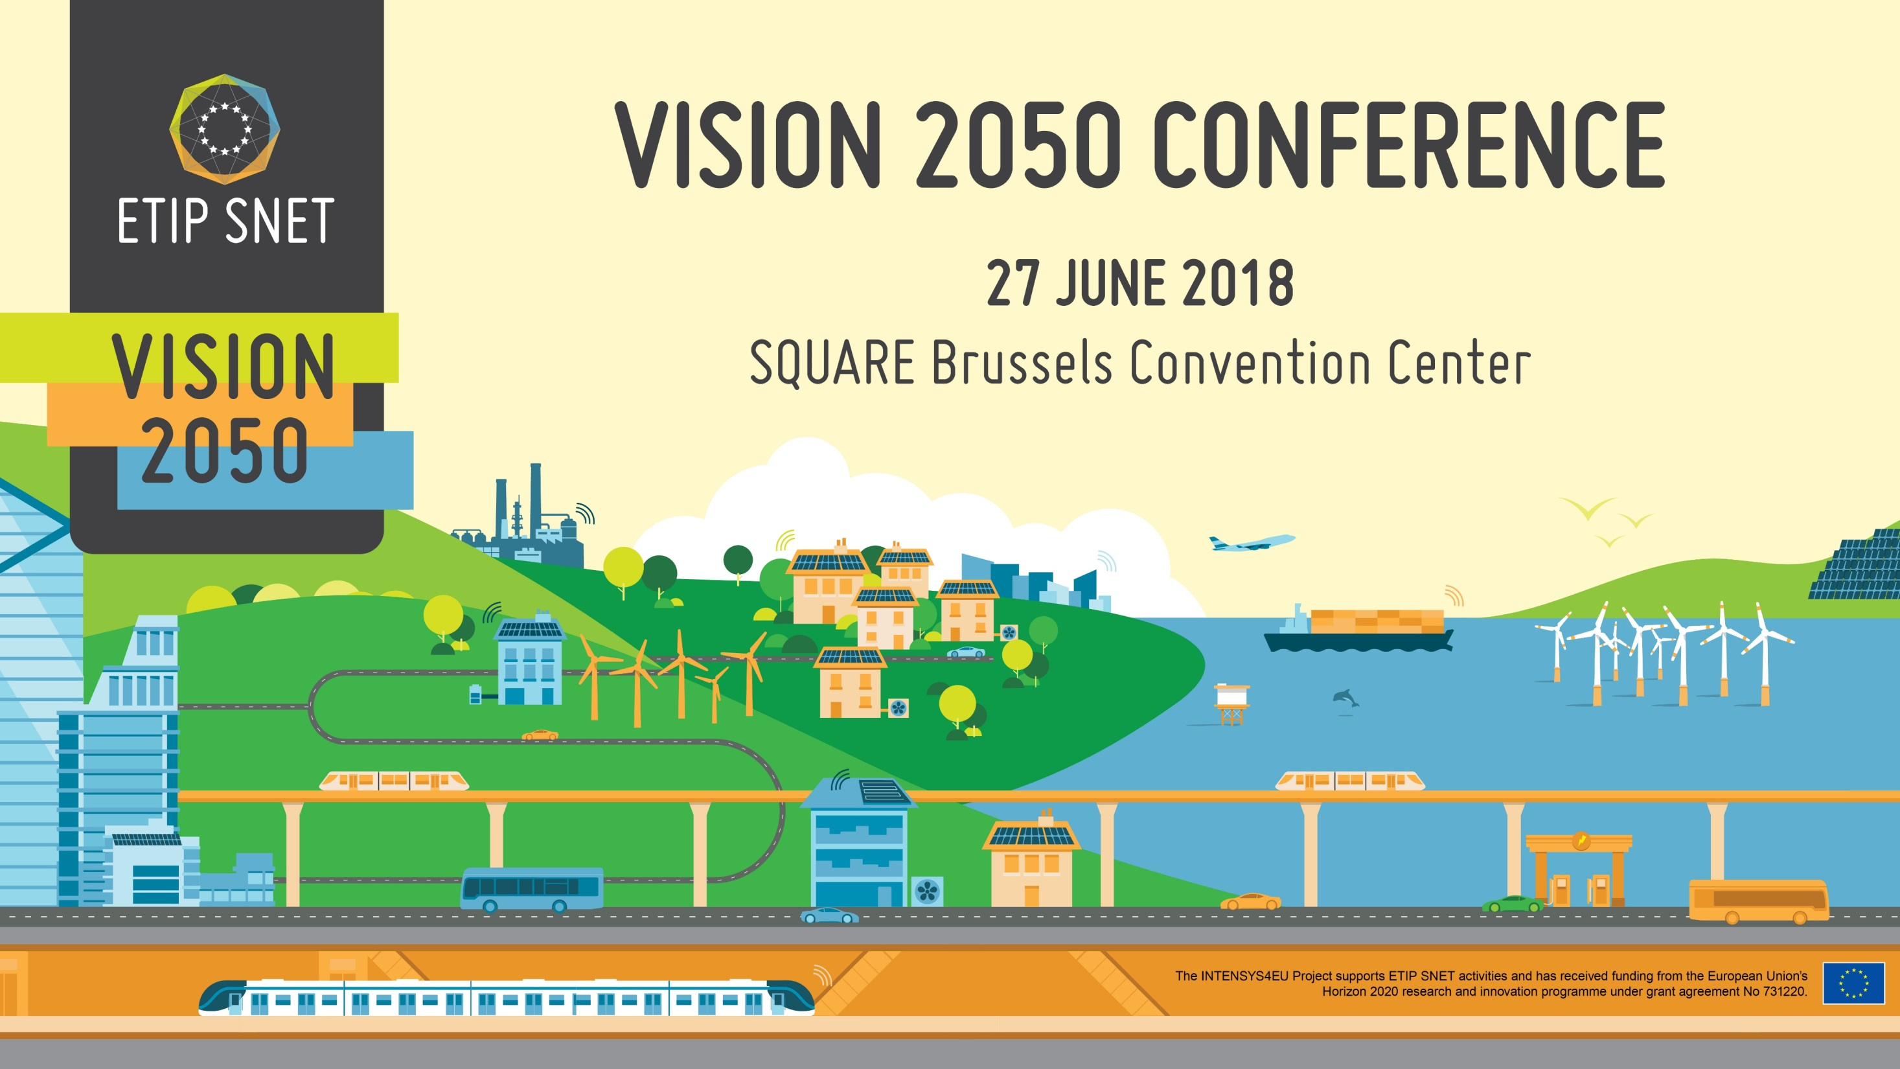
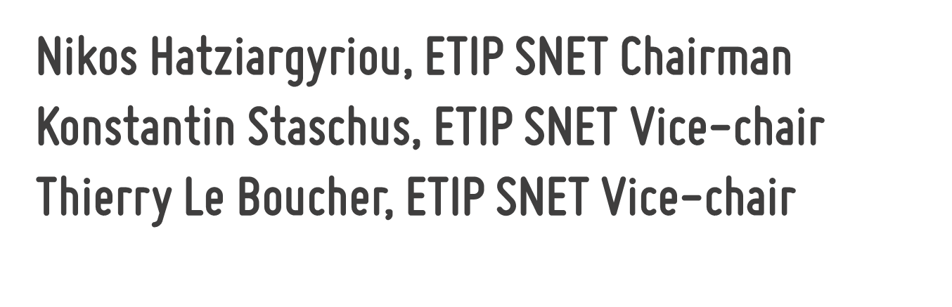

Nikos Hatziargyriou, ETIP SNET Chairman
Konstantin Staschus, ETIP SNET Vice-chair
Thierry Le Boucher, ETIP SNET Vice-chair

Slide 2





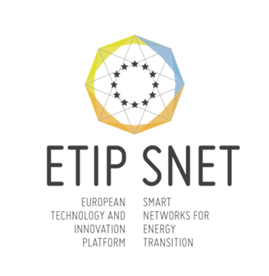
A new focus on innovation / implementation and on sector coupling
Main objective is to address the innovation challenges in energy system and market evolution necessary for achieving climate protection and renewables integration with affordability and security of supply ... beyond smart electricity grids (whole energy system)
2016

Slide 3

Set-out a vision for RD&I for Smart Networks for Energy Transition and engage stakeholders in this vision.
Prepare and update the Strategic Research and Innovation Roadmap.
Report on the implementation of RD&I activities at European, national/regional and industrial levels.
Provide input to the SET Plan action 4 which addresses the technical challenges raised by the transformation of the energy system.
Identify innovation barriers, notably related to regulation and financing.
Develop enhanced knowledge-sharing mechanisms that help bring RD&I results to deployment.
Prepare consolidated stakeholder views on Research and Innovation to European Energy Policy initiatives.

Slide 4

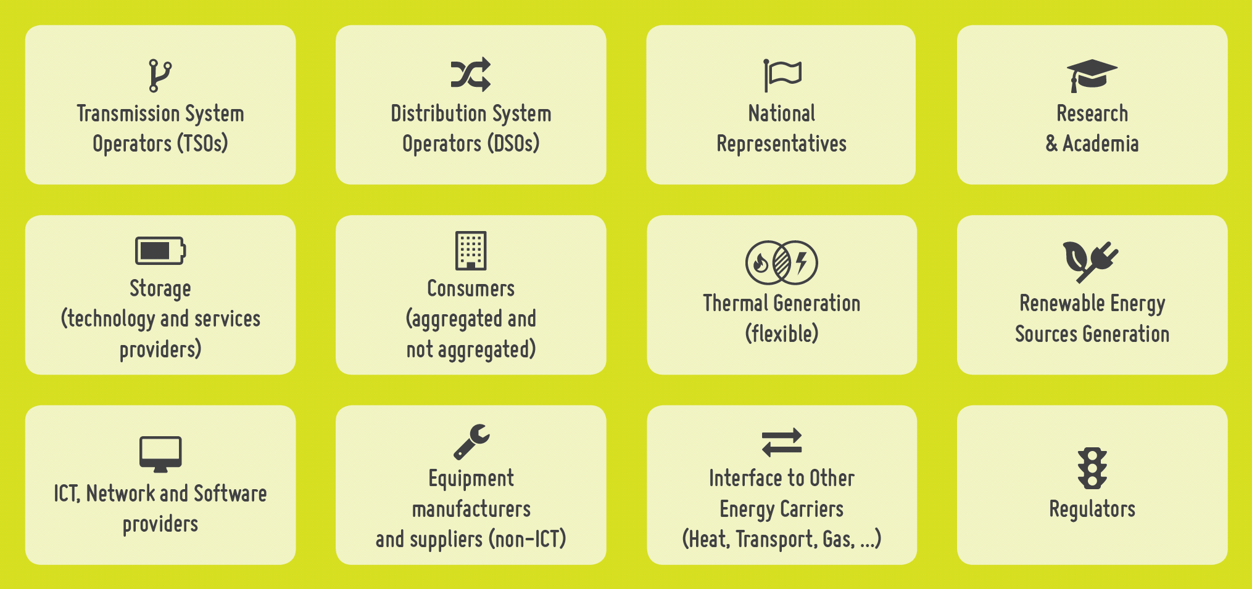

Slide 5

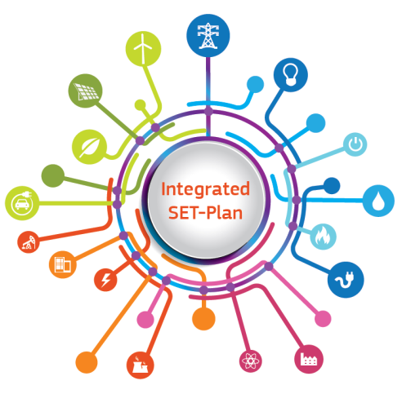
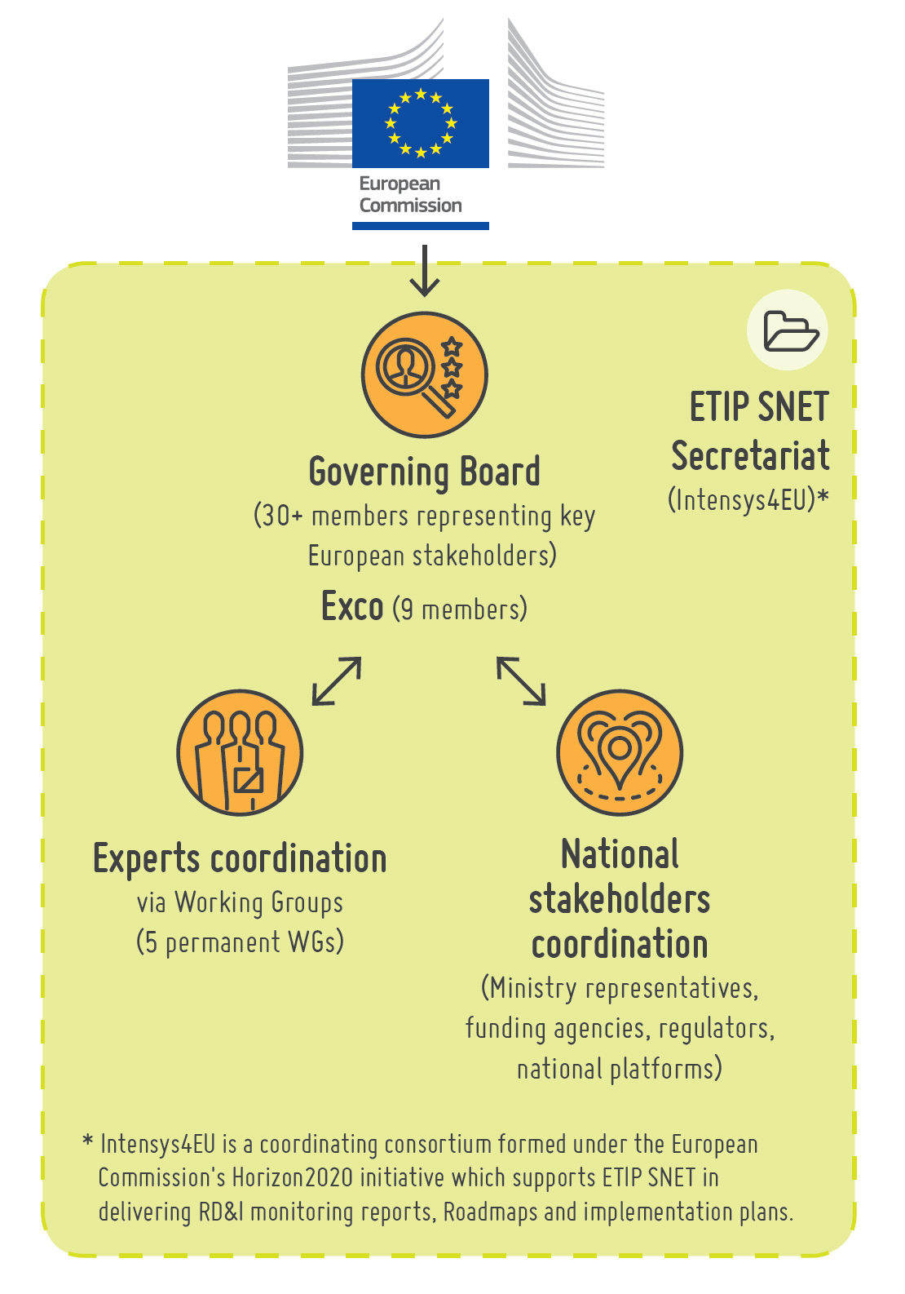
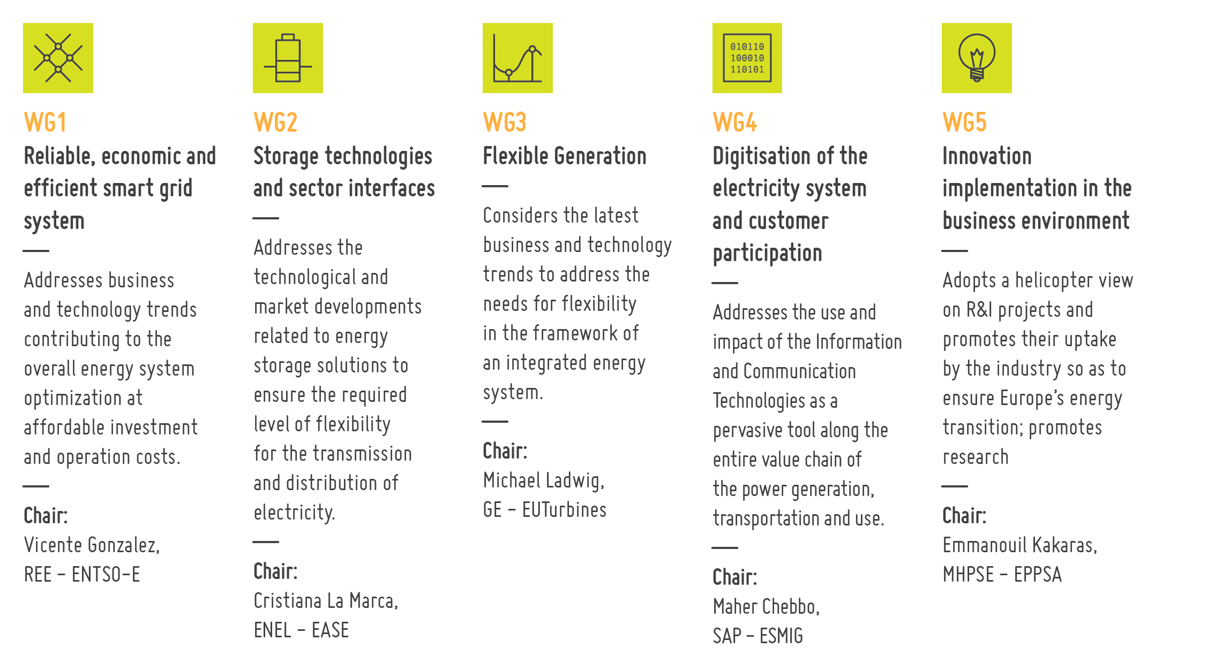



Slide 6

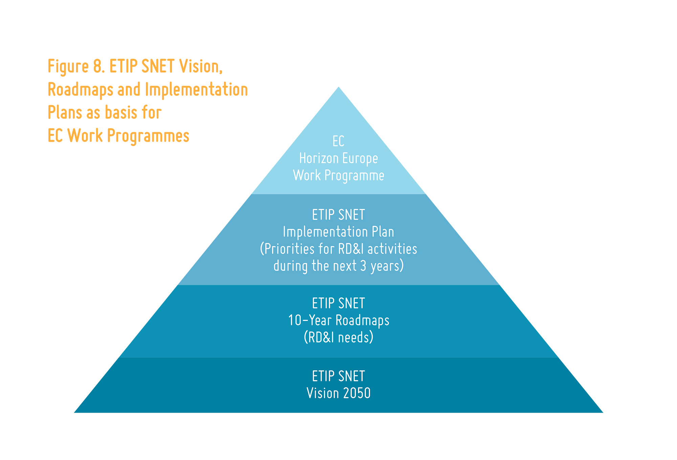





Slide 7

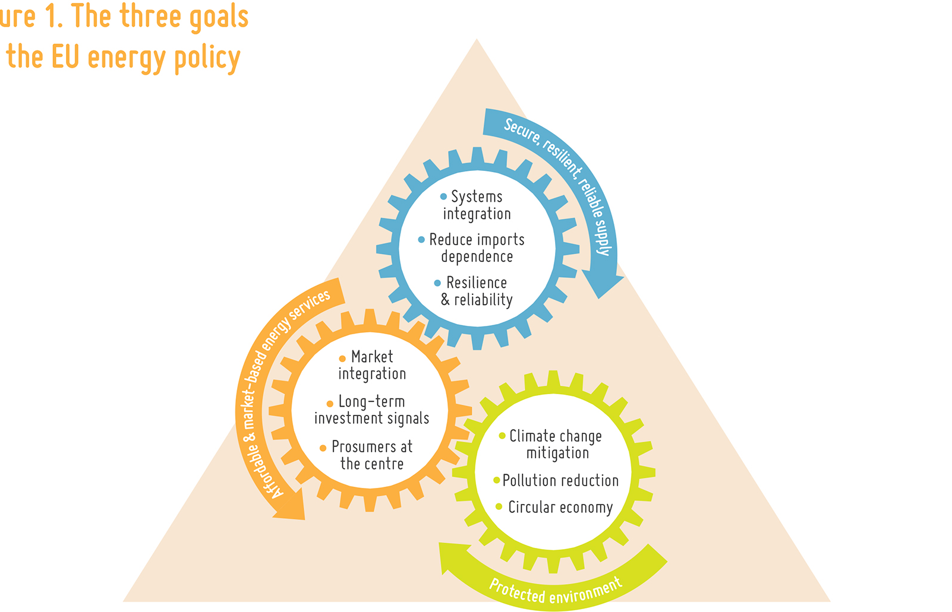
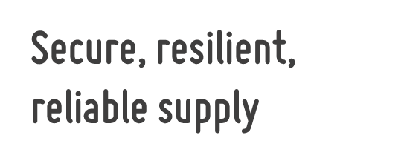
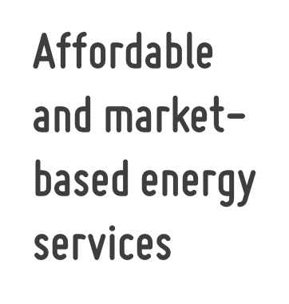


Slide 8
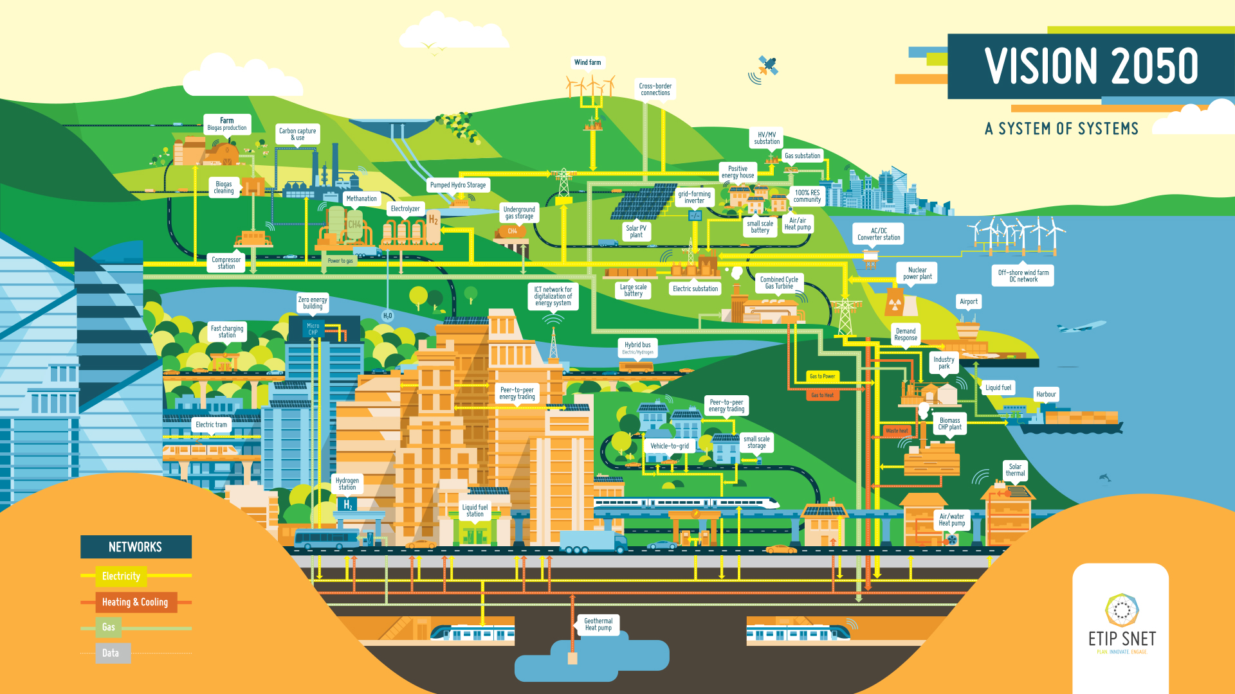
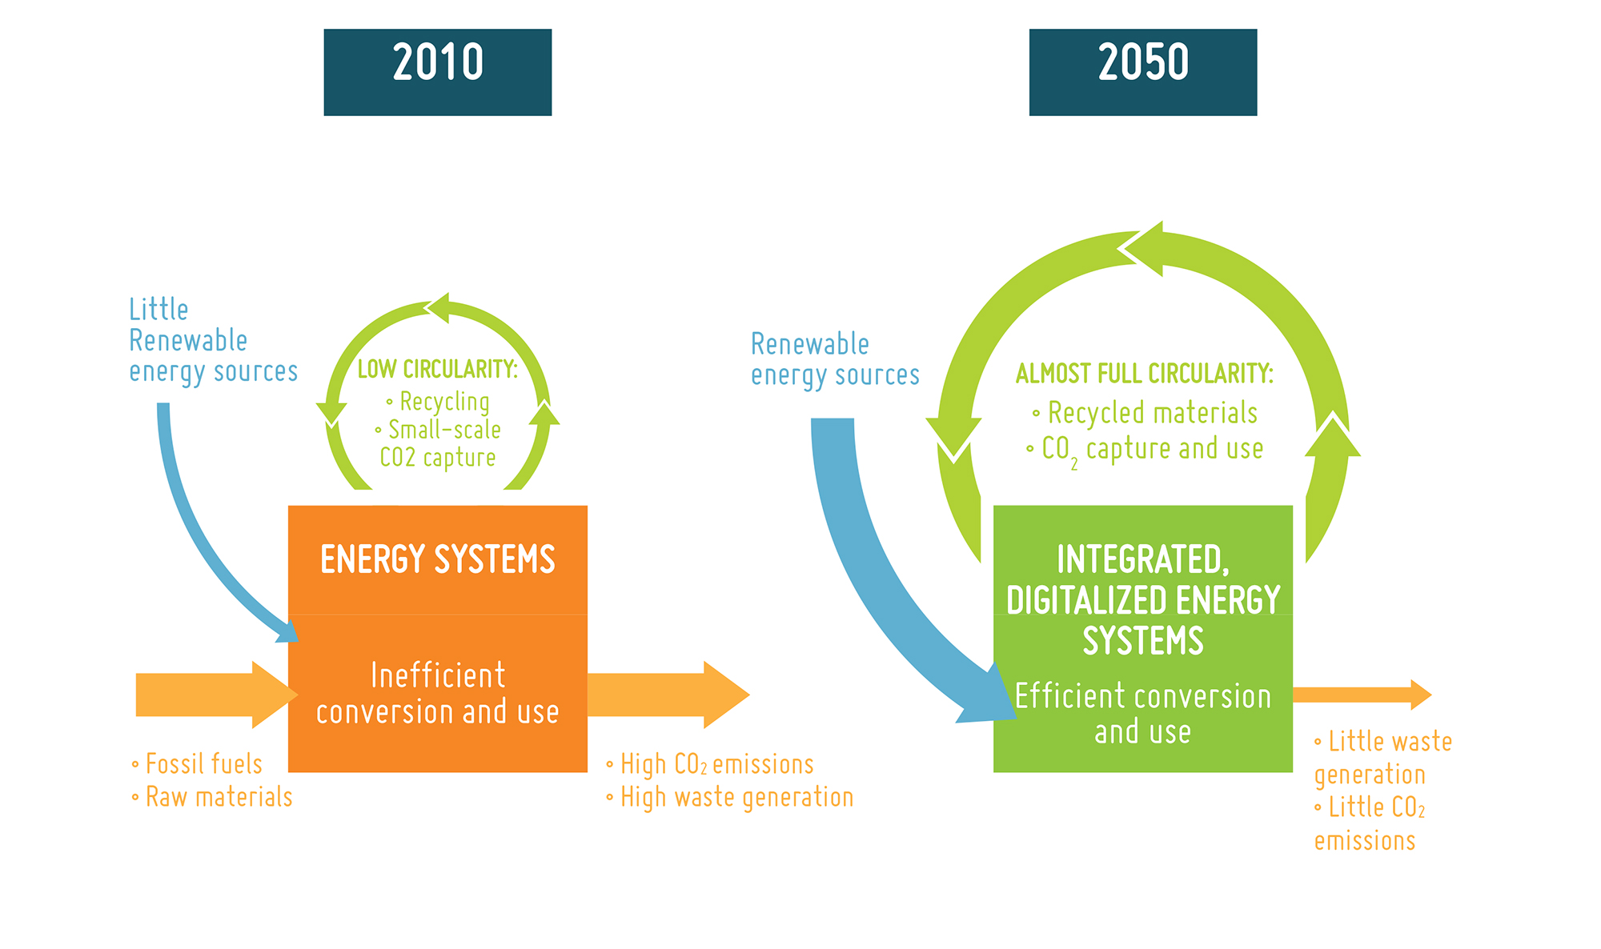

Slide 9

Vision 2050

Slide 10





Slide 11

Vision ETP SG 2030
Developed in 2006
Notes:
Show old Vision : where we come from , 12 years ago, we did not look to 2050 yet, anything we build today is likely to be there still in 2050
In 2006: Vision was incomplete
We go towards a fully decarbonised vision, and the role of sector coupling is key

Slide 12
1.
Variety of generation sources in size, both centralised and decentralised, fully or largely circular
Small: biogas, PV, solarthermal
Medium: solar power plants, Wind on/off-shore, CCGT
Large, nuclear, CCGT
Notes:
Message : this is fully carbon neutral
No more natural gas, no more coal, fully decarbonised, therefore demand Will be a different story : flexible demand and storage

Slide 13

1.
Variety of generation sources in size, both centralised and decentralised, fully or largely circular
Small: biogas, PV, solarthermal
Medium: solar power plants, Wind on/off-shore, CCGT
Large, nuclear, CCGT
Notes:
Message : this is fully carbon neutral
No more natural gas, no more coal, fully decarbonised, therefore demand Will be a different story : flexible demand and storage

Slide 14
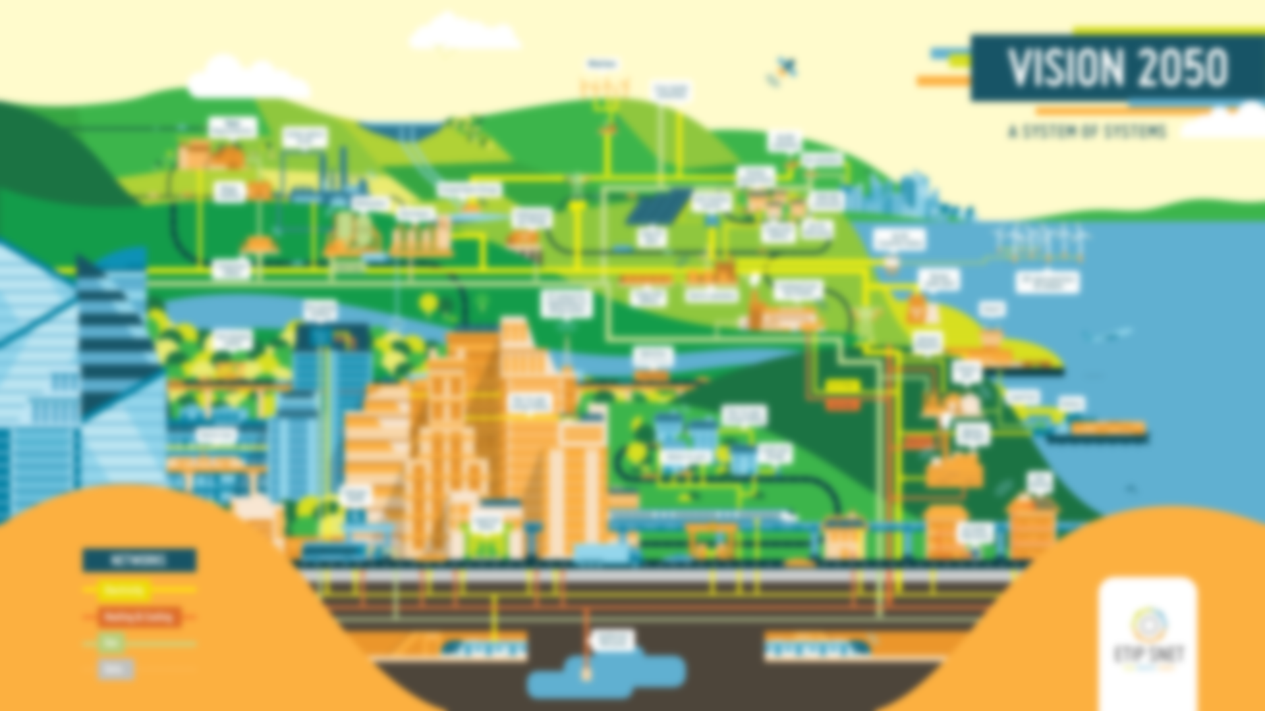
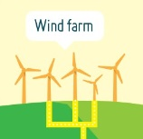
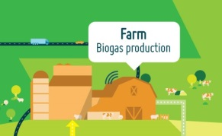
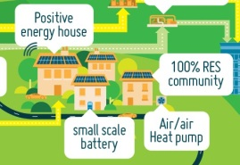
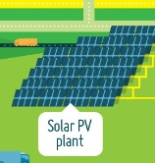
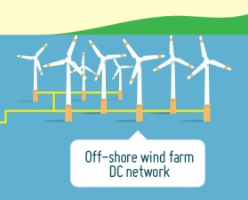
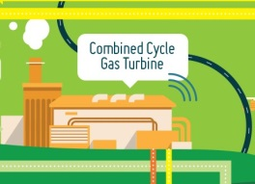



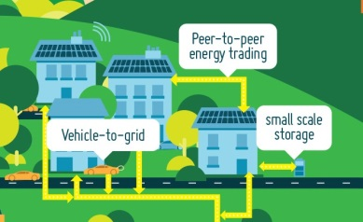
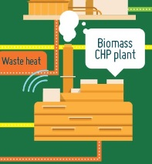


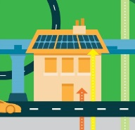
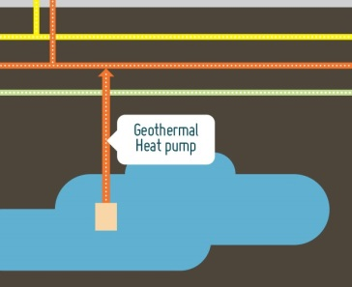
Notes:
Message : this is fully carbon neutral
No more natural gas, no more coal, fully decarbonised, therefore demand Will be a different story : flexible demand and storage

Slide 16
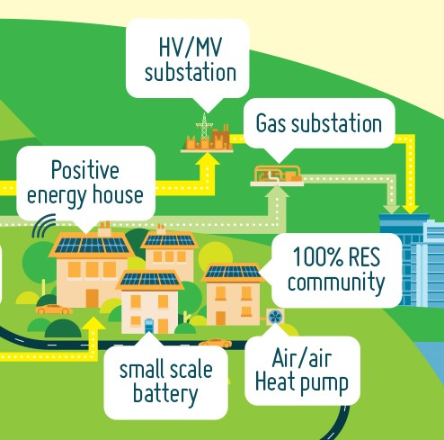
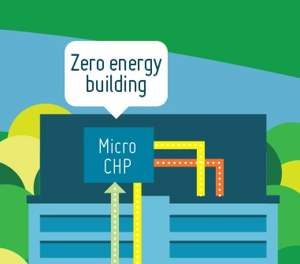
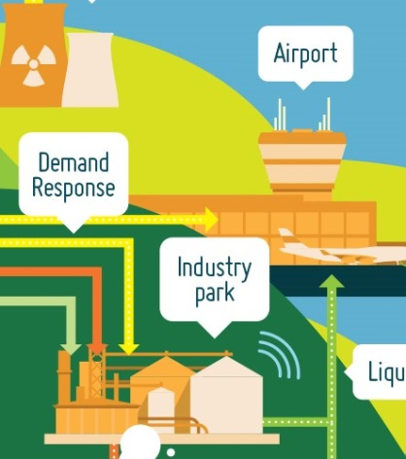
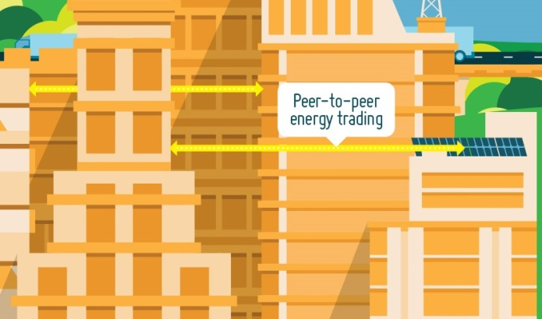
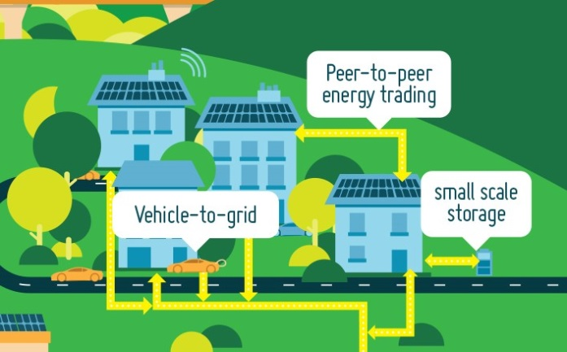
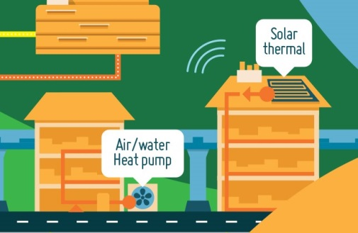

Slide 17


Slide 18
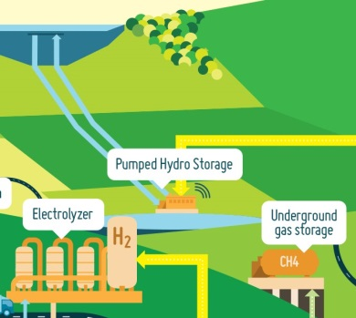

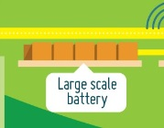
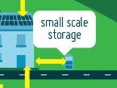

Slide 19
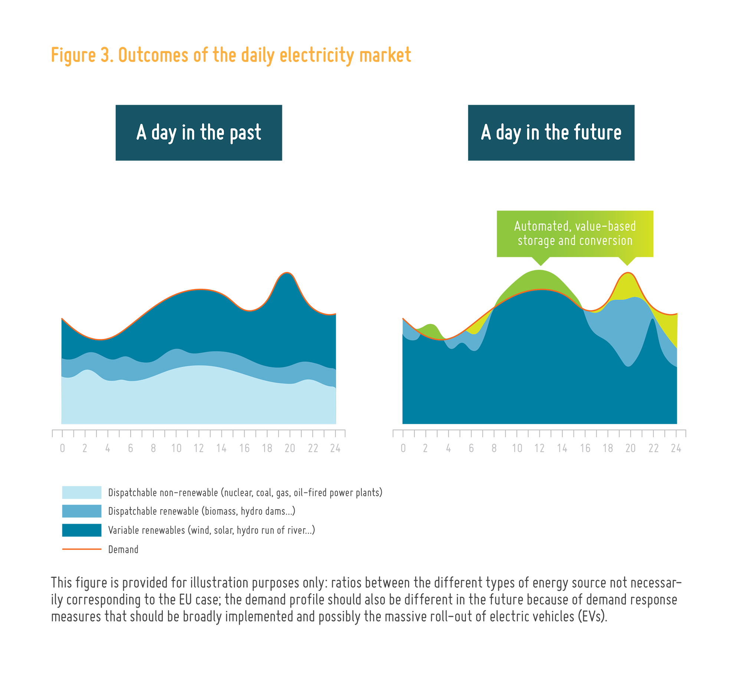
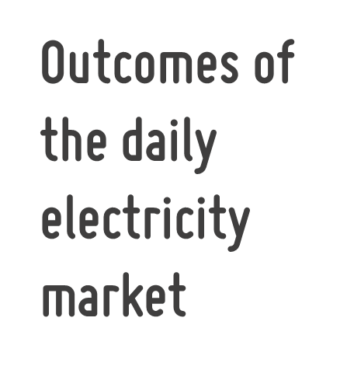

Slide 20
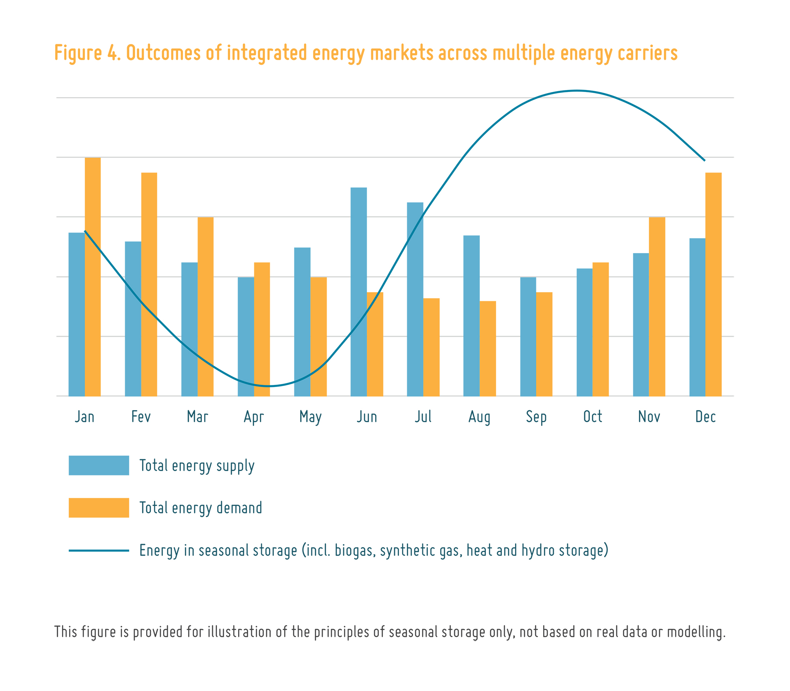
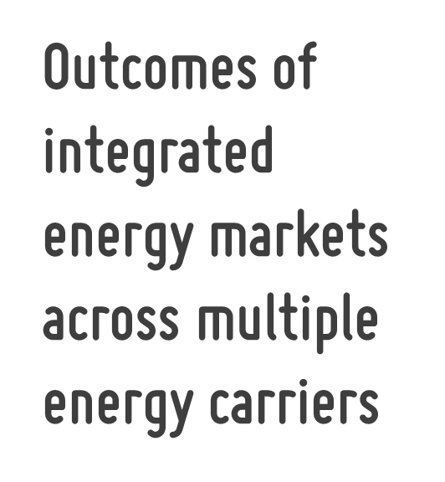

Slide 21


Slide 22
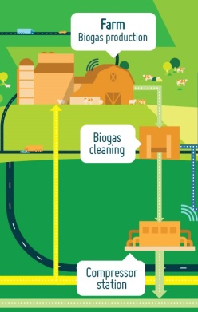
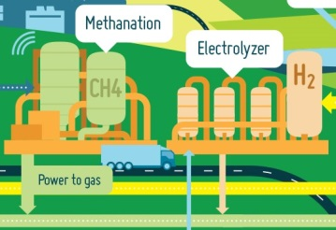
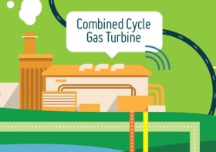

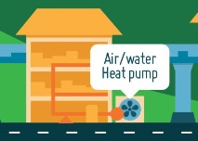
PtG
GtP&H
PtL
PtH

Slide 23
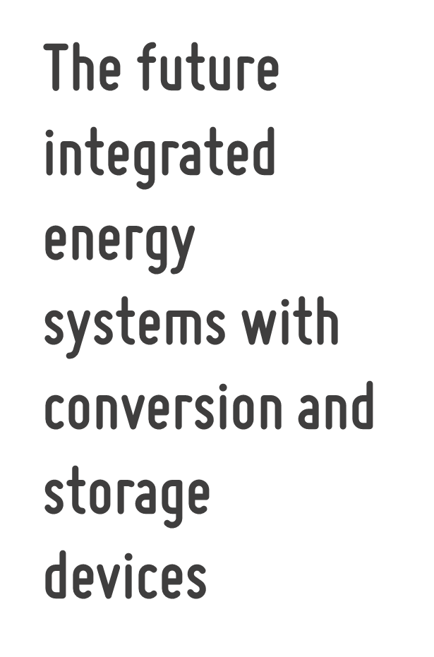
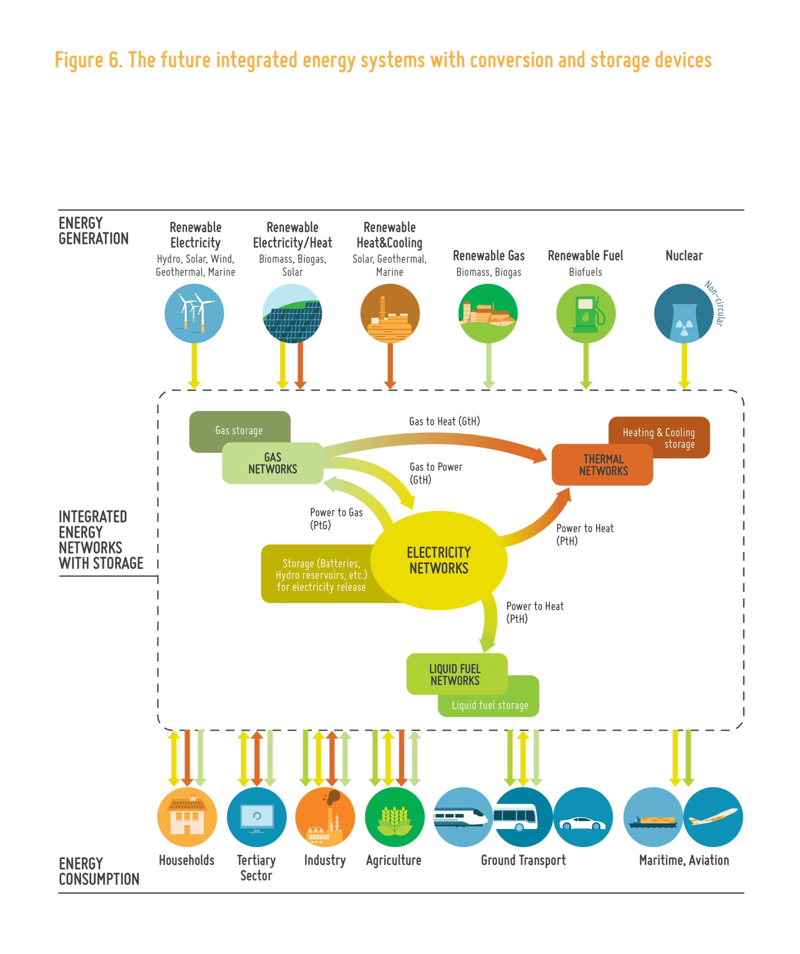
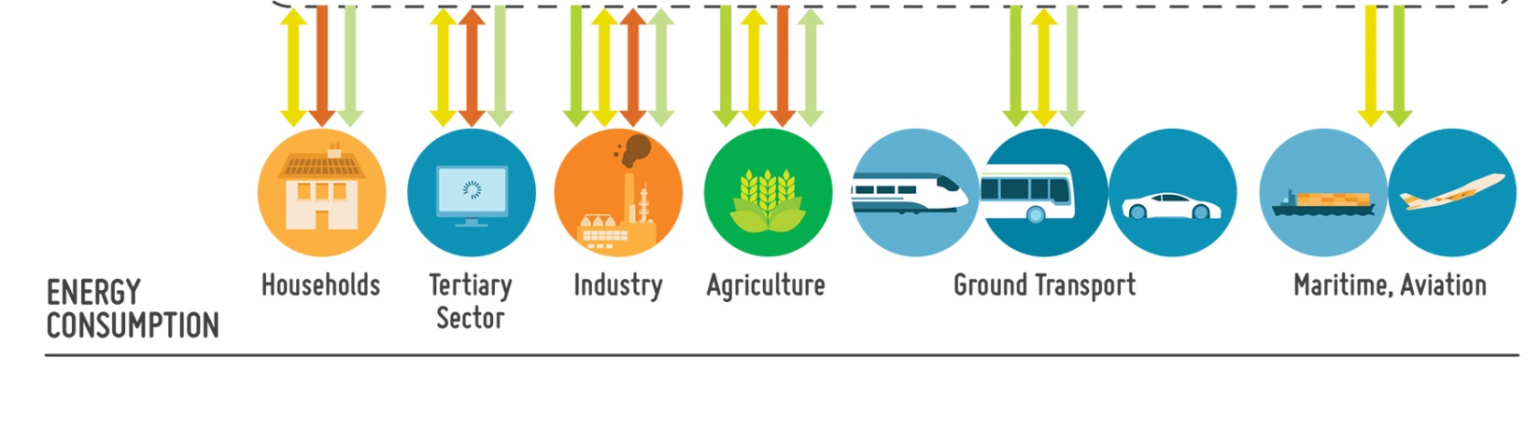

Slide 24


Slide 26

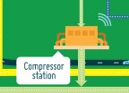

Slide 27

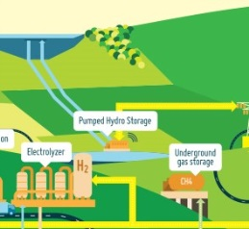
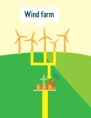

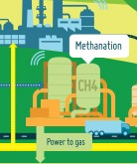
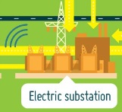
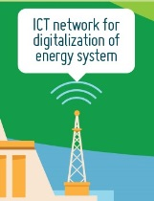





Slide 28
Vision 2050
Building Blocks:
The Ingredients of the Vision

Slide 29





Slide 30



Slide 31




Slide 32


Slide 33




Slide 34


Slide 35








Slide 36



Slide 37




RD&I Environment: The Framework
Notes:
Maintain and enlarge the European leadership in the world economy
In standardisation and interoperability
In integrated storage, distribution and transmission of all energy carriers and their conversions
Foster new businesses to create jobs
Support economic growth thanks to the digitalisation of the energy system and the development of new energy markets
Adapt education and training
Consider high system complexity and automation requirements (integrated energy carrier skills)
Develop new programs for students and professionals (Automation, ICT and digitalization skills)
Accelerate deployment of the results from RD&I projects
along the whole value chain (research, prototype, demonstrate, validate)
adapt the funding mechanism for the right RD&I activities
Bring stakeholders together
guide paths, link platforms and stakeholders, communicate societal benefits

Slide 38



The INTENSYS4EU Project supports ETIP SNET activities and has received funding from the European Union’s Horizon 2020 research and innovation programme under grant agreement 731220

