Slide 1
CIGRE’s Contribution to ETIP SNET R&I Roadmap
Prof. Nikos Hatziargyriou
nh@power.ece.ntua.gr
CIGRE Steering Committee and Technical Council Meeting, Athens, 8-13 Jan. 2023

Slide 2
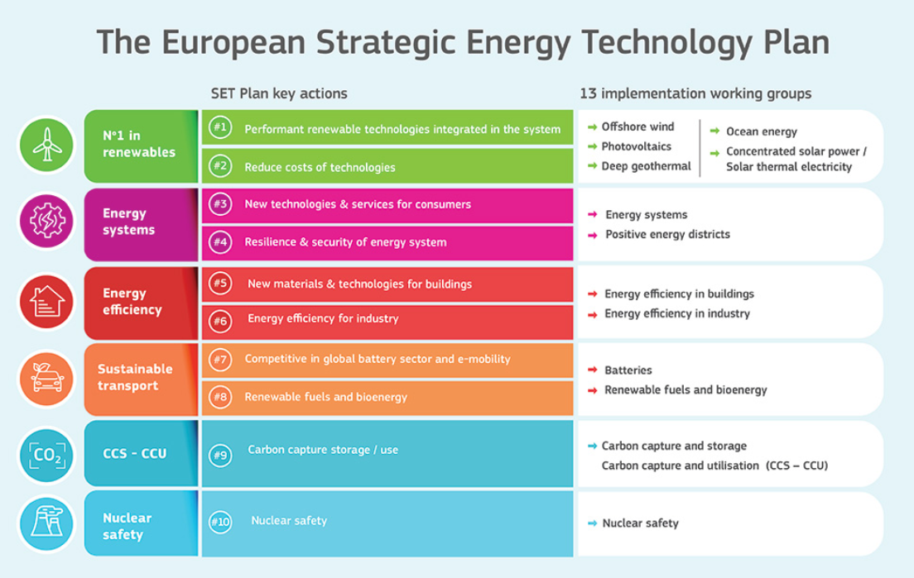
ETIPs under the SET PLAN Umbrella
The European Strategic Energy Technology Plan (SET Plan) is a key stepping-stone to boost the transition towards a climate neutral energy system through the development of low-carbon technologies in a fast and cost-competitive way.
The SET Plan consists of
10 Keys Action and related Implementation Working Group (IWGs).
Under the SET PLAN
The European Technology and Innovation Platforms (ETIPs) were created:
to support the implementation of the SET Plan by bringing together EU countries, industry, and researchers in key areas.
to promote the market uptake of key energy technologies by pooling funding, skills, and research facilities.

Slide 3
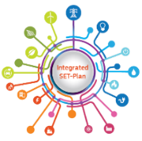
ETIP Smart Networks for Energy Transition - Goals and Structure
Guide and identify R&I priorities to support Europe’s energy transition, addressing the innovation challenges for the energy system and market evolution toward climate resilience and renewables integration while ensuring affordability and security of supply beyond smart electricity grids.
Brings together main stakeholders and more than 350 experts from the energy sector from all around Europe and beyond
Prepares and updates Visions, Roadmaps and Implementation Plans
It crafts a consolidated stakeholder view on R&I to European Energy Policy initiatives toward Energy Transition in order to achieve medium and long term objectives

Slide 4
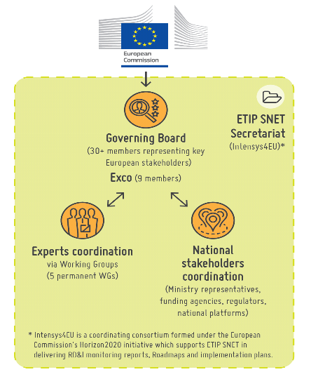
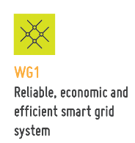
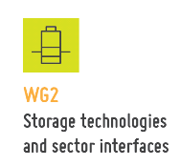
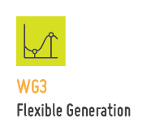
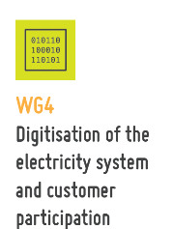
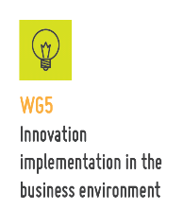

Slide 5
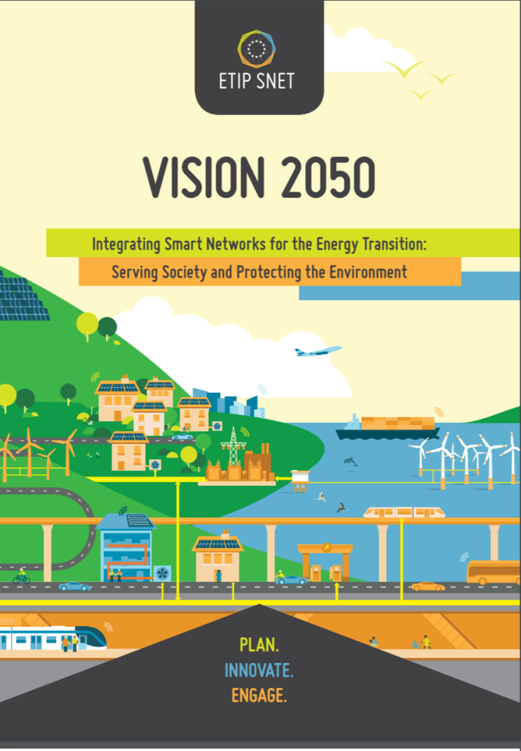
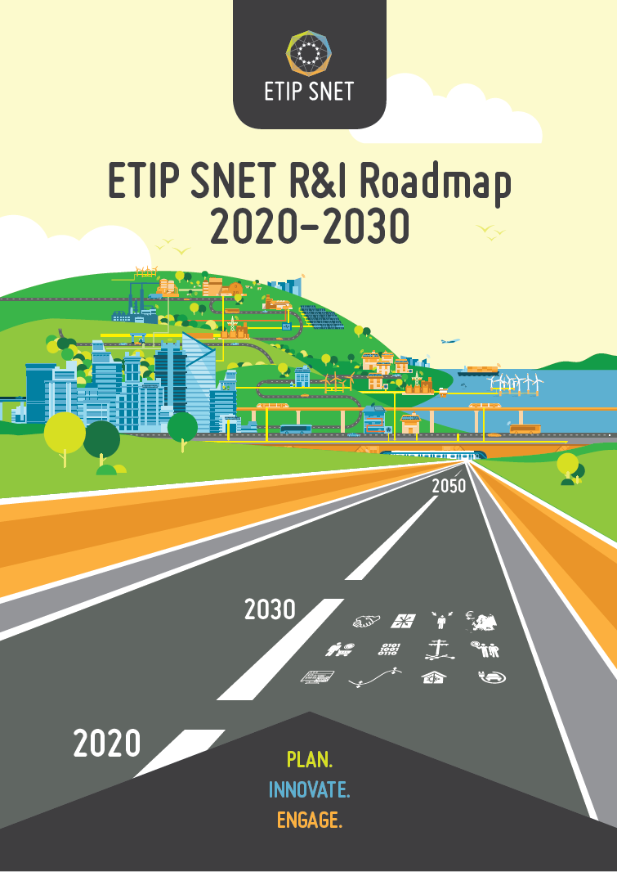
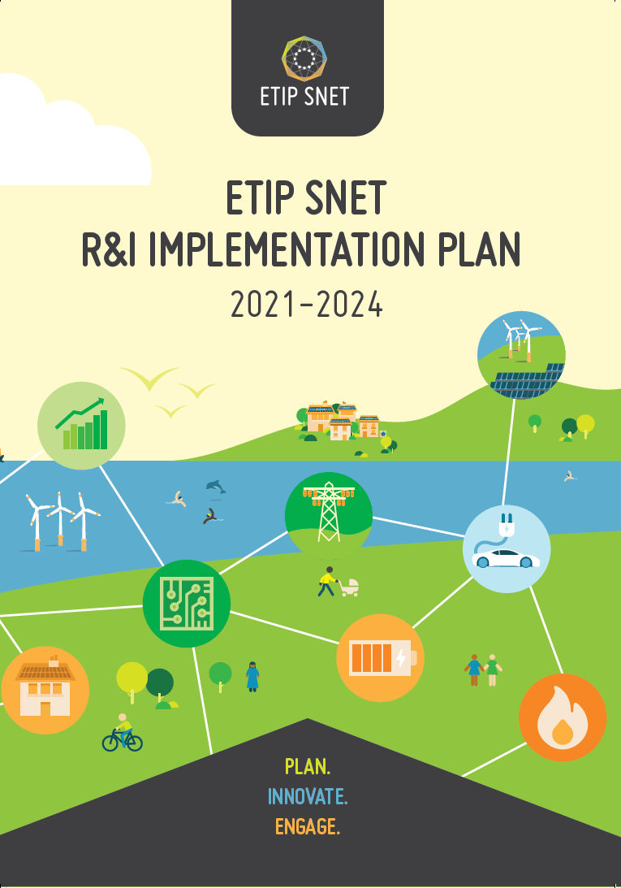
ETIP SNET Main achievement for R&I priorities
Published 2018
Published Feb 2020
Published May 2020
HERE
HERE
HERE
Notes:
Since its establishment in 2016, the ETIP has already delivered several key publications.

Slide 6
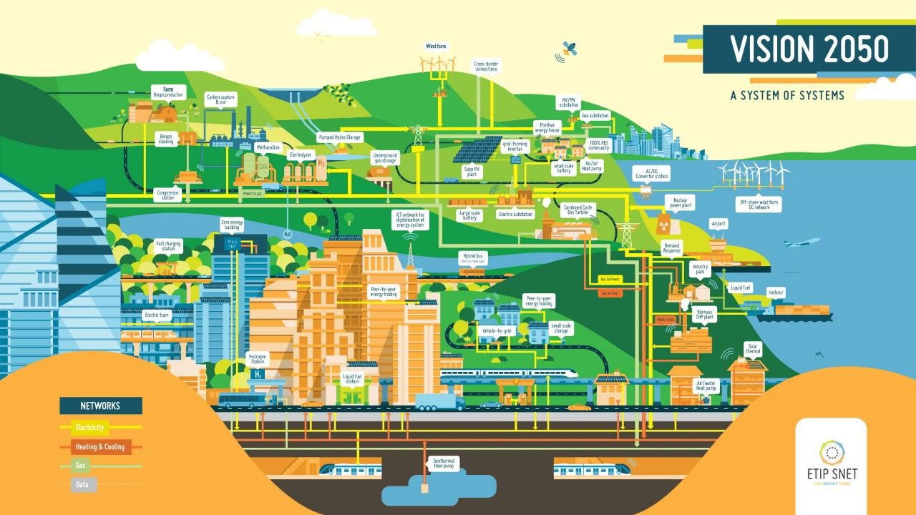
1.
Variety of generation sources in size, both
Small: biogas, PV, solarthermal
Medium: solar power plants, Wind on/off-shore, CCGT
Large, nuclear, CCGT
Notes:
Message : this is fully carbon neutral
No more natural gas, no more coal, fully decarbonised, therefore demand Will be a different story : flexible demand and storage

Slide 7
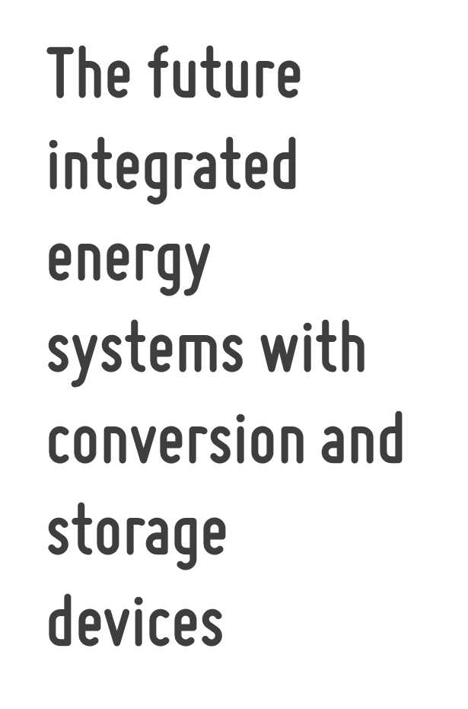
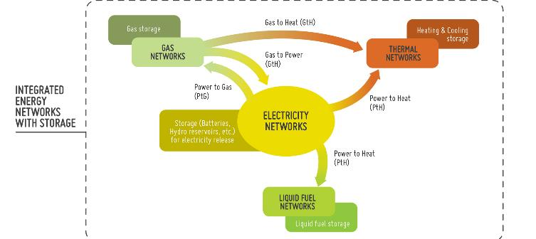

Slide 8
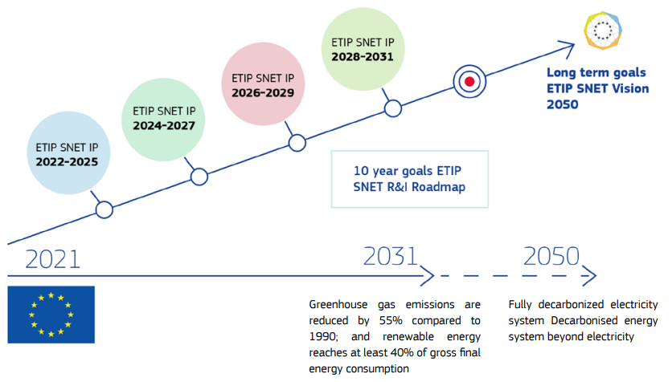
Roadmap & Implementation Plan (IP)
The ETIP SNET R&I Roadmap 2020-2030 describes the 10-year path towards this future. The Roadmap has been updated at the end of 2022.
The ETIP SNET Implementation Plan 2022-2025 outlines in detail the priority R&I needs for the next four years 2022-2025.

Slide 9
Main Drivers of the Roadmap and the IP
Digitalisation as key enabler of the environmental transition and participative energy markets
Reliability, adaptability and resilience of the integrated energy systems
Decarbonisation of energy systems,
transport, industry,
and building stock
Involvement of consumers and citizen communities in energy systems
REPOWER EU

Slide 10
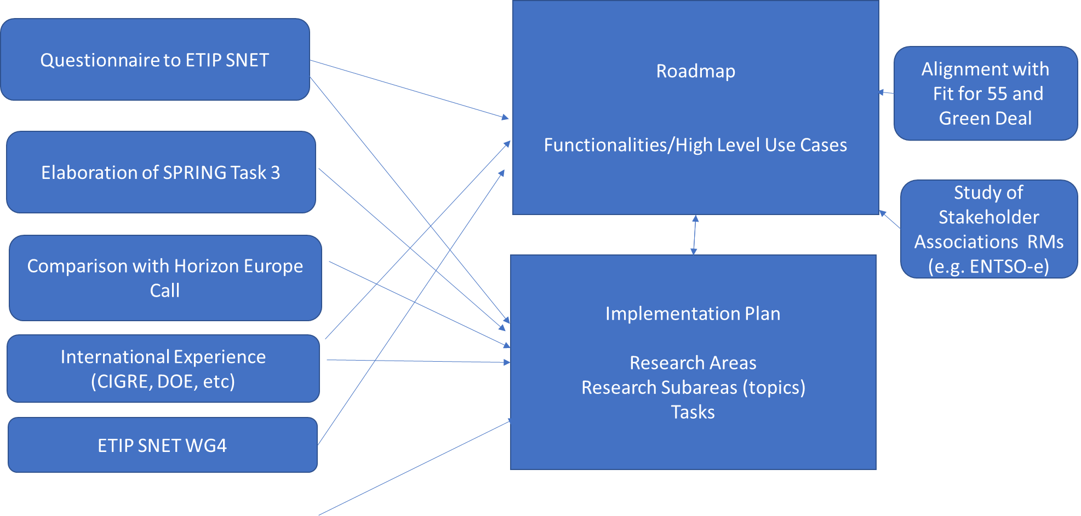
Inputs for Updating the RM and IP

Slide 11
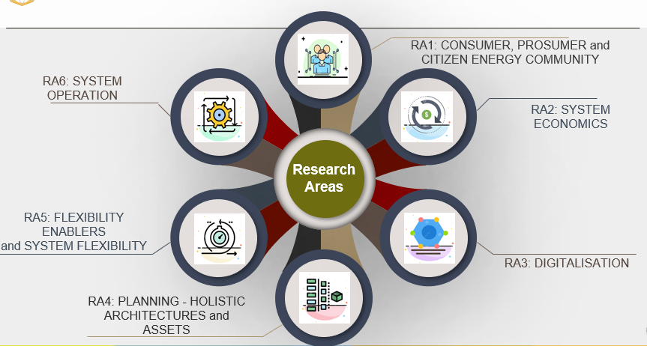

Slide 12
16 Chapters aiming at providing possible scenarios and sound elements for the technological, economic, regulatory and market progress of the power industry that will follow in 20 or 30 years from now.
M. Szechtman

Slide 13
CIGRE - International Council on Large Electric Systems

Slide 14
CIGRE’s Study Committees aligned with ETIP SNET Research Areas
Group C – Systems:
C1 Power system development and
economics
C2 Power system operation and
control
C3 Power system environmental
performance
C4 Power system technical
performance
C5 Electricity markets and
regulation
C6 Active distribution systems and
distributed energy resources
RA1. CONSUMER, PROSUMER and CITIZEN ENERGY COMMUNITY
RA2. SYSTEM ECONOMICS
RA3. DIGITALISATION
RA4. PLANNING - HOLISTIC ARCHITECTURES and ASSETS
RA5. FLEXIBILITY ENABLERS
RA6. SYSTEM OPERATION
Group D – New materials & IT:
D1 Materials and emerging test
techniques
D2 Information systems and
telecommunication

Slide 15
Implementation Plan Main Concepts
The ETIP SNET R&I Implementation Plan 2022-2025 describes the R&I efforts to be achieved by 2024 based on two principles:
It reuses the basic ideas defined in the previous R&I Roadmaps and Implementation plans, such as Research Areas, Research TOPICS and Research TASKS to organise the research for the proposed research priorities.
It adopts the key concept of High-Level Use Cases (HLUCs) with associated sets of Priority Project Concepts (PPCs) to specify the targeted outcome of R&I projects in general, including demonstration.

Slide 16
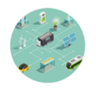
High Level Use Cases
HLUC 5
HLUC 4
HLUC 6
HLUC 7
HLUC 3
The HLUCs - for the next 10 years (until 2031) –
to structure the R&I Priority Project Concepts (PPCs)
in the R&I Implementation Plan 2022-2025
HLUC 8
HLUC 2
HLUC 9
HLUC 1

Slide 17
High Level Use Cases
HLUC 1: Optimal Cross sector Integration and Grid Scale Storage
Total Budget: 130M€
HLUC 3: Pan European Wholesale Markets, Regional and Local Markets
Total Budget: 80M€
HLUC 5: One stop shop and Digital Technologies for market participation of consumers (citizens) at the center
Total Budget :
120M€
HLUC 7: Enhance System Supervision and Control including Cyber Security
Total Budget
135M€
HLUC 9: Flexibility provision by Building, Districts and Industrial Processes
Total Budget: 100M€
HLUC 2: Market-driven TSO–DSO–System User Interactions
Total Budget: 90M€
HLUC 4: Massive Penetration of RES into the transmission and distribution grid
Total Budget: 145M€
HLUC 6: Secure operation of widespread use of power electronics at all systems levels
Total Budget:
100M
HLUC 8: Transportation Integration & Storage
Total Budget: 100M€

Slide 18
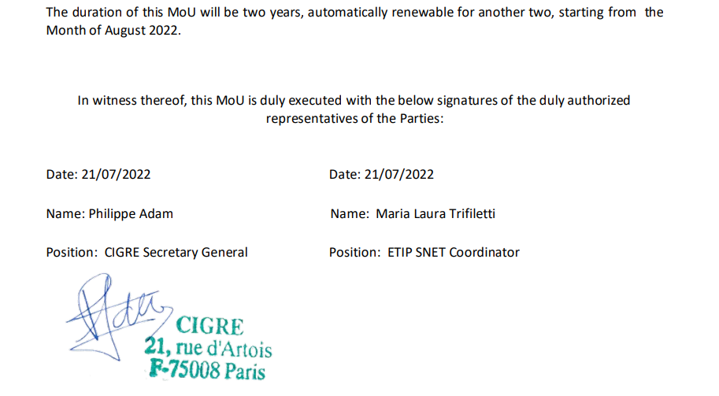
Further Collaboration Between CIGRE and ETIP SNET

Slide 19
Workshops and Electra publications

Slide 20
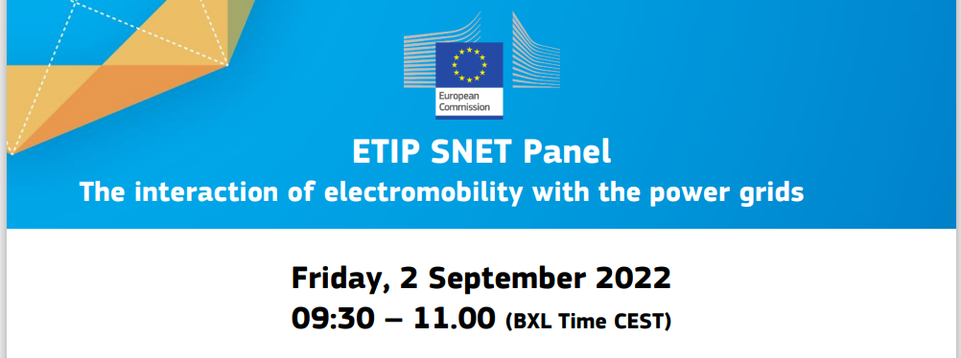
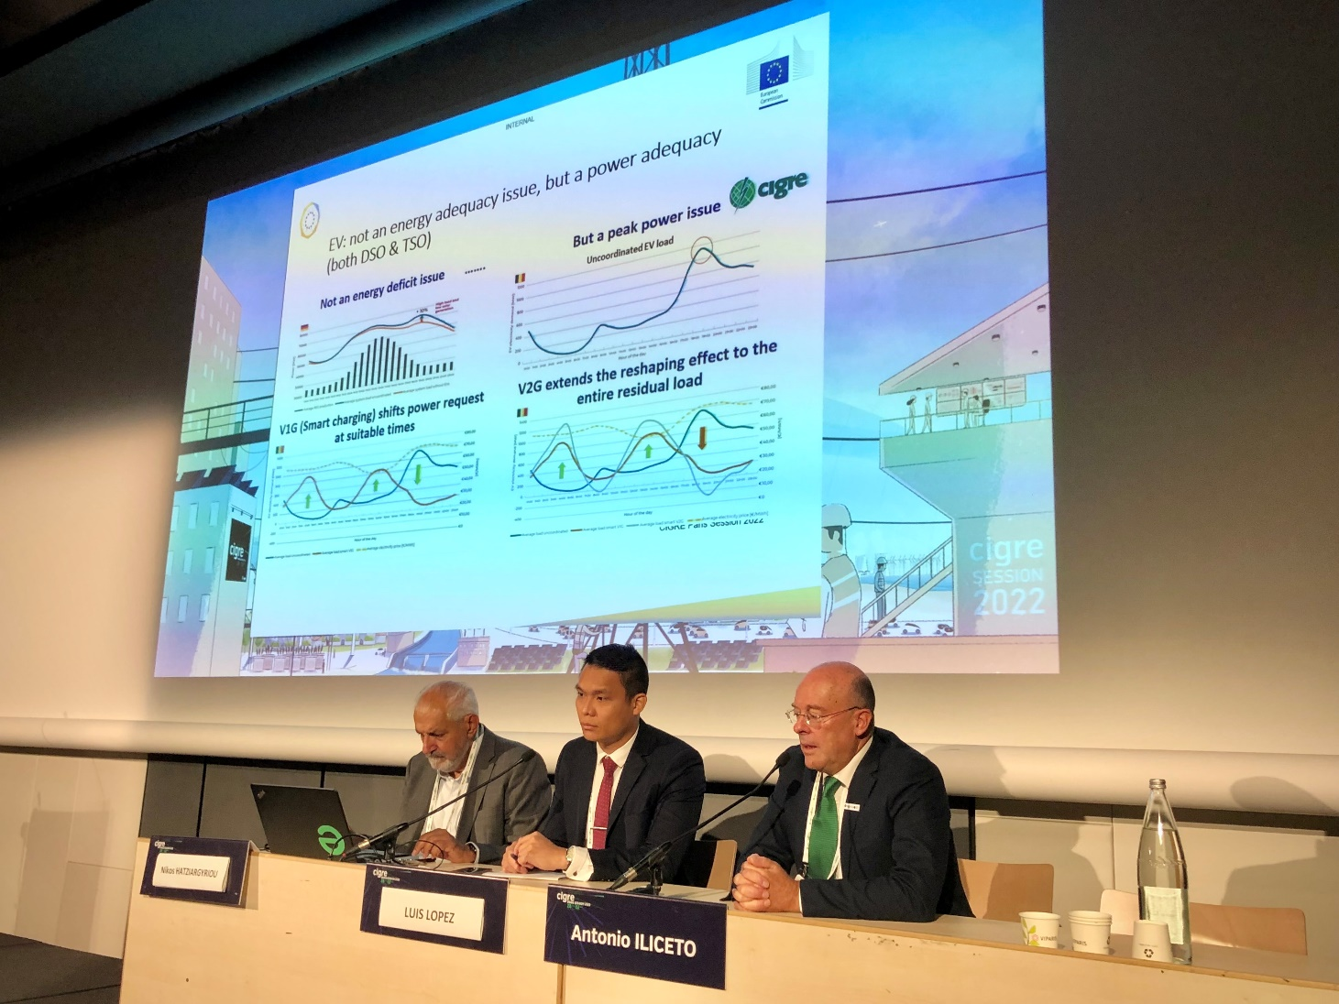

Slide 21
Thank you for your attention! Nikos Hatziargyriou nh@power.ece.ntua.gr

